Slide 1
Comparing hydropathic interactions between Phenylalanine and Tyrosine
Sam Portillo
BNFO 300

Slide 2
Homology Modeling – Begins with Amino Acid Sequence

Slide 3
Comparative search to find similar protein in structure database
Structure Database

Slide 4
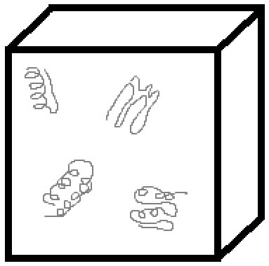
Predicted Structure

Slide 5
Ahmed et al. (2015) uses “hint!”
Developed by Drs. Glen Kellogg and Donald Abraham at VCU

Slide 6
Ahmed et al. (2015) uses “hint!”
Developed by Drs. Glen Kellogg and Donald Abraham at VCU
Quantifies hydropathic interactions between molecules

Slide 7
Ahmed et al. (2015) uses “hint!”
Developed by Drs. Glen Kellogg and Donald Abraham at VCU
Quantifies hydropathic interactions between molecules
Uses experimental data on previously determined structures

Slide 8
“Hydropathy”
Four classes of interactions

Slide 9
1. Favorable Hydrophobic Interactions¹

Slide 10
1. Favorable Hydrophobic Interactions

Slide 11
2. Unfavorable Hydrophobic Interactions²

Slide 12
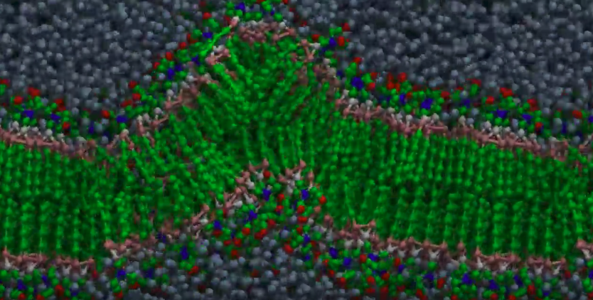
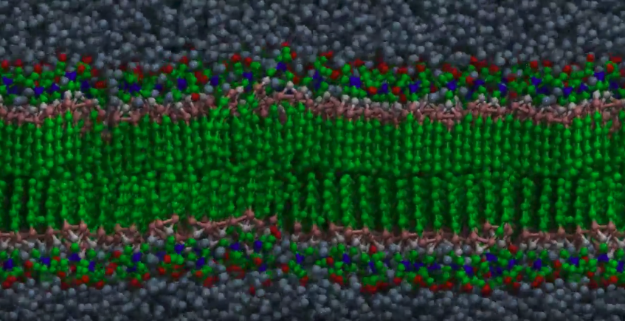
2. Unfavorable Hydrophobic Interactions³

Slide 13
3. Favorable Polar Interactions⁴

Slide 14
4. Unfavorable Polar Interactions⁵

Slide 15
Visualization of the classes

Slide 16
Ahmed et al. methods Ramachandran plot of 30,000 Tyrosines

Slide 18
Notes:
Beta sheets form at -135, 135. Alpha helices form from (-90,-15) to (-35,-70)

Slide 19
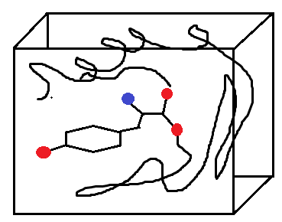
HINT scoring
Box is 20 Å³

Slide 20
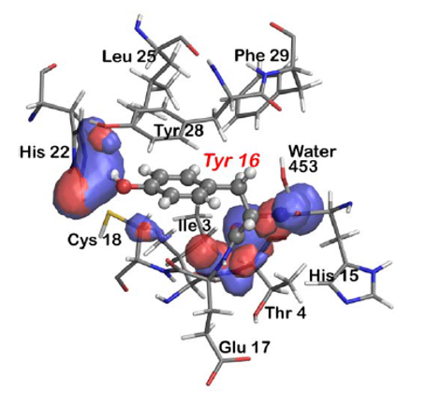
HINT basis map
Once mapping methods are applied, a 3D representation of the interactions is produced

Slide 21
Map-map similarity is calculated

Slide 22
Clustering with k-means

Slide 23
Tyrosine forms a limited number of 3D conformations

Slide 24
Phenylalanine v. Tyrosine
Phenylalanine
Tyrosine

Slide 25
Chess square d4 predicts alpha helix structure

Slide 26
Highest residue counts in chess squares

Slide 27
Highest residue counts in chess squares

Slide 28
Ulmschneider et al. (2001) calculates Amino acid frequencies in alpha helices

Slide 29
Amino acid frequencies in alpha helices
Extracellular Space
Cytosol

Slide 30
Amino acid frequencies in alpha helices
Extracellular Space
Cytosol

Slide 31
Structure conservation among amino acids

Slide 32
References
https://dna02.wikispaces.com/file/view/dna_molecule.gif/228169598/396x316/dna_molecule.gif
http://myhome.sunyocc.edu/~weiskirl/phospholipid.gif
https://www.youtube.com/watch?v=lm-dAvbl330
https://revisionscience.com/a2-level-level-revision/chemistry-level-revision/bonding-and-structure/hydrogen-bonding
Adapted from https://snipcademy.com/binf/img/lessons/pairwise-alignments/pam/hvsa.svg
Ahmed MH, Koparde VN, Safo MK, Neel Scarsdale J, Kellogg GE. 3D interaction homology: The structurally known rotamers of tyrosine derive from a surprisingly limited set of information-rich hydropathic interaction environments described by maps. Proteins Struct Funct Bioinforma. 2015;83(6):1118-1136. doi:10.1002/prot.24813.
Ulmschneider MB, Sansom MSP. Amino acid distributions in integral membrane protein structures. Biochim Biophys Acta. 2001;1512(1):1-14. doi:10.1016/S0005-2736(01)00299-1.

