Slide 1
How does CagA in H. pylori contribute to apoptosis in gastric cancer cells?
Angela Michalak

Slide 2
Gastric Cancer
Why should we care?
Notes:
-Gastric cancer is the second leading cause of cancer-related deaths worldwide and it is estimated that 10,960 people will die from gastric cancer this year alone.
- Cancer in general is caused by either a decrease in apoptosis (cell death) or an increase in cell proliferation.
- In people who do not have cancer, apoptosis will occur which is when cells will trigger a series of events in order to make room for newer cells, eliminate unhealthy cells, or to get rid of unnecessary cells (Apoptosis, 2016). In cancerous cells, apoptosis can be hindered or completely evaded which can lead to uncontrolled cell division

Slide 3
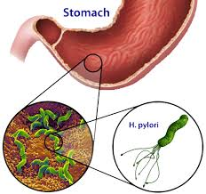
One of the biggest contributors to gastric cancer: Helicobacter pylori
Notes:
H. pylori- a gram negative bacteria with a spiral shape that is grown in the digestive tract.
In most cases it is harmless however, in some cases it has been known to cause diseases such as peptic ulcers and gastric cancer when penetrating the stomach lining.
Is recognized as a group 1 carcinogen

Slide 4
CagA (Cytotoxin- associated gene A) : is injected into the cytoplasm of the host cell
Notes:
There are two strains of H. pylori, CagA-positive and CagA-negative.
When H. pylori CagA positive bacteria come in contact with gastric host cells, CagA is injected into the cytoplasm of the host cell.
CagA is a protein encoded on the Cag pathogenicity island, and has been hypothesized by Ohnishi et al to be an oncoprotein, which turns regular host cells into tumorous cells, however, researchers do not know exactly how CagA affects apoptosis of gastric cancer cells.

Slide 5
CagA- Positive H. pylori
CagA- Negative H. pylori
Figure 2: The cag Pathogenicity Island. Most H. pylori strains that cause disease (so-called type I strains) contain the cag pathogenicity island, a chromosomal region with about 37,000 bp and 29 genes, whose location is indicated by the arrows. Modified from Suerbaum & Michetti, 2002.
Notes:
As I mentioned early, CagA is a protein encoded on the Cag pathogenicity island, which are distinct genetic elements on the chromosomes of a large number of bacterial pathogens. PAIs encode various virulence factors and are normally absent from non-pathogenic strains of the same or closely related species.
The only difference between the CagA-positive strain and CagA-negative strain of H. pylori is that the CagA-positive strain contains the entire pathogenicity island containing the CagA gene while the CagA-negative strain is missing the entire pathogenicity island.
Therefore, in order to compare the CagA-positive plasmid and CagA-negative plasmid to determine the difference in apoptosis, I want these plasmids to be exactly the same other than the CagA gene, which means the CagA negative strain needs to include the pathogenicity island, but not the CagA gene.

Slide 6
Obtain gastric cancer cell lines (ATCC)
Grow and replicate CagA- positive H. pylori
Testing: How does CagA in H. pylori contribute to apoptosis in gastric cancer cells?
Gastric Cancer cell lines
Gastric Cancer cell lines
H. pylori- CagA +
Notes:
The source organism for the gastric cancer cells are homosapiens

Slide 7
3. The H. pylori CagA-positive (+) strain is split into two CagA-positive strains.
H. pylori-
CagA +

Slide 8
4. PCR is used to replicate the H. pylori plasmid, except the CagA gene
CagA
H. pylori CagA- positive
H. pylori CagA-negative

Slide 9
5. CagA-negative and CagA-positive plasmids are inserted into gastric cancer cell lines
Gastric Cancer Cell lines
H. pylori CagA-negative Plasmids
Gastric Cancer Cell lines
H. pylori CagA-positive Plasmids

Slide 10
6. Leave to incubate
G.C.C with H. pylori- Cag +
G.C.C with H. pylori- Cag -

Slide 11
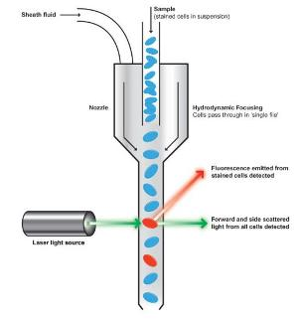
7. Prepare a solution from the G.C.C lines to put through flow cytometer
Figure 4: Visualization of flow cytometry. From Faculty of Medicine and Dentistry at University of Alberta, Canada.
Notes:
-When cells undergo apoptosis the cells undergo a morphological change that is able to be measured by flow cytometry.
- when performing flow cytometry when light interacts with the cells, light is scattered in both the forward and lateral/side direction. During apoptosis there is an initial increase in side and forward scatter followed by a decrease in forward and side scatter during later stages of apoptosis.

Slide 12
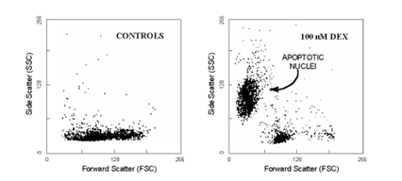
8. Visualize the results from a graph produced from the flow cytometer
Figure 5: Scatter analysis of DEX-induced apoptosis in mouse thymocytes. Apoptotic cells are clearly distinguishable from normal thymocytes for the reduced cell size (low FSC) and enhanced density (high SSC). Modified from Nicoletti et al.
Notes:
we then compare the graphs that we get from the CagA - plate and the plate with CagA to determine if CagA has an effect on apoptosis.
We can assume that any change that we visualize between the two plates is due to the CagA since the gastric cancer cell lines are exactly the same and the H. pylori bacteria are exactly the same other than that once contains CagA and one doesn’t
It is hypothesized that the initial increase in FSC and SSC that is observed during apoptosis is due to chromatin condensation and the shrinking of the cell (Vermes, et al., 2000). Chromatin condensation is not an unusual occurrence for apoptotic cells as nuclear condensation is one of the criteria in identifying apoptotic cells (Toné et al., 2007). The decrease in FSC and SSC is attributed to the emergence of necrosis, cell death

Slide 13
Future Research Possibilities
Stop the injection of CagA
Understanding the PAI gene interactions

