Slide 1
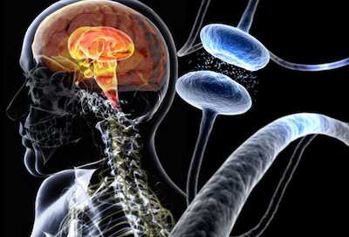
Inhibition of alpha-synuclein using promazine derivatives
https://images.medicinenet.com//images/slideshow/parkinsons-disease-s1-illustration-of-parkinsons-disease-composite.jpg
Shwetha Kochi

Slide 2
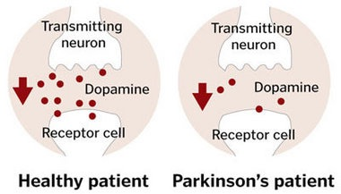
Parkinson’s Disease
Tremors
Complete loss of motor function
Key Players: Lewy bodies -> protein aggregates of misfolded alpha-synuclein
http://www.chillcryo.net/wp-content/uploads/2017/06/parkinsons-dopamine.jpg
Notes:
Talking Points:
Neurogenerative disorder in which the buildup of Lewy bodies in the brain leads to dopaminergic neuronal death, and, in turn, decrease in Dopamine concentration in the brain
Decrease in Dopamine causes tremors and later leads to complete loss of motor function
Dopamine main role: movement, emotions, and sensations of pleasure and pain
Approx. 60, 000 Americans diagnosed with PD each year

Slide 3
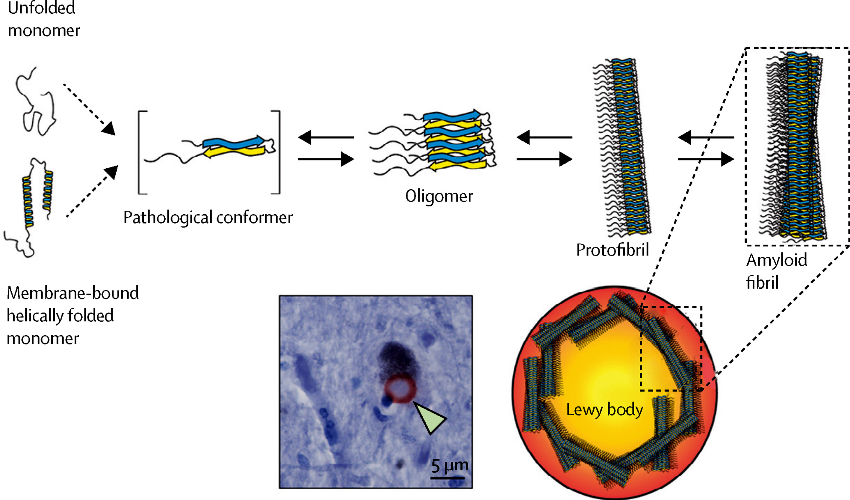
Aggregated Alpha-Synuclein: Key Player of Parkinson’s Disease
http://www.thelancet.com/cms/attachment/2105035563/2081061692/gr2_lrg.jpg
Notes:
Talking Points:
Alpha-synuclein primary role: assist in vesicle formation to release Dopamine in the synaptic cleft between two neurons. When misfolded…
Conformational change from alpha helical to antiparallel beta sheets, allows alpha-synuclein to enter the brain, increasing concentration, and leads to aggregation of beta sheets into amyloid fibrils, which are just protein aggregates (shown in picture)
These amyloid fibrils aggregate further to create Lewy bodies – found mostly in the substantia nigra of Parkinson’s patients

Slide 4
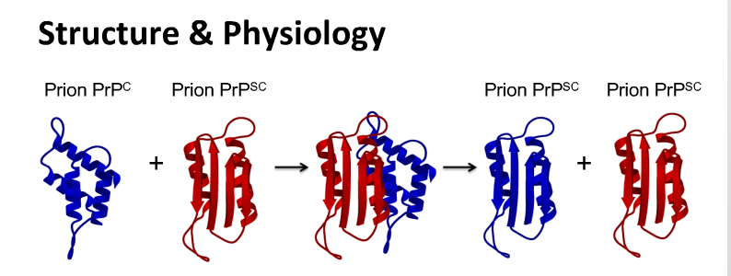
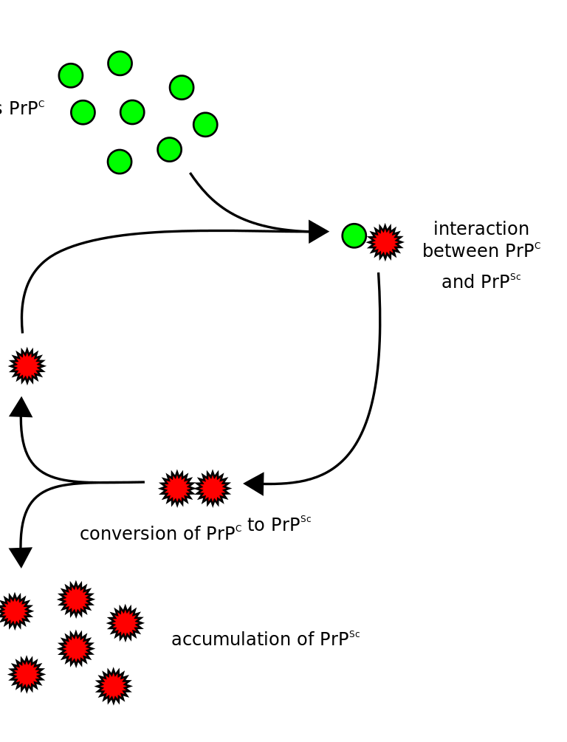
Conformational Change -> Prion Effect
http://d1yboe6750e2cu.cloudfront.net/i/80b9afb4ee6d4c6abce029be2a9e278112af3fd4
https://ars.els-cdn.com/content/image/1-s2.0-S0925443914002014-gr4.jpg
Notes:
Talking Points:
prions: irregularly folded proteins that infect regularly folded proteins, causing then to misfold
The exact mechanism of how these prions cause other proteins to misfold is still unknown, but the most commonly known prion is PrP^{Sc}, misfolded form of PrP^{C}, key player in CJD – human equivalent of Mad Cow Disease
This undergoes same conformational change as alpha-synuclein: alpha helical to antiparallel beta sheet
Also forms amyloid fibrils
Alpha-synuclein has this prion effect when it becomes misfolded

Slide 5
Problem: Aggregation Solution: Inhibition!
12 different drugs studied
Molecular markers on the right of each gel correspond to 37 kDa (upper band) and 20 kDa (lower band)
Two antibodies:
Fab fragment D13
Secondary HRP-labeled
Most Potent: Chlorpromazine, Promazine, and Acepromazine
Adapted from Ref 5 of written proposal: Korth, C., May, B. C., Cohen, F. E., & Prusiner, S. B. (2001). Acridine and phenothiazine derivatives as pharmacotherapeutics for prion disease. Proceedings of the National Academy of Sciences,98(17), 9836-9841. doi:10.1073/pnas.161274798
Notes:
Talking Points: 1. 12 different drugs were studied
2. Cells infected with PrP^{Sc}. Inhibitors introduced after cell culturing.
3. Cells lysed. Lysates digested with Proteinase K.
4. Lysates centrifuged and pellets suspended in buffer, loaded onto SDS-PAGE gel.
5. After running gel, two antibodies introduced:
Human anti-mouse prion protein antibody (Fab fragment D13) – this was chosen because this antibody specifically binds to prions
Secondary HRP-labeled antibody was introduced which binds specifically to the primary antibody. This contains an enzyme called horseradish peroxidase that, when bound with a specific substrate – TMB – produces a dark blue or black color that we see on the gel
6. Explain gel results

Slide 6
CENTRAL QUESTION
Will these promazine derivatives that inhibited PrP^{Sc} also inhibit aggregated alpha-synuclein?

Slide 7
Strategy
1: Overexpression of alpha-synuclein in E. coli (BL21)
2: Protein Purification via Anion Exchange Chromatography
3: Protein Misfolding Cyclic Amplification (PMCA)
4: Thioflavin T Assay x2 (beginning of reaction and after 30-min incubation)
Notes:
Talking Points:
1. Explain why each step is done

Slide 8
Overexpression of alpha-synuclein
BL21 (DE3) – E. coli strain carries copies of T7 RNA Polymerase gene and LacI gene
pET21a – plasmid carries gene encoding human alpha-synuclein downstream from T7 promotor region
http://biochimej.univ-angers.fr/Page2/LaboThemEJ/2HSP22/2FIGURES/3VECTEURpETpLys/5ControleEXPRESSION.gif
Notes:
Talking Points:
Transformation – process in which bacterial cell takes up foreign DNA from a plasmid and expresses this genetic information
Transformation will be induced via heat shock – alters the membrane fluidity, creating pores in plasma membrane that allows for plasmid DNA to enter the bacterial cell
After bacterial cells contain plasmid DNA, E. coli T7 RNA Polymerase that transcribes the mRNA to make proteins can’t recognize the T7 promotor region on the plasmid because the Lac repressor is in the T7 promotor region blocking the T7 RNA Polymerase from binding
LacI can only be removed in the presence of lactose or a lactose derivative.
IPTG, a lactose derivative, binds to LacI, preventing it from blocking the promotor region, so that T7 RNA polymerase can begin transcribing any genes that are downstream from the promotor region

Slide 9
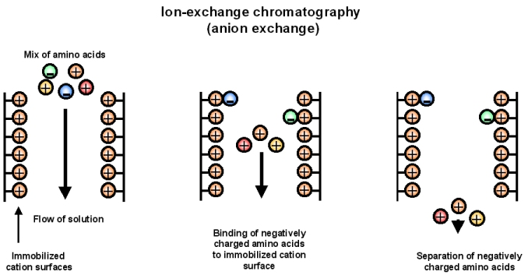
Anion Exchange Chromatography
To separate alpha-synuclein from the other components in the bacterial cell
24 aliquots to be used in Steps 3 and 4
https://chem.libretexts.org/@api/deki/files/223/ion_exch.jpg?revision=1
Notes:
Talking Points:
The bacterial cells that were induced to overexpression alpha-synuclein will be plated, cultured, lysed, and centrifuged.
Alpha-synuclein will be purified from the lysate supernatant using anion exchange chromatography.
Anion exchange chromatography separates based on charge with the positively charged molecules eluting first and the negatively charged molecules eluting last, and alpha-synuclein is heavily negatively charged.
The stationary phase has a cation surface that binds all the negatively charged molecules, in this case alpha-synuclein, while all other components elute out.
After elution of positively charged molecules, the alpha-synuclein will be eluted out using Cl- ions that will take the place of the alpha-synuclein on the stationary phase surface

Slide 10
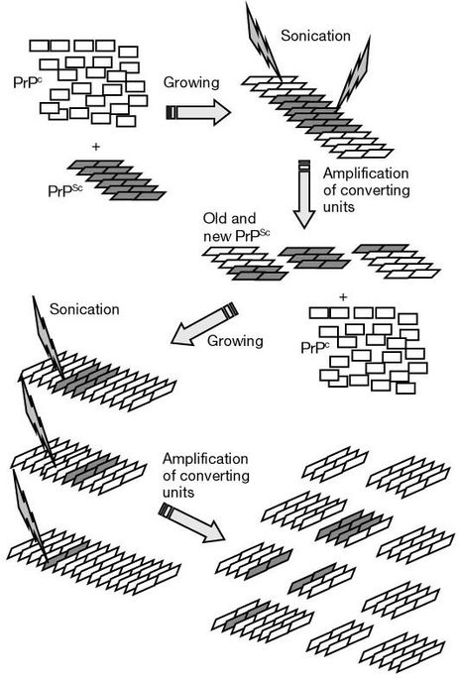
Protein Misfolding Cyclic Amplification (PMCA)
Increased surface area allows misfolded alpha-synuclein to bind to regularly folded alpha-synuclein, causing conformational change and aggregation
Saborio, G. P., Permanne, B., & Soto, C. (2001). Sensitive detection of pathological prion protein by cyclic amplification of protein misfolding. Nature, 411(6839), 810-813. doi:10.1038/35081095

Slide 11
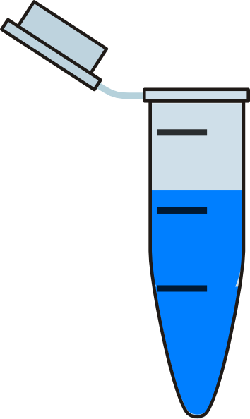
Introduction of Inhibitors
Promazine, Chlorpromazine, and Acepromazine
Able to cross blood brain barrier
Two different concentrations: 2 micromolar and 10 micromolar
Diluted in DMSO
1
2
3
4
5
6
7
8
Notes:
1,2: Promazine Inhibitor + Alpha-Synuclein (2 or 10 μM)
3.4: Chlorpromazine Inhibitor + Alpha-Synuclein (2 or 10 μM)
5,6: Acepromazine Inhibitor + Alpha-Synuclein (2 or 10 μM)
7: Alpha-Synuclein (control)
8: DMSO + Alpha-Synuclein (control)

Slide 12
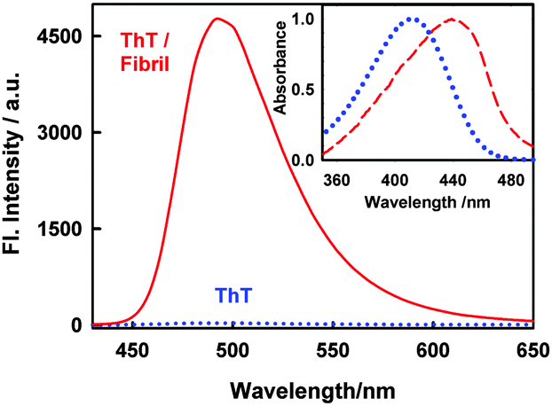
Thioflavin T Assay
Thioflavin T → benzathoile stain that binds to amyloid fibrils and fluoresces with binding
Relationship: Fluorescence = concentration of aggregated alpha-synuclein
Free rotation of carbon bond causing electrons to stay in stable state → when bound with amyloid fibrils, free rotation destroyed, and molecule “locked” in place
https://encrypted-tbn0.gstatic.com/images?q=tbn:ANd9GcQyQhmjT2hq4iZ38iCMSiLkBTMz-bnJ7kapQj68jS5ED4gGiDP1XQ

Slide 13
Concentration of aggregated alpha-synuclein
Two different scenarios can occur: Inhibitors work or the Inhibitors don’t work
Herva, M. E., Zibaee, S., Fraser, G., Barker, R. A., Goedert, M., & Spillantini, M. G. (2014). Anti-amyloid Compounds Inhibit α-Synuclein Aggregation Induced by Protein Misfolding Cyclic Amplification (PMCA). Journal of Biological Chemistry, 289(17), 11897-11905. doi:10.1074/jbc.m113.542340

Slide 14
Problems and Progress
Problems that might occur:
Thioflavin T staining might interact with the alpha-synuclein during the 30-min incubation period
Progress that can be made:
Mechanism of inhibition
Drug studies using these derivatives as “main ingredients”

