Slide 1
The Role of G_{βγ} in Opioid Tolerance and Withdrawal
Shahzeb Hasan
12/14/2017

Slide 2
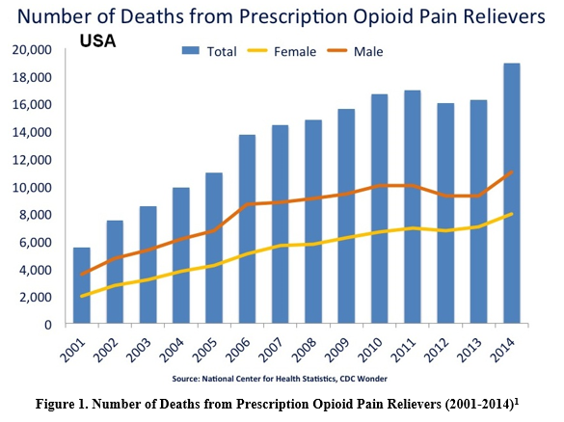
Current Opioid Epidemic
Notes:
The current opioid epidemic in the U.S. has been much discussed both in class and in current events. According to the National Institute on Drug Abuse, drug overdose is now the leading cause of accidental death in the US, with 32,000 of those deaths related to opioids.
US prescription rates have risen 600% from 1997 to 2007 according to the CDC.

Slide 3
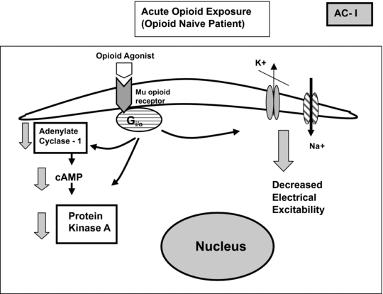
Sharma et al. 1975
Suggested cAMP/PKA pathway as mechanism

Slide 4
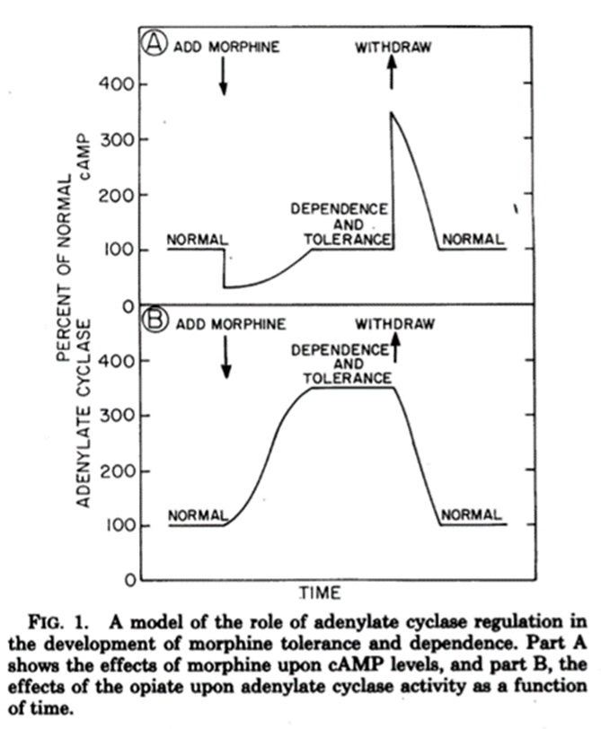
Mechanism of Tolerance and Withdrawal
Notes:
So how does opioid tolerance build and by what mechanism do opioid withdrawals affect the body?
One of the proposed mechanisms is the cAMP/PKA pathway. When morphine binds to the mu opioid receptor, the Gi and Go subunits (AC inhibitors) are stimulated leading to inhibition of Adenylate Cyclase and thus a reduction in cAMP levels.
cAMP is a secondary messenger molecule used to activate PKA that is a kinase responsible for many downstream physiological mechanisms. However, over chronic morphine use, cAMP levels return to basal levels and once an antagonist is given or morphine is withdrawn, cAMP levels spike due to AC super activation. This spike in cAMP levels causes the physiological reactions we see as withdrawal symptoms.

Slide 5
Avidor-Reiss et al. 1996
Role of G alpha subunits
Found that of the Gα subunits (Gα₀, Gα_{i1}, Gα_{i2}, and Gαi₃) only knockout of Gα₀ prevented adenylate cyclase inhibition
Notes:
Avidor-Reiss et al. found that the Go subunit from the Galpha subunit family is what actually causes inhibition of AC and was able to prevent AC inhibition.

Slide 6
Research Question
Does the G_{βγ} subunit mediate adenylate cyclase super activation following chronic opioid exposure?

Slide 7
Overview of Experiment
Cell Line: Nueroblastoma x Glioma Hybrid Cell Line
Control Group – cells exposed to morphine (10 µM) for 48 hours and then to Naloxone (10 µM), an opioid antagonist
Experimental Group – G_{βγ} inhibited cells exposed to morphine (10 µM) for 48 hours and then to Naloxone (10 µM)
cAMP levels taken at regular intervals through a cAMP assay
Notes:
The aim of this experiment is to determine if adenylate cyclase super activation is mediated through G_{βγ} stimulation of G_{αs} following chronic opioid use and if inhibition of the G_{βγ} can cause attenuation of tolerance by preventing adenylate super activation and thus cAMP overshoot upon opioid withdrawal.

Slide 8
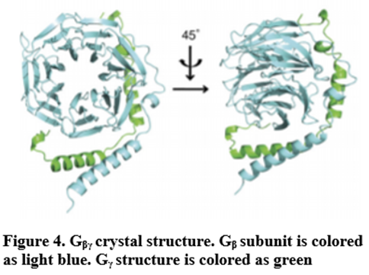
Inhibition of G_{βγ}
Competitive Inhibition through M119
Binds to G_{βγ} “hotspot” preventing effector binding

Slide 9
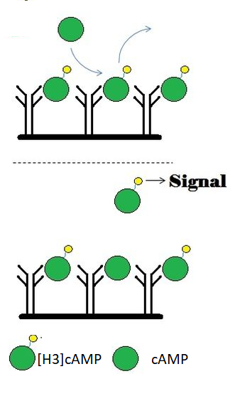
Cyclic-AMP Assay
Competitive homogenous immunoassay
Eluted cAMP displaces [H₃]cAMP previously bound to cAMP-dependent protein kinase
Displaced [H₃]cAMP emission measured
Cross-Referenced to Standard Curve

Slide 10
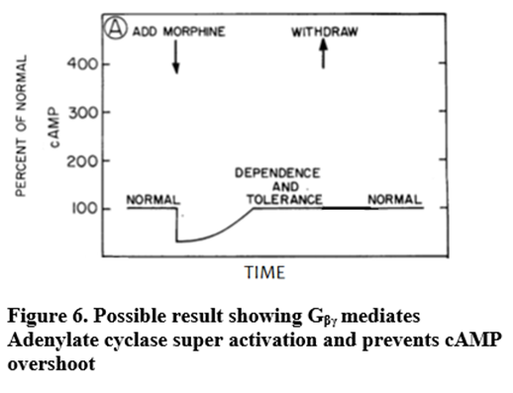
Possible Result #1
G_{βγ} mediates adenylate cyclase super activation
Notes:
The G_{βγ} subunit is essential for the formation of heterotrimeric G protein through its association with the G_{α} subunit allowing the G proteins coupling to the GPCR. Therefore, any agent inhibiting the G_{βγ} subunits signaling effects must not interfere with the heterotrimeric G protein formation or G_{α}subunit signaling.
G_{βγ} expression is universal throughout almost all the cells of the body so any agent acting to inhibit this subunit could elicit numerous side effects.
Small molecule inhibitors that target the coupling of G_{βγ} to specific effectors and do not interfere with normal G protein cycling/ heterotrimeric formation, have the potential to work as therapeutic agents in treating some specific diseases.

Slide 11
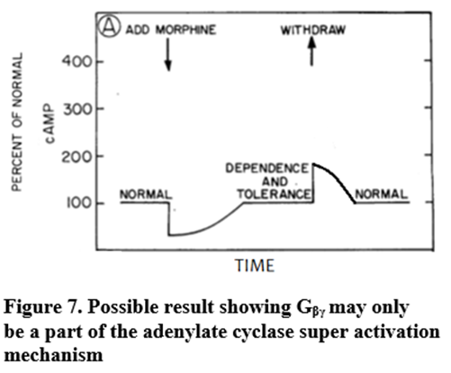
Possible Result #2
G_{βγ} plays a partial role in adenylate cyclase super activation

Slide 12
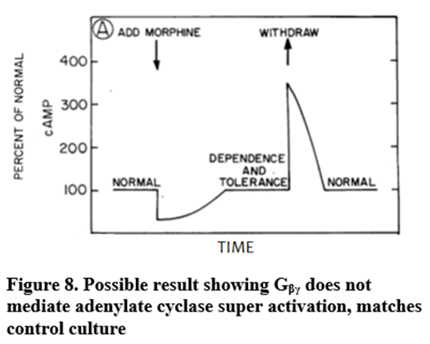
Possible Result #3
G_{βγ} does not mediate adenylate cyclase super activation

Slide 13
Limitations
Inhibition of G_{βγ} may lead to unintended side effects of PKA pathways
Does not pinpoint the exact pathway with which G_{βγ} causes adenylate cyclase super activation
Use of inhibitor may not only inhibit G_{βγ} but may inhibit other cellular processes leading to inaccurate conclusions

Slide 14
Steps Prior to Assay
Growth in Media
  Growth in DMEM, 10% fetal bovine serum
  Reaction termination through 1.0 ml of trichloroacetic acid
Centrifugation
  Two washes with 1 ml of trichloroacetic acid
Elution
  Supernatant applied to elution column
  cAMP eluted with HCOOH (Formic Acid)
Assay

Slide 15
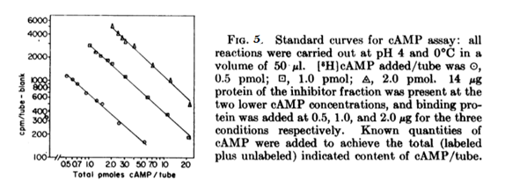
cAMP Assay Standard Curve

Slide 16
References
1. National Institute on Drug Abuse. (2015). Drugs of Abuse: Opioids. Bethesda, MD: National Institute on Drug Abuse. Available at http://www.drugabuse.gov/drugs-abuse/opioids.
2. National Institute on Drug Abuse. (2014). Drug Facts: Heroin. Bethesda, MD: National Institute on Drug Abuse. Available at http://www.drugabuse.gov/publications/drugfacts/heroin.
3. Centers for Disease Control and Prevention Grand rounds: Prescription Drug Overdoses: A U.S. Epidemic. http://www.cdc.gov/mmwr/preview/mmwrhtml/mm6101a3.htm
4. Fortuna RJ, Robbins BW, Caiola E, Joynt M, Halterman JS. Prescribing of controlled medications to adolescents and young adults in the United States. Pediatrics. 2010;126(6):1108-1116. https://www.ncbi.nlm.nih.gov/pubmed/21115581
6. U.S. National Library of Medicine: MedlinePlus. (2016). Opiate and Opioid Withdrawal. https://medlineplus.gov/ency/article/000949.htm
7. Sharma, S K, W A Klee, and M Nirenberg. “Dual Regulation of Adenylate Cyclase Accounts for Narcotic Dependence and Tolerance.” Proceedings of the National Academy of Sciences of the United States of America 72.8 (1975): 3092–3096. Print. https://www.ncbi.nlm.nih.gov/pmc/articles/PMC432926/
8. Avidor-Reiss, Tomer, et al. “Chronic Opioid Treatment Induces Adenylyl Cyclase V Superactivation.” Journal of Biological Chemistry, vol. 271, no. 35, 1996, pp. 21309–21315., doi:10.1074/jbc.271.35.21309. https://www.ncbi.nlm.nih.gov/pubmed/8702909
9. Gilman, Alfred G. “A Protein Binding Assay for Adenosine 3′:5′-Cyclic Monophosphate.” Proceedings of the National Academy of Sciences of the United States of America 67.1 (1970): 305–312. Print. https://www.ncbi.nlm.nih.gov/pmc/articles/PMC283204/
10. Feng, Yuan et al. “Current Research on Opioid Receptor Function.” Current Drug Targets 13.2 (2012): 230–246. Print. https://www.ncbi.nlm.nih.gov/pmc/articles/PMC3371376/
https://www.drugabuse.gov/about-nida/legislative-activities/testimony-to-congress/2015/harnessing-power-science-to-inform-substance-abuse-addiction-policy-practice
https://www.cambridge.org/core/books/acute-pain-management/acute-pain-management-in-patients-with-opioid-dependence-and-substance-abuse/F2B1FE2EBB45C17E8E07DD1A4C67731D

