Slide 1
Tbx5 Dominant Negative Protein Inhibiting Myocardial Regeneration in Zebrafish
Joshua Fung
BNFO300
12/15/17

Slide 2
Introduction
610,000 people die of cardiovascular disease per year
Possible solution: Heart Regeneration
Zebrafish: one of few organisms that possess this ability
Tbx5: expressed in heart development

Slide 3
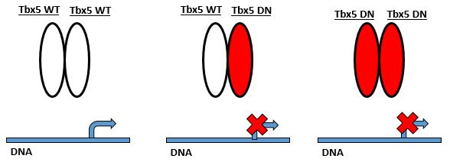
Dominant Negative Mutation
mutation that alters protein so it interferes with function of wild-type protein produced by other allele

Slide 4
Methods
Zebrafish Purchase
Heterozygous cmlc2-creEr(T2) transgene zebrafish
Wild-type zebrafish embryos for tbx5DN transgene
Tbx5 Dominant Negative construction
CreLox Recombination

Slide 5
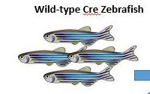
Methods
Cre
Er(T2)
Hsp90
Cmlc2 (promoter, regulatory DNA sequences)
restricts the Cre only to the heart
cmlc2
CreEr(T2)

Slide 6
Methods
Zebrafish Purchase
Tbx5 Dominant Negative construction
CreLox Recombination

Slide 7
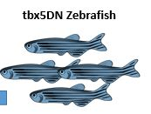
Method
β-actin
STOP
BFP (blue)
mCherry (red)
Tbx5 DN
loxP
loxP
Transgenic line: Tg(bactin2:loxP-mTagBFP-STOP-loxP-mCherry-tbx5dn)

Slide 8
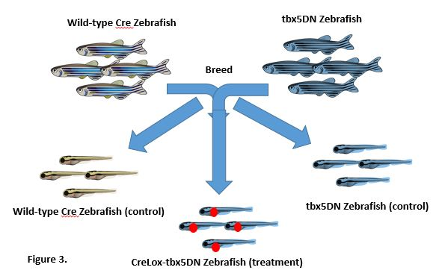
Methods

Slide 9
Methods
Zebrafish Purchase
Tbx5 Dominant Negative construction
CreLox Recombination

Slide 10
Cre
Er(T2)
Hsp90
Cmlc2 (promoter, regulatory DNA sequences)
restricts the Cre only to the heart
cmlc2
CreEr(T2)
4HT
Hsp90
Knocked off by 4HT hormone
(4-hydroxytamoxifen)
Hormone that allows CreEr
to go to nucleus
NUCLEUS
β-actin
STOP
BFP (blue)
mCherry (red)
Tbx5 DN
loxP
loxP
Transgenic line: Tg(bactin2:loxP-mTagBFP-STOP-loxP-mCherry-tbx5dn)

Slide 11
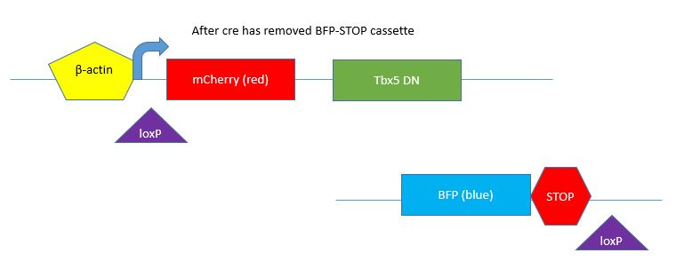

Slide 12
Methods continued
Ventricular resection surgery- surgical injury
Allow for regeneration or scarring
Euthanization- immersion in tricaine
Perfusion- phosphate buffered formalin
Cryosectioning- slide preparation
Acid Fuchsin-Orange G Staining

Slide 13
Methods continued
Ventricular resection surgery- surgical injury
Allow for regeneration or scarring
Euthanization- immersion in tricaine
Perfusion- phosphate buffered formalin
Cryosectioning- slide preparation
Acid Fuchsin-Orange G Staining

Slide 14
Methods continued
Ventricular resection surgery- surgical injury
Allow for regeneration or scarring
Euthanization- immersion in tricaine
Perfusion- phosphate buffered formalin
Cryosectioning- slide preparation
Acid Fuchsin-Orange G Staining

Slide 15
Methods continued
Ventricular resection surgery- surgical injury
Allow for regeneration or scarring
Euthanization- immersion in tricaine
Perfusion- phosphate buffered formalin
Cryosectioning- slide preparation
Acid Fuchsin-Orange G Staining

Slide 16
Methods continued
Ventricular resection surgery- surgical injury
Allow for regeneration or scarring
Euthanization- immersion in tricaine
Perfusion- phosphate buffered formalin
Cryosectioning- slide preparation
Acid Fuchsin-Orange G Staining

Slide 17
Methods continued
Ventricular resection surgery- surgical injury
Allow for regeneration or scarring
Euthanization- immersion in tricaine
Perfusion- phosphate buffered formalin
Cryosectioning- slide preparation
Acid Fuchsin-Orange G Staining

Slide 18
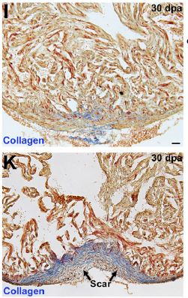
Results
One of two things can happen:
Resected hearts scar or regenerate
1. Scarring indicates tbx5DN inhibits regeneration and that tbx5 is necessary (Bottom)
2. Successful regeneration indicates that tbx5 is not necessary for heart regeneration (Top)
Figure5. Gupta et al, 2013

Slide 19
Synthesis and recap
Expressing tbx5DN vs conditional knockout
If conditional knockout approach was used, which would be the “real” results

