Slide 1
Examining the Role of Verapamil on Protein Kinase C Activity in the Hepatic Cells of Diabetic Mice
Samhitha Dhandamudy

Slide 2
Purpose:
Will Verapamil cause PKC activation or inhibition in hepatic liver cells?

Slide 3
Type 2 Diabetes
Type 2 Diabetes: When body resists or does not produce enough insulin which is a hormone which regulates glucose levels in the bloodstream.

Slide 4
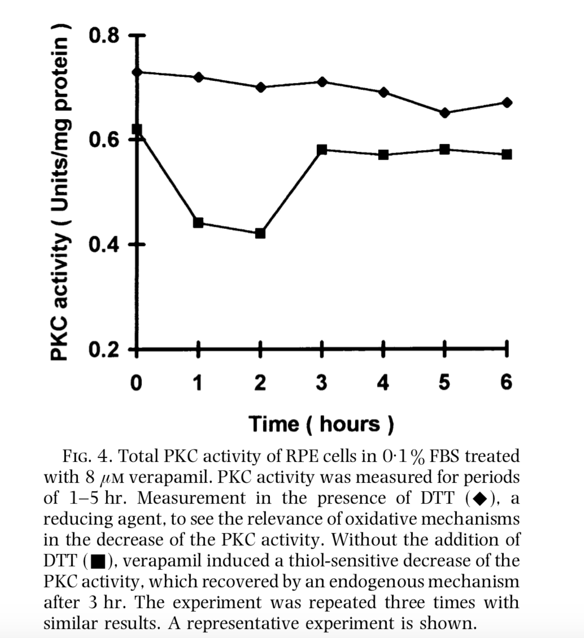

Slide 5
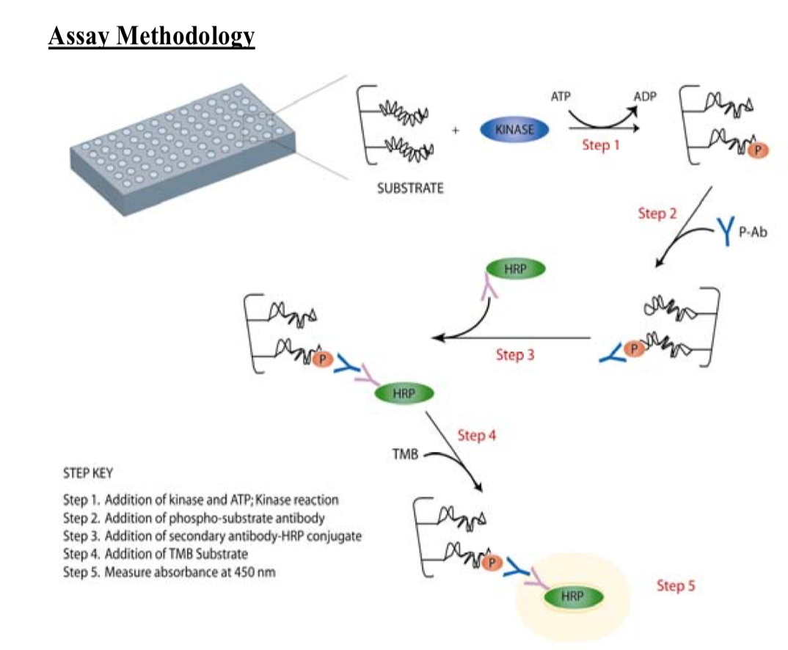
PKC Assay
Notes:
Know the steps

Slide 6
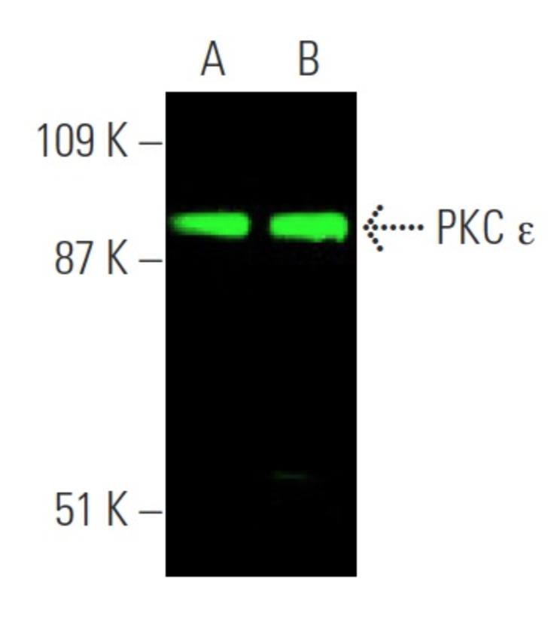

Slide 7
References
Santa Cruz Biotechnology. (2017). Retrieved 12 14, 2017, from scbt.com: https://www.scbt.com/scbt/product/pkc-epsilon-antibody-e-5
Stephan Hofmann a,b, Rayudu Gopalakrishna, Usha Gundimeda, Toshinori Murat a,b, Christine Spee, Stephen J. a,b  David R. Hinton* Verapamil Inhibits Proliferation, Migration and Protein Kinase C Activity in Human Retinal Pigment Epithelial Cells.(Received Seattle 20 October 1997 and accepted in revised form 13 February 1998)
Protein Kinase C Assay Activation Kit, Assay Designs, 7/6/2009

