Slide 1
Discovery of possible connection between cln3 and cisd2 genes through notch signaling
Rebecca Culpepper
Notes:
My proposal is to determine if there is a possible connection between cln3 and cisd2 through cell to cell notch signaling

Slide 2
Genetic Diseases
Cause - Mutations
Deadly, Debilitating
CISD2
cisd2
CISD2 → Wolfram Syndrome 2
Equal to fly gene
CLN3
cln3
CLN3 → Batten Disease
Equal to fly gene
Jones, M., Amr, S., Ferebee, A., Huynh, P., Rosenfeld, J., Miles, M., . . . Grotewiel, M. (2014). Genetic studies in Drosophila and humans support a model for the concerted function of CISD2, PPT1 and CLN3 in disease. Biology Open, 3(5), 342-52.
Tuxworth, RI., Vivancos, V., O’Hare, MB., Tear, G. (2009). Interactions between the juvenile Batten disease gene, CLN3, and the notch and JNK signaling pathways. Human Molecular Genetics, 18(4), 667-678.
Notes:
Genetic diseases, we’ve all likely heard of them, caused by mutations and can be deadly and/or debilitating.
Cisd2
Transmembrane domain and iron-sulfur domain, localize to ER
Unknown if involved in regulation of the unfolded protein response
causes wolfram syndrome 2, neurodegenerative disease cause blindness, deafness and diabetes; generally death in 30 years
Cln3
Encodes transmembrane protein
Function unique to neurons or neurons just susceptible? unknown
causes batten disease, neurodegenerative disease, loss of mental and motor skill, death by 25 years generally
Functions of both are unclear and not fully uncovered.
Goal – find more out

Slide 3
Jones et al. (2014)
Proposed model for cisd2, Ppt1 and cln3 function:
Overexpress Ppt1 -> Black ommatidia
Overexpress cln3 -> Rough eyes
***Overexpress cln3 & knockdown cisd2 -> black ommatidia (negative regulator)***
Overexpress Ppt1 & knockdown cisd2 -> partially suppressed black ommatidia (positive regulator)
Knockdown cisd2 -> No obvious effect
Cisd2 affects phenotype of these genes? (specifically cln3)
How?
Notes:
Figure from Jones et al. (2014)
Possible model of theses genes connections, based on results from paper
Results from paper ‘Genetic studies of Drosophila and humans support a model for the concerted function of CISD2, PPT1, and CLN3 in disease’
Found that genes were connected to each other
CISD2 -> PPT1
CISD2 -> CLN3
CLN3 -> PPT1

Slide 4
What connects one genes function to another genes function?
“Another possibility is that CLN3-mediated signaling via Notch and JNK or synthesis of sphingolipids might be important for the function of CISD2, PPT1 or other genes in the network” (Jones et al. 2014)
notch
Notch Signaling
Notes:
So, the genes are connected, based on results from this paper however how?
Quote from paper, -> signaling connects them?
Focused on notch because affected by cln3 -> other paper on cln3 Tuxworth et al
Cln3 overexpress, notch activation down.

Slide 5
Notch signaling
Contact Dependent Cell-to-Cell signaling
How cells talk to each other
Important in Development
Nucleus
Nucleus
Borggrefe, T., & Oswald, F. (2009)
Artavanis-Tsakonas, S., Rand, M., & Lake, R. (1999)
Greenwald, I. (2012).
Notes:
Notch signaling is a cell to cell signaling mechanism; important during development for the differentiation of cells into different cell types. Works only with direct contact, a receptor on one cell must come in direct contact with the other cells ligand protein (a specific ligand protein). This then cleaves the receptor which allows a piece connected on the inside to translocate into the nucleus.

Slide 6
How are these genes connected
Is there a connection of cln3 gene and cisd2 gene through the notch signaling pathway?
cisd2
cln3
?
Notch signaling
Notes:
So the ultimate question is there a connection of cln3 and cisd2 through notch. We know that there is a connection based on results from previous paper however we don’t know what connects them or how.

Slide 7
How are these genes connected
Experiment set 1
cln3 overexpression with notch rescue
cln3 overexpression(control)
Notch overexpression (control)
Experiment set 2
Notch knockdown and cisd2 knockdown
cisd2 knockdown (control)
Notch knockdown (control)
cisd2
cln3
notch
Jones, M., Amr, S., Ferebee, A., Huynh, P., Rosenfeld, J., Miles, M., . . . Grotewiel, M. (2014). Genetic studies in Drosophila and humans support a model for the concerted function of CISD2, PPT1 and CLN3 in disease. Biology Open, 3(5), 342-52.
Tuxworth, RI., Vivancos, V., O’Hare, MB., Tear, G. (2009). Interactions between the juvenile Batten disease gene, CLN3, and the notch and JNK signaling pathways. Human Molecular Genetics, 18(4), 667-678.
Notes:
My plans for experiments; these experiments will test whether the phenotype seen in Jones et al and in Tuxworth et al. when cln3 was overexpressed was caused by notch, I will overexpress cln3 which lower notch activation; to compensate I shall overexpress notch gene. The controls will then be those two separate. Second, and assuming the results follow my hypothesis I will knockdown notch and cisd2, with controls of them by themselves as well. The results should tell me whether or not notch is the connection and responsible for the phenotype.

Slide 8
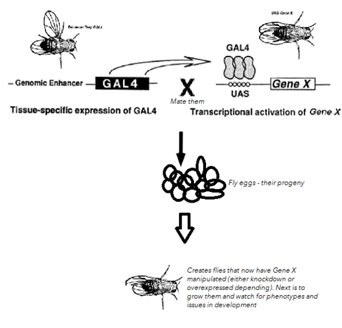
Gene Manipulation
Gal4-UAS system
Is there a connection of CLN3 gene and CISD2 gene through the notch signaling pathway?
Refurbished/edited fig 1 graphic from paper Brand, A.H. and Perrimon, N. (1993). Targeted gene expression as a means of altering cell fates and generating dominate phenotypes. Development, 118, 401-415.
Notes:
Gal4-UAS system will be used to manipulate the genes – to overexpress or knockdown.
A fly with the GAL4 inserted near the correct Enhancer/promoter region where we want gene x to be expressed will be bought from Bloomington Stock Center.
They will be crossed with flies that have the UAS promoter in front of target gene (whole in case of overexpression or short hairpins in case of knockdown) and the two flies will be bred (mated) together. The progeny of these flies will as a result have the UAS sight activated and the gene will have been manipulated – knockdown or overexpression.
In the case of knockdown, the knockdown will cause the creation of RNAi transgenes – that is how the genes will be repressed (expression greatly reduced).

Slide 9
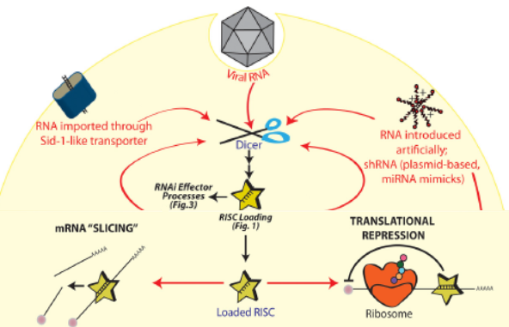
Gene Manipulation
RNAi transgenes
Refurbished/edited fig 1 & fig 3 graphic from paper Pratt, A., & Macrae, I. (2009). The RNA-induced Silencing Complex: A Versatile Gene-silencing Machine. Journal Of Biological Chemistry, 284(27), 17897-17901.
Notes:
RNAi transgenes are pieces of RNA code that can either be put in the cell by a researcher or created by the cell itself. The transgenes will enter the cell and be transcribed and then picked up by RISC (RNA-induced silencing complex), RISC will take the RNA sequence and will used it to find the matching mRNA sequence, it will then either slice the sequence preventing translation or it will suppress the translation by sitting on the sequence and preventing ribosome from being able to translate it.

Slide 10
Notch signaling a connection for genes
cln3 overexpression with notch rescue – No phenotype
Cisd2 knockdown (control) – No phenotype
notch rescue – No phenotype
Notch knockdown and cisd2 knockdown – Severe phenotype
cln3 overexpression (control)– Mild phenotype
Notch knockdown (control) – Mild phenotype
No phenotype | No black ommatidium | Some black ommatidium | Clusters black ommatidium | Multiple clusters black
Fig. 1 (adapted from Fig 3 in Jones et al.)¹ Scale used for measuring the black ommatidium phenotype in the flies. Based on similar system from Jones et al.
Refurbished/edited fig 3 graphic from paper Jones, M., Amr, S., Ferebee, A., Huynh, P., Rosenfeld, J., Miles, M., . . . Grotewiel, M. (2014). Genetic studies in Drosophila and humans support a model for the concerted function of CISD2, PPT1 and CLN3 in disease. Biology Open, 3(5), 342-52.
Jones, M., Amr, S., Ferebee, A., Huynh, P., Rosenfeld, J., Miles, M., . . . Grotewiel, M. (2014). Tuxworth, RI., Vivancos, V., O’Hare, MB., Tear, G. (2009)

Slide 11
Connections between genes
Is there a connection of cln3 gene and cisd2 gene through the notch signaling pathway?
Test different genes with functions to see changes
Understand better the functional connections between genes to add to knowledge about genes and the diseases they cause.
Notes:
Again, question and why I believe this is something worth studying.

