Slide 1
AEG-1 ALTERS methylation status of IGFBP7 promoter via activation of the Wnt/β-catenin signaling pathway in HCC
Ayshah Asmat

Slide 2
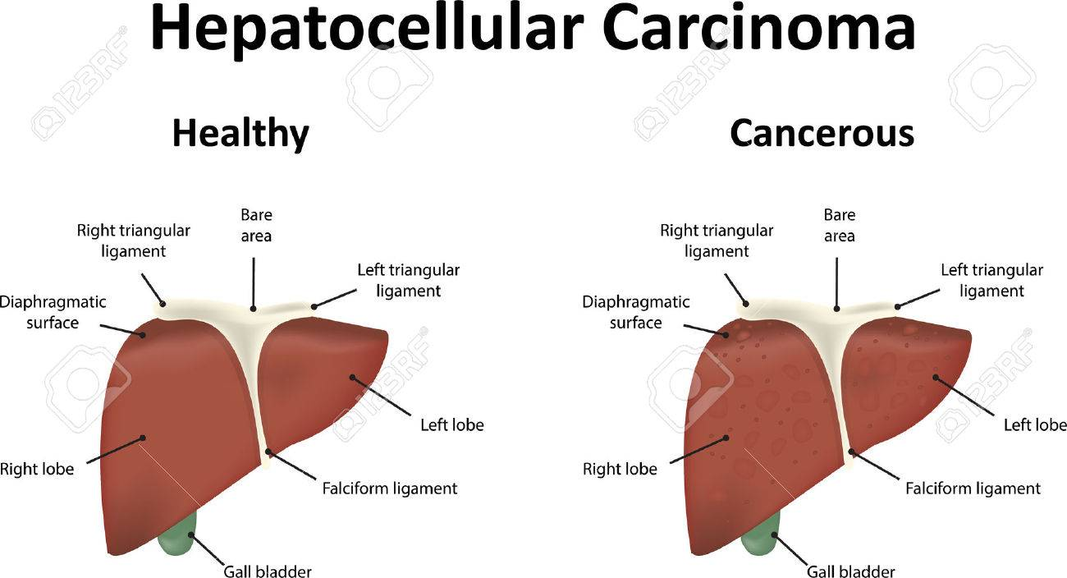
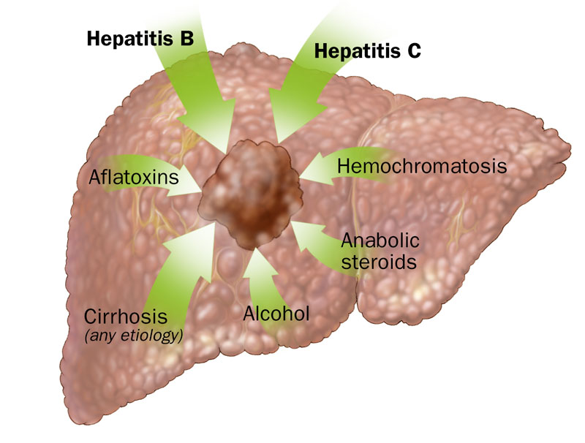
Hepatocellular Carcinoma (HCC)
A common malignancy of the liver
Treatment Options – Surgery?
What other options are there?...
Notes:
- HCC is a common malignancy of the liver and is now the third leading cause of cancer deaths worldwide, with over 500,000 people affected. In most cases, liver cancer can lead to long-term damage and cirrhosis (scarring of liver and poor liver function). Common causes of HCC are Hepatitis B or C and alcohol abuse. Hep B/C are irritation and swelling of the liver due to their corresponding viruses.
- Treatments:
- Surgery is an option, but less than one-third of patients qualify as surgical candidates’ due to various limiting factors, such as severe impairment of reserve hepatic function, bilobar tumor distribution and extrahepatic (originating outside of the liver) metastasis (spreads to different part of body than where it started).

Slide 3
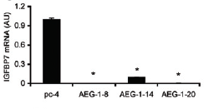
Insulin-growth factor binding protein-7 (IGFBP7)
A secreted protein
Roles in growth, differentiation, and proliferation
Consists of two growth factors - IGF-I and IGF-II (and corresponding receptors)
Chen et al. 2011 – Showed its potential tumor suppressive activity and downregulation by the oncogene AEG-1
Determination of IGFBP7 mRNA levels by RT-qPCR
(Chen et al 2011)
Notes:
- Chen et al. 2013 showed IGFBP7 has potential tumor suppressive activity; downregulation of IGFBP7 as the tumor progresses.
- They found that IGFBP7 was initially identified as an AEG-1–downregulated gene, so they checked 3 different AEG-1–overexpressing clones and had a control. In all 3 AEG-1–overexpressing clones, IGFBP7 mRNA expression was robustly downregulated compared with the control group.
- Although this possible tumor suppressor exists, the malignancy of HCC continues due to the presence of astrocyte elevated gene-1 (AEG1) which acts as an oncogene and helps with progression and development of HCC.

Slide 4
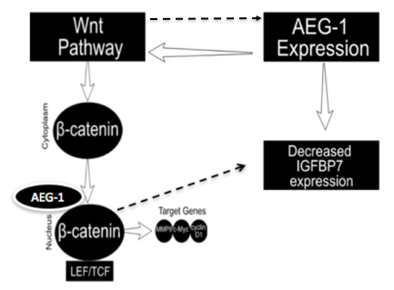
Astrocyte-Elevated Gene-1 (AEG-1)
Oncogene
AEG-1 overexpression can be accounted for by?
Multiple pathways, such as the Wnt/β-catenin signaling pathway
Proposed Pathway
Figure 1. Proposed Pathway of AEG-1 Overexpression on Status of IGFBP7
Notes:
- AEG-1 is an oncogene that helps with the progression of HCC.
- Previous studies demonstrate that AEG1 was significantly overexpressed in various malignant cells and plays a major role in tumorigenesis. The overexpression of AEG1 can be accounted for due to a number of pathways. These pathways can be used in studying different types of HCC. I'd like to focus on the Wnt signaling pathway for its close association with tumor development.
- Here, I have proposed a pathway to depict how AEG-1 overexpression could effect status of IGFBP7.
-The figure shows the process of the Wnt pathway, where where β-catenin is the main downstream effector. When the pathway is activated, β-catenin accumulates in the cytosol at high levels, binds to Lymphoid Enhancer Factors (LEF) and T-Cell Factors (TCF), and shifted to the nucleus. Once in the nucleus, it induces expression of target genes. I have also included a feedback loop between the Wnt pathway and AEG-1 expression and noted how B-catenin and AEG-1 interact to activate the pathway, thus causing for decreased IGFBP7 expression.

Slide 5
Experiment
Determine if AEG-1 silencing alters IGFBP7 expression and promoter methylation in HCC
Notes:
- The goal of my experiment is to determine if AEG1 silencing alters IGFBP7 expression and promoter methylation in HCC.
In order to determine this, an experiment focused on effects of AEG-1 silencing will be performed. HCC cell lines will be used in two different experimental groups.
The cells will be infected with either the lentivirus Lenti-AEG-1-sh or with Lenti-control-infected cells. The Lenti-AEG-1-sh will be targeted by a short hairpin RNA (shRNA). The above-mentioned shRNAs will be delivered by Lenti virus because it is able decrease gene expression of both dividing and non-dividing cells. In this case, the shRNA will be used to downregulate AEG-1.
- Western blotting will be performed on each of these groups to detect the relative protein levels of axin and adenomatous polyposis coli protein (APC), and IGFBP7 levels. Axin is known as an inhibitor of the Wnt signaling pathway, and APC is known as a tumor suppressor gene.

Slide 6
Step 1: Cell Culture
Will use HCC cells
Divided into two groups :
Lenti-AEG-1-sh group
Lenti-control group
Lenti-AEG-1-sh will be targeted by a short hairpin RNA (shRNA)
‘5’-AACTTACAACCGCATCATT-3’
Able decrease gene expression of AEG-1
Notes:
- The HCC cells will be checked for viability through MTT assay. MTT assay acts as an indicator of cellular metabolic activity. The assay works by viable cells metabolizing a water-soluble salt into a water-insoluble formazan product. DMSO acts as the most suitable solvent for dissolving the water-insoluble product.
- And as I mentioned, the HCC cells will be divided into the following two groups.

Slide 7
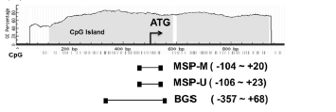
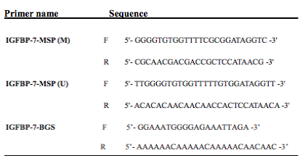
STEP 2: Methylation-Specific Polymerase Chain Reaction (MS-PCR) and Bisulfite Genomic Sequencing (BGS)
IGFBP7 contains a CpG island around promoter region
CpG islands covering transcription start site were used to design primers and primer sets
Position of CpG Islands
Depiction of 5’ Region of IGFBP7
Transcription Start Site
(Chen et al 2015)
Position of primers
(Chen et al 2015)
Notes:
- Next, the genomic DNA will be isolated from HCC cell lines and applied to bisulfite conversion in order to allow for the conversion of unmethylated cytosine to uracil.
- We will focus on the promoter region because IGFBP7 contains CpG Island in this area. There will be 3 primers used and these were designed due to the CpG islands covering transcription start site.

Slide 8
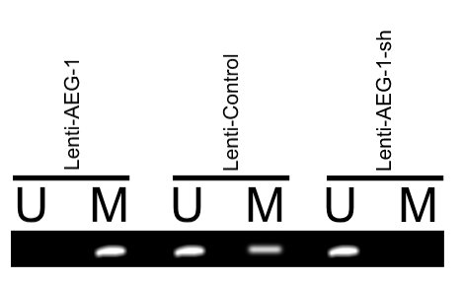
Methylation-Specific Polymerase Chain Reaction (MS-PCR)
IGFBP7 is strongly methylated in the Lenti-AEG-1
IGFBP7 is weakly methylated in the Lenti-control
IGFBP7 is not methylated in the Lenti-AEG-1-sh
IGFBP7 is silenced or downregulated
IGFBP7 will be expressed normally
IGFBP7 will be expressed at greater levels than normal
Faux MS-PCR Results
(Lenti-AEG-1 included as a reference point)
(Suzuki et al 2010)
Notes:
MS-PCR allows for the analysis of DNA methylation patterns in CpG islands.
CpG islands are focused on the regulation of gene expression and the excess methylation of CpG in a promoter represses gene expression.
Discuss expected results

Slide 9
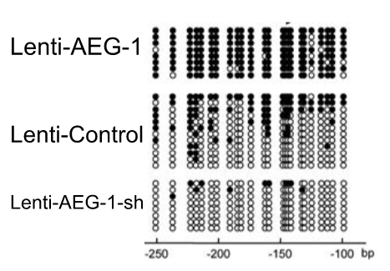
Bisulfite Genomic Sequencing (BGS)
Determine the pattern of methylation
Reinforces MS-PCR results
Faux BGS Results
Methylated CpG Sites (black dots)
(Lenti-AEG-1 included as a reference point)
Unmethylated CpG Sites (white dots)
(Suzuki et al 2010)
Notes:
- BGS uses bisulfite treatment (Bisulfite is used for its deamination capabilities to unmethylated cytosine, causing for chemical conversion to uracil) of DNA in order to determine the pattern of methylation.
- The PCR for the methylated and unmethylated products will then be visualized.

Slide 10
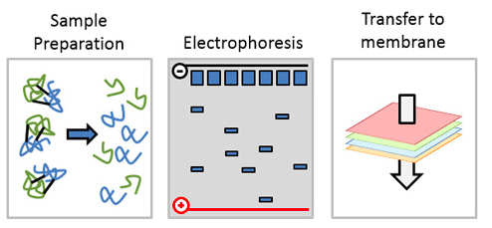
STEP 3: Western Blotting
Set Up:
HCC cells will be washed and lysed
Separation by SDS-PAGE – detergent that denatures proteins – causes for net negative charge
Gel electrophoresis
Electrophoretic transfer
Western Blot Set-Up
Notes:
HCC cells will be washed then be lysed.
Following cell lysis, the proteins in the cell will undergo separation by SDS-PAGE.
SDS is a detergent that denatures proteins by altering their tertiary structure via unfolding them, which causes for a net negative charge. - The molecules migrate in to the gel by an electric field that separates them based on size- smaller molecules will travel further down the gel and larger molecules will travel less far.
Then, moved to the highly hydrophobic PVDF membrane, this is known as electrophoretic transfer because the negatively charged proteins are transferred onto a positively charged membrane again by an electric current.

Slide 11
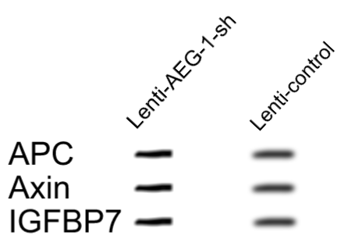
STEP 3: Western Blotting Continued
Faux Western Blot Results
Detection:
Primary Antibodies: Rabbit anti-APC, rabbit anti-axin, and rabbit anti-IGFBP7
Secondary Antibodies: Anti-rabbit lgG HRP-linked
Target Proteins: APC, Axin, IGFBP7
Enhanced chemiluminescent (ECL) detection
Substrate detects antibodies
(Li et al 2017)
Notes:
Primary antibodies for the experiment are listed.
Then, the secondary rabbit antibody will be incubated and they will have the addition of horseradish peroxidase (HRP). The secondary antibody will be added onto the membrane to bind to the primary antibody.
- Target proteins will be detected by ECL western blotting and the substrate can detect antigen via imaging and will be used to the detection of horseradish peroxidase (HRP).

Slide 12
Discussion: Goals and Setbacks
Goals:
Determine if AEG-1 plays a role in regulation of HCC
Help in treatment of HCC by focusing on one pathway vs. multiple
Setbacks:
AEG-1 would not activate the Wnt/β-catenin pathway due to the current state of the disease’s progression
Infection of AEG-1-sh may not increase or change IGFBP7 expression
Notes:
From this experiment, the goal is to determine if AEG1 regulates HCC because its activation of the Wnt pathway. And this would help in finding treatments of HCC by focusing on the purpose of the Wnt pathway because there has been difficulty due to the multiple pathways it uses.
However, setbacks can occur, AEG1 may not activate the Wnt pathway or it may vary depending on the state of the cancer. And a major issue would be if AEG-1-sh does not even increase or change IGFBP7 expression. This would make it difficult to see if AEG1 does regulate HCC and leave us to wonder what factor is decreasing IGFBP7’s expression because of its key role as a tumor suppressor.
- One way to do this is to silence beta-catenin pathway in AEG-1 overexpressed cells and then check IGFBP7 by WB which should be same as control now (not decreased anymore rescued by betacatenin silencing).

Slide 13
Questions?

