Slide 1
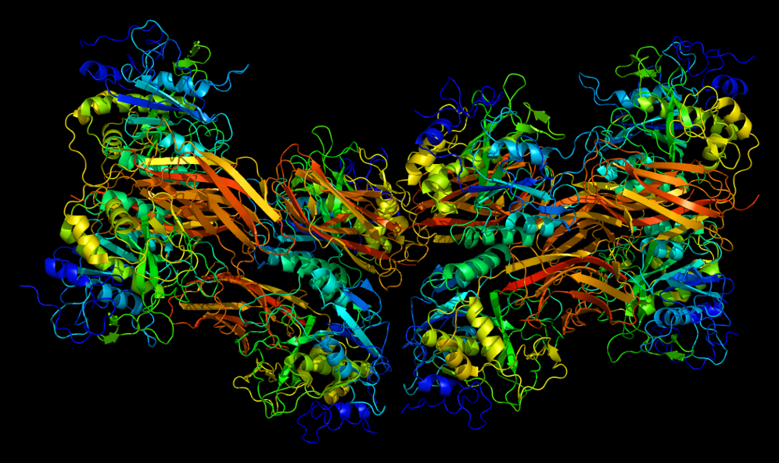
Furin deletion in B cells alters ADAM10 prodomain processing and the downstream effects on allergic asthma
Sharoon Arshad

Slide 2
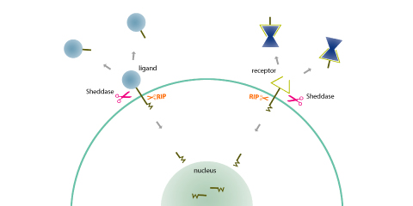
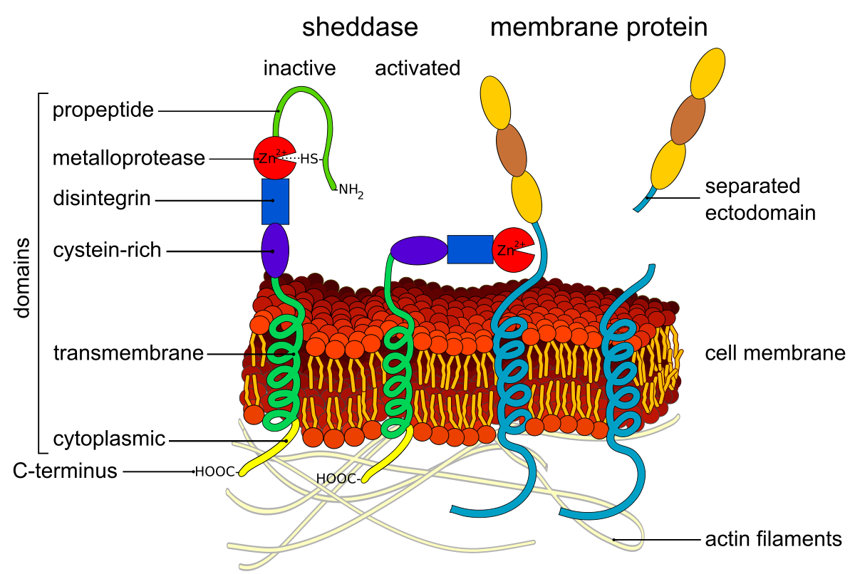
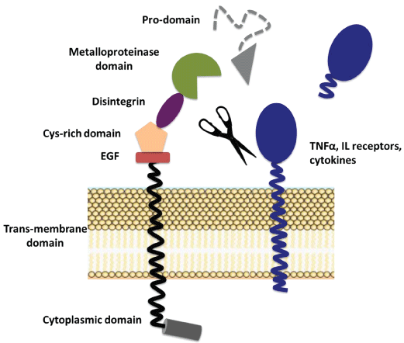
ADAM10
What is ADAM10?
Why is it important?
I hypothesize that furin deletion from B cells will result in the reduction of airway hyperresponsiveness (AHR) in a mouse model of asthma.
Notes:
-ADAM10 is a member of metalloproteinases and disintergins that are responsible for the proteolytic processing of transmembrane receptors and ligands
(metalloprotease – protease enzyme whose catalytic mechanism involves a metal in this case its zinc)
-ADAM10 is also a zymogen so it will remain inactivate until its prodomain region is cleaved.
-The prodomain of ADAM10 keeps the metalloprotease(part that cleaves proteins) inactive
-Furin is one of the convertases that activates ADAM10 through cleavage of the prodomain.
-Since a deletion of Furin will result in a possible partial loss of ADAM10, it may possibly be a more beneficial drug target for asthma therapy.
- I propose that Furin deletion from B cells will result in the reduction of airway hyperresponsiveness (AHR) in a mouse model of asthma through the processing of ADAM10 and ICOSL.

Slide 3
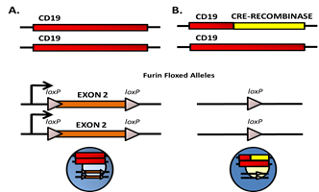
Breeding furin knockout mice
Breeding furin knockout mice (Cre-Recombinase)
Breeding with CD-19 mice to knock out B-cell specific
Furin
Notes:
To being the experiment I will procure mice that have exon 2 of the furin gene flanked with lox-p sites
These lox-p sites will facilitate a looping out and deletion of exon 2 of the DNA in cells that express the protein cre-recombinase. This will essentially delete furin from those cells
Germline deletion of furin is embryonically lethal and therefore cell-specific functionality of furin is still being examined. These mice have been bred to mice expressing T cell cre-recombinase, but never B cell cre-recombinase (which is ofcourse the bases of my experiment)
I propose to breed these mice to CD19-cre mice.

Slide 4
Cd19 is a biomarker for Bcells
Notes:
-CD19 is a transmembrane glycoprotein which is a biomarker for B cells and is critical for B cell signaling
CD19 is also expressed at the earliest stages and throughout B cell development and differentiation(refer to diagram)
CD(Cluster of Differentiation)19

Slide 5
Cassette Insertion On CD19 /Genetic construct for CD19-cre mouse
Neomycin
Cre
Herpes Simplex
Virus Tk
Homologous end
CD19 exon 2
Notes:
Embryonic stem cells will be collected from a breeding mouse and placed in a tissue culture condition where the cells will grow
We used the CD-19 genetic sequence to make a construct so we can disrupt the naturally occurring CD19 gene.
This construct will have homologous ends with CD19 which will help it insert in the right place
Then we will insert a neomycin resistance gene to ensure the construct is inserted as well as the cre recombinase gene
Finally, outside the homologous ends we will have a herpes simplex viruse Thymadine kinase gene, which will ensure that random insertion does not occur.
After we insert the cassette into the embryonic stem cells, we can select for properly inserted cassettes using neomycin and ganciclovir which will select for gene insertion and kill random insertion, these cells will then move to the next stage
- The remaining cells will be reinserted into mice blastocyts(already fertilized egg)
Sequences for CD19 and cre-recombinase are available on NCBI database

Slide 6
Breeding Scheme
STEP 1
STEP 2
Notes:
Once a heterozygous CD19-cre mouse and homozygous furin flanked mouse is developed, these will be bred and approximately 50% of the offspring will be heterozygous for loxP-flanked and heterozygous for the CD19-cre
Those mice will then mate with the homozygous loxP-flanked mice and approximately 25% of the offspring will be homozygous for loxP-flanked allel and heterozygous for CD19-cre (those mice will be our experimental mice)
Genotyping through PCR will determine if the mice were bred properly and a western blot will be done to see if furin is present in bcells.

Slide 7
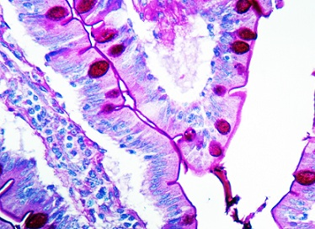
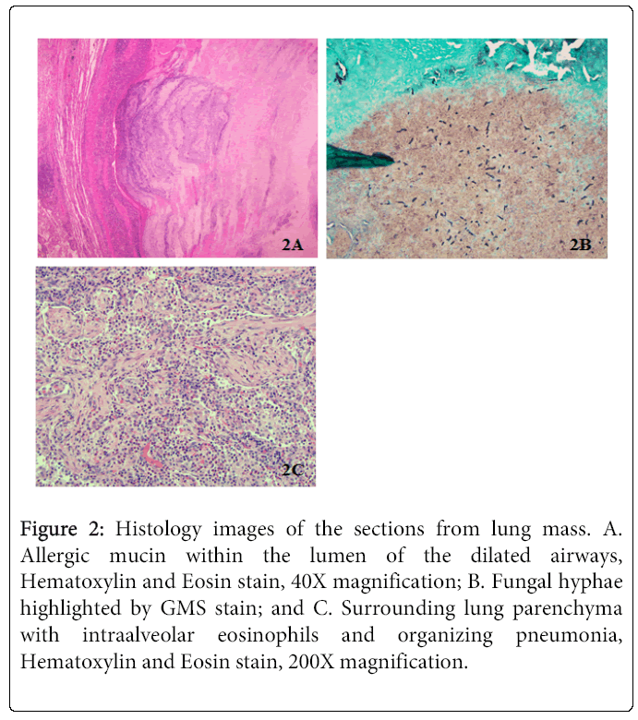
Experiment continued…..
Periodic acid-Schiff stain
Hematoxylin and eosin (top left) stained lung tissue
Notes:
-I propose to test these mice in a mouse model of airway hyperresponsiveness (AHR).
-In order to do this, first house dust mite (HDM) extract is intranasally administered daily for ten days with two, two day breaks (experimental group of mice)
-on the 14th day the mice will be subjected to a Flexivent apparatus that measures the responsiveness of the airway to methacholine which is a drug used to diagnose bronchial hyperreactivity.
-The drugs introduction results in bronchoconstriction and if the mice display a pre-existing hyperreactive airway, such as asthma, a lower dose of the methacholine is needed to stimulate a response
-This procedure can tell if the mice have developed restricted airways, as compared to control wild type mice , as well as to saline controls. In previous studies, ADAM10 inhibition significantly alleviated airway hyperreactivity proposing that increased ADAM10 activity may be a predisposing factor to allergic disease
-lungs will be removed from the mice after euthanasia and histology will be performed to measure the cell infiltration into airways and also the mucus production with PAS stain (Periodic acid-Schiff) and (hematoxylin and eosin staining for cell infiltration)
-In addition, spleens will be removed and ICOSL levels will be examined by flow cytometry on B cells and ICOS levels on T cells. This will support the mechanism.
-(Periodic acid–Schiff (PAS) is a staining method used to detect polysaccharides such as glycogen, and mucosubstances such as glycoproteins, glycolipids and mucins in tissues. This will let us know the extent of damage/obstruction to alveoli in the lungs )

Slide 8
References
Anders, A., Gilbert, S., Garten, W., Postina, R., & Fahrenholz, F. (2001). Regulation of the alpha-secretase ADAM10 by its prodomain and proprotein convertases. FASEB Journal : Official Publication of the Federation of American Societies for Experimental Biology, 15(10), 1837–9. Retrieved from http://www.ncbi.nlm.nih.gov/pubmed/11481247
Asthma Statistics | AAAAI. (n.d.). Retrieved October 22, 2017, from http://www.aaaai.org/about-aaaai/newsroom/asthma-statistics
Chaimowitz, N. S., Martin, R. K., Cichy, J., Gibb, D. R., Patil, P., Kang, D.-J., … Conrad, D. H. (2011). A disintegrin and metalloproteinase 10 regulates antibody production and maintenance of lymphoid architecture. Journal of Immunology (Baltimore, Md. : 1950), 187(10), 5114–22. https://doi.org/10.4049/jimmunol.1102172
Cooley, L. F., Martin, R. K., Zellner, H. B., Irani, A.-M., Uram-Tuculescu, C., El Shikh, M. E., & Conrad, D. H. (2015). Increased B Cell ADAM10 in Allergic Patients and Th2 Prone Mice. PloS One, 10(5), e0124331. https://doi.org/10.1371/journal.pone.0124331
David, Gibbs (2010). ADAM10 is a critical regulator of B cell development, antibody production,
and myeloidderived suppressor cell expansion: Effects of B cellspecific ADAM10 deletion and
overexpression in vivo (PHD thesis).
flexiVent | SCIREQ. (n.d.). Retrieved November 23, 2017, from http://www.scireq.com/flexivent
How Is Asthma Treated and Controlled? - NHLBI, NIH. (n.d.). Retrieved November 22, 2017, from https://www.nhlbi.nih.gov/health/health-topics/topics/asthma/treatment
Kim, M., Suh, J., Romano, D., Truong, M. H., Mullin, K., Hooli, B., … Tanzi, R. E. (2009). Potential late-onset Alzheimer’s disease-associated mutations in the ADAM10 gene attenuate {alpha}-secretase activity. Human Molecular Genetics, 18(20), 3987–96. https://doi.org/10.1093/hmg/ddp323
Knolle, M. D., & Owen, C. A. (2009). ADAM8: a new therapeutic target for asthma. Expert Opinion on Therapeutic Targets, 13(5), 523–40. https://doi.org/10.1517/14728220902889788
Lownik, J. C., Luker, A. J., Damle, S. R., Cooley, L. F., El Sayed, R., Hutloff, A., … Conrad, D. H. (2017). ADAM10-Mediated ICOS Ligand Shedding on B Cells Is Necessary for Proper T Cell ICOS Regulation and T Follicular Helper Responses. Journal of Immunology (Baltimore, Md. : 1950), 199(7), 2305–2315. https://doi.org/10.4049/jimmunol.1700833
Lownik, J. C., Luker, A., Martin, R., Damle, S., & Conrad, D. H. (2017). ADAM10 regulates the ICOS:ICOSL axis. The Journal of Immunology, 198(1 Supplement).
Methacholine. (2010). Retrieved from https://www.drugbank.ca/drugs/DB06709
Pesu, M., Watford, W. T., Wei, L., Xu, L., Fuss, I., Strober, W., … O’Shea, J. J. (2008). T-cell-expressed proprotein convertase furin is essential for maintenance of peripheral immune tolerance. Nature, 455(7210), 246–250. https://doi.org/10.1038/nature07210
Roebroek, A. J. M., Taylor, N. A., Louagie, E., Pauli, I., Smeijers, L., Snellinx, A., … Creemers, J. W. M. (2004). Limited redundancy of the proprotein convertase furin in mouse liver. The Journal of Biological Chemistry, 279(51), 53442–50. https://doi.org/10.1074/jbc.M407152200
Wang, K., Wei, G., & Liu, D. (2012). CD19: a biomarker for B cell development, lymphoma diagnosis and therapy. Experimental Hematology & Oncology, 1(1), 36. https://doi.org/10.1186/2162-3619-1-36
Why Pick PAS for Histology? - Bitesize Bio. (n.d.). Retrieved November 25, 2017, from https://bitesizebio.com/13413/why-pick-pas-for-histology/
Woodfolk, J. A. (2007). T-cell responses to allergens. Journal of Allergy and Clinical Immunology, 119(2), 280–294. https://doi.org/10.1016/j.jaci.2006.11.008
Zhang, L., Prietsch, S. O., & Ducharme, F. M. (2014). Inhaled corticosteroids in children with persistent asthma: effects on growth. In L. Zhang (Ed.), Cochrane Database of Systematic Reviews. Chichester, UK: John Wiley & Sons, Ltd. https://doi.org/10.1002/14651858.CD009471.pub2
Cre/lox Breeding for Dummies. (n.d.). Retrieved December 12, 2017, from https://www.jax.org/news-and-insights/jax-blog/2011/september/cre-lox-breeding-for-dummies

