Slide 1
Measurement of fetal γ-globin expression due to KLF1 being a negative or positive regulator
By: Ashria Arora

Slide 2
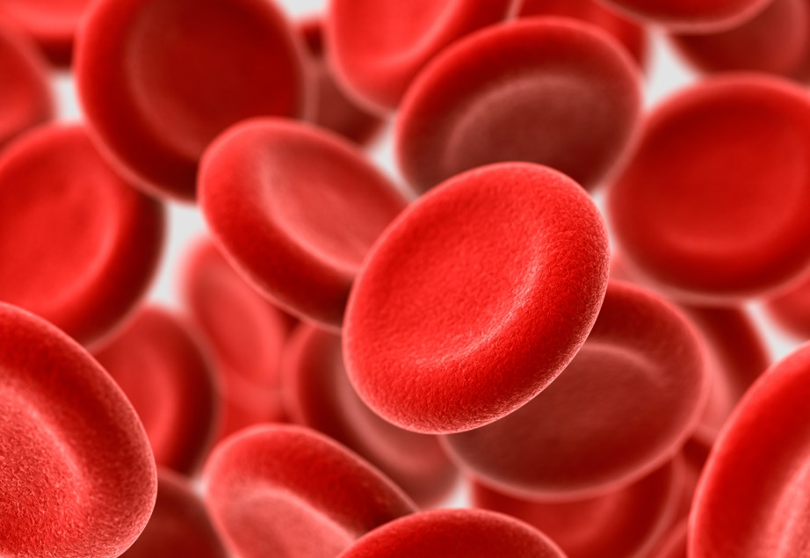
ABOUT γ-GLOBIN GENES AND KLF1
γ – globin genes:
Fetal blood cells
Globin- type of red blood cells
CACCC promoter region
KLF1:
Transcription factor
Regulates beta globin genes
Family of 17 members
Binds to CACCC

Slide 3
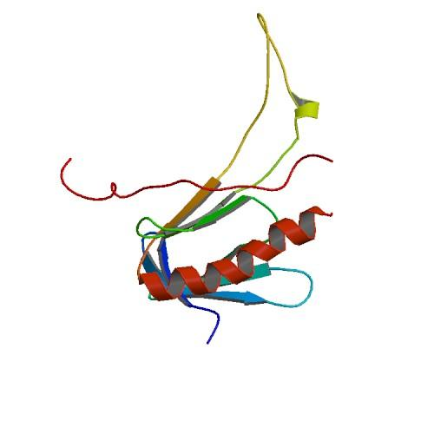
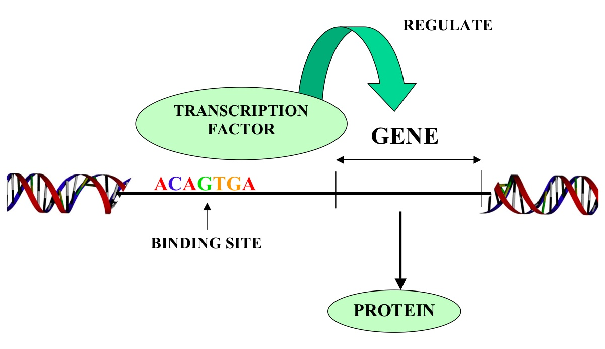
PURPOSE
KLF1 regulation γ-globin genes
Positive or negative

Slide 4
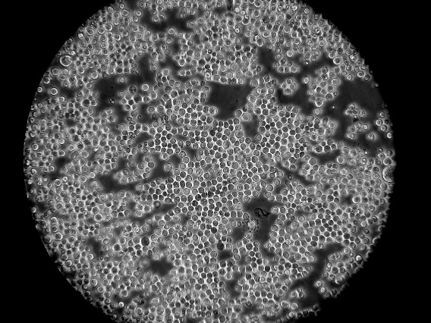
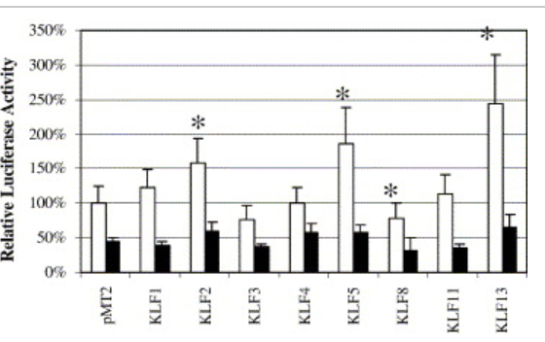
THE CELL LINE
Past experiment- K562 cells
Starting off with a cell that does not contain γ-globin or KLFs, Drosophila cell line, S2.
Why use luciferase?
Fig 1. Ping et all (2005)

Slide 5
METHODS
Plasmid constructs-
1. γLuc
2. KLF1
3. Empty vector

Slide 6
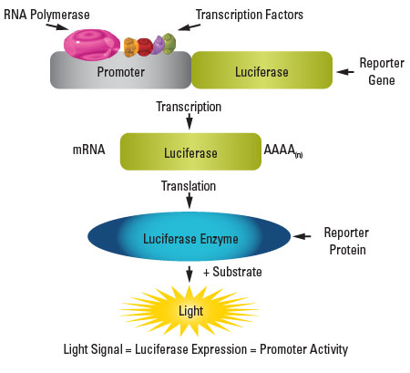
METHODS
Transfection and Luciferase assay
1. Electroporation
2. Luciferase assay kit
-Control- transfect S2 cells with γLuc and an
empty vector
-Luminometer- measures the amount of light emitted by
the S2 cells

Slide 7
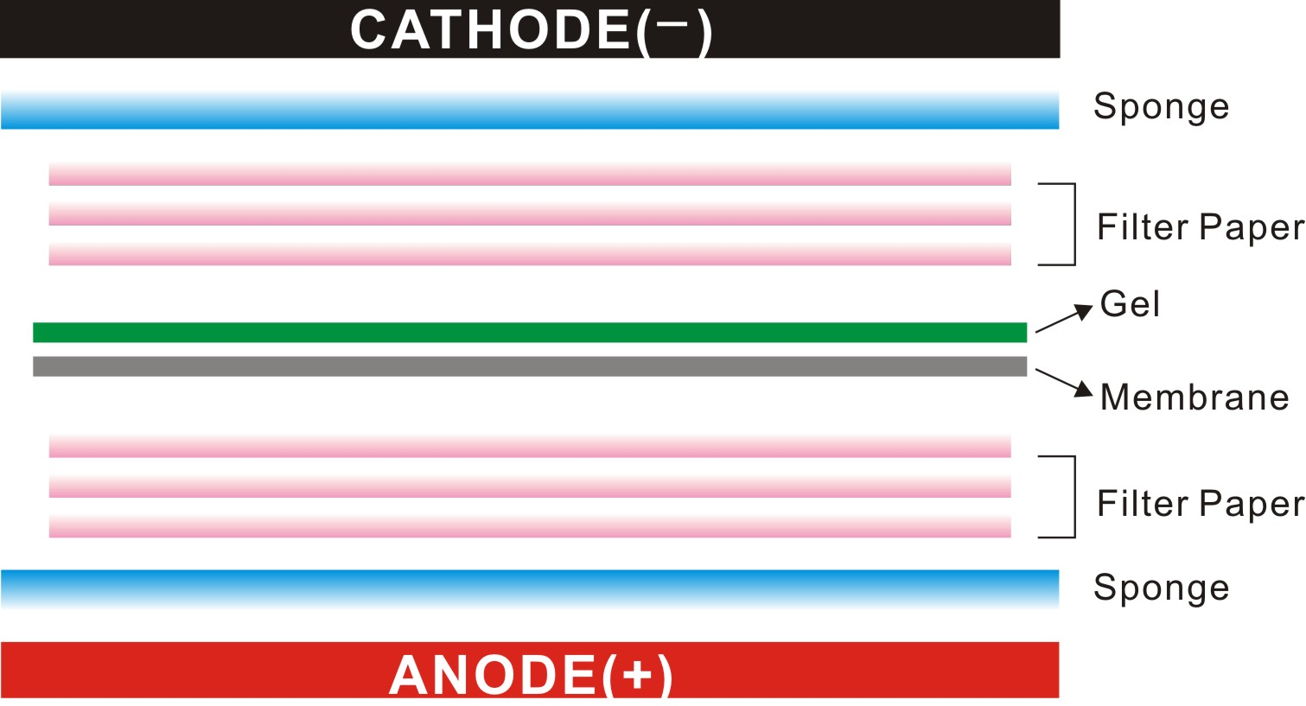
METHODS
Western Blotting- insure KLF1 is being expressed in the S2 cells
Anti-body EKLF used

Slide 8
DISCUSSION
Compare the control cells with KLF1 transfected cells
1. Light emitted with γLuc and KLF1 cDNA is more than the control- KLF1 is a positive regulator
OR
2. Light emitted with γLuc and KLF1 cDNA is less than the control- KLF1 is a negative regulator
OR
3. Light emitted is equal to the control, therefore the KLF1 expression construct has no impact on the transcription of γ- globin genes.

Slide 9
Questions?

