Slide 1
Measurement of natural killer cells and T-cells in ERAP2-N and ERAP2-K
Ashley Arora

Slide 2
Cancer
Major problem in treatments:
Certain cancers cannot be killed with treatments such as irradiation, chemotherapy, and immunotherapy
One way to potentially help kill cancer cells more efficiently:
Introduce a protein called ERAP2

Slide 3
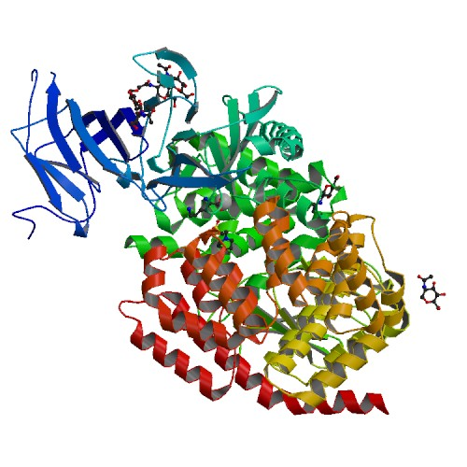
What is ERAP2?
Structure of ERAP2 protein
Notes:
-Endoplasmic Reticulum Aminopeptidase 2
-Responsible for peptide trimming in the endoplasmic reticulum
-A gene and a protein
-The ERAP2 protein is encoded by the ERAP2 gene
-It is essential for immune control because it can potentially kill cancer cells
-It has not been proven yet but not having the ERAP2 protein present can lead cancer to grow

Slide 4
What is ERAP2?
Is an enzyme that stands for endoplasmic reticulum aminopeptidase 2
Located on chromosome 5
It is responsible for trimming peptides in the ER
It is essential for immune control because it can potentially kill cancer cells

Slide 5
ERAP2 has two isoforms
Notes:
-ERAP2-N & ERAP2-K
-In most cells, ERAP2-K and ERAP2-N are present but majority of ERAP2 expresses the K isoform
-ERAP2-N is genetically present but the protein cannot be expressed

Slide 6
ERAP2-N and ERAP2-K
Main difference between the two:
ERAP2-N trims peptides 165 times faster than ERAP2-K
ERAP2-N cannot genetically be expressed
(Evnouchidou et al, 2012)
Notes:
Inside the cell, the nucleotide T (asparagine..) always travels with the nucleotide G (lysine). Every time the T nucleotide travels with the G nucleotide, it is able to go through transcription but is not able to go through translation because it results in early mRNA degradation, which prevents the T
nucleotide (N isoform) to be expressed.
RAMC is the fluorescent they use to measure the hydrolysis (cleaving/trimming)

Slide 7
SNP in the ERAP2 gene
K and N result from an SNP in the ERAP2 gene:
When nucleotide G changes into nucleotide T in the location single nucleotide polymorphism (SNP) rs2549782.
This SNP results in a single amino acid change that can change the trimming capabilities of ERAP2

Slide 8
Melanoma cancer cell MRN-1
Chosen to test whether ERAP2-N or ERAP2-K will induce a better immune response
Has low amounts of ERAP2

Slide 9
Central question
After introducing more ERAP2 into the melanoma cancer cell, either N or K, which isoform induces a better immune response?
This will be determined by which isoform:
Potentially activates more natural killer cells
Potentially activates more T-cells
Notes:
-The purpose of this experiment is to introduce ERAP2-N into the cell line and see which isoform, between N and K, induces a better immune response
-An ideal cell line for this experiment would not express ERAP2, but no cell lines without ERAP2 have been found yet.
-That’s why this cell line is ideal for this experiment:
-It has low amounts of ERAP2
- Has a peptide transporter called TAP which helps make sure that the ERAP2 gene functions the way it needs by transporting the peptides to the endoplasmic reticulum to go through the final peptide processing prior to loading onto the HLA molecule
The goal of this experiment is to measure the lymphocytes in the melanoma cell line, MRN-1 and determine which isoform of the ERAP2 protein, N or K, induces a better immune response.
-

Slide 10
Transfection
Since ERAP2-N is not expressed in the cell it will need to be introduced by transfection:
Using a pTracer plasmid CMV promoter:
Contains the ERAP2-N gene, mammalian promoter region, and a red fluorescent protein

Slide 11
Transfection
Mammalian promoter region:
Has transcription factors binding regions that will help activate gene expression
Red fluorescent protein:
Is used for detection of the ERAP2-N gene
When the cell is put under UV light, the cells will light up red and that will confirm that ERAP2-N is expressed in MRN-1

Slide 12
Lymphocyte activation
Lymphocytes are white blood cells that are part of the immune system:
Include T-cells and natural killer cells
Natural killer cells:
Immune cells that can kill cancer cells
T-cells:
Helps the body fight cancer
Notes:
Lymphocytes are white blood cells that are part of the immune system
Lymphocytes include natural killer cells, T-cells, and B-cells
Natural killer cells are immune cells that can kill cancer cells
T-cells can help the body fight cancer
Lymphocyte activation occurs when the body is trying to fight off an infection

Slide 13
Lymphocyte activation
In order for lymphocyte activation to occur:
Once the peptides are in the ER, ERAP2 is responsible for trimming the peptides to 8-9 amino acids
Proteins need to transport to the surface of the cell by binding to the MHC class I molecule from the ER

Slide 14
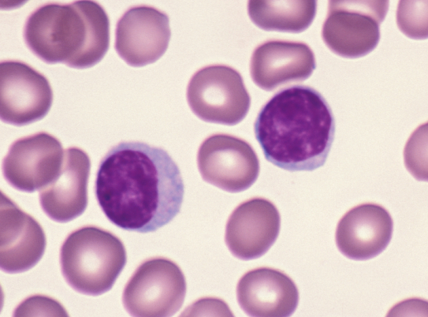
Lymphocyte activation assay
Will be used to measure and compare:
Natural killer cells activation in ERAP2-N and ERAP2-K expressed in MRN-1
T- cell activation in ERAP2-N and ERAP2-K expressed in MRN-1

Slide 15
PBMC isolation
Before lymphocyte activation assay is performed, this method is used to extract lymphocytes by using gradient separation:
Isolates peripheral blood monocytes, which include natural killer cells and T-cells

Slide 16
Lymphocyte activation assay

Slide 17
Results
Possible result:
Exogenously introduced ERAP2-N induces more natural killer cells and T-cells compared to ERAP2-K
Why?
Since ERAP2-N trims peptides at a faster rate than ERAP2-K, N can potentially trigger more natural killer and T-cells
Possible pitfalls:
Antibodies bind to foreign substances, such as bacteria and viruses, and cause them to be destroyed
It’ll be harder for the antibodies to bind to the lymphocytes after they are isolated because natural killer cells and T-cells do not produce antibodies
In order for the T-cells and NK cells to activate, antibodies need to bind to them
Notes:
-One result could be that the exogenously introduced ERAP2-N induces more NK and T-cells
-Another result could be that ERAP2-K induces more activated natural killer cells and T-cells
Or ERAP2-N and ERAP2-K have the same amounts of activated NK and T-cells.
To determine which isoform will induce a better immune response, the activated NK and T-cells will be counted, so more natural killer cells mean that more cancer cells are killed
ERAP2-N trims peptides at a fast rate, about 165 times more than ERAP2-K which can alter with the activation of NK and T-cells.
If ERAP2-N trims at a faster rate than ERAP2-K, it may provide a better immune response than ERAP2-K because if peptides are being trimmed at a faster rate that may trigger more NK and T-cells

Slide 18
THANK YOU!

