Slide 1
Antirepressor identification in bacillus bacteriophage phicm3
Bethany Yachuw

Slide 2
Repressor
operator
promoter
gene
Transcription stops
Repressor
RNA Polymerase

Slide 3
antirepressor
promoter
operator
gene
Transcription continues
Repressor
RNA Polymerase
Antirepressor

Slide 4
Experiment outline
Identify putative antirepressor
Test the antirepressor
Use lacZ as a reporter gene
lacZ codes for β-galactosidase
IPTG and ONPG
Use spectrophotometer to calculate Miller Units
Everything will be done in Bacillus subtilis

Slide 5
Identify the putative antirepressor
Yuan et al (2014)
Via conceptual translation
putative antirepressor (gp37)
BUT Promoter, Operator, and Repressor were not annotated

Slide 6
New Experiment outline
Identify putative antirepressor
Identify promoter, operator, and repressor
Test the repressor
Use lacZ as a reporter gene
IPTG and ONPG
Test the antirepressor
Use lacZ as a reporter gene
IPTG and ONPG
Use spectrophotometer to calculate Miller Units

Slide 7
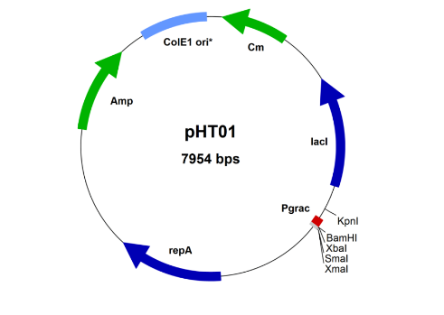
Constructing plasmids
REPRESSOR ANTIREPRESSOR
Insert putative repressor gene at BAM site with promoter, operator
Via Gibson Assembly

Slide 8
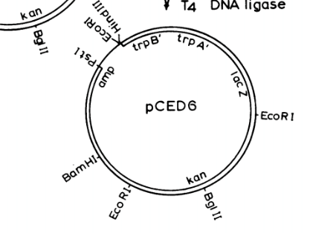
REPRESSOR ANTIREPRESSOR
Constructing plasmids
Add promoter and operator at the HindIII site
Gibson Assembly

Slide 9
IPTG
REPRESSOR ANTIREPRESSOR
Isopropyl β-D-1-thiogalactopyranoside
operator
promoter
Repressor gene
Lacl repressor
NOT phiCM3

Slide 10
IPTG Induction
REPRESSOR ANTIREPRESSOR
Isopropyl β-D-1-thiogalactopyranoside
promoter
operator
Repressor gene
Transcription
continues
Quick plating of the plasmids with
phiCM3. If phage plating is blocked in
the presence of IPTG, it is likely the
repressor.
Lacl repressor
IPTG

Slide 11
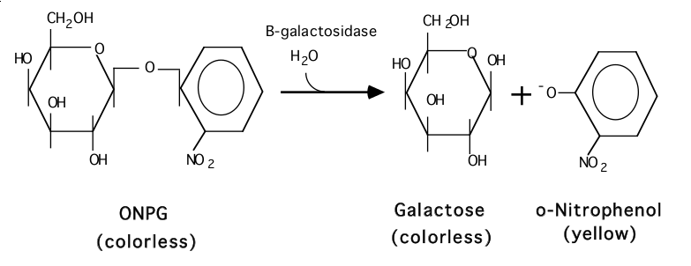
ONPG Test
REPRESSOR ANTIREPRESSOR

Slide 12
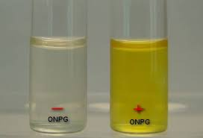
Hopeful Results
REPRESSOR ANTIREPRESSOR

Slide 13
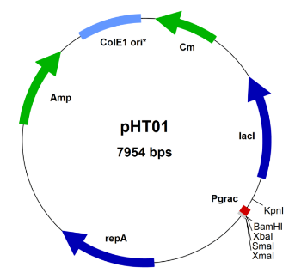
Constructing plasmids
REPRESSOR ANTIREPRESSOR
Anitrepressor
Repressor

Slide 14
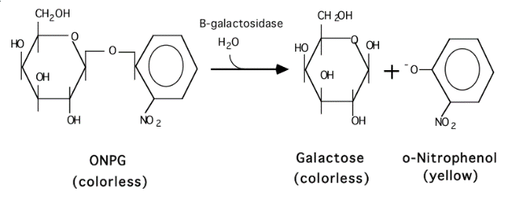
IPTG induction and onpg testing
REPRESSOR ANTIREPRESSOR
promoter
operator
Antirepressor gene

Slide 15
Hopeful Results
REPRESSOR ANTIREPRESSOR

Slide 16
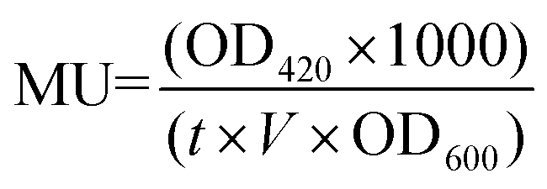
spectrophotometer
REPRESSOR ANTIREPRESSOR
Measure the yellow color made
Convert to Miller Units (measures β-galactosidase activity)
t = reaction time in minutes
v = volume in mL
OD = absorbance at 420 and 600

Slide 17
Questions?

