Slide 1
INHIBITING AIM2 IN ORDER TO RESTORE FUNCTION IN INJURED CARDIOMYOCYTES DUE TO ISCHEMIA & REPERFUSION
Ankita Thakur
BNFO 300
Mentor: Stefano Toldo

Slide 2
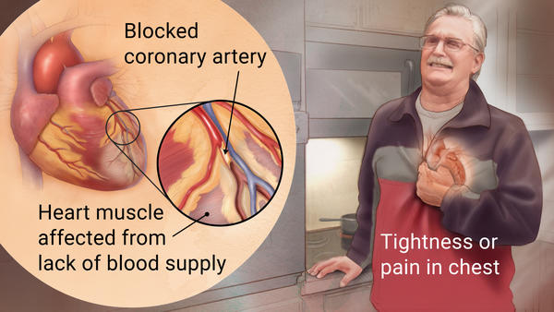
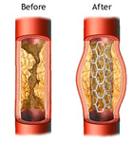
AMI & Treatment
Acute Myocardial Infarction: aka Heart Attack
Most common reason: Coronary Artery Disease
Which leads to Ischemia
Standard approach to mortality and HF after AMI acute myocardial infarction is reperfusion of the area

Slide 3
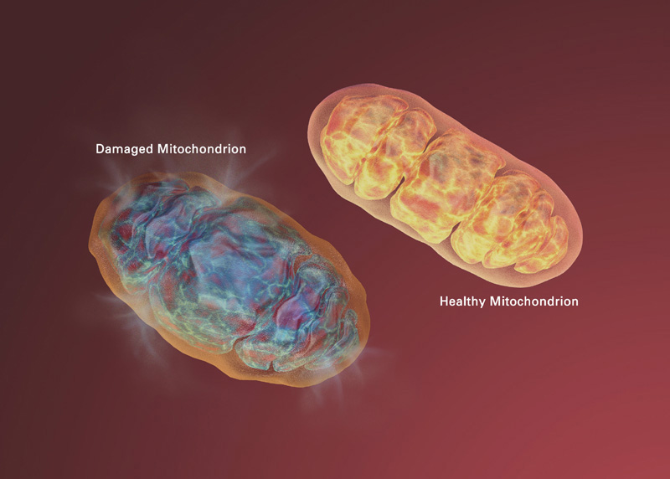
Reperfusion Injury
New reactive oxygen species (ROS) reacts with byproducts of the dying cell, which causes further injury in that cell
Notes:
*Causes a loss in the benefit of the treatment
*Go into slight detail about mechanism: Increase in ROS and other components of the cell causes MPT to open, which eventually leads to cell death

Slide 4
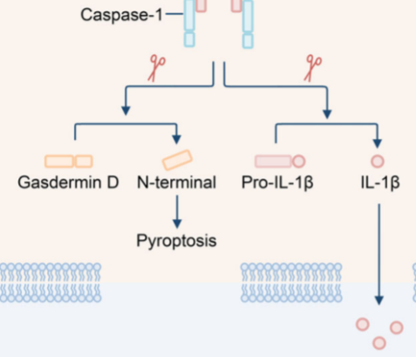
Caspase 1
The process of the cell dying initiates formation of the inflammasome, a multicomplex protein
Caspase-1 is an enzyme that is responsible for the production of pro-inflammatory cytokines of the interleukin-1 family of cytokines
Targeting caspase-1 has shown promise, but there are drawbacks

Slide 5
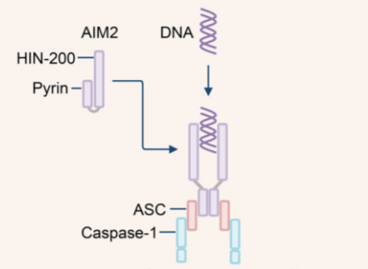
AIM2
AIM2 = Absent in Melanoma 2
Inflammasome sensor that recognizes double stranded DNA (dsDNA) in the cytoplasm
When mitochondrial DNA is detected by AIM2 it leads to the formation of the AIM2 inflammasome
AIM2 inflammasome binds to procaspase-1

Slide 6
How does this all tie together?
The mtDNA binding AIM2 leads to the formation of the inflammasome, activation of caspase-1, and an exacerbation of the inflammatory response, which in the bigger picture leads to an increase in cell death and myocardial dysfunction.

Slide 7
Experiment Overview
Define a AIM2 knock-down (KD) strategy to reduce the myocardial levels of AIM2
Measure the effects of inhibition of AIM2 signaling on the activation of the inflammasome in an in vivo model of AMI
Assess the effects of AIM2 inhibition on the cardiac function and the infarct size

Slide 8
Reduction of Myocardial levels of AIM2
Based on experiments performed by Mezzaroma et al.
siRNA administration - both directed and scattered
Directed to target cryopyrin or P2X7 (encodes for purinergic ATP receptor)
Western Blot to observe the levels of their target protein after silencing cryopyrin and P2X7
we will target the AIM2 gene, PYHIN4
AIM2 expression will be measured at 24, 48, 72, and 96 hours after silencing
can determine for how long an effective dose of siRNA reduces the expression of AIM2 in the heart in vivo
Use antiAIM2 antibody (ab93015) for Western Blot
Notes:
We will test different doses of a specific AIM2 siRNA or a scrambled control siRNA to measure the AIM2 expression in the heart at several time intervals (24, 48 72 or 96 hours). In this way we can determine for how long an effective dose of siRNA reduces the expression of AIM2 in the heart in vivo.

Slide 9
Measuring Effects of AIM2 Signaling Inhibition on Inflammasome Activation
Measured by observing caspase-1 activity levels.
Measuring in 6 groups of mice
sham control (Surgery but no AMI)
wt mice with AMI (mice with coronary artery ligation for 30 minutes followed by 24 hours of reperfusion)
KO mice sham control
KO mice with AMI
KD mice sham control
KD mice with AMI
Mezzaroma et al. (2011) measured these levels in two steps
Measured pro-caspase-1 levels with SYBR-green real-time PCR from Applied Biosystems
Monitor caspase-1 activity by monitoring caspase-1 protein levels using Western blot

Slide 10
Assess Effects of AIM2 Inhibition on Cardiac Function and Infarct Size
Based on experiments performed by Abbate et al (2008)
used a transthoracic echocardiogram on all animals before the surgery and 7 days after the surgery just before the sacrifice
The second step, the measurement of cell death, requires staining, as illustrated by Marchetti et al.

Slide 11
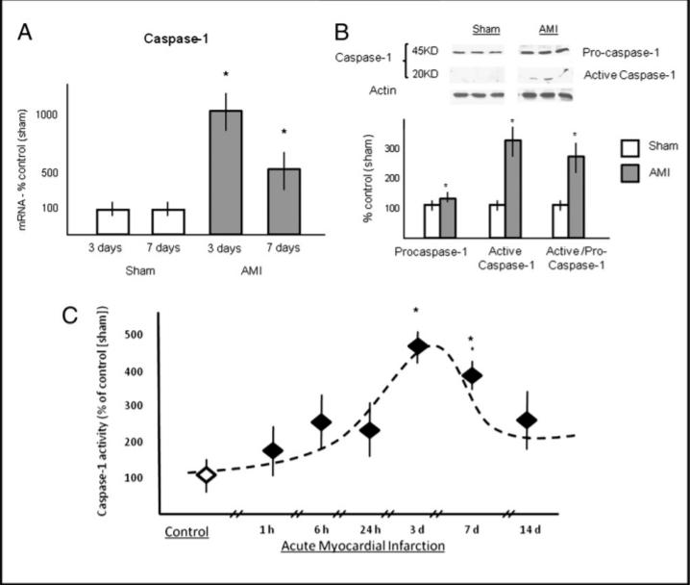
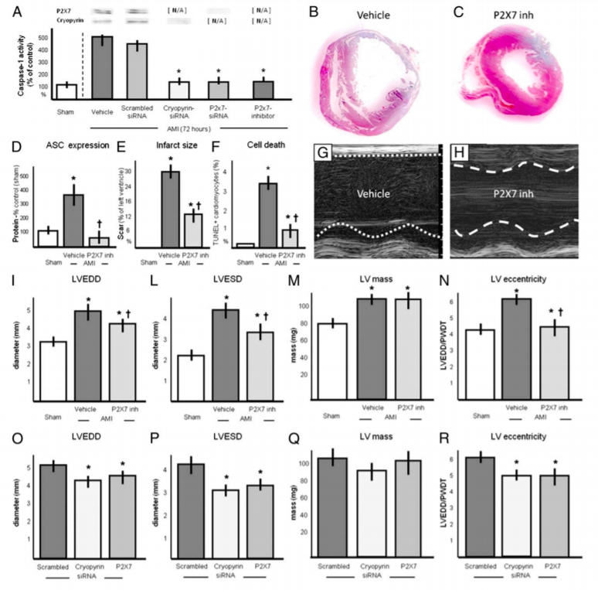
Expected Results
Notes:
First figure shows the levels of caspase-1
Second figure shows the Western blot results

Slide 12
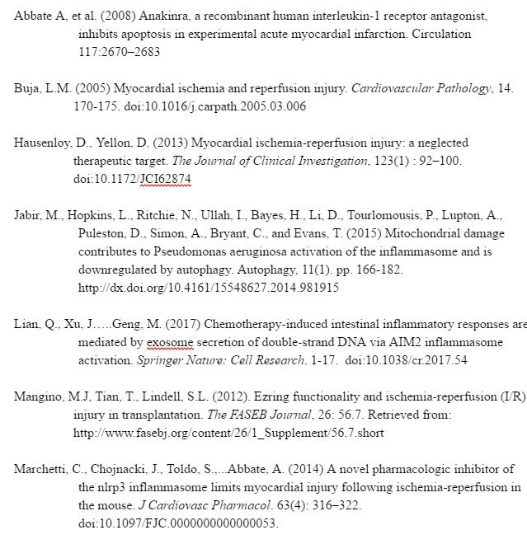
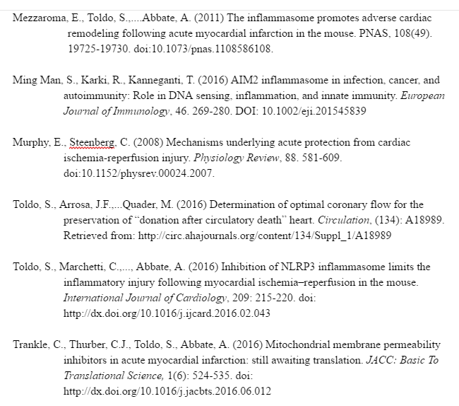
References

