Slide 1
Activation of the Ryanodine Receptor (UNC-68) and the Success of Neuronal Regeneration in c.elegans
Neha Sehgal

Slide 2
NEURONAL REGENERATION

Slide 3
BACKGROUND
Notes:
Ryanodine receptors are ion channels that release Ca²⁺ from the ER in animal tissues like neurons and muscles.
Resulting increase in Ca²⁺ from RYR2 channel triggers the cardiac muscle to contract, which pumps blood out of the heart.
3 major forms: RYR1 in skeletal muscle, RYR2 in heart muscle, RYR3 in the brain
A gain-of-function RyR2 mutation (R176Q) can lead to increased activity of RYR2 receptor

Slide 4
HYPOTHESIS
In this experiment, I want to find out if increased activity of the ryanodine receptor might improve axon regeneration in the C. elegans system

Slide 5
LOSS OF UNC-68 REDUCES SUCCESS RATE
Notes:
Panel A illustrates how axons can regrow, B shows how they can regrow incorrectly in the unc-68 loss-of-function mutant, and D shows the quantitation of the success rate.

Slide 6
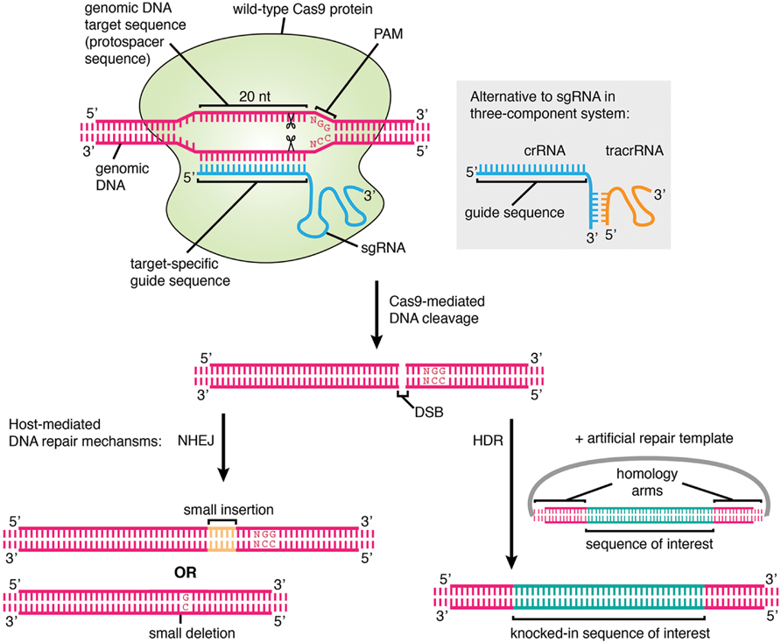
BASIC STEPS OF CRISPR/CAS9
Notes:
repair template to produce a specific edit
CRISPR/Cas9 complex consists of 2 imp molecules that introduce a mutation into the DNA.
first molecule is the Cas9 enzyme which acts like a pair of “molecular scissors” that can cut the two strands of DNA at a specific location so that DNA can be added.
second molecule is the guide RNA (gRNA) which consists of about 20 nucleotides which “guides” Cas9 to cut at the right location in the genome.
Once the cut is made on both strands of the DNA, the cell recognizes that the DNA is damaged and tries to repair it. This is when changes to one or more genes can be introduced in the genome of a cell of interest.

Slide 7
METHODS 1
Compared sequence with human RYR2 protein using BLAST to find the corresponding arginine in question which in humans is R176.
Located the arginine in question (position 169) and then copied 40 nucleotides from either side to screen for CRISPR-Cas9 guides
Notes:
Obtained nucleotide coding sequence for unc-68 and amino acid sequence for UNC-68 from wormbase.org
Took the DNA sequence and translated that sequence online using the ExPASy tool to obtain an alignment of the nucleotide with the protein sequence.

Slide 8
METHODS 2
Guide RNA (gRNA) was obtained from http://crispr.mit.edu, this also includes PAM site. Chose guide 1
ssDNA repair template that contains the genome modification.

Slide 9
METHODS 3
To identify CRISPR modifications, use Co-CRISPR: screening strategy that uses a visible phenotype at one locus to identify potential edits at a second locus
Gonads injected with plasmid targets dpy-10 and unc-68
F₂ progeny of F₁ animals that show heterozygous R169Q conversion are then screened using PCR to identify animals carrying homozygous R169Q
Laser axotomy performed on homozygous F₂ unc-68(R169Q) mutants
Notes:
gonads of wild-type C. elegans will be injected with plasmids that allow for germline expression of sgRNAs that target the dpy-10 and unc-68 genes

Slide 10
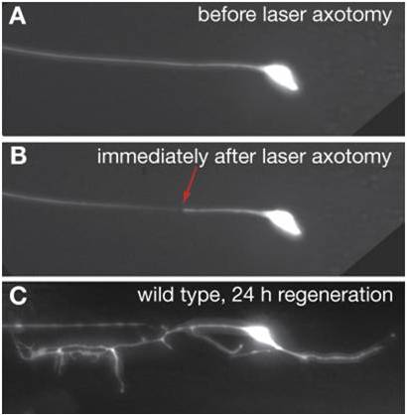
EXPECTED RESULTS
Notes:
to remind them what you expect to see if your hypothesis is reported.

Slide 11
DISCUSSION
If the hypothesis is supported, the unc-68 mutant worms should show more success in regeneration than the non-mutant control worms after laser axotomy within 24 hours.
If it is successful, this could be a huge finding for treating spinal injuries in humans.

Slide 12
REFERENCES
Huebner, A. E., and Strittmatter, M.S. 2009. Axon Regeneration in the Peripheral and Central Nervous Systems. Results and problems in cell differentiation 48(1): 339 – 351.
Cheah, M., and Andrews, R. M. Targeting cell surface receptors for axon regeneration in the central nervous system. Neural Regeneration Research 11(12): 1884 – 1887.
Sun, L., Shay, J., McLeod, M., Roodhouse, K., Chung, H.S., Clark, M.C., Pirri, K.J. Alkema, J.M., and Gabel, V.C. 2014. Neuronal regeneration in C. elegans requires subcellular calcium release by ryanodine receptor channels and can be enhanced by optogenetic stimulation. The Journal of neuroscience: the official journal of the Society for Neuroscience, 34(48): 15947-56.
Bejjani, E. R., Hammarlund, M. 2012. Neural Regeneration in Caenorhabditis elegans. Annual Review of Genetics 46(1): 499-513.
Lanner, J. T., Georgiou, D. K., Joshi, A. D., & Hamilton, S. L. 2010. Ryanodine Receptors: Structure, Expression, Molecular Details, and Function in Calcium Release. Cold Spring Harbor Perspectives in Biology, 2(11).
Kromer, F.L., and Cornbrooks, J.C. 1987. Identification of Trophic Factors and Transplanted Cellular Environments That Promote CNS Axonal Regeneration. Annals of the New York Academy of Sciences 32(1).
Vukcevic, M., Zorzato, F., Keck, S., Tsakiris, A.D., Keiser, J., Maizels, M.R., and Treves, S. Gain of function in the immune system caused by a ryanodine receptor 1 mutation. Journal of Cell Science 126(15): 3485 – 3492.
Dickinson, D. J., and B. Goldstein. 2016. CRISPR-Based Methods for Caenorhabditis Elegans Genome Engineering. Genetics 1(5): 885-901.
Gabel, V.C., Antoine, F., Chuang, F.C., Samuel, D.A., and Chang, C. 2008. Distinct cellular and molecular mechanisms mediate initial axon development and adult-stage axon regeneration in C. elegans. Development 135(1): 1129 – 1136.

Slide 13
THANK YOU! QUESTIONS OR COMMENTS?

