Slide 1
L-citrulline coupled with Arsenic Trioxide as a potential inducer of the PERK/eIF2-alpha apoptotic pathway
Center for the Study of Biological Complexity
Peter Samuel
BNFO 300

Slide 2
Center for the Study of Biological Complexity
Cancer and Treatment
Dysregulated cell proliferation
2nd leading cause of death in US, 3rd in the world
Current cancer therapies fall short

Slide 3
Center for the Study of Biological Complexity
Cellular Stress and Cell Death
Cancer cells resist programmed cell death
Cellular stress leads to programmed cell death or apoptosis (Appierto et al. 2009)
How can one induce cellular stress?
Adapted from https://images.novusbio.com/design/blog_image1.png & https://www.amplexhearing.com.au/wp-content/uploads/2016/04/Untitled-1.png

Slide 4
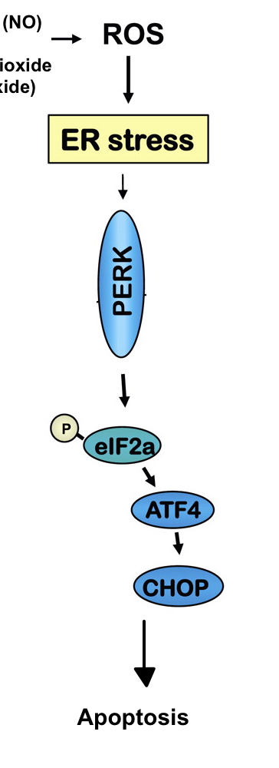
Center for the Study of Biological Complexity
Reactive Oxygen Species (ROS) → Endoplasmic Reticulum Stress
?
ROS → ER Stress (Verfaillie et al. 2012)
Protein Endoplasmic Reticulum Kinase → phosphorylates eIF2-alpha
Protein synthesis arrested
Eventually, apoptosis
Adapted from Velasco et al. (2010)

Slide 5
Center for the Study of Biological Complexity
L-citrulline & Arsenic Trioxide (ATO) → ROS
ATO induces apoptosis & an increase in ROS generation (Selvaraj et al. 2013)
ATO is NO dependent (Kang et al. 2003)
L-citrulline increases NO bioavailability (Wijnands et al. 2012)

Slide 6
Center for the Study of Biological Complexity
My Experimental Question
Do L-citrulline and ATO induce apoptosis mediated by PERK?

Slide 7
Center for the Study of Biological Complexity
GBM Cells
Negative Control
Treatment Group
siRNA knock down of PERK
No use of siRNA
Sub-groups
Saline
L-citrulline
ATO
L-citrulline/ATO
Sub-groups
Saline
L-citrulline
ATO
L-citrulline/ATO

Slide 8
Center for the Study of Biological Complexity
siRNA
How do siRNA ”knock down” the synthesis of proteins?
Adapted from Wittrup et al. (2015)

Slide 9
Center for the Study of Biological Complexity
Expected* Measurements – Western Blot
Treatment Group
Negative Control Group
*These are not real Western Blots, simply predictions

Slide 10
Center for the Study of Biological Complexity
Further Understanding Apoptosis
Learning more about PERK/eIF2-alpha apoptotic pathway
ROS → ER Stress → PERK → peIF2-alpha → apoptosis
Different Results/Possible Explanation
Different apoptotic pathway?
Measure protein markers of other known apoptotic pathways
Understanding the interactions between drug therapies and apoptosis in cancer

Slide 11
Center for the Study of Biological Complexity
Questions?

