Slide 1
Comparison of Exemplars of Rotamer Clusters Across the Proteinogenic Amino Acids
Jesse Raynor

Slide 2
Comparison of Exemplars of Rotamer Clusters Across the Proteinogenic Amino Acids
Proteins:
Drug targets
Pharmaceutical agents
Methods of determining similarity
Sequence alignment
Homology modelling
Threading

Slide 3
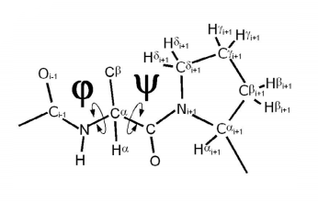
Rotamers
Each amino acid can adopt rotate around certain bonds. The various possible conformations produced by rotating an amino acid around these bonds are called rotamers.
The rotation of the amino acid’s main chain is described by the phi and psi angles.
Figure adapted from Ho and Brasseur (2005).

Slide 4
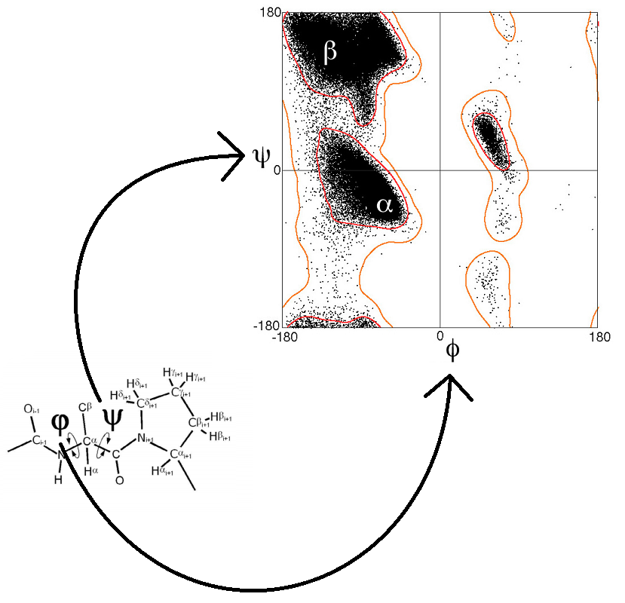
Ramachandran Plots
Ramachandran plots depict sterically allowed combinations of phi and psi angles.
The Ramachandran plot to the right was generated by plotting the phi and psi angles of 81,234 amino acids from X-ray crystallography data.
Regions form in the plots which correspond to secondary structural features of proteins.
Figure adapted from Lovell et al (2003) and Ho and Brasseur (2005).

Slide 5
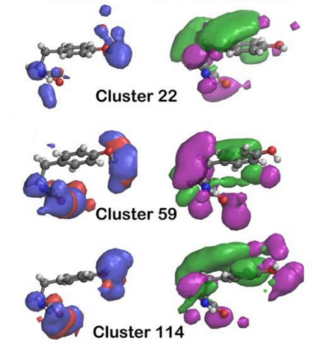
Rotamer Clusters
Ahmed et al (2015) found that rotamers can be sorted into groups based on their similarity to one another.
It is hoped that these groups, called rotamer clusters, can be used as the basis for a new method of determining protein similarity.
Figure adapted from Ahmed et al (2015).

Slide 6
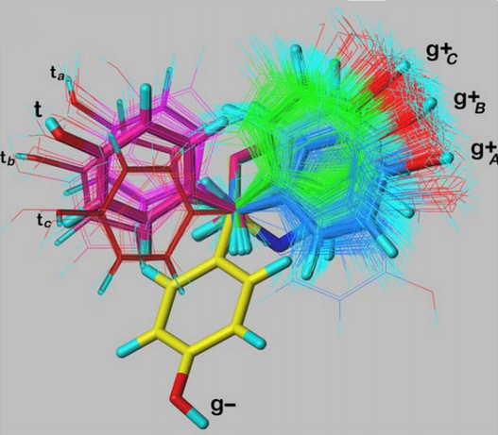
Rotamer Cluster Exemplars
We can average all the rotamers of a cluster together to produce an average map quartet. This set of maps correspond to the theoretical rotamer at the center of the cluster (pictured as the thicker tyrosine structures).
The exemplar is the member of the rotamer cluster most similar to this centroid rotamer.
Figure adapted from Ahmed et al (2015).

Slide 7
The Question
Research into rotamer clustering has thus far focused on finding groups of highly-similar rotamers of single amino acids.
Do there exist highly-similar groups of rotamers among different types of amino acids?

Slide 8
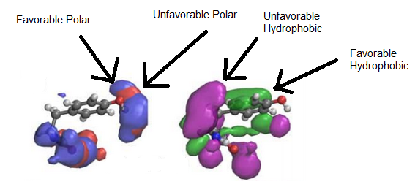
Rotamers in silico
Each rotamer is represented as a set of four maps, each representing a class of forces affecting the conformation of the protein.

Slide 9
Procedure
Using known clusters of rotamers, we can find their exemplars and use those to represent their respective clusters.
By repeating the clustering procedure used in Ahmed et al (2015), we can determine whether these exemplars cluster as well as they do in Ahmed et al (2015).
In brief:
Calculate the similarity between each pair of rotamer cluster exemplars,
...sort the rotamer clusters into groups based on those similarity scores,
...and then validate the results.

Slide 10
Closing Notes
A positive result would indicate that certain rotamer clusters of different types are similar enough to be combined, allowing determination of protein similarity to be divorced from amino acid identity somewhat.
A negative result can also be useful here, as it would serve to reinforce previous findings.
In either case, the next steps might entail developing a method of predicting which rotamer cluster a given amino acid in a protein belongs to.

Slide 11
References
1. Ahmed, M. et al (2015). 3D interaction homology: The structurally known rotamers of tyrosine
derive from a surprisingly limited set of information-rich hydropathic interaction
environments described by maps. Proteins 83: 1118-1136.
2. Ramachandran, G.N., Ramakrishnan, C. & Sasisekharan, V. (1962). Stereochemistry of
Polypeptide Chain Configurations. J. Mol. Biol. 7: 95-99.
3. Lovell, S. et al (2003). Structure Validation by C-alpha Geometry: Phi, Psi, and C-beta
Deviation. Proteins 50: 437-450.
4. Forster, M.J. (2002). Molecular modelling in structural biology. Micron 33: 365-384.
5. Ho, B.K. & Brasseur, R. (2005). The Ramachandran plots of glycine and pre-proline. BMC
Structural Biology 5:14.
6. Tibshirani, R., Walther, G. & Hastie T. (2000). Estimating the number of clusters in a data set via the
gap statistic. J. R. Statist. Soc. B 63: 411-423.

Slide 12
Questions?

Slide 13
L(Gt) transforms individual points in the map
to a form more appropriate to our calculations
D(I,J) finds the similarity between two
rotamer maps. We repeat this four times,
once for each map in the exemplar quartet.
C(m,n) calculates a weighted average
of the maps, creating an overall score
of similarity.
The calculated similarity of each pair of
exemplars is stored in a matrix

Slide 14
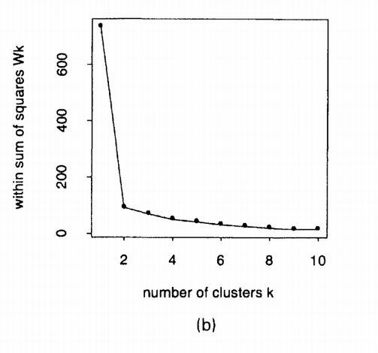
Clustering
We use k-means clustering.
K-means clustering involves splitting a set of datapoints into k groups. In this case, the datapoints are the pairwise similarity scores.
To determine a good value of k, we use the “gap statistic”, developed by Tibshirani et al (2001).
Figure adapted from Tibshirani (2001)

Slide 15
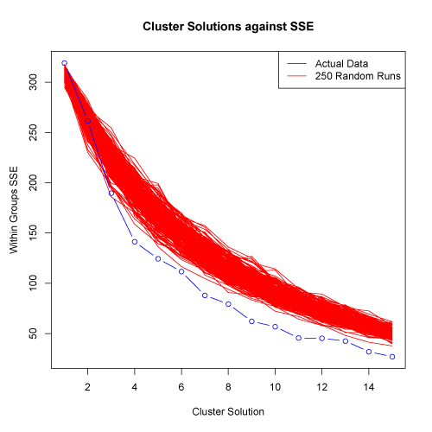
Validation
In brief:
Scramble matrix of similarity scores 250 times to generate 250 new similarity matrices.
Perform clustering for a range of cluster counts.
Calculate sum of squared error (SSE) for the actual data and the generated data
Plot SSE vs number of clusters.
Figure adapted from http://www.mattpeeples.net/kmeans.html

