Slide 1
Determination of Short, Amyloid-Beta Derived Peptides Which Reduce Apolipoprotein E Mediated Amyloid-Beta Aggregation
Research Proposal
By Thomas Raymond

Slide 2
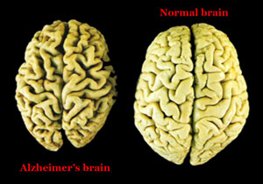
Introduction: Alzheimer’s Disease
Neurological disorder
  Neuronal Death
Current drugs
  Slow, but don’t stop
Causes

Slide 3
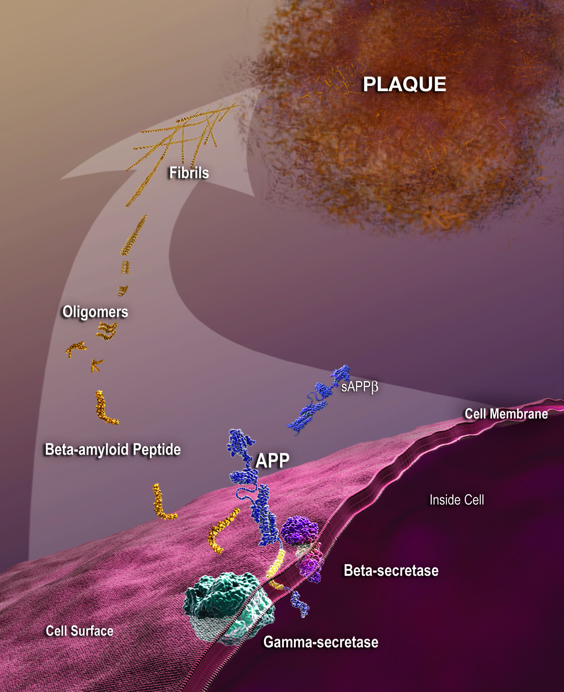
Amyloid Beta (Aβ)
Aβ Cascade Hypothesis
Varying Sizes

Slide 4
Apolipoprotein E (APOE)
Primary cholesterol transporter in the brain
Three variants: APOE2, APOE3, and APOE4
  Genome-Wide Association Studies

Slide 5
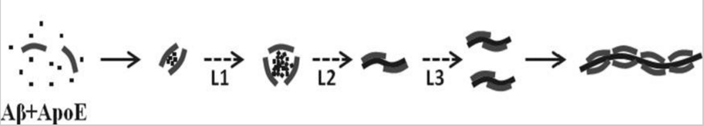
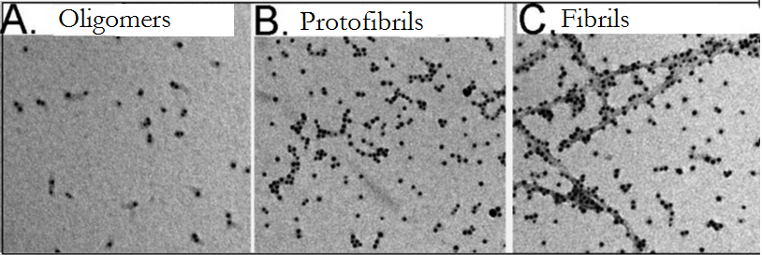
APOE Mediated Aβ Aggregation

Slide 6
Targeting the APOE-Aβ Complex
When APOE and Aβ bind, the binding residues of Aβ are 12-28
1
42
12-28
20-29

Slide 7
Structure-Based Drug Synthesis
Peptides as drugs are usually unsuccessful
  Stability and delivery
Peptide structures → Non-peptide drug
  6-8 residues

Slide 8
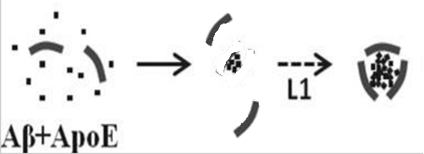


The Research Proposal
The goal of the following proposed experiment is to determine 6-8 residue sections within Aβ12-28 which are capable of reducing aggregation of Aβ in the presence of APOE.

Slide 9

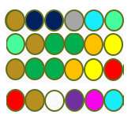


The Peptides Being Tested
Because Aβ residues 12-28 are the binding site, these residues will be focused on
Peptides | Number of Residues
Aβ12-17, Aβ17-22, Aβ18-23, Aβ23-28 | 6
Aβ12-18, Aβ17-23, Aβ22-28 | 7
Aβ12-19, Aβ21-28 | 8

Slide 10
Aggregation Assay
Test the aggregation of a protein in the presence of certain compounds
  May test aggregation of a protein in the presence of itself
Commonly used technique when testing Aβ aggregation

Slide 11
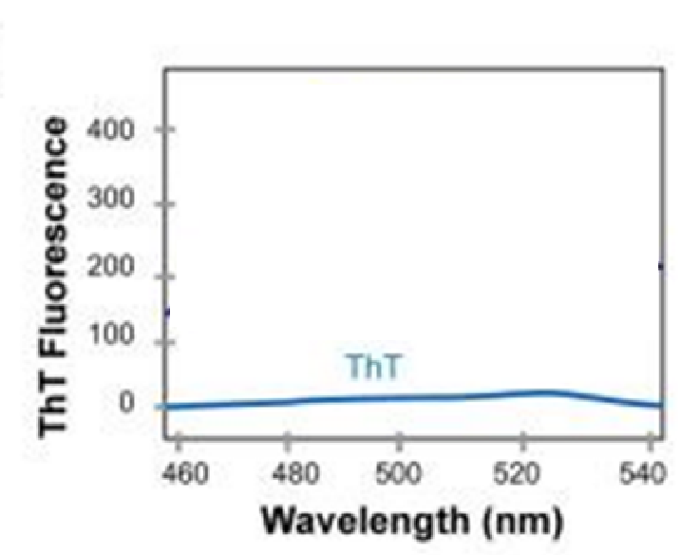
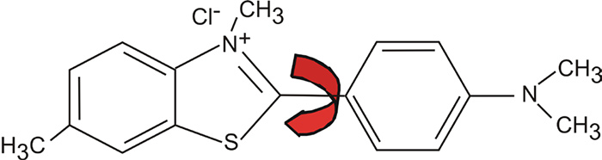
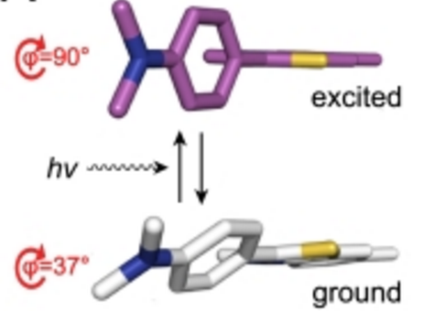
Thioflavin T: Isolated
Excitation
Emission
ϕ angle > 60°

Slide 12
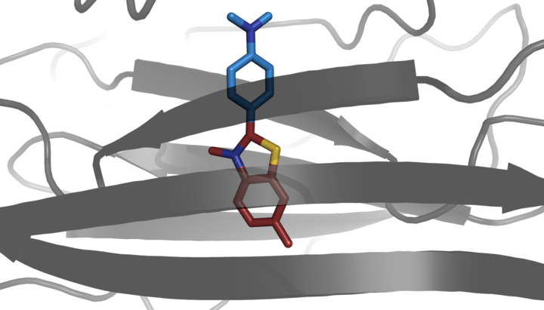
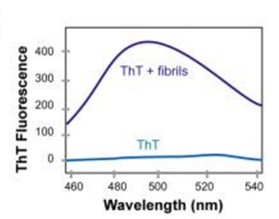
Thioflavin T: Presence of Beta Sheets
Molecules becomes “locked”
ϕ < ∼ 60°
Excitation
Emission

Slide 13


Thioflavin T: Monomers vs Fibrils
440 nm wavelength
440 nm wavelength
480 nm wavelength
Excitation
Emission
Excitation
Emission
Amyloid Beta monomers + Thioflavin T
Amyloid Beta fibrils + Thioflavin T

Slide 14

The Experiment: Aggregation Assays
Inhibitor Tests
APOE4 + Aβ1-42
APOE4 + Aβ1-40

Slide 15
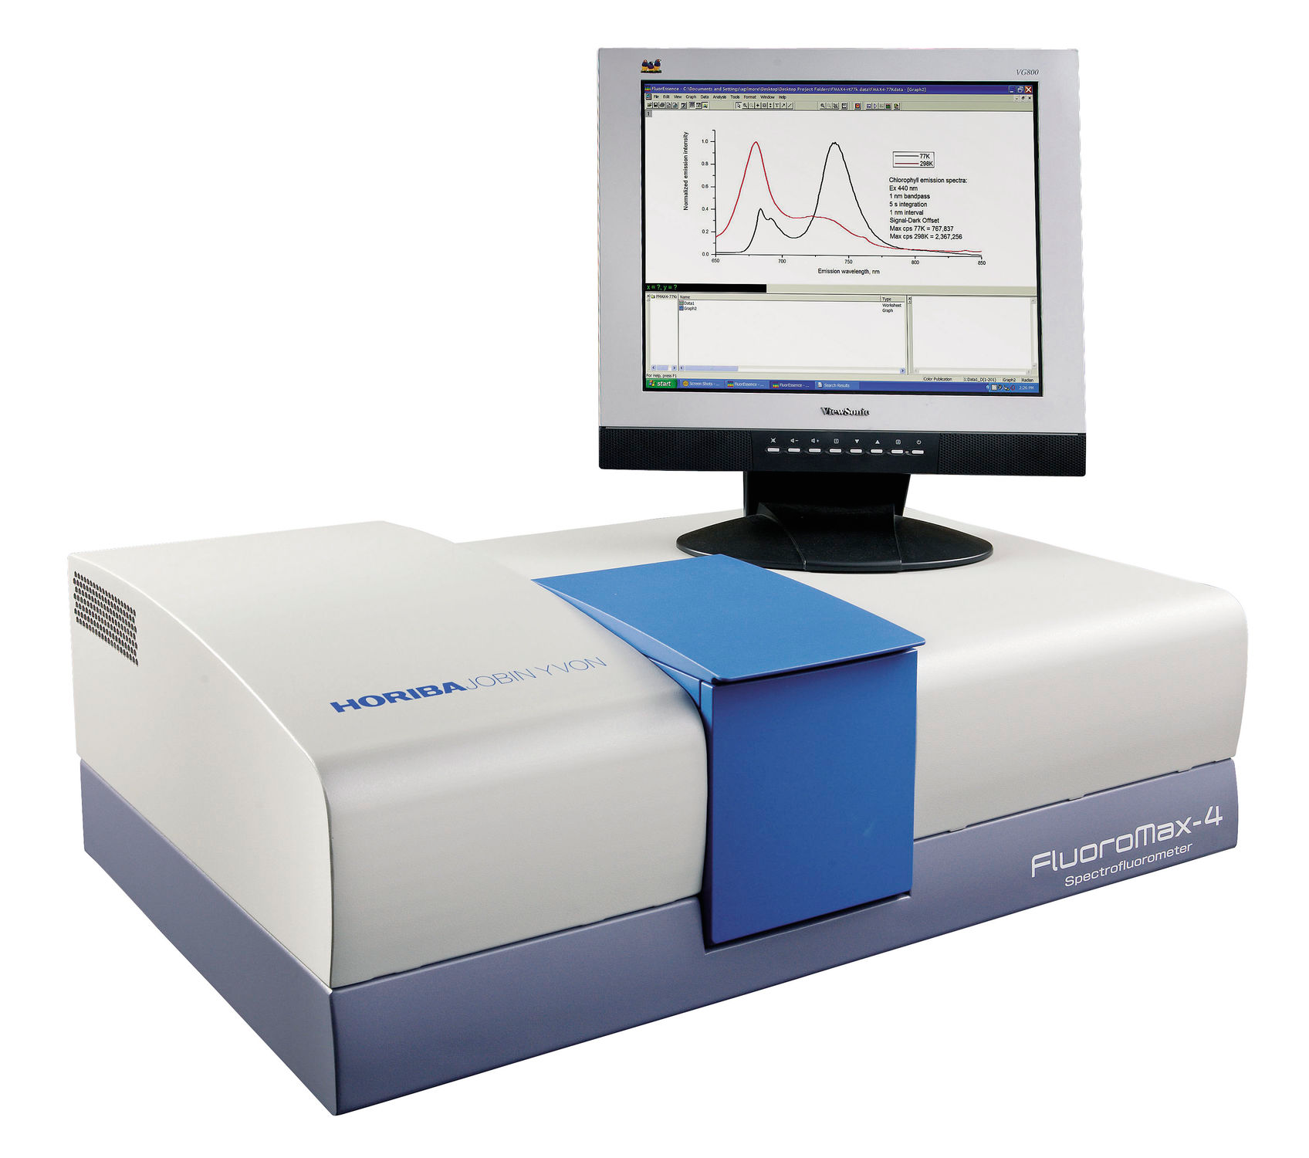
The Experiment: Measuring Aggregation
Every six hours for 120 hours, a sample will be taken.
ThT will be added to the sample
    A spectrofluorometer will be used to measure the level of fluorescence of the sample.

Slide 16
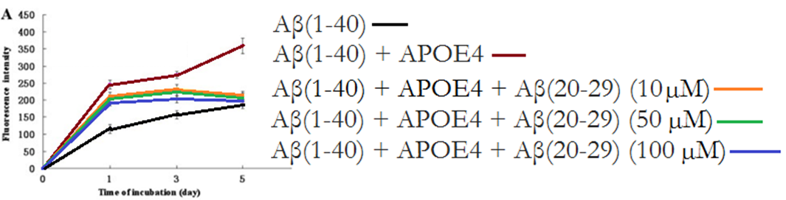
Expected Results: Reduced Aggregation
Hao et. al (2010)

Slide 17
Future Directions
In vivo tests
Structure based drug design/further peptide testing

