Slide 1
Defining Epidermal Growth Factor Receptor exon 20 mutant sensitivity to tyrosine kinase inhibition
Danny Rayes

Slide 2
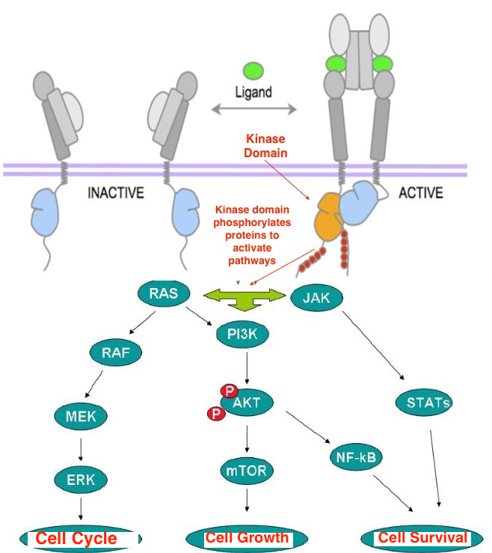
Epidermal Growth Factor Receptor
EGF + EGFR → growth and proliferation
Mutant EGFR (no ligand) → growth and proliferation

Slide 3
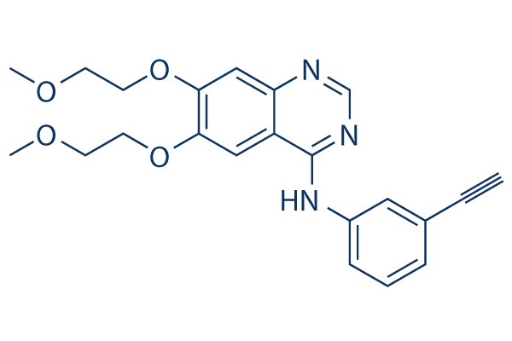
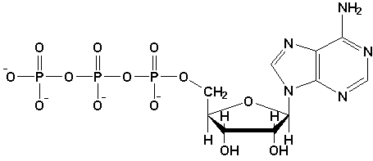
Inhibiting activating mutations
Epidermal Growth Factor Receptor
Tyrosine kinase inhibitor
Kinase domain
ATP can’t bind

Slide 4
Mutations in EGFR resistant to TKIs

Slide 5
What makes exon 20 mutations resistant?
Yasuda et al 2013 studied the resistance of seven prevalent exon 20 mutations to tyrosine kinase inhibitors
Unexpectedly, they found one mutation that was sensitive. An insertion of four amino acids, FQEA, between residue 763 and 764
Tyrosine kinase inhibitor
Kinase domain- insertion FQEA
ATP can’t bind

Slide 6
Experimental Question
Are there other exon 20 insertion mutations that cannot auto-phosphorylate in the presence of tyrosine kinase inhibitors?

Slide 7
My Experiment
Choose exon 20 mutations not previously studied in vitro
Focus on residues 762-768 (Arcila et al 2013)
Create stable cell lines expressing mutant EGFR
Expose cell lines to Erlotinib and Western blot EGFR to determine phosphorylation

Slide 8
Expressing mutations
1) Create an expression vector containing Wild Type EGFR and a selectable marker (GFP)
2) Use the vector as a template for constructing mutants by site-directed mutagenesis

Slide 9
Site-Directed Mutagenesis

Slide 11
Creation of a stable cell line
Transfect mutant construct into packaging cell
Packaging cell transcribes proteins necessary for retroviral assembly (gag, pol, env)
Retrovirus transduces mutant construct into Ba/F3 cell line
Additional screening to asses transforming ability of mutations
Successfully integrated constructs will express the Green Fluorescent Protein

Slide 12
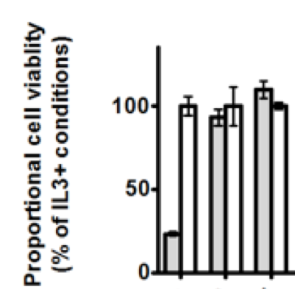
Creation of a stable cell line
Mutant Ba/F3 cells grow in absence of IL3
IL3-
IL3+
Empty mutant mutant

Slide 13
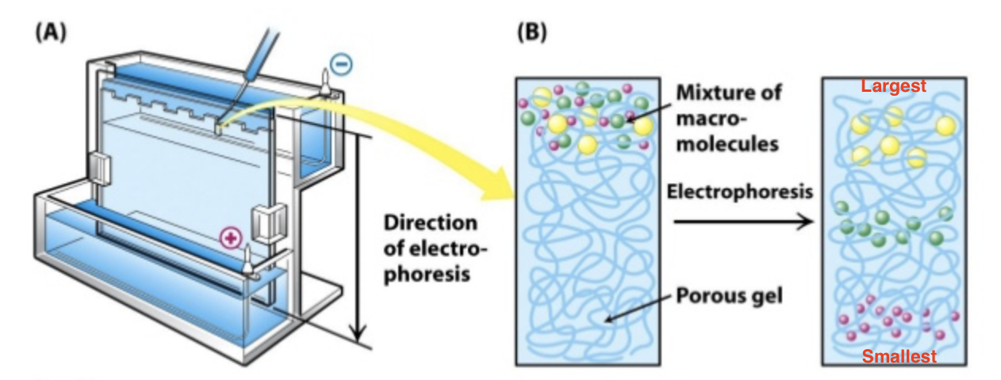
Western Blotting
Protein separated by size using gel electrophoresis

Slide 14
Western Blotting

Slide 15
Predictions

Slide 16
Limitations
This experiment tests sensitivity in vitro, meaning it does not directly translate to live cells
If Erlotinib inhibits a mutation, it does not necessarily mean that treatment would be effective for a diseased patient
Another study must be done to asses the dose response of the mutation to Erlotinib
There must be a therapeutic window, aka Erlotinib must bind to the mutated EGFR with higher affinity than the Wild type EGFR in order to be a viable treatment

