Slide 1
The effect of duplication of the variable region stem loop structures of the 3’UTR on sfRNA virulence in the dengue virus
NIKHITA PUTHUVEETIL

Slide 2
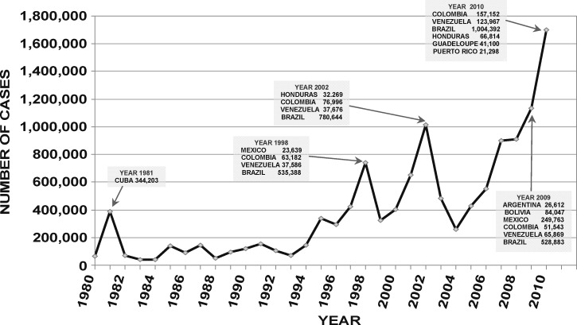
Outbreaks of Dengue

Slide 3
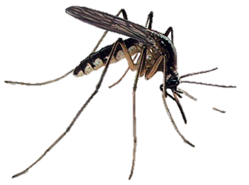
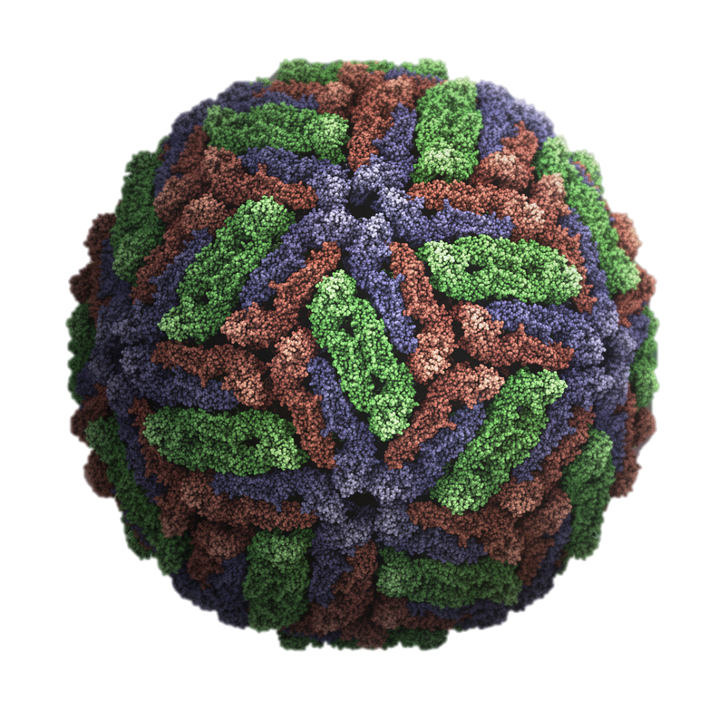
The dengue virus prefers humans

Slide 4
The dengue virus prefers humans
How do we stop this cycle?

Slide 5
How does the dengue virus survive in a host?
Affects humans and mosquitoes

Slide 6
How does the dengue virus survive in a host?
Affects humans and mosquitoes
How to adapt? Mutations

Slide 7
Dengue genome

Slide 8
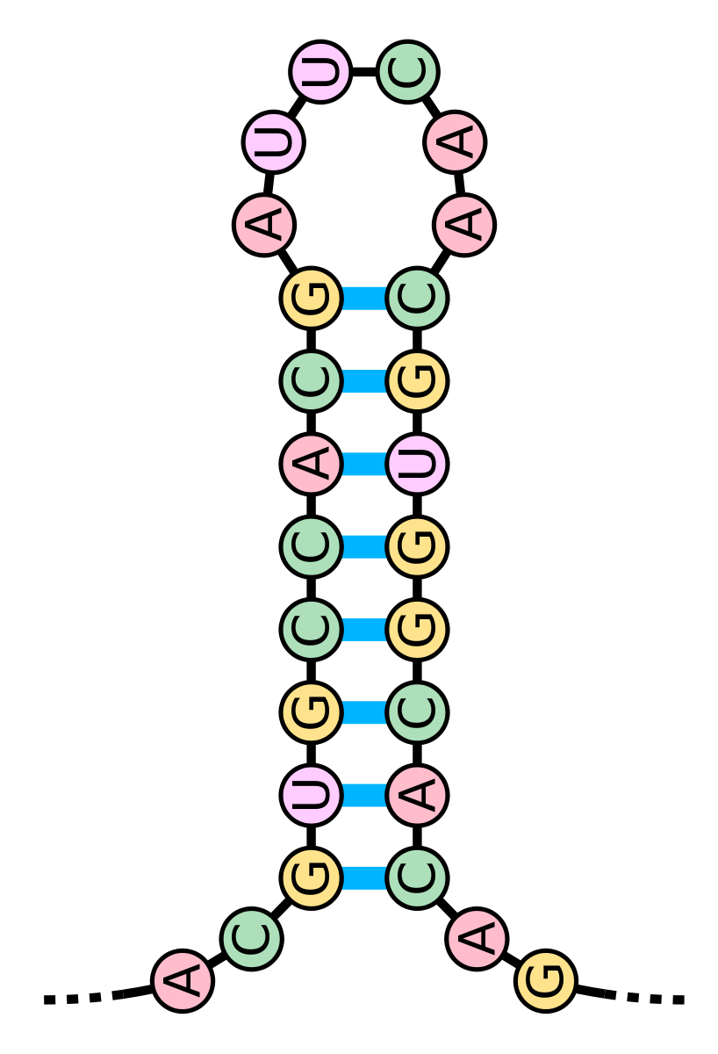
5’ and 3’UTR have stem loops
RNA can fold to form hairpin or stem loops

Slide 9
Dengue genome with stem loops

Slide 10
Mutations will be host-specific: only allows survival in one host

Slide 11
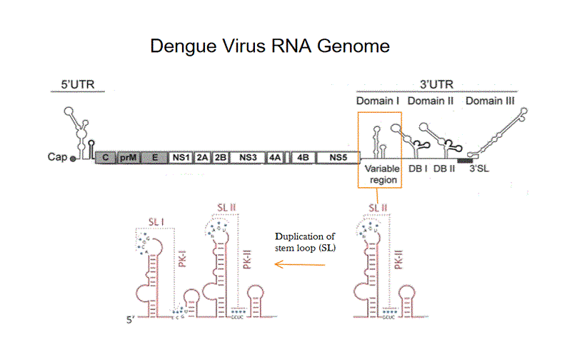
Duplication of a hair pin/stem loop

Slide 12
How Duplication of Stem Loops Work

Slide 13
How Duplication of Stem Loops Work

Slide 14
How does the host respond to the dengue virus?
RNA-Binding Proteins
XRN1
exoribonuclease

Slide 15
XRN1 will try to degrade dengue genome
XRN1
an immune protein that degrades RNA
exoribonuclease

Slide 16
Stem Loops will stall it
sfRNA
Will create subgenomic flavivirus RNA (sfRNA)
XRN1
exoribonuclease

Slide 17
Stem Loops will stall it
sfRNA
Creates subgenomic flavivirus RNA (sfRNA)
sfRNA can now act on its own
XRN1
exoribonuclease

Slide 18
sfRNA will bind to RNA-Binding Proteins
RNA-Binding Proteins
enhance immune response

Slide 19
Binding causes inactivation of RNA-Binding Proteins
Immune Response

Slide 20
Two stem loops vs. one stem loop
How does it change the virulence of sfRNA in humans?

Slide 21
Step 1: Generate sfRNA
Infect mosquito cells with dengue virus

Slide 22
Step 1: Generate sfRNA
Infect cells with dengue virus
Serial passage in same cell line for 10 passages

Slide 23
Step 1: Generate sfRNA
Infect cells with dengue virus
Serial passage in same cell line for 10 passages
Will create a genome that is adapted to a mosquito environment

Slide 24
Step 1: Generate sfRNA
Sequence for a mosquito-adapted virus
Reverse Transcriptase
Sequencing

Slide 25
Step 2: Test for Resistance
Will the created sfRNA be resistant to XRN1?
Do a fluorescence-based test

Slide 26
Step 2: Preparations for Resistance Test
Add fluorescent aptamer
Aptamer

Slide 27
Step 2: Preparations for Resistance Test
Add fluorescent aptamer
Add 40 nucleotide leader sequence with attached phosphate

Slide 28
Step 2: XRN1 Resistance Test
Add fluorescent aptamer
Add 40 nucleotides leader sequences with attached phosphate
Add XRN1
XRN1

Slide 29
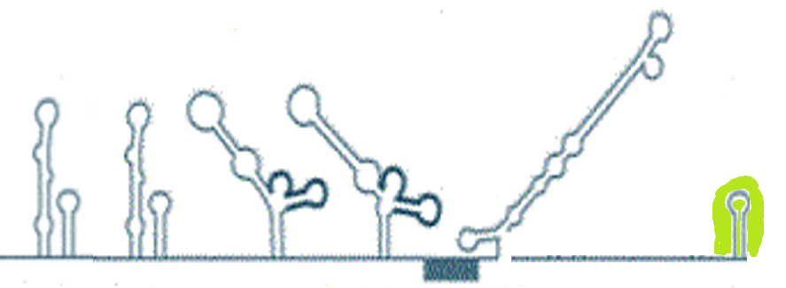
If sfRNA is viable…
XRN1
Fluorescence will be maintained

Slide 30
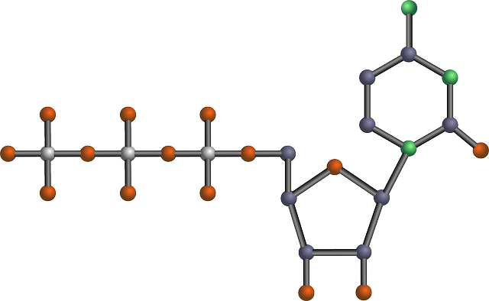
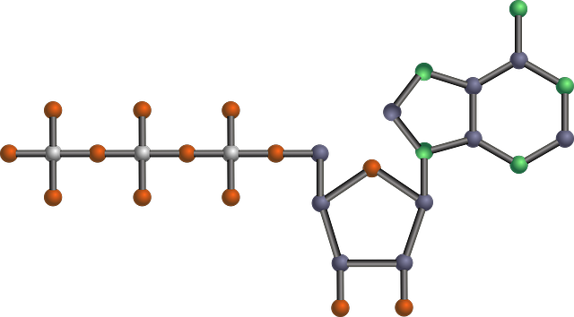
If sfRNA isn’t viable…
XRN1
Complete degradation of RNA
No fluorescence

Slide 31
Step 3: Test for Virulence
Will sfRNA decrease immune response?
Do an ELISA assay
Immune Response

Slide 32
Step 3: Test for Virulence
Will sfRNA decrease immune response?
Infect cells with sfRNA
Examine the amount of signaling proteins produced

Slide 33
Expected Results
Duplicated stem loop sfRNA should be virulent
Will show low levels of signaling proteins
XRN1 resistant
Since:
Second stem loop will provide it the advantage to grow in a human environment
The one stem loop sfRNA should show low virulence
XRN1 resistant

