Slide 1
Furin-Enhanced In Vivo Production of Factor IX
Aarthi Prakash
May 9, 2017

Slide 2
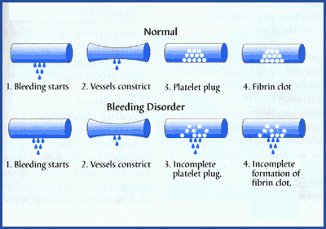
Hemophilia B
X-linked Recessive
Mutated or reduced FIX
1/30,000 Affected
Prophylactic treatments
Transient, reduced efficacy
Notes:
http://www.hemophilia.ca/images/1395859030_400x282.gif

Slide 3
Factor IX (FIX)
Furin/PACE
Clotting Factor
Distinct Domains
Many posttranslational modifications
Ex) Gamma Carboxylation (Glu residue) – phospholipid and calcium bonding
Serine Protease
Profactor → mature FIX
Type of Paired Amino acid Cleaving Enzyme
Hepatocyte – ubiquitous
Chinese Hamster Ovary Cells

Slide 4
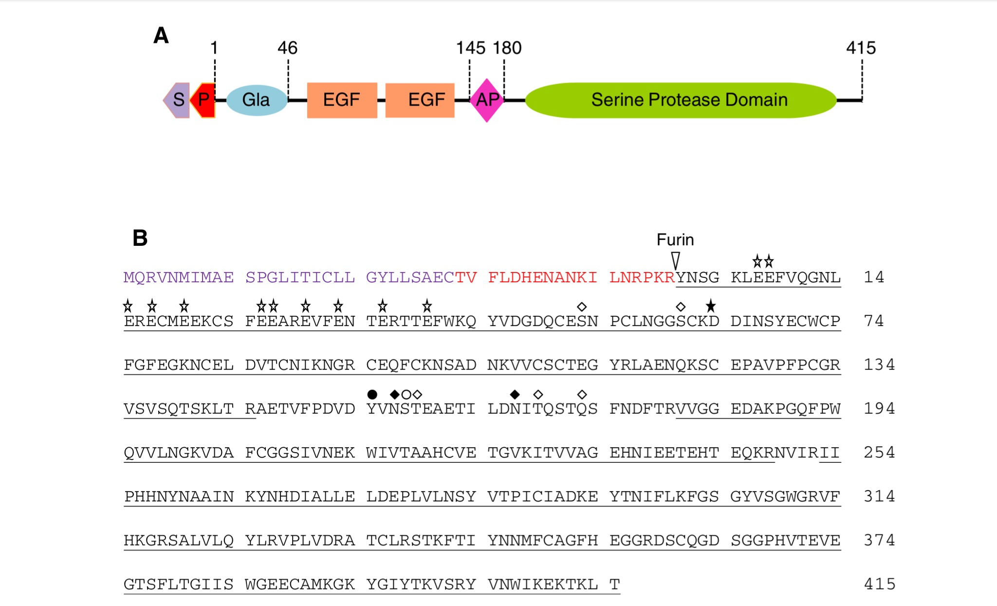
Figure 1. (A) Schematic drawing of FIX. S is the signal peptide, P is the propeptide, Gla is the domain with the glutamic acid residues, EGF is the epidermal growth factor like domains, AP is the activating protein domain, and there is the Serine Protease Domain. (B) This is the amino acid sequence of FIX and shows where Furin cleaves the protein. The shapes above the amino acids represent the posttranslational modifications the protein undergoes.

Slide 5
Current Research
Liu et al. – Chinese Hamster Ovary Cells
Co-expression of FIX with modifying enzymes
Activation of rhFIX
Optimal conditions required

Slide 6
Proposed Experiment

Slide 7
Vector Development
Use HB mice
Vector plasmid with liver-specific enhancer/promoter
Human FIX gene
Furin gene
Figure 2. Schematic drawing of the pAAV-LSP-hFIX-Furin vector.
Notes:
Photo from Wang et al. (1999)

Slide 8
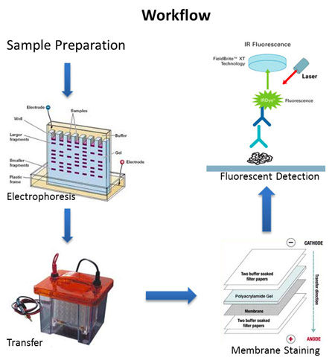
Western Blot
Notes:
http://proteomics.case.edu/proteomics/westernblot-sm.jpg

Slide 9
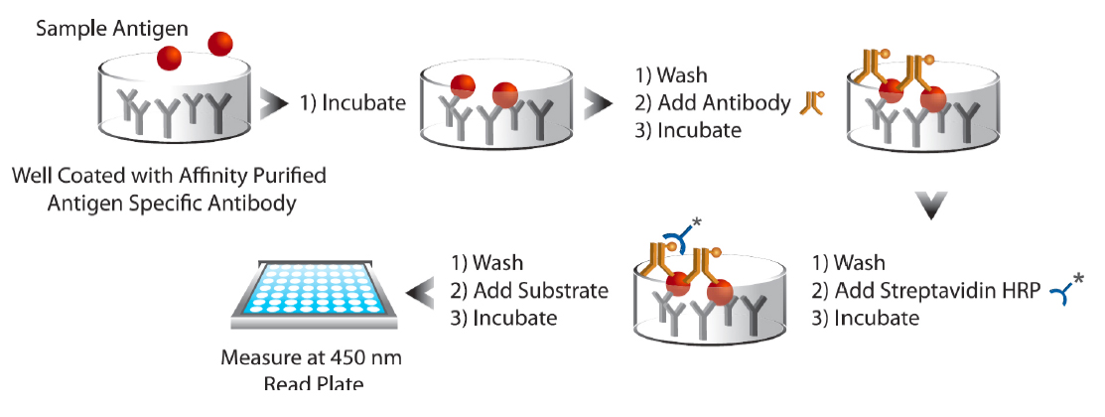
ELISA
Notes:
http://www.enzolifesciences.com/fileadmin/redacteur/bilder/Platforms/Immunoassay_and_Assay_Development/Immunoassay_kits/2014-06-Immunoassay-ELISA-figure1.jpg

Slide 10
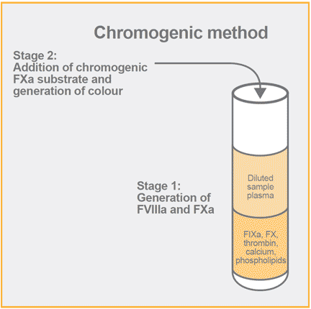
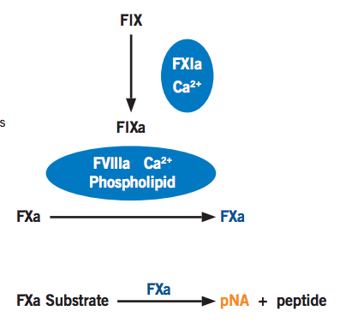
Chromogenic FIX Activity Assay
Notes:
http://diapharma.com/wp-content/uploads/2016/02/fviii_chromogenic_s.png.pagespeed.ce.VbOw0ZCrPf.png – Left image
http://diapharma.com/wp-content/uploads/2016/06/900020_950030_Rox_Factor_IX_FIX-A_Flyer_ML-00-00009REV02.pdf – Right image

Slide 11
Questions?

