Slide 1
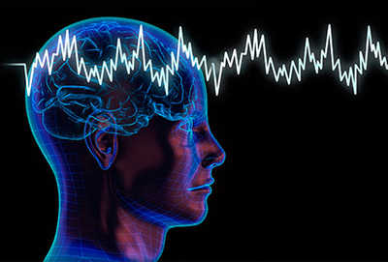
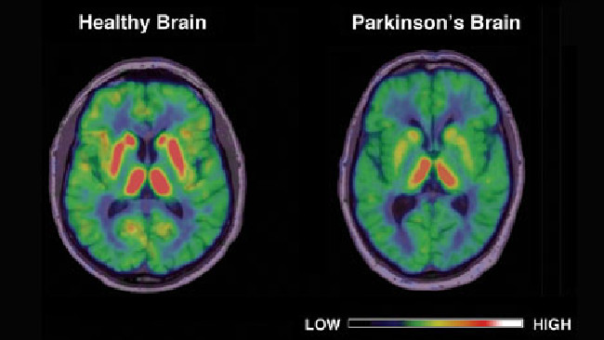
Understanding the structure of a protein involved in Parkinson’s disease
http://img.webmd.com/dtmcms/live/webmd/consumer_assets/site_images/article_thumbnails/news/2012/06_2012/parkinsons_brain_stimulation/493x335_parkinsons_brain_stimulation.jpg?resize=400px:*&output-quality=50
http://cdn.newsapi.com.au/image/v1/eae65a0aa1e3362ef70bc789b1a096de?width=650
Bharath Peddibhotla
Notes:
-My research proposal was “Relating the structure of aggregated alpha synuclein to its preferential binding on the outer mitochondrial membrane”

Slide 2
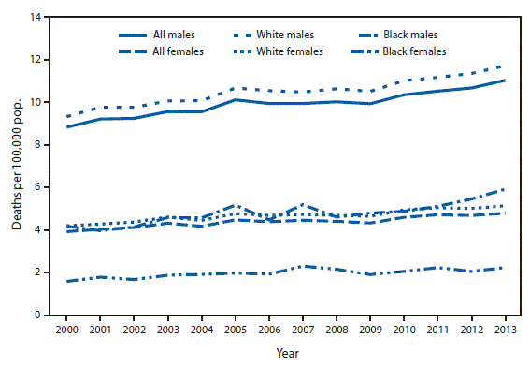
Why should we care?
https://www.cdc.gov/mmwr/preview/mmwrhtml/mm6436a9.htm

Slide 3
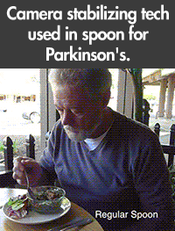
Symptoms
2 types
Non-motor: depression, hallucination, memory problems
Motor: Gait, Trembling, Movement
https://giphy.com/gifs/camera-spoon-stabilising-131XhoinXf0cLu

Slide 4
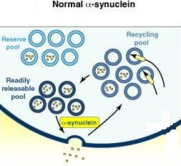
α-Synuclein
Assists vesicle formation (Burre et al., 2010)
http://www.cell.com/cms/attachment/607469/4835709/gr3.jpg
Notes:
-The relationship between alpha synuclein and dopamine mainly highlighted in Parkinson’s disease is that alpha synuclein assists vesicle formation to exocytose dopamine into the synaptic cleft. Remember, we are talking about a junction between 2 neurons

Slide 5
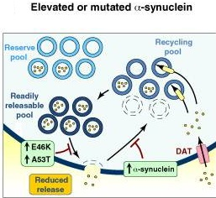
Aggregated α-Synuclein

Slide 6
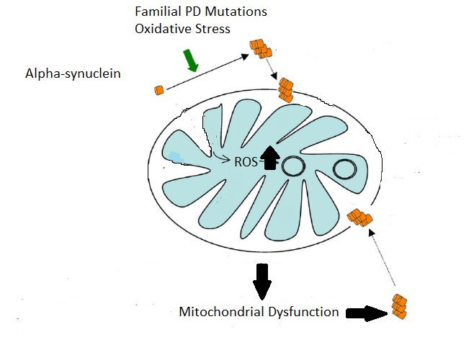
Aggregated α-Synuclein
Bueler Hansruedi (2009) Impaired mitochondrial dynamics and function in the pathogenesis of Parkinson’s disease. Experimental Neurology. 218: 235-246.
Notes:
-No one knows why alpha synuclein aggregates but scientists believe that there are two positively correlating factors that could explain the reason they aggregate
Familial PD mutations such as LRRK2 and PARK2 are genetic mutations and/or
(2) oxidative stress

Slide 7
My proposal is to find differences in amino acid sequence (primary protein level) in order to understand the change in function of native α-synuclein in comparison to aggregated α-synuclein.
Native α-synuclein
Aggregated α-synuclein
Notes:
-I wondered if the primary amino acid level would be the change that the alpha synuclein protein is needed to cause this change in interaction with its surrounding molecules
-DNA → mRNA → Protein; we all know this concept of the Central Dogma, and we know that Parkinson’s disease can be caused by mutations

Slide 8
Strategy
Extraction of α-synuclein
Western blot to determine presence of α-synuclein / aggregated α-synuclein
Addition of Trypsin (Protease)
Aggregated α-synuclein fragments undergo 2D-SDS PAGE to determine components

Slide 9
Extraction of α-synuclein
Bandopadhyay, R. Sequential Extraction of Soluble and Insoluble Alpha-Synuclein from Parkinsonian Brains. J. Vis. Exp. (107), e53415, doi:10.3791/53415 (2016)
Notes:
Centrifuge is used to separate components of different densities, the lighter molecules rise to the top called the supernatant whereas the more dense molecules fall to the bottom called the pellet

Slide 10
Western blot
Urea = insoluble
SDS & TBS = soluble
Bandopadhyay, R. Sequential Extraction of Soluble and Insoluble Alpha-Synuclein from Parkinsonian Brains. J. Vis. Exp. (107), e53415, doi:10.3791/53415 (2016)
Urea
TBS
SDS
Notes:
Arrow = native alpha synuclein

Slide 11
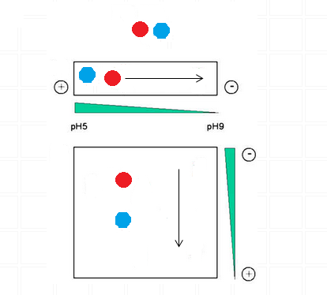
2D-SDS PAGE
1) Fragmented α-synuclein
2) Seperation via pI
3) Gel Electrophoeresis
Notes:
Cleave protein components by known protease such as trypsin
Isoelectric focusing
SDS Polyacrymilide gel electrophoeresis

Slide 12
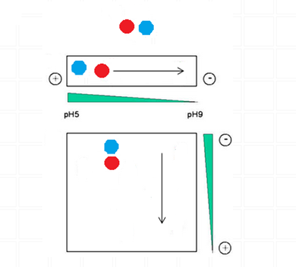
Results

Slide 13
