Slide 1
Comparing the blockage of the S1PR1 receptor to silencing microRNA miR-155
Rachel Miller
BNFO 300 Spring 2017

Slide 2
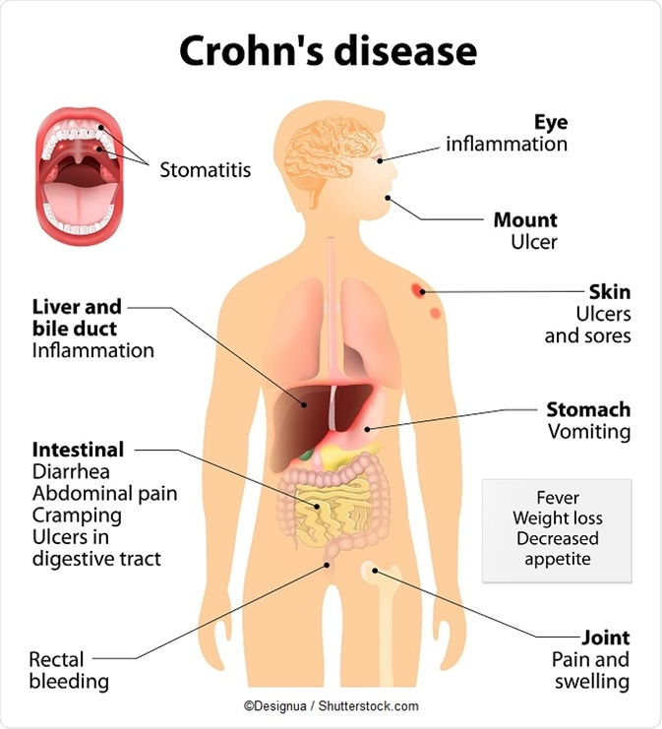
Crohn’s Disease
Autoimmune Disease
Classified by the Inflammation of the GI tract
400,000 people affected in the United States
Notes:
http://www.news-medical.net/image.axd?picture=2017%2F4%2FCrohn%27s_disease_symptoms__infographic_680x_-_Designua.jpg

Slide 3
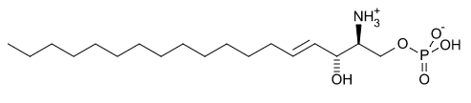
S1P and S1PR1
Sphingosine-1-phosphate (S1P)
Involved in regulation of lymphocyte migration, maturation and trafficking
S1PR1 main S1P receptor involved in the immune system
Sphingosine-1-phosphate receptor 1 (S1PR1)
Notes:
https://upload.wikimedia.org/wikipedia/commons/9/9c/3v2y.png
https://upload.wikimedia.org/wikipedia/commons/6/6a/Sphingosine-1-phosphate.svg
S1P – sphingolipid with phosphate group at the end
Phosphorylation of sphingosine is catalyzed by sphingosine kinase
S1PR1 – G coupled protein receptor bind to it
S1P modulator interrupts the G coupled protein receptor

Slide 4
MicroRNAs
Notes:
https://assets.labroots.com/_public/_files/system/ck/trending/micrornadiag_9f05ac432c93c6af01e3f4c7e3f9d79f.jpg

Slide 5
BACKGROUND EXPERIMENT
Step 1
Group 1: Mice with ileitis are given S1P modulator Fingolomid i.e blocking S1PR1 receptor on T cells
Group 2 (Control): Mice with ileitis are not given S1P modulator Fingolomid
Step 2
Measure microRNAs expression in exosomes from inflamed tissue
Step 3
Compare the expression of microRNAs between control and experimental
Measure microRNAs expression in T cells
Notes:
Step 1
Group 1: Mice with ileitis are given S1P modulator Fingolomid i.e blocking S1PR1 receptor on T cells
Group 2 (Control): Mice with ileitis are not given S1P modulator Fingolomid
Step 2
Measure microRNAs expression in exosomes from inflamed tissue
Measure microRNAs expression in T cells
Step 3
Compare the expression of microRNAs between control and experimental

Slide 6
The Results from Background Experiment
When Fingolomid was present, the number of microRNAs decreased in both T cells and exosomes
Which leads us to our big question....

Slide 7
Big Question
Is the reduction of microRNAs in T cells caused by the blockage of S1PR1 using Fingolomid or is it correlated?

Slide 8
Experiment:
Step 1
T cell
S1PR1
Fingolomid

Slide 9
Experiment:
Step 1
T cell
S1PR1
Fingolomid

Slide 10
Experiment:
Step 1
T cell
S1PR1
Fingolomid

Slide 11
Experiment:
Step 1
T cell
S1PR1

Slide 12
Experiment:
Step 1
T cell
S1PR1

Slide 13
Experiment:
Step 1
T cell
S1PR1
S1P

Slide 14
Experiment:
Step 1
T cell
S1PR1
Measure
S1P
miR-155

Slide 15
Experiment:
Step 1
T cell
S1PR1
Measure
S1P
miR-155
Measure
Cytokines:
IL-2
IL-17
IFN-gamma

Slide 16
Experiment:
Step 2
T cell
S1PR1
S1P

Slide 17
Experiment:
Step 2
T cell
S1PR1
S1P

Slide 18
Experiment:
Step 2
T cell
siRNA
S1PR1
S1P
miR-155
Measure
Notes:
siRNA transfection procedure
Generate siRNA that would match cell

Slide 19
Experiment:
Step 2
T cell
siRNA
S1PR1
S1P
miR-155
Measure
Measure
Cytokines:
IL-2
IL-17
IFN-gamma

Slide 20
How we are measuring our results: miRNAs
qPCR – quantitative polymerase chain reaction
Real time PCR with
  Fluorescent dye binds to DNA
Fluorescent light will increase as qPCR continues
Notes:
http://www.medicinalgenomics.com/wp-content/uploads/2014/09/Screen-Shot-2015-01-15-at-9.16.09-PM.png
http://media.biocompare.com/m/37/product/3228864-400x300.jpg

Slide 21
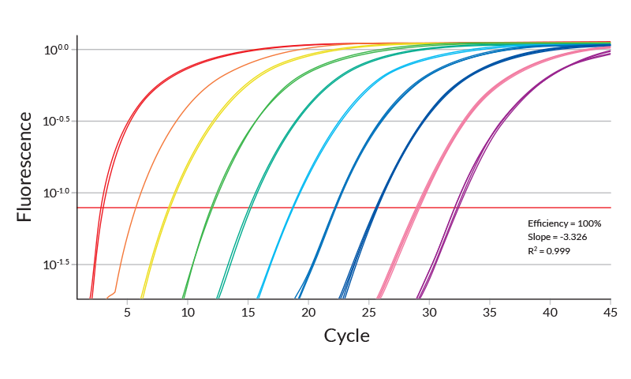
Quantify microRNA Expression
Notes:
Show the difference between the microRNA-155 expression
Threshold line

Slide 22
How we are measuring our results: Cytokines
ELISA
Targets are pro-inflammatory cytokines
  IL-2
  IL-17
  IFN-gamma
Notes:
Results would show If the inflammatory response would be occurring or not

Slide 23
Quantify Cytokine Expression
Notes:
https://www.immunology.org/sites/default/files/Enzyme-linked-immunosorbent-assay-ELISA-Figure-2.png

Slide 24
Expected Results
When Fingolomid is blocking the S1PR1 receptor, microRNA-155 expression will decrease AND cytokine expression will decreased
When miRNA-155 is silenced with siRNA, cytokine expression will match the results with Fingolomid was present
What would these results tell us?

Slide 25
Recap
Is the reduction of microRNAs in T cells caused by the blockage of S1PR1 using Fingolomid or is it correlated?
Experiment:
Compare silencing of miR-155 using siRNA to adding Fingolomid to block S1PR1
Compare microRNA expressions between the two tests using qPCR
Compare cytokine expression between the two tests using ELISA

Slide 26
Why it Matters
One step closer in understanding Crohn’s disease and other autoimmune diseases
Shows evidence that S1PR1 and microRNAs are tied together
Possible treatment for patients with Crohn’s disease
Notes:
http://www.beatricebiologist.com/wp-content/uploads/2014/05/autoimmune-01.png

Slide 27
Questions?
Notes:
http://cdn.red-recruitment.com/redmedia/uploads/questions.jpg

