Slide 1
Downregulation of Sox2 with CBD via AMPK
Jared Mann

Slide 2

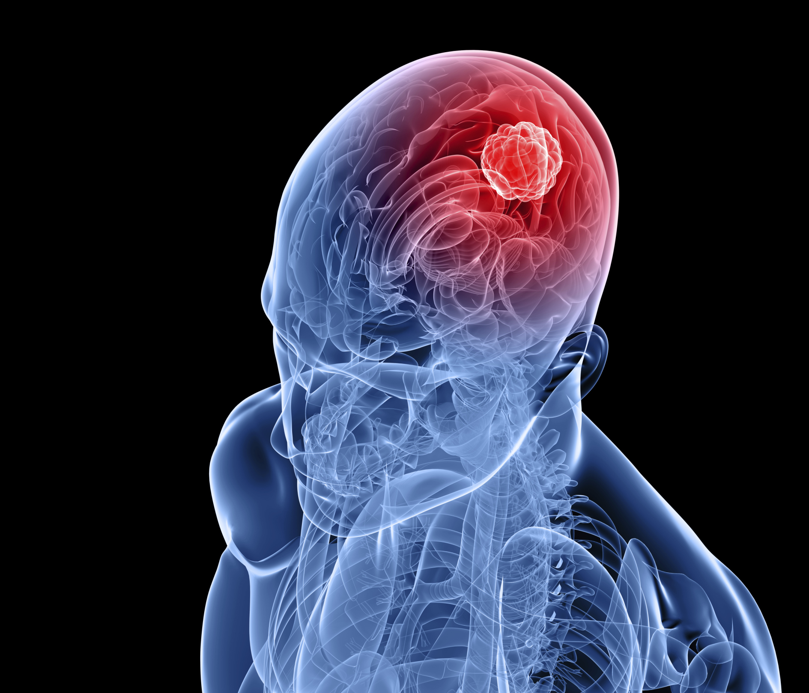
GLIOBLASTOMA

Slide 3
GLIOBLASTOMA
14.6 month median survival

Slide 4
GLIOBLASTOMA
14.6 month median survival
Most malignant brain tumor

Slide 5
GLIOBLASTOMA
14.6 month median survival
Most malignant brain tumor
Stem-like qualities ← transcription factors

Slide 6
GLIOBLASTOMA
14.6 month median survival
Most malignant brain tumor
Stem-like qualities ← transcription factors
Sox2: transcription factor

Slide 7
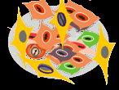


Cancer Stem cells
DRUG

Slide 8

Cancer Stem cells
Overexpression of Sox2
RNA
Sox2 Protein
Sox2 gene

Slide 9
Cancer Stem cells
Overexpression of Sox2
Pluripotency
RNA
Sox2 Protein
Sox2 gene

Slide 10
Cancer Stem cells
Overexpression of Sox2
Pluripotency
Tumor Initiation
RNA
Sox2 Protein
Sox2 gene

Slide 11
Cancer Stem cells
Overexpression of Sox2
Pluripotency
Tumor Initiation
RNA
Sox2 Protein
Sox2 gene
Downregulating Drug?

Slide 12
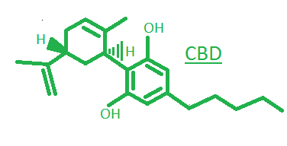
cannabidiol
Cannabis Derivative

Slide 13
cannabidiol
Cannabis Derivative
Non-Psychoactive

Slide 14
cannabidiol
Cannabis Derivative
Non-Psychoactive
Antitumor Activity

Slide 15
cannabidiol
Cannabis Derivative
Non-Psychoactive
Antitumor Activity
Downregulates Sox2

Slide 16
cannabidiol
Cannabis Derivative
Non-Psychoactive
Antitumor Activity
Downregulates Sox2
Needs More Research

Slide 17

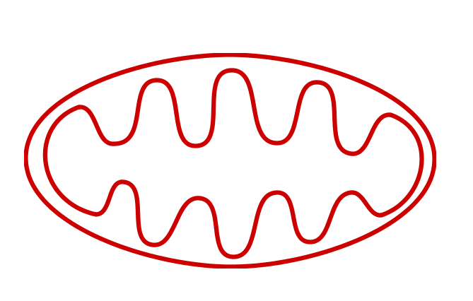
Pathway
NADH Increase

Slide 18
Pathway
NADH Increase
Electron Transport Chain

Slide 19
Pathway
NADH Increase
Electron Transport Chain
e⁻
e⁻
e⁻
e⁻

Slide 20
Pathway
NADH Increase
ROS
Electron Transport Chain
O₂⁻
O₂ +
e⁻
e⁻
e⁻
e⁻

Slide 21
Pathway
NADH Increase
ATM censor
ROS
Electron Transport Chain
O₂⁻
O₂ +
e⁻
e⁻
e⁻
e⁻

Slide 22
Pathway
NADH Increase
ATM censor
ROS
Electron Transport Chain
LKB1
O₂ +
e⁻
O₂⁻
e⁻
e⁻
e⁻
AMP ADP

Slide 23
Pathway
NADH Increase
ATM censor
ROS
Electron Transport Chain
LKB1
O₂ +
e⁻
p-AMPK
O₂⁻
e⁻
e⁻
e⁻
AMP ADP

Slide 24
Pathway
NADH Increase
ATM censor
ROS
Electron Transport Chain
LKB1
O₂ +
e⁻
p-AMPK
O₂⁻
e⁻
e⁻
e⁻
+TAB1
AMP ADP
p-p38

Slide 25
Pathway
NADH Increase
ATM censor
ROS
Electron Transport Chain
LKB1
O₂ +
e⁻
p-AMPK
O₂⁻
e⁻
e⁻
e⁻
+TAB1
AMP ADP
p-p38
p21

Slide 26

Pathway
NADH Increase
ATM censor
ROS
Electron Transport Chain
LKB1
O₂ +
e⁻
p-AMPK
O₂⁻
e⁻
e⁻
e⁻
+TAB1
AMP ADP
p-p38
p21

Slide 27
Pathway
NADH Increase
ATM censor
ROS
Electron Transport Chain
LKB1
O₂ +
e⁻
p-AMPK
O₂⁻
e⁻
e⁻
e⁻
+TAB1
AMP ADP
p-p38
p21
Inhibitory Bond

Slide 28
Pathway
NADH Increase
ATM censor
ROS
Electron Transport Chain
LKB1
O₂ +
e⁻
p-AMPK
O₂⁻
e⁻
e⁻
e⁻
+TAB1
AMP ADP
Sox2 Protein
p-p38
p21
Inhibitory Bond

Slide 29
Research Question
What is the extent of which CBD downregulates the expression of Sox2 in GBM via AMP Kinase?

Slide 30
The experiment
RNA
Sox2 Protein
Sox2 gene

Slide 31
The experiment
RNA
Sox2 Protein
Sox2 gene
In vitro experiment aimed at measuring protein content

Slide 32
The experiment
RNA
Sox2 Protein
Sox2 gene
In vitro experiment aimed at measuring protein content
Analyzed with a Western Blot

Slide 33
The experiment
RNA
Sox2 Protein
Sox2 gene
In vitro experiment aimed at measuring protein content
Analyzed with a Western Blot
U251 GBM cell lines will be used because of their high Sox2 content

Slide 34
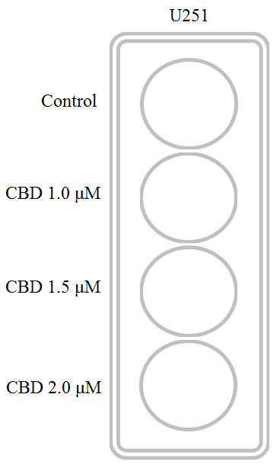
Variables
Multiple variable model

Slide 35
Variables
Multiple variable model
  Control – no CBD

Slide 36
Variables
Multiple variable model
  Control – no CBD
  CBD 1 – 1.0 micromole dilution CBD in ethanol

Slide 37
Variables
Multiple variable model
  Control – no CBD
  CBD 1 – 1.0 micromole dilution CBD in ethanol
  CBD 1.5 – 1.5 micromole dilution CBD in ethanol

Slide 38
Variables
Multiple variable model
  Control – no CBD
  CBD 1 – 1.0 micromole dilution CBD in ethanol
  CBD 1.5 – 1.5 micromole dilution CBD in ethanol
  CBD 2 – 2.0 micromole dilution CBD in ethanol

Slide 39
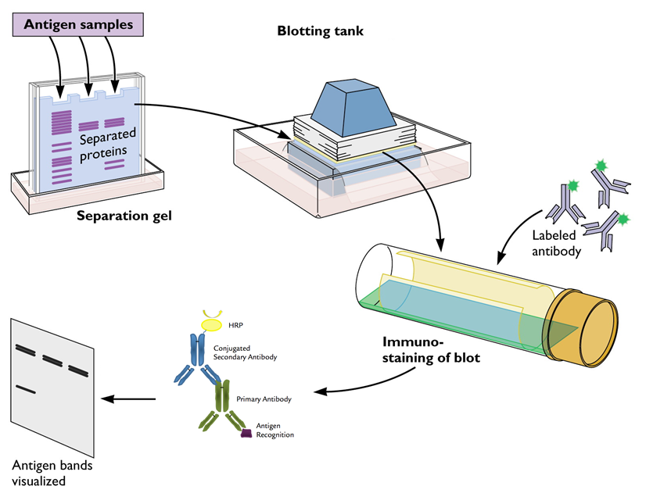
Western blot
1)
2)
2)
1)
3)
3)
4)
5)
4)
5)
5)

Slide 40
Western blot
1)
2)
2)
1)
3)
3)
4)
5)
4)
5)
5)

Slide 41
Western blot
1)
2)
2)
1)
3)
3)
4)
5)
4)
5)
5)

Slide 42
Western blot
1)
2)
2)
1)
3)
3)
4)
5)
4)
5)
5)

Slide 43
Western blot
1)
2)
2)
1)
3)
3)
4)
5)
4)
5)
5)

Slide 44
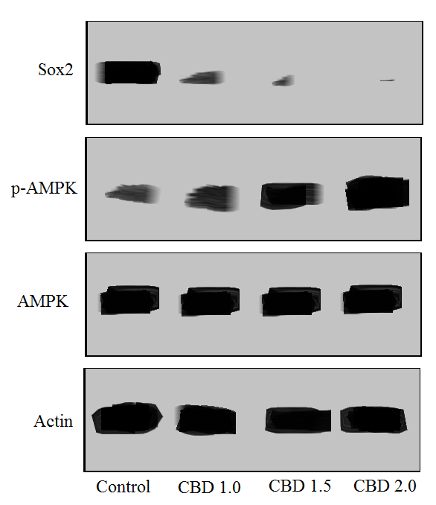
Expected Results
If all goes well…
  Control should show signs of Actin, AMPK and Sox2 but low signs of p-AMPK

Slide 45
Expected Results
If all goes well…
  Control should show signs of Actin, AMPK and Sox2 but low signs of p-AMPK
  CBD 1.0 should start to increase p-AMPK and decrease Sox2

Slide 46
Expected Results
If all goes well…
  Control should show signs of Actin, AMPK and Sox2 but low signs of p-AMPK
  CBD 1.0 should start to increase p-AMPK and decrease Sox2
  CBD 1.5 should continue this increase

Slide 47
Expected Results
If all goes well…
  Control should show signs of Actin, AMPK and Sox2 but low signs of p-AMPK
  CBD 1.0 should start to increase p-AMPK and decrease Sox2
  CBD 1.5 should continue this increase
  CBD 2.0 should have the highest increase in p-AMPK and highest decrease in Sox2

Slide 48
Densitometry
Image J or similar software will be used for densitometry analysis

Slide 49
Discussion
GBM treatments with CBD increase 1 year survival rate by 83%

Slide 50
Discussion
GBM treatments with CBD increase 1 year survival rate by 83%
If experiment shows increase in p-AMPK, evidence that CBD activates AMPK

Slide 51
Discussion
GBM treatments with CBD increase 1 year survival rate by 83%
If experiment shows increase in p-AMPK, evidence that CBD activates AMPK
To what extent: higher levels of CBD shows increase in p-AMPK

Slide 52
Discussion
GBM treatments with CBD increase 1 year survival rate by 83%
If experiment shows increase in p-AMPK, evidence that CBD activates AMPK
To what extent: higher levels of CBD shows increase in p-AMPK
Knowing that AMPK is involved in the downregulation of Sox2 is important for future research

Slide 53
References
McAllister, S. D., Soroceanu, L., & Desprez, P. Y. (2015). The antitumor activity of plant-derived non-psychoactive cannabinoids. Journal of Neuroimmune Pharmacology, 10(2), 255-267.
Ray, S., Bonafede, M. M., & Mohile, N. A. (2014). Treatment Patterns, Survival, and Healthcare Costs of Patients with Malignant Gliomas in a Large US Commercially Insured Population. American health & drug benefits, 7(3).
Lathia, J. D., Mack, S. C., Mulkearns-Hubert, E. E., Valentim, C. L., & Rich, J. N. (2015). Cancer stem cells in glioblastoma. Genes & development, 29(12), 1203-1217.
Fong, Y. W., Inouye, C., Yamaguchi, T., Cattoglio, C., Grubisic, I., & Tjian, R. (2011). A DNA repair complex functions as an Oct4/Sox2 coactivator in embryonic stem cells. Cell, 147(1), 120-131.
Singer, E. Judkins, J. Salomonis, N. Matlaf, L. Soteropoulos, P. McAllister, S. Soroceanu, L. (2015). “Reactive oxygen species-mediated therapeutic response and resistance in glioblastoma”. Nature Publishing Group. DOI: 10.1038/cddis.2014.566.
Usami, N., Yamamoto, I., & Watanabe, K. (2008). Generation of reactive oxygen species during mouse hepatic microsomal metabolism of cannabidiol and cannabidiol hydroxy-quinone. Life sciences, 83(21), 717-724.
Valvassori, S. S., Bavaresco, D. V., Scaini, G., Varela, R. B., Streck, E. L., Chagas, M. H., ... & Quevedo, J. (2013). Acute and chronic administration of cannabidiol increases mitochondrial complex and creatine kinase activity in the rat brain. Revista Brasileira de Psiquiatria, 35(4), 380-386.
Murphy, M. P. (2009). How mitochondria produce reactive oxygen species. Biochemical Journal, 417(1), 1-13.
Alexander, A., & Walker, C. L. (2011). The role of LKB1 and AMPK in cellular responses to stress and damage. FEBS letters, 585(7), 952-957.
Wang, W., & Guan, K. L. (2009). AMP‐activated protein kinase and cancer. Acta Physiologica, 196(1), 55-63.
Mackenzie, R. M., Salt, I. P., Miller, W. H., Logan, A., Ibrahim, H. A., Degasperi, A., ... & Dominiczak, A. F. (2013). Mitochondrial reactive oxygen species enhance AMP-activated protein kinase activation in the endothelium of patients with coronary artery disease and diabetes. Clinical science, 124(6), 403-411.
Emerling, B. M., Weinberg, F., Snyder, C., Burgess, Z., Mutlu, G. M., Viollet, B., ... & Chandel, N. S. (2009). Hypoxic activation of AMPK is dependent on mitochondrial ROS but independent of an increase in AMP/ATP ratio. Free Radical Biology and Medicine, 46(10), 1386-1391.
El Alami, M., Vina-Almunia, J., Gambini, J., Mas-Bargues, C., Siow, R. C., Penarrocha, M., ... & Vina, J. (2014). Activation of p38, p21, and NRF-2 mediates decreased proliferation of human dental pulp stem cells cultured under 21% O 2. Stem cell reports, 3(4), 566-573.
Lanna, A., Henson, S. M., Escors, D., & Akbar, A. N. (2014). AMPK-TAB1 activated p38 drives human T cell senescence. Nature immunology, 15(10), 965.
Li, J., Miller, E. J., Ninomiya-Tsuji, J., Russell, R. R., & Young, L. H. (2005). AMP-activated protein kinase activates p38 mitogen-activated protein kinase by increasing recruitment of p38 MAPK to TAB1 in the ischemic heart. Circulation research, 97(9), 872-879.
Lanna, A., Henson, S. M., Escors, D., & Akbar, A. N. (2014). AMPK-TAB1 activated p38 drives human T cell senescence. Nature immunology, 15(10), 965.
Han, Y. T., Chen, X. H., Gao, H., Ye, J. L., & Wang, C. B. (2015). Physcion inhibits the metastatic potential of human colorectal cancer SW620 cells in vitro by suppressing the transcription factor SOX2. Acta Pharmacologica Sinica.
Chen, X., Gao, H., Han, Y., Ye, J., Xie, J., & Wang, C. (2015). Physcion induces mitochondria-driven apoptosis in colorectal cancer cells via downregulating EMMPRIN. European journal of pharmacology, 764, 124-133.
Kim, I., & He, Y. Y. (2013). Targeting the AMP-activated protein kinase for cancer prevention and therapy. Frontiers in oncology, 3, 175.
Soroceanu, L., Murase, R., Limbad, C., Singer, E., Allison, J., Adrados, I., ... & Khan, S. (2013). Id-1 is a key transcriptional regulator of glioblastoma aggressiveness and a novel therapeutic target. Cancer research, 73(5), 1559-1569.
Al-Tubuly, A. A. (2000). SDS-PAGE and western blotting. Diagnostic and Therapeutic Antibodies, 391-405.
Immobilon® Membranes, Sandwiches and Blotting Filter Paper. (2005). Immobilon. EMD Millipore, Billerica, Massachusetts.
Schindelin, J., Rueden, C. T., Hiner, M. C., & Eliceiri, K. W. (2015). The ImageJ ecosystem: an open platform for biomedical image analysis. Molecular reproduction and development, 82(7-8), 518-529.
GW Pharmaceuticals. (2017). GW Pharmaceuticals Achieves Positive Results in Phase 2 Proof of Concept Study in Glioma [Press Release].
Images: DNA – icone-png.com, Stem cells – Atlas of genetics and cytogenetics in oncology and hematology, Western blot procedure- virology blog, antibodies - biopioneer

Slide 54
Thanks

Slide 55
Questions?

