Slide 1
Identifying the Protein Interactions Responsible for LIN52 Degradation
Amanda Luong

Slide 2
Cancer cells develop due to the deregulated progression of a mutated cell through the cell cycle. A mechanism to minimize such proliferation is the enter quiescence or the G₀ state where the cell becomes inactive.
Canadian Cancer Society
Notes:
http://www.cancer.ca/en/cancer-information/cancer-101/what-is-cancer/cancer-cell-development/?region=on

Slide 3
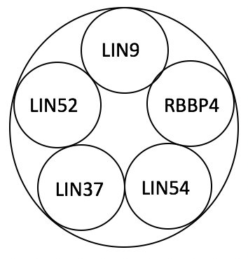
The MuvB Core
Five member protein complex
Binds to promoter regions to regulate the transcription of cell cycle genes

Slide 4
The DREAM Complex
Dimerization Partner, RB-like, E2F, and MuvB
The MuvB Core + p130
p130: RB protein related to tumor suppression
Protein Kinase, DYRK1A, phosphorylation of LIN52-S28 is required for p130 attachment
Quiescence

Slide 5
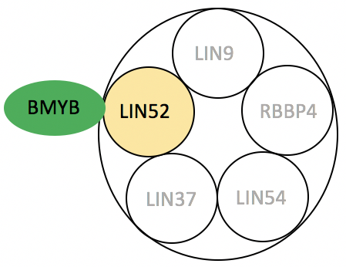
The MMB complex
Myb and MuvB
The MuvB Core + BMYB
BMYB: Transcription factor that upregulates expression of cell cycle genes
BMYB can easily and readily bind to LIN52
Entry into the Cell Cycle

Slide 6
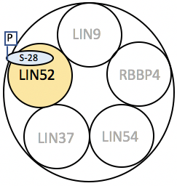
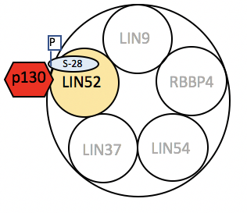
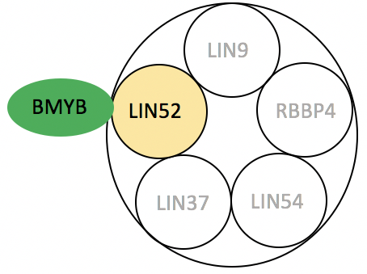
X
DYRK1A
BMYB
p130
Quiescence
DREAM
Cell Cycle
Entry
MMB

Slide 7
DYRK1A
BMYB
p130
Quiescence
DREAM
Cell Cycle
Entry
MMB

Slide 8
Proteasome
An E3 ligase is responsible for the ubiquitination of LIN52-K106. This may be a part of a greater Ubiquitin Proteasome System

Slide 9
Experimental Goal: Identify the protein(s) involved in the ubiquitination of LIN52

Slide 10
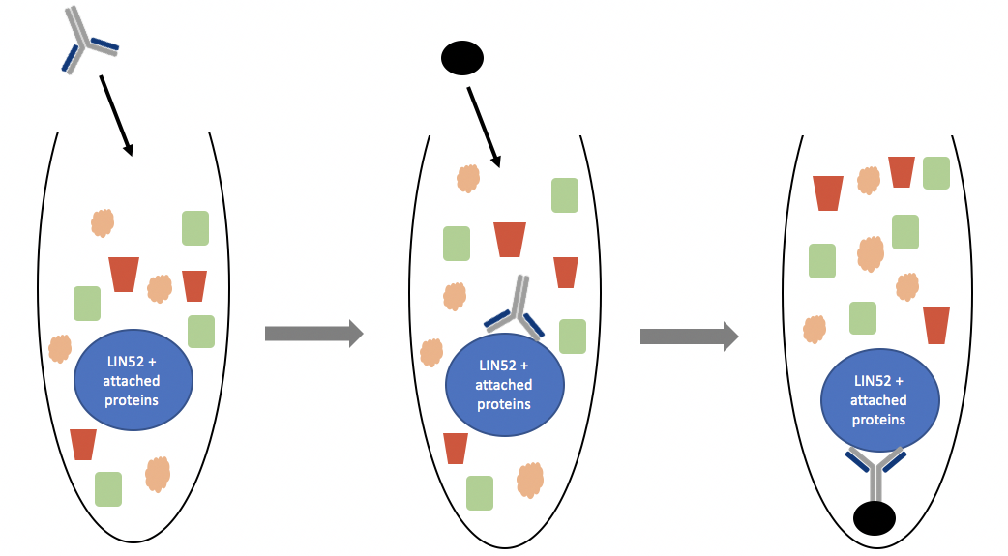
Co-Immunoprecipitation allows the isolation of LIN52 and the proteins attached to it

Slide 11
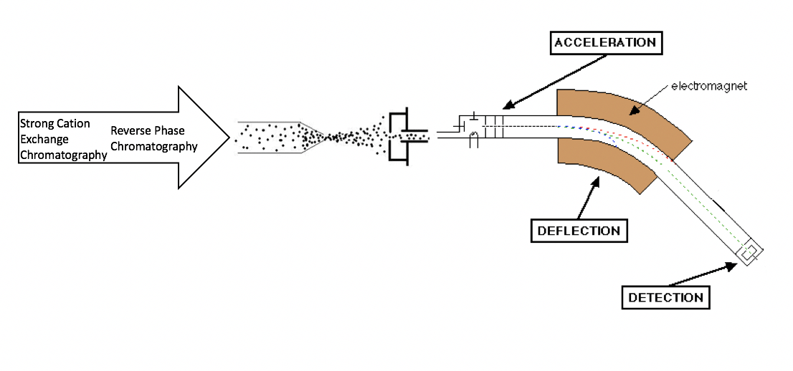
Multidimensional Protein Identification Technology (MudPIT) Mass Spectrometry of the LIN52 Sample.
Adapted from Jim Clark
Notes:
http://www.chemguide.co.uk/analysis/masspec/howitworks.html

Slide 12
Chromatography of MudPIT
Cation Exchange Chromatography
Reverse Phase Chromatography
Nonpolar proteins bind to stationary phase
Nonpolar stationary phase
Polar proteins do not bind and wash out
Notes:
SCX:
http://cbc.arizona.edu/classes/bioc460/spring/460web/lectures/LEC8-9_ProteinPurChar/LEC8-9_ProteinPurChar.html
RP: https://upload.wikimedia.org/wikibooks/en/thumb/e/e0/Reversedphase.PNG/500px-Reversedphase.PNG

Slide 13
Electrospray Ionization applies a strong electric field to a liquid sample to remove the presence of a solvent, leaving only positively charged gas ions to undergo mass spectrometry.
Notes:
http://www.waters.com/waters/en_US/Common-Ionization/nav.htm?cid=10073251&locale=en_US

Slide 14
Mass Spectrometry Model.
Ionized sample will be accelerated through electromagnet plates that cause the sample molecules to be deflected based on its size and charge.
Notes:
http://www.chemguide.co.uk/analysis/masspec/howitworks.html

Slide 15
Mass spectrometry comparative analysis to known peptide databases
Washburn Lab
Notes:
http://research.stowers.org/proteomics/DataMatch.html

Slide 16
Expected Results
MudPIT results may likely return a large pool of proteins
Focus on identifying an E3 ligase responsible for the ubiquitination of LIN52 -K106

Slide 17
DYRK1A
BMYB
p130
Quiescence
Cell Cycle
Entry
DREAM
MMB

Slide 18
