Slide 1
How Attenuation Of Microglial Cell Using Cre-Lox Can Effect Pathology of EAE Induce Mice
By Kevin Limlengco

Slide 2
Introduction
Multiple Sclerosis
Inflammatory disease of the Central Nervous System
Over 400,000 cases
2 out of 5 results in death
No cure
No known causes
Symptoms – Loss of motor Function, loss of vision etc..

Slide 3
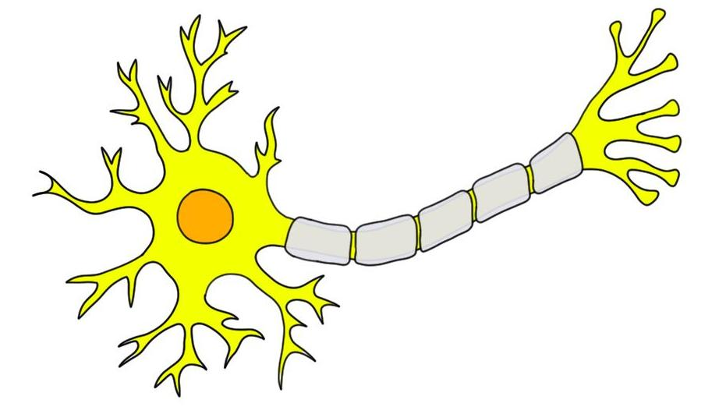
Introduction (Closer Look) - Neuron

Slide 4
Neuron During M.S.
Neuron
Inflammation
Demyelination
Degeneration

Slide 5
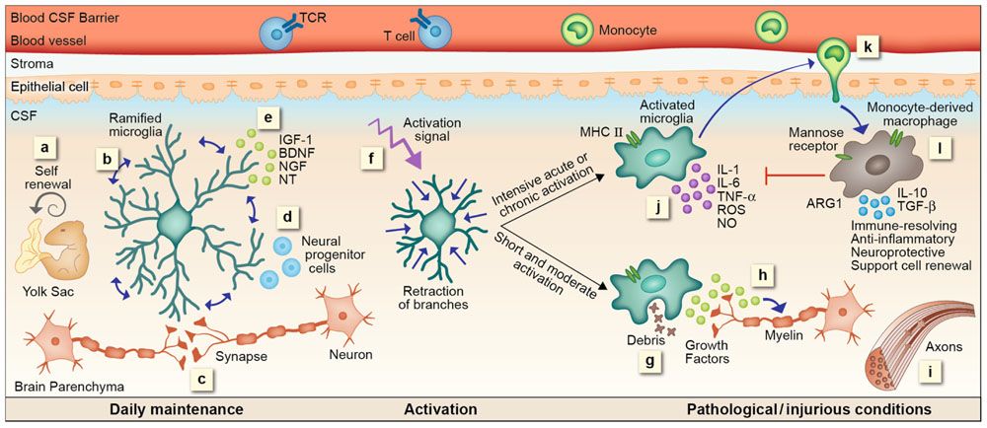
The Microglia (Good Guy)
Microglia
Residents of the CNS
Immune System
Decrease Inflammation

Slide 6
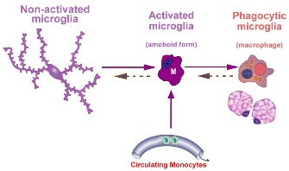
Microglia (Turned Bad)
Morphology Changes
T-cells and B Cells get Involved

Slide 7
Experiment (Clark et al. 2016)
Investigate the AIS Under Inflammatory Model
EAE Induced Mice
Assessment of mice
Didox Administration
Inhibits Replication
Intervention – Prevent and Reverse Pathology

Slide 8
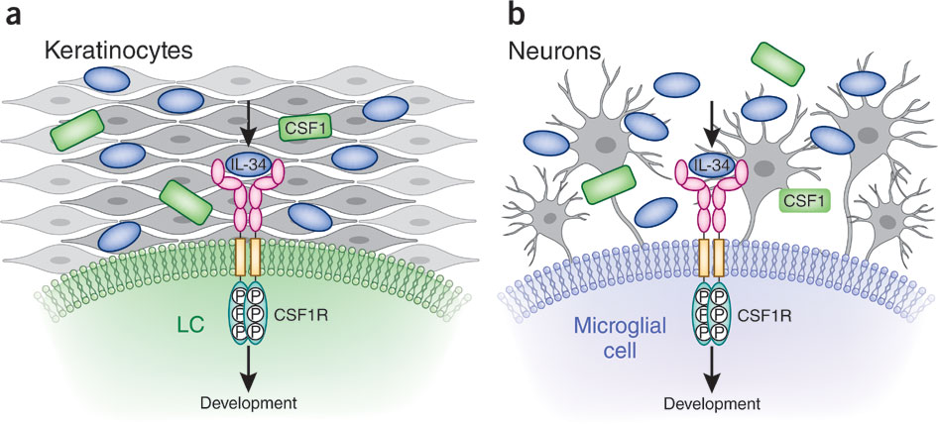
My Proposal (Background)
Colony Stimulating Factor 1 Receptor (CSF1R)
Regulator of Myeloid Lineage Cells
Necessary for Microglial Survival

Slide 9
My proposal (Inspired by Clark et al. 2016)
Cx3cr1-creER – (Allows Inducible Knockout) + CSF1R (Floxed)
Cre Recombination on the offspring

Slide 10
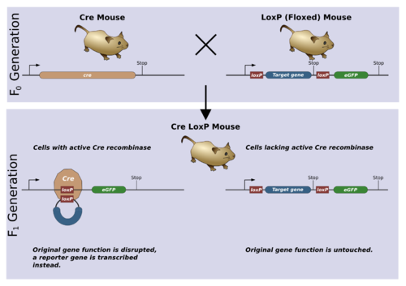
What is Cre-Recombination??

Slide 11
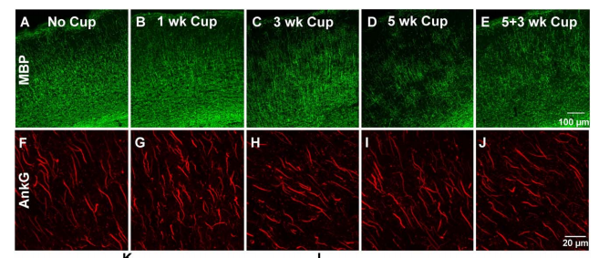
My Proposal
Induce EAE
Antibodies – Aknryn-G & Micrgolia
Visualization (Confocal Microscopy)

Slide 12
Conclusion
Attenuation of Microglia

