Slide 1
Differences in GTPase Hydrolysis rates of developmentally regulated rRNAs of Plasmodium Falciparum
EJ Kochis
Shozo Ozaki - Mentor

Slide 2
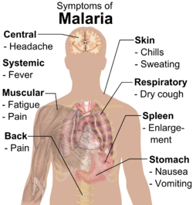
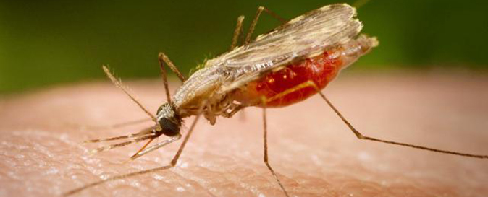
Malaria Overview
Malaria infects over 212 million people each year, mostly in developing countries
Incurring a healthcare cost of over 15 billion dollars
Malaria is caused by the Plasmodium parasite spread via mosquitos
Plasmodium Falciparum is one
of the deadliest strains

Slide 3
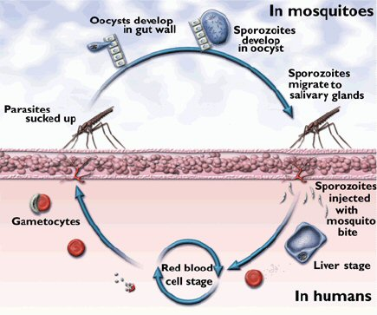
Plasmodium Life cycle
Sexual Phases in the mosquito
Asexual Phases in human host

Slide 4
Plasmodium Falciparum rRNA genes change throughout the life cycle -S type is expressed in sexual phases in mosquito -A type is expressed during asexual phases mostly in human host -There are differences in these genes!
S type
A type

Slide 5
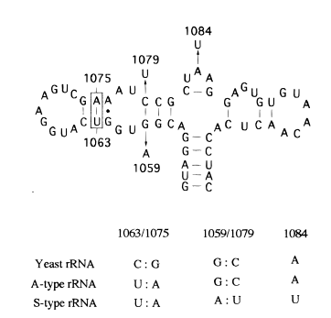
S type and A type have nucleotide differences at GTPase domain on the ribosome
The GTPase center is where GTP binds to GTP binding site to signal for protein synthesis and elongation
GTP
GTPase Center
Ribosome
GTP
GDP

Slide 6
This GTPase change has been shown to be functionally significant
Yeast
Velichutina et al 1998, Isolated only A and S type rRNA and how observed growth
A type rRNA thrived while S type rRNA was unable to colonize under most conditions
A type
S type
Further research on the GTPase site is limited

Slide 7
Central Question – Expanding upon Velichutina et al
What is the difference in GTPase hydrolysis rates between A and S type rRNA?

Slide 8
My Experiment Overview
1. A and S type rRNA genes must be cloned into yeast vectors
-3 conditions only A type, only S type and Mix
2. RNA must be extracted and sequenced to confirm successful transformation
-via RiboPure Kit and sequenced via primer extension
3. GTPase rate must be measured in A vs S type
-via Gloassay

Slide 9
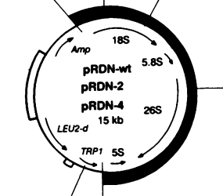
A and S type cloning
First, a yeast vector with no rDNA will be used. It will be kept alive with by a wildtype yeast rRNA gene with URA3 gene used for selection later
A and S type will be cloned into the yeast
Wild type will be selected against with FOA+ medium
A and S contain TRP1 and LEUd-2 mutations instead of URA3
Yeast with Wild type URA3
Mix of Wild type, A and S type
Only A and S type left
S
A
A
A
S
W
S
A and S cloned
S
FOA+ Selection
A
W

Slide 10
RNA extraction and Sequencing
Total yeast RNA will be extracted with RiboPure Kit from ThermoFisher
RNA will be sequenced via primer extension to determine presence of A type and S type
This will confirm presence of A type and S type with no wild type present

Slide 11
Ideal Sequencing and PCR results
3 nucleotide difference built into wild type primer to differentiate between wildtype, A and S
3 nucleotide difference apparent and wildtype is not found after FOA+ selection

Slide 12
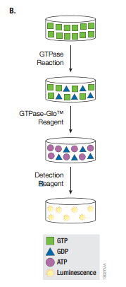
Gloassay used to measuring GTPase rate
Works by converting any leftover GTP into ATP
The ATP is formed then detected using a luciferase recombinant
GTP Hydrolysis
ATP
Light Produced
GTP Hydrolysis
ATP
Light Produced

Slide 13
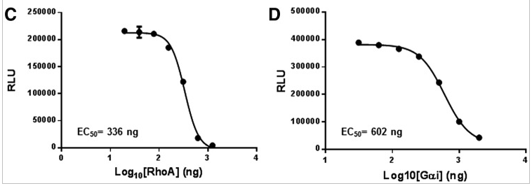
Possible Results
It is likely both types will have similar GTPase hydrolysis rates
However, if the results match with Velichutina then it is possible S type could have lower rate

Slide 14
Possible Implications and confounding variables
If one type is found to be far more efficient it could be a good target for drug therapy
Knocking out the more efficient rRNA could hinder the fitness of plasmodium
Velichutina was not able to properly grow S type colonies, that could happen in this experiment.
I would need to find another way to isolate S type rRNA

Slide 15
Questions?
Thank you for your time!

Slide 16
References
CDC. "CDC and Malaria." Internal Medicine News 38.4 (2016): 68.CDC and Malaria. Web. 29 Apr. 2017.
Chernoff YO, Vincent A, Liebman SW+ 1994+ Mutations in eukaryotic 18S ribosomal RNA affect translational fidelity and resistance to aminoglycoside antibiotics+ EMBO J 13:906–913+
Cui, Liwang, Scott Lindner, and Jun Miao. "Translational Regulation during Stage Transitions in Malaria Parasites." Annals of the New York Academy of Sciences1342.1 (2014): 1-9. Web.
Li, Jun, Robin R. Gutell, Simon H. Damberger, Robert A. Wirtz, Jessica C. Kissinger, M.john Rogers, Jetsumon Sattabongkot, and Thomas F. Mccutchan. "Regulation and Trafficking of Three Distinct 18 S Ribosomal RNAs during Development of the Malaria Parasite." Journal of Molecular Biology 269.2 (1997): 203-13. Web.
Mondal, Subhanjan, Kevin Hsiao, and Said A. Goueli. “A Homogenous Bioluminescent System for Measuring GTPase, GTPase Activating Protein, and Guanine Nucleotide Exchange Factor Activities.” Assay and Drug Development Technologies 13.8 (2015): 444–455. PMC. Web. 16 Mar. 2017.
Spaendonk, R. M. L. Van, J. Ramesar, A. Van Wigcheren, W. Eling, A. L. Beetsma, G.-J. Van Gemert, J. Hooghof, C. J. Janse, and A. P. Waters. "Functional Equivalence of Structurally Distinct Ribosomes in the Malaria Parasite, Plasmodium Berghei."Journal of Biological Chemistry 276.25 (2001): 22638-2647. Web.
Teklemariam, M., A. Assefa, H. Mohamed, and H. Mamo. "Therapeutic Efficacy of Artemether- lumefantrine against Uncomplicated Plasmodium Falciparum Malaria in a High-transmission Area in Northwest Ethiopia." PloS One 12.4 (2017): n. pag.Pubmed. Web. 29 Apr. 2017.
ThermoFisher. "The Basics: RNA Isolation." Thermo Fisher Scientific. N.p., n.d. Web. 29 Apr. 2017.
Rogers MJ, Gutell RR, Damberger SH, Li J, McConkey GA, Waters AP, McCutchan TF+ 1996+ Structural features of the large subunit rRNA expressed in Plasmodium falciparum sporozoites that distinguish it from the asexually expressed subunit rRNA+ RNA 2:134– 145+
Velichutina, Irina V., M. John Rogers, Thomas F. Mccutchan, and Susan W. Liebman. "Chimeric RRNAs Containing the GTPase Centers of the Developmentally Regulated Ribosomal RRNAs of Plasmodium Falciparum Are Functionally Distinct."Rna 4.5 (1998): 594-602. Web.
Xue, Shifeng, and Maria Barna. “Specialized Ribosomes: A New Frontier in Gene Regulation and Organismal Biology.” Nature reviews. Molecular cell biology 13.6 (2012): 355–369. PMC. Web. 16 Feb. 2017

