Slide 1
Maltose and Maltotriose Use by Different Saccharomyces Clades
By: Jacob Jaminet
Mentor: Stephen Fong

Slide 2
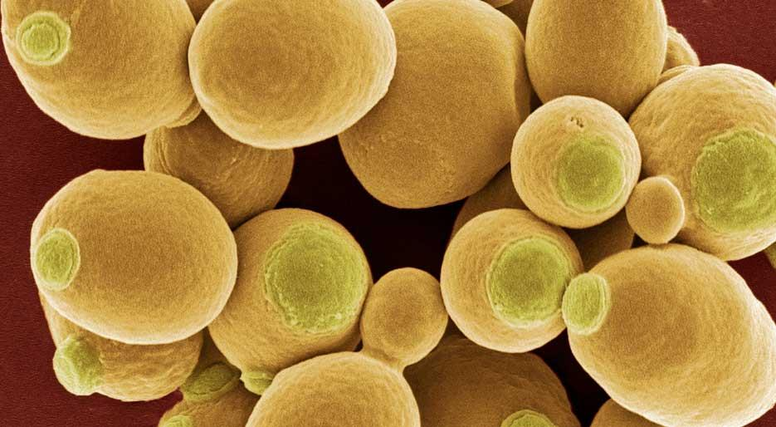
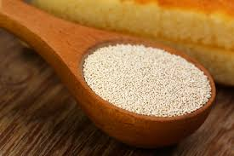
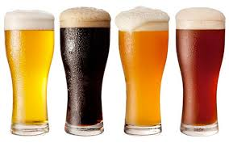
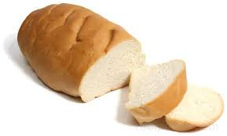
Saccharomyces cerevisiae
Notes:
Saccharomyces cerevisae = baker’s yeast
Been used for millenial for variety of purposes:
Preservation
Bread Making
Brewing

Slide 3
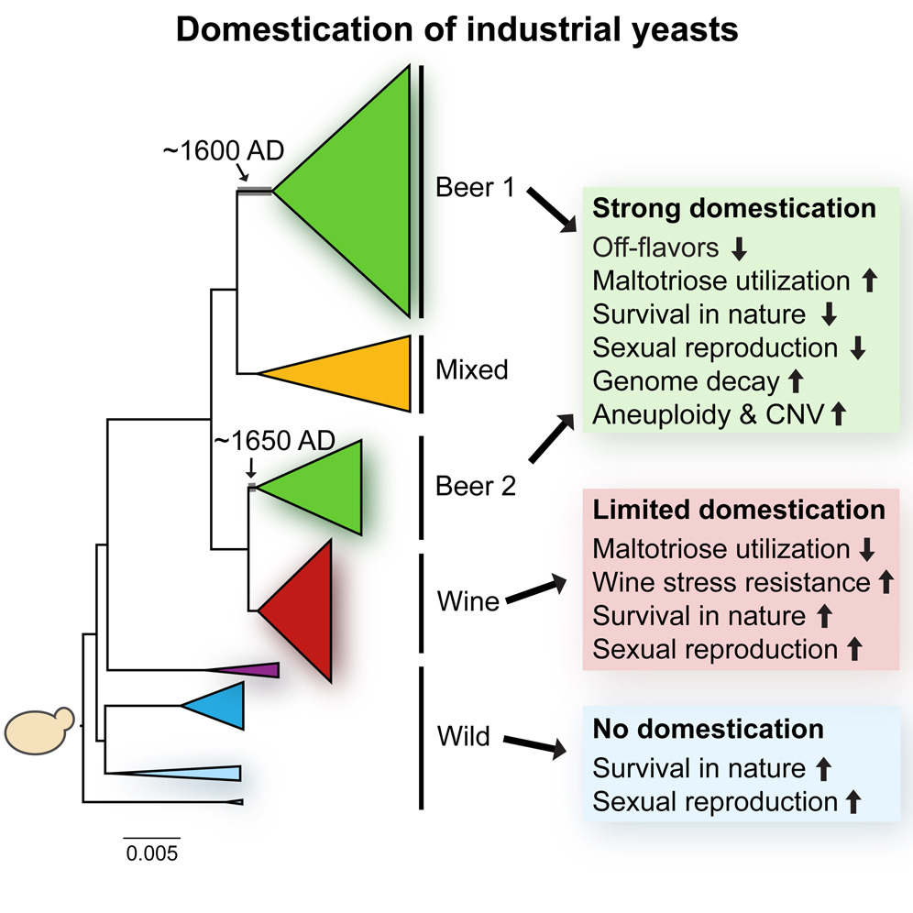
Clades
Diverged by geography and by culinary usage

Slide 4
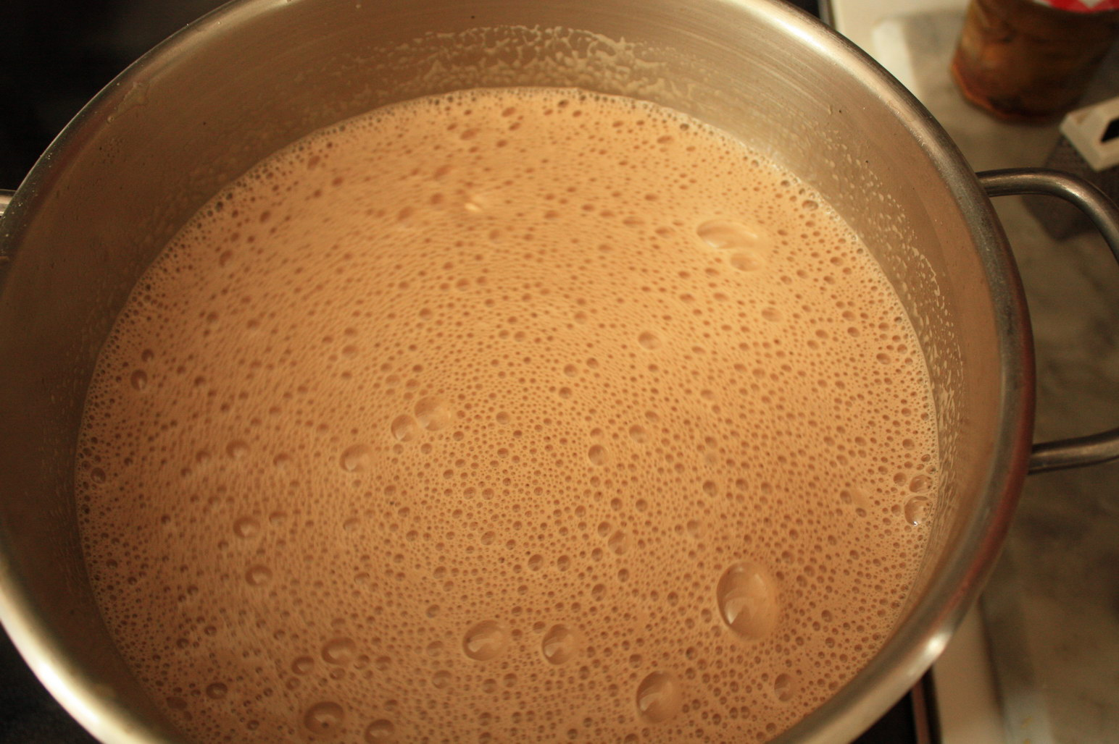
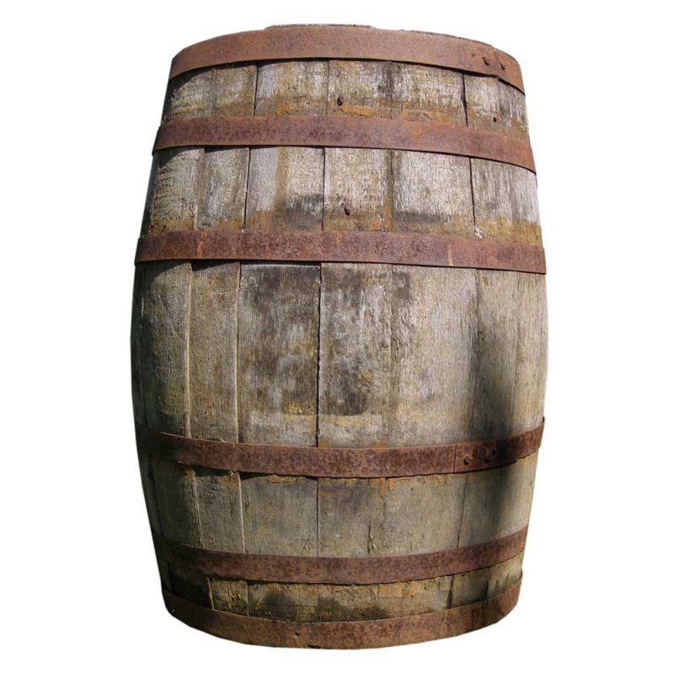
Beer Wort
Glucose (~15%)
Maltose (~60%)
Maltotriose (~20%)

Slide 5
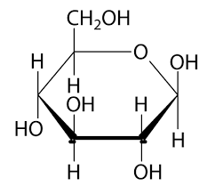
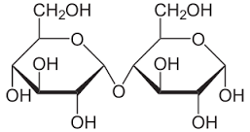
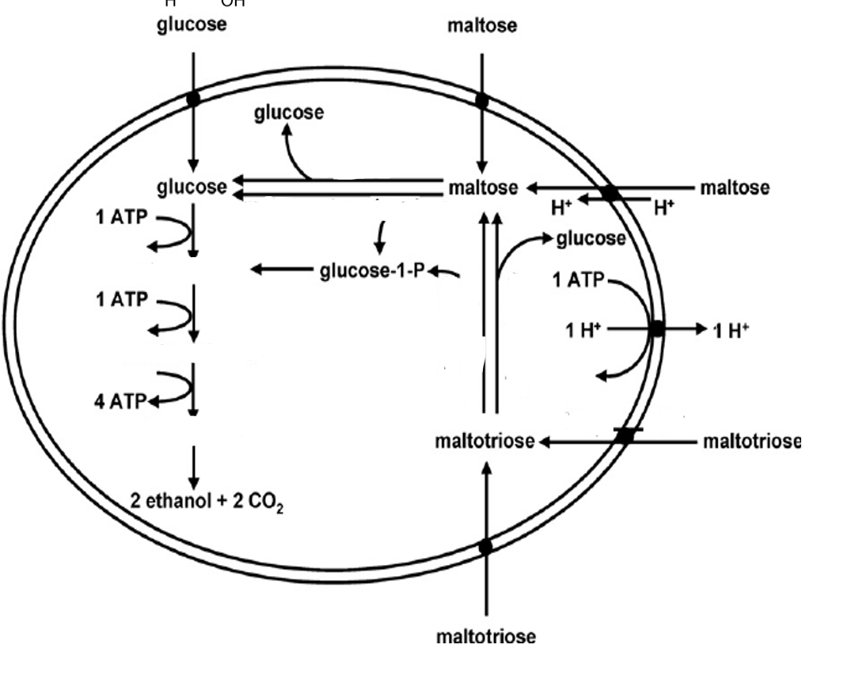
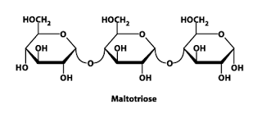
Sugars Used

Slide 6
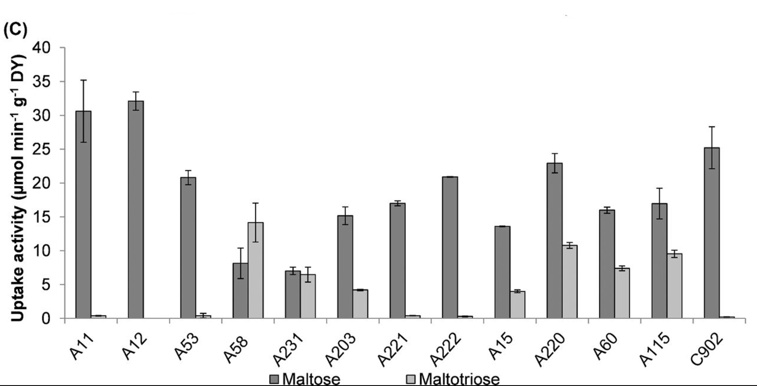
Is uptake the limiting reaction?
High uptake
Strains with highest uptake
A11
A12
A53
C902

Slide 7
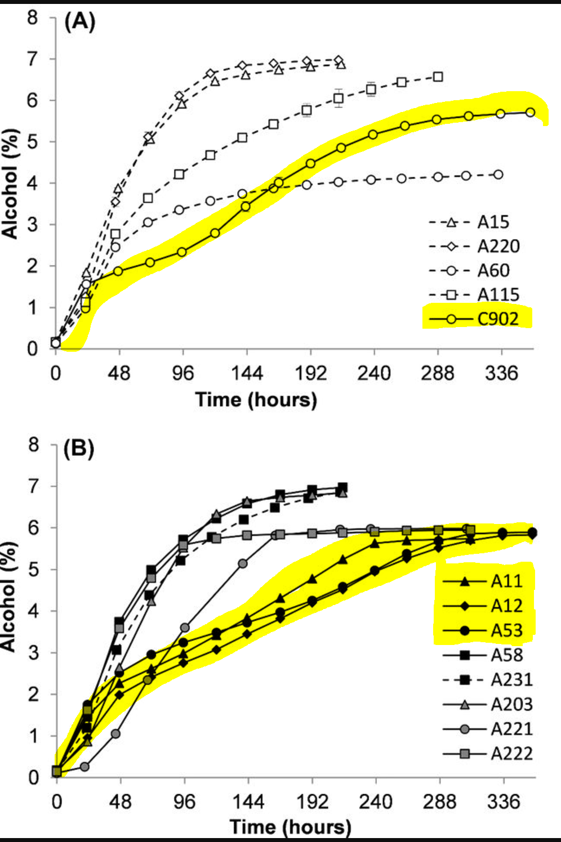
Fermentation Rates
Larger slope = faster fermentation
Smaller slope = slower fermentation
Strains with highest uptake
C902
A11
A12
A53

Slide 8
How do we measure uptake?
Measure the sugar being extracted from the wort.
Measure the alcohol produced.
Measure the uptake itself
1. Zero-trans assay
2. Proton Symport Assay

Slide 9
Measuring Uptake: Zero-trans
Heavy sugar (carbon-14)
Transport protein
Yeast

Slide 10
Measuring Uptake: Zero-Trans

Slide 11
Measuring Uptake: Zero-trans
Can overestimate uptake if
contaminants enter the cell

Slide 12
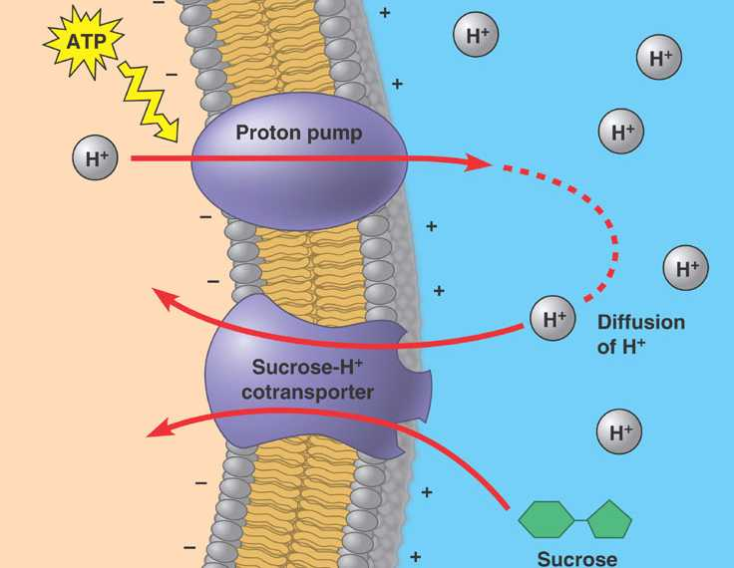
Measuring Uptake
Proton Measurement
pH: 6

Slide 13
Measuring Uptake: Proton Co-Transport Assay
pH: 6
pH: 7
pH: 6
pH: 6

Slide 14
Measuring Uptake: Proton Co-Transport
Avoids overestimation from contaminents
pH: 6

Slide 16
Impact
Understand how different clades use sugars
Taste
Efficiency
Glucose (~15%)
Maltose (~60%)
Maltotriose (~20%)

Slide 17
References
Gallone B Steensels J Prahl T Soriaga L Saels V et. al. Cell 2016 vol: 166 (6) pp:1397-1410.e16
Alves S L Herberts R A Hollatz D T Miletti L C de Araujo P S Stambuk B U App and Env Microbio vol: 74 (5) pp: 1494-1501
Magalhães F Vidgren V Ruohonen L Gibson B; Maltose and maltotriose utilisation by group I strains of the hybrid lager yeast Saccharomyces pastorianus. FEMS Yeast Res 2016; 16 (5): fow053. Doi:10.1093/femsyr/fow053

Slide 18
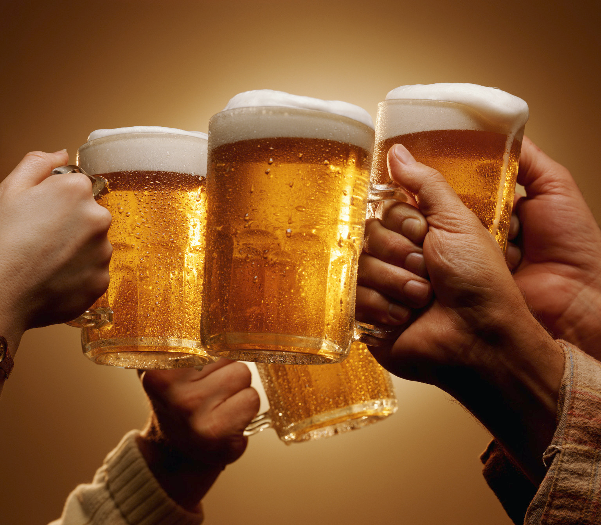
Cheers! / Questions?

