Slide 1
Measurement of Changes in Force Generation of Cardiomyocytes through the Down Regulation of Vinculin using CRISPR-Cas Gene Editing
Fadi Hijaz
Virginia Commonwealth University
Center for the Study of Biological Complexity

Slide 2
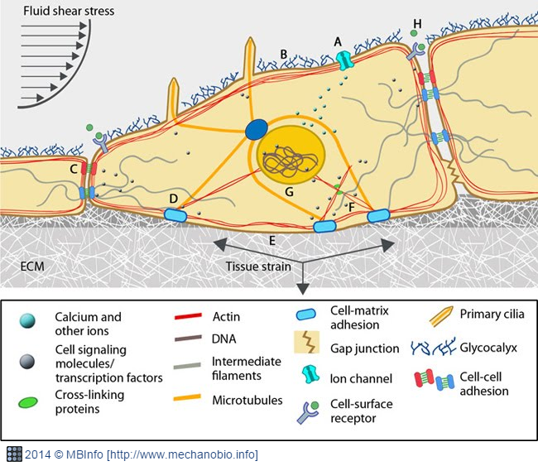
Mechanobiology
Cells are intrinsically mechanosensitive
Experience externally & internally applied forces
Force Dictates…
Development
Gastrulation
Disease

Slide 3
Mutations & the Effects
Dilated Cardiomyopathy (DCM)
Hypertrophic Cardiomyopathy

Slide 4
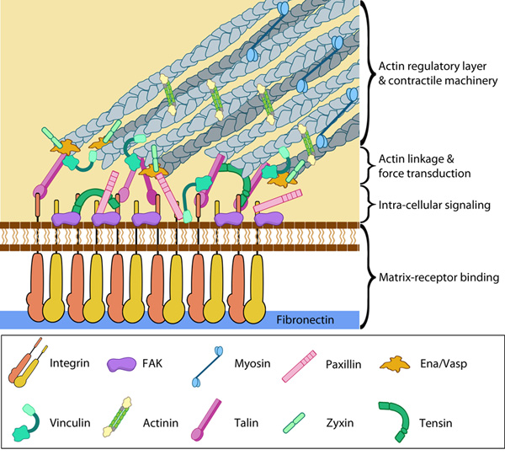
Role of the Cytoskeleton
Cell shape, muscle contraction, mitosis, migration, etc.
Mechanotransduction
4 Zones
Matrix-Receptor Binding
Intra-cellular signaling
Actin linkage & force transduction
Actin Regulatory layer & contractile machinery

Slide 5
Vinculin
https://doi.org/10.1016/j.febslet.2013.02.042

Slide 6
Experiment Overview
Cardiomyocyte Mutation
Create a Vcl KO mouse through use of Clustered Regularly Interspaced Short Palindromic Repeats (CRISPR) associated genes (Cas9)
Introduce edited embryos to female oviducts
Collect cardiac cells from ko and wild type control mice (verified by protein analysis)
Functional analysis
Grow cardiac cells on microfabricated postarray deflection device (mPAD)
Use data measured to interpret vinculin performance in ko & wt

Slide 7
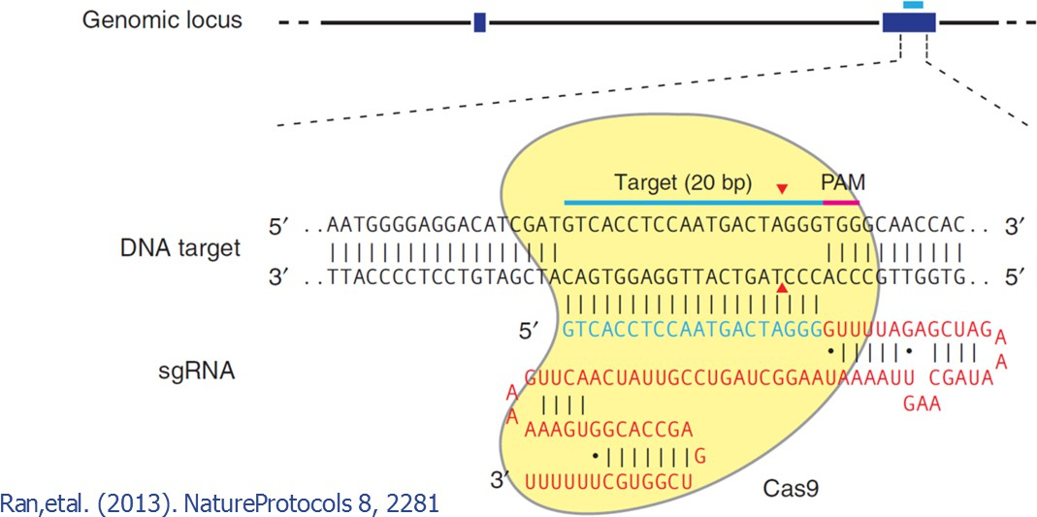
CRISPR-Cas9 to induce a Vinculin knockout

Slide 8
Factors to Consider in CRISPR-Cas Experimentation
The spacer; crRNA (20-25 nucleotide)
Unique to the genome
Immediately upstream from PAM
Protospacer Adjacent Motif (PAM)
5’-NGG-3’
The scaffold; tracrRNA (42 nucleotides)
Vcl crRNA | gRNA Target Sequence
1 | TTCCCCTAGAGCCGTCAATG
2 | GCGCGGGATTACCTCATTGA
3 | CCAGGAACACCGTGTGATGT
4 | TTCAGGTTCGTAAAATTATT
5 | GTTACTCACTTAATAAAGGC
6 | TGCCCCAGGAATGACTAAGA
http://www.genscript.com/gRNA-detail/mouse/22330/Cas9/Vcl-CRISPR-guide-RNA.html#grna

Slide 9
Mutations of Vinculin
Non-Homologous End Joining
Fixes the Double Strand Break (DSB)
Insertions and Deletions of Nucleotides
Possible-mutations
Frameshifts
Loss of Vital amino acid
Insertion of amino acid causing obstruction
Premature STOP codon
No effect
Do this many times with different sgRNA until KO occurs.
*Not all pups will survive*
https://www.addgene.org/crispr/guide/

Slide 10
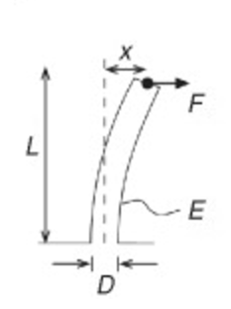
mPADs and the Functional Analysis Experiment
$$F=\frac{3π{ED}^{4}}{64L^{3}}x$$
https://doi.org/10.1016/S0091-679X(07)83013-5

Slide 11
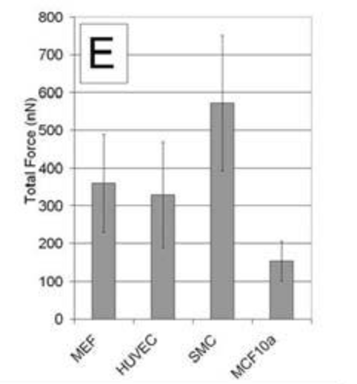
Results we expect to see…
PMCID: PMC1480360

Slide 12
Questions and Comments

