Slide 1
The role of microglia in regulating axon initial segment integrity in health and disease

Slide 2
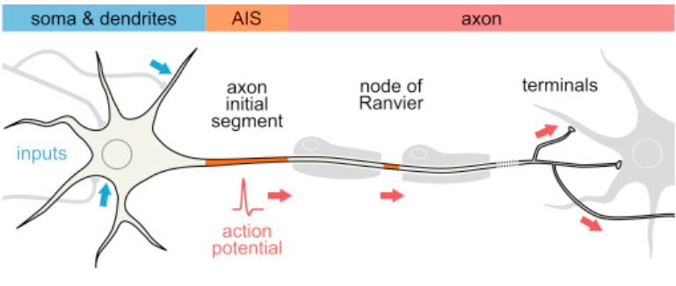
Multiple Sclerosis (MS)
myelin
sheath

Slide 3
The axon initial segment (AIS)
AIS stability independent of demyelination
Inflammation disrupts AIS-- What affects inflammation?

Slide 4
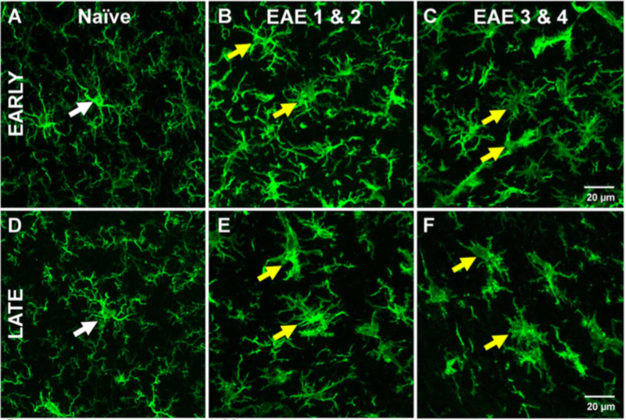
Microglia
Surveying
(non-reactive)
Reactive
Surveying phenotype (white arrows) and Reactive phenotype (yellow arrows)

Slide 5
Microglia vs. AIS
In healthy subject
-- surveying phenotype
In inflammatory model of MS (EAE)
-- reactive phenotype
In brain injury (TBI)
-- reactive phenotype
Surveying phenotype (white arrows) and
Reactive phenotype (yellow arrows)

Slide 6
Focus
Do surveying microglia support the AIS?
Do reactive microglia damage the AIS?
Experiment
Remove microglia
Examine consequence to AIS: length, number, function

Slide 7
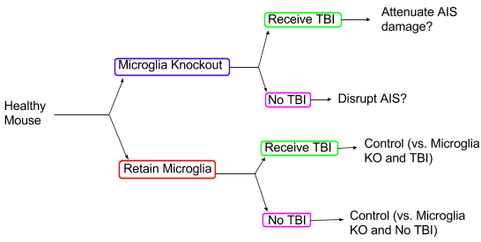
Healthy CNS
Surveying microglia may support AIS → no surveying microglia → decrease health AIS?
CNS after traumatic brain injury (TBI)
Microglial activation follows TBI
Remove microglia → no reactive microglia → reduce damage to AIS?

Slide 8
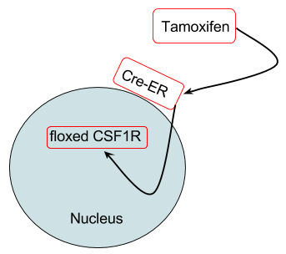
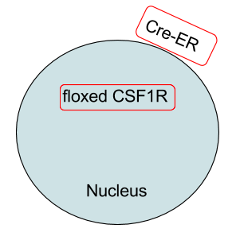
Removal microglia
colony stimulating factor 1 receptor (CSF1R) → gene produces microglia
(Cre)/LoxP ablation → knockout CSF1R
floxed (flanking LoxP) mouse → LoxP: specific amino acid sequence target site
Cx3cr1^{Cre-ER} mouse
IBA-1 immunostaining → assess KO

Slide 9
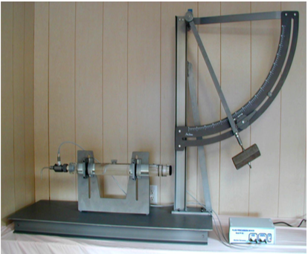
Method TBI
Central fluid percussion

Slide 10
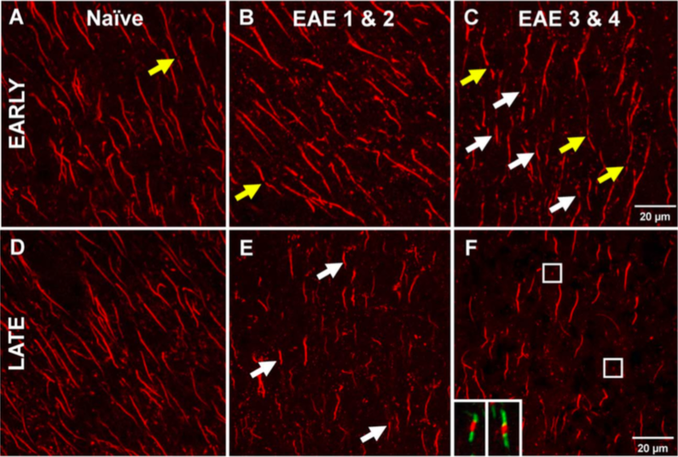
AIS analysis
length and number
Function (EP)
shortened AIS (white arrows) and fragmented AIS
(yellow arrows)

Slide 11
Discussion
Healthy (no TBI) mice
Surveying microglia support AIS
TBI mice
Small population surveying microglia supports
Small population reactive microglia disrupts
Is reactivity//disruption more consequential?
Desired result
Remove microglia in health → no support from surveying microglia → AIS disruption
Remove microglia in TBI → no exacerbation from reactive microglia → attenuate AIS disruption

