Slide 1
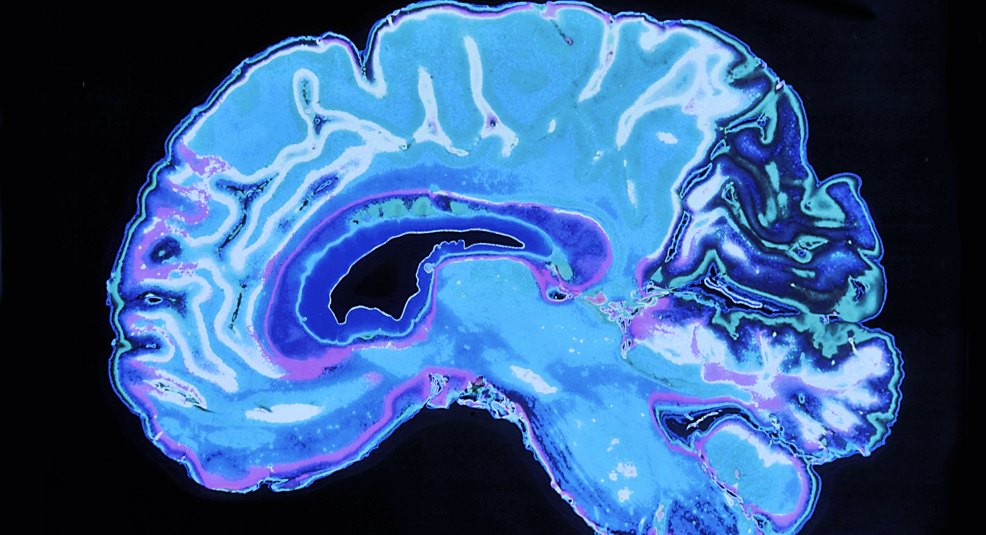
THE PATH TO THE BRAIN
Transendothelial Leukocyte Migration
And Scientific Writing
Sailasya Gundlapudi
BNFO 301

Slide 3
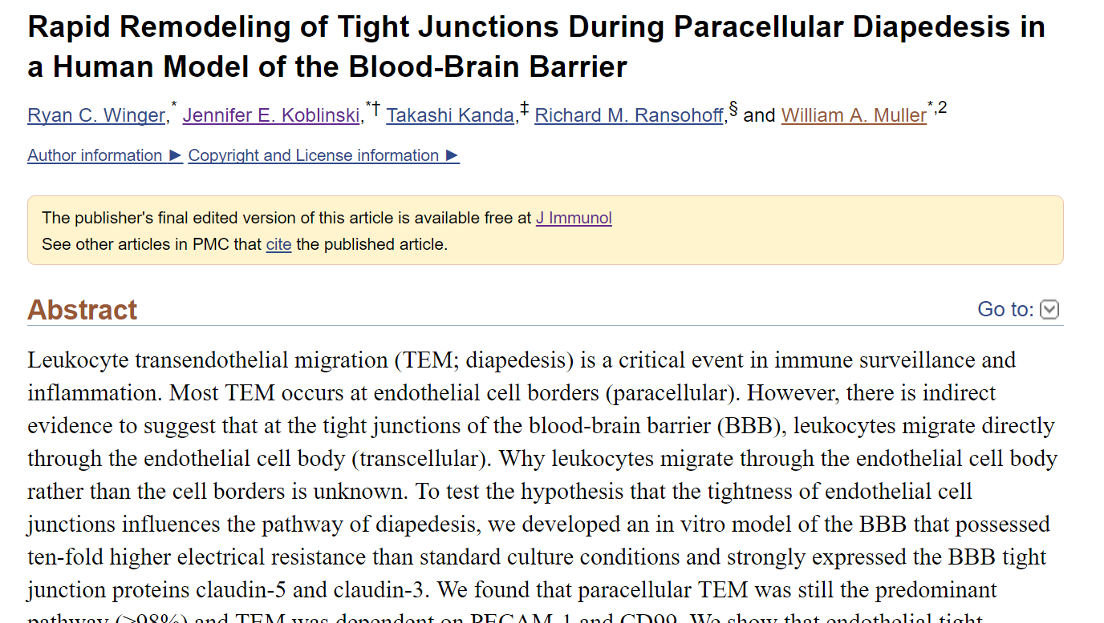

Slide 4
How does anything reach the brain?
Central Nervous System
Blood Brain Barrier
Endothelial cells line the blood vessels

Slide 5
Leukocytes can Enter the Brain
White blood cells
Fight infection
Linked to multiple sclerosis, stroke, and other neurological disorders

Slide 6
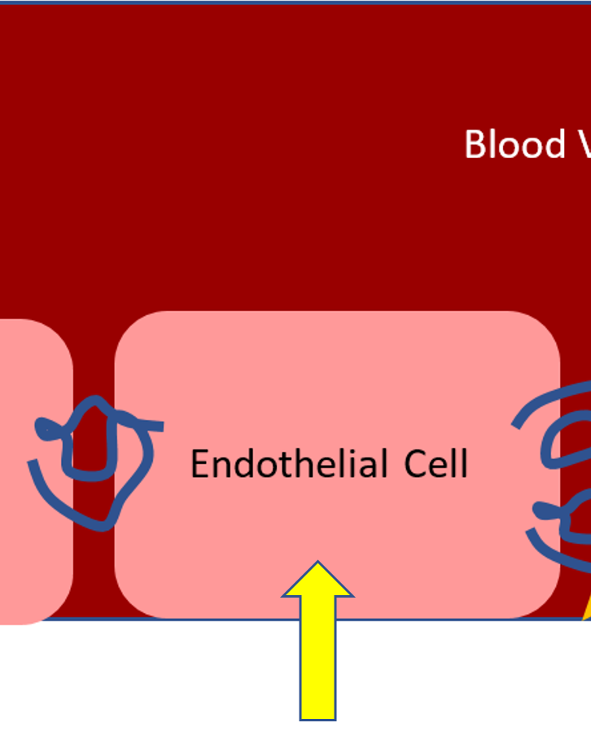
How do Leukocytes cross Endothelial Cells?
Paracellular Migration
Transcellular Migration
The smaller the gap between endothelial cells, the more likely leukocytes would migrate transcellularly.

Slide 7
Making a Model of the Blood Brain Barrier
+ CPT-CAMP + Astrocytes

Slide 8
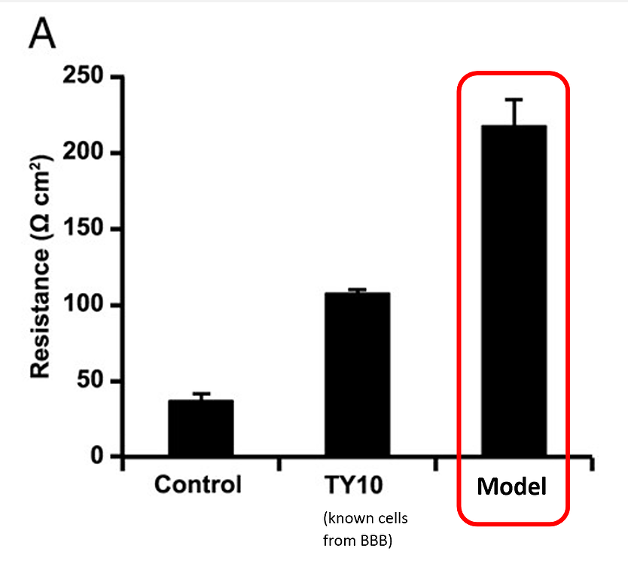
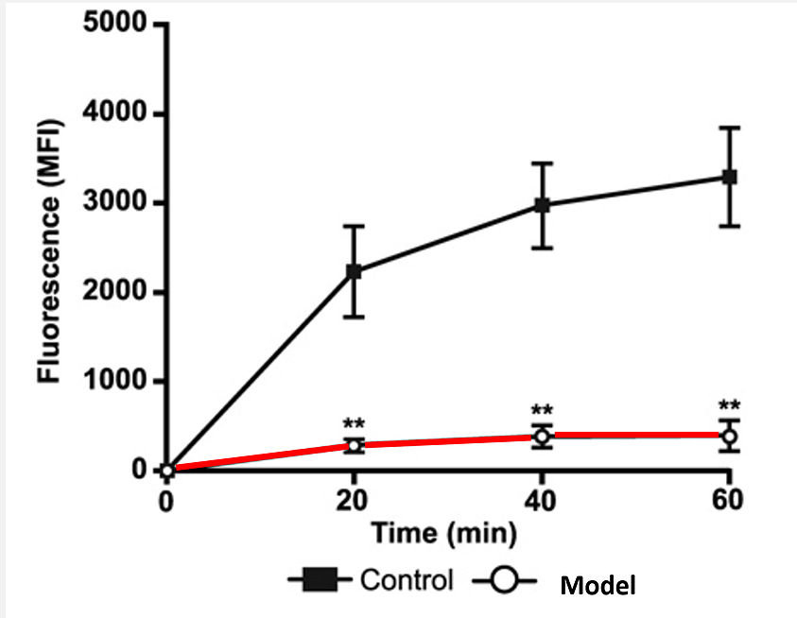
Does the model represent the blood brain barrier?
Flourescein Isothiocynate Dextran Permeability
Trans endothelial electrical resistance (TEER)

Slide 9
Paracellular vs. Transcellular Migration
Experiment 1: How many leukocytes migrate through the cell vs. in between the gaps?
Two groups of cell models
Migration for one hour

Slide 10
Leukocytes Migrate Paracellularly
In the end, how did leukocytes migrate across the endothelial cells?
>98% migrated paracellularly
But what happens to tight junctions as leukocytes cross?

Slide 11
Tight Junctions During Migration
Stained claudin-5, a protein that forms tight junctions
Observed tight junctions during migration
TIGHT JUNCTIONS DISSAPEAR DURING MIGRATION

Slide 12
LEUKOCYTES MIGRATE PARACELLULARLY
Even when endothelial cells are tightly packed together
Tight junctions in endothelial cells reform themselves to accommodate incoming molecules
Could potentially lead to a method of controlling leukocyte migration to the brain
Maybe eventually treating neurological disorders like MS and stroke

Slide 13
QUESTIONS

