Slide 1
Creating zebrafish models of novel NRAP variants using CRISPR/cas9
Photo courtesy of Darryl Leja, National Human Genome Research Institute
Ryan Duong

Slide 2
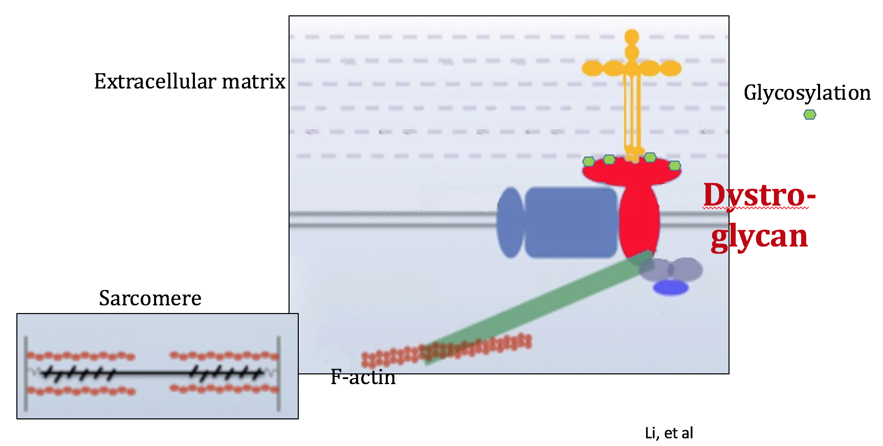
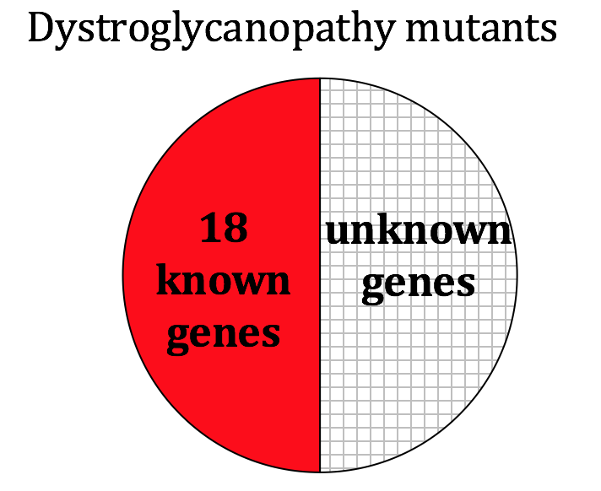
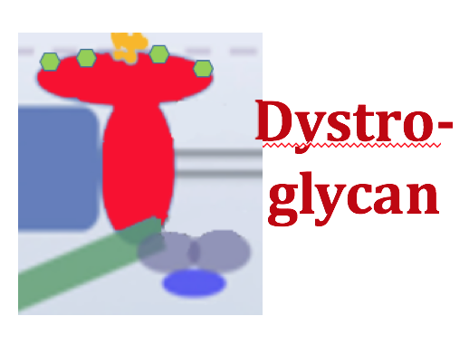
Dystroglycanopathy

Slide 3
NRAP mutations associated with dystroglycanopathy
intron
Gene and primary transcript
WT
Excise introns
mRNA
Missense A1270T
Splice site mutation
Excise introns
mRNA

Slide 4
Is there a causative effect between the patient’s NRAP genotype and decreased glycosylation of dystroglycan?
NRAP

Slide 5
Experimental Overview
Make an zebrafish model
2. Look for glycosylated alpha dystroglycan
3. If it is decreased, then YES

Slide 6
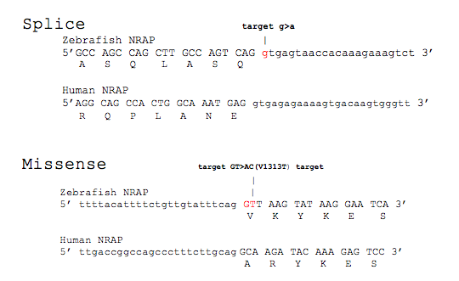
Finding corresponding zebrafish NRAP mutations that will mimic the human variants

Slide 7
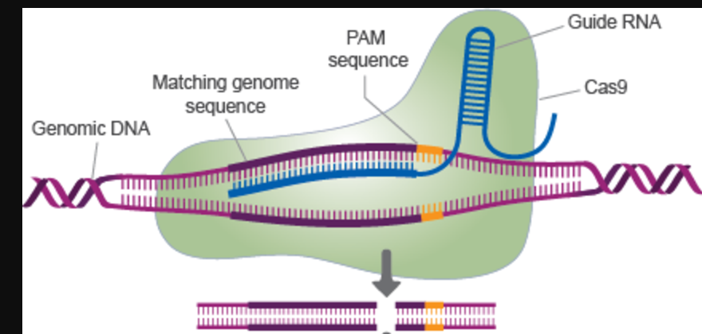
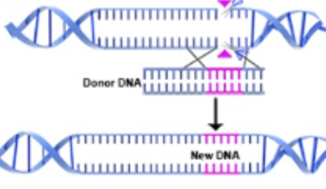
Using CRISPR/cas9 to create zebrafish NRAP mutants
Homology Directed Repair

Slide 8
Splice
5’ GGCCAGCCAGCTTGCCAGTCAGGTGAGTAACCACA 3’
|||||||||||||||||||||||||||||||||||
3’ CCGGTCGGTCGAACGGTCAGTCCACTCATTGGTGA 5’
WT MUTATION LOCUS
5’ GGCCAGCCAGCTTGCCAGTCAGGTGAGTAACCACA 3’
GGCCAGCCAGCTTGCCAGTC
||||||||||||||||||||
3’ CCGGTCGGTCGAACGGTCAGTCCACTCATTGGTGA 5’
gRNA attaches upstream of PAM
Cas9 DSB cleavage
5’ GGCCAGCCAGCTTGCC AGTCAGGTGAGTAACCACA 3’
|||||||||||||||| |||||||||||||||||||
3’ CCGGTCGGTCGAACGG TCAGTCCACTCATTGGTGA 5’
Donor DNA
5’ CCAGCCAGCTTGCCAGTCAGATGAGTAACCACA 3’
5’ GGCCAGCCAGCTTGCCAGTCAGATGAGTAACCACA 3’
|||||||||||||||||||||||||||||||||||
3’ CCGGTCGGTCGAACGGTCAGTCTACTCATTGGTGA 5’
Integration of target mutation via HDR

Slide 9
Missense
WT MUTATION LOCUS
5’ ATTTTCTGTTGTATTTCAGGTTAAGTACAAGGAATCATGGAATGTGCTT 3’
|||||||||||||||||||||||||||||||||||||||||||||||||
5’ TAAAAGACAACATAAAGTCCAATTCATGTTCCTTAGTACCTTACACGAA 5’
5’ ATTTTCTGTTGTATTTCAGGTTAAGTACAAGGAATCATGGAATGTGCTT 3’
TGTATTTCAGGTTAAGTACA
||||||||||||||||||||
5’ TAAAAGACAACATAAAGTCCAATTCATGTTCCTTAGTACCTTACACGAA 5’
gRNA attaches upstream of PAM
Cas9 DSB cleavage
5’ ATTTTCTGTTGTATTTCAGGTTAAGT ACAAGGAATCATGGAATGTGCTT 3’
|||||||||||||||||||||||||| |||||||||||||||||||||||
5’ TAAAAGACAACATAAAGTCCAATTCA TGTTCCTTAGTACCTTACACGAA 5’
Donor DNA
5’ TTCTGTTGTATTTCAGACTAAGTACAAGGAATCATGGAATG 3’
Integration of target mutation via HDR
5’ ATTTTCTGTTGTATTTCAGACTAAGTACAAGGAATCATGGAATGTGCTT 3’
|||||||||||||||||||||||||||||||||||||||||||||||||
5’ TAAAAGACAACATAAAGTCCGATTCATGTTCCTTAGTACCTTACACGAA 5’

Slide 10
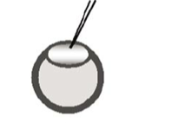
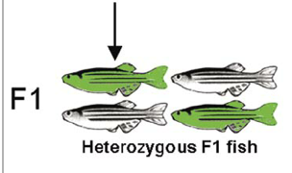
Transfection of CRISPR/cas9 components
gRNA, cas9 mRNA, donor DNA

Slide 11
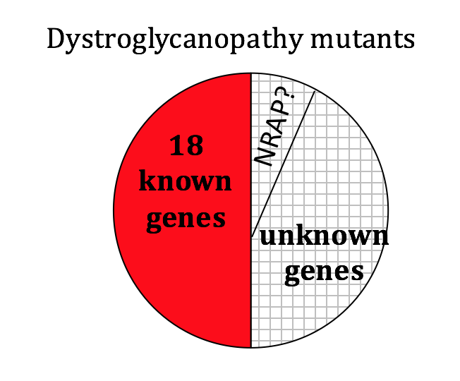
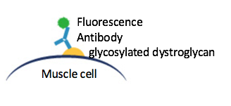
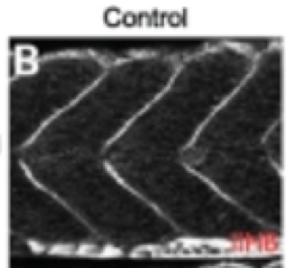
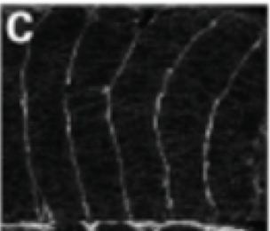
Examining mutant NRAP lines to show NRAP variants’ involvement in pathogenicity
Is there a causative effect between the patient’s NRAP genotype and decreased glycosylation of dystroglycan?
Mutant Zebrafish NRAP lines
splice/WT
Missense/WT
Splice/missense

