Slide 1
Measurement of the p38 signaling pathway in the Pro253Arg mutation of FGFR2 in Apert syndrome
Kaivalya Dandamudi

Slide 2
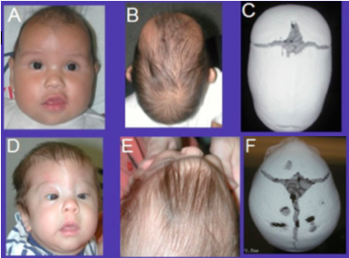
BIRTH DEFECTS A SEVERE PROBLEM
1 in 33 newborns in the U.S. are born with birth defects
Craniofacial birth defects make up 1/3 of birth defects
Craniosynostosis: most common craniofacial birth defect
(Center for Disease Control and Prevention, 2016)
(Center for Disease Control and Prevention, 2016)

Slide 3
BONE DEVELOPMENT TWO PROCESSES
Intramembranous ossification
bone tissue
Endochondral ossification
cartilage tissue

Slide 4
APERT SYNDROME A SEVERE FORM OF CRANIOSYNOSTOSIS
(Koka, 2016)

Slide 5
APERT SYNDROME CAUSES TWO MUTATIONS
Mutations in the fibroblast growth receptor 2 (FGFR2) gene
Ser252Trp mutation
Pro253Arg mutation

Slide 6
FGFs & FGFRs TYPICAL STRUCTURE AND FUNCTION
Extracellular binding domain
Intracellular domain
Transmembrane region
(Su, Jin, & Chen, 2014)

Slide 7
FGFs & FGFRs PLAY A ROLE IN ENDOCHONDRAL BONE FORMATION
Extracellular binding domain
Intracellular domain
Transmembrane region
(Su, Jin, & Chen, 2014)

Slide 8
EXPERIMENT GOAL
Determine if the p38 signaling pathway is involved in the Pro253Arg mutation of FGFR2 through a Western Blot Analysis

Slide 9
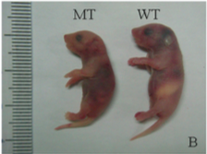
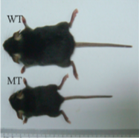
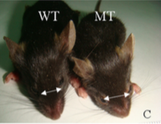
WESTERN BLOT ANALYSIS STEP 1: BMSCs obtained from a mouse model
(Chen, et al., 2014)

Slide 10
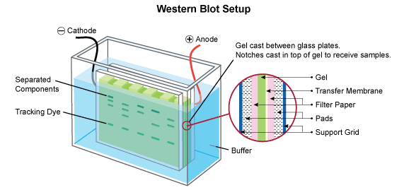
WESTERN BLOT ANALYSIS STEP 2: Set up
Protein concentrations in lysate determined
Protein samples are heated to denature and give them a net negative charge
Gel electrophoresis
Electrophoretic transfer
Figure 3 Western Blot Setup (Leinco Technologies, 2017)

Slide 11
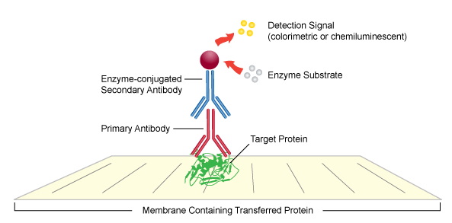
WESTERN BLOT ANALYSIS STEP 3: Detection
Target proteins:
p38 and phospho-p38
Primary antibodies:
p38- rabbit antibody #9212
phospho-p38- rabbit antibody #9211
Secondary antibody:
anti-rabbit IgG HRP-linked antibody
Indirect chemiluminescence detection method
Antibodies detected with substrate
Figure 4 Indirect detection method in Western Blots

Slide 12
DISCUSSION POSSIBLE OUTCOMES
Figure 2 Western Blot Results
WT= wild type mice
MT = mutant mice
(Chen, et al., 2014)

Slide 13
DISCUSSION FUTURE STEPS
How is the p38 pathway involved in bone development?
What exactly does the p38 pathway affect in bone development?
New treatment methods using p38 modulator for Apert syndrome

