Slide 1
Cannabinoid-Receptor Interacting Protein 1a (CRIP1a) effects on CB1 Inverse Agonists
Erin Cochran

Slide 2
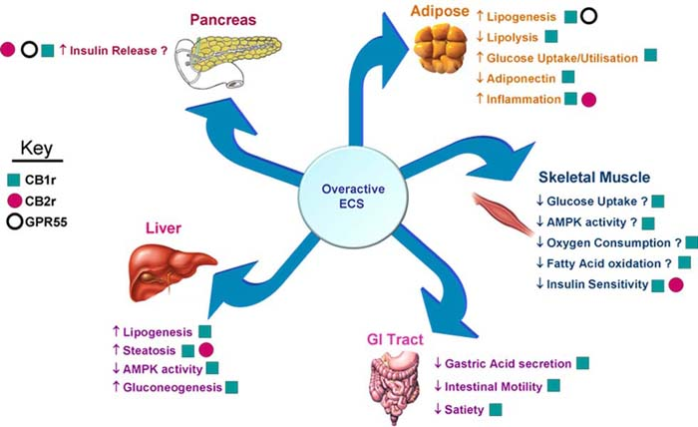
Endocannabinoid System

Slide 3
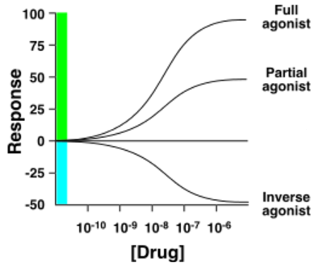
Pharmacology Terms
Basal or Constitutive activity- physiological response in the absence of an agonist or inverse agonist
Agonist- ligand that increases basal activity
Inverse Agonist- a ligand that inhibits or eliminates basal activity

Slide 4
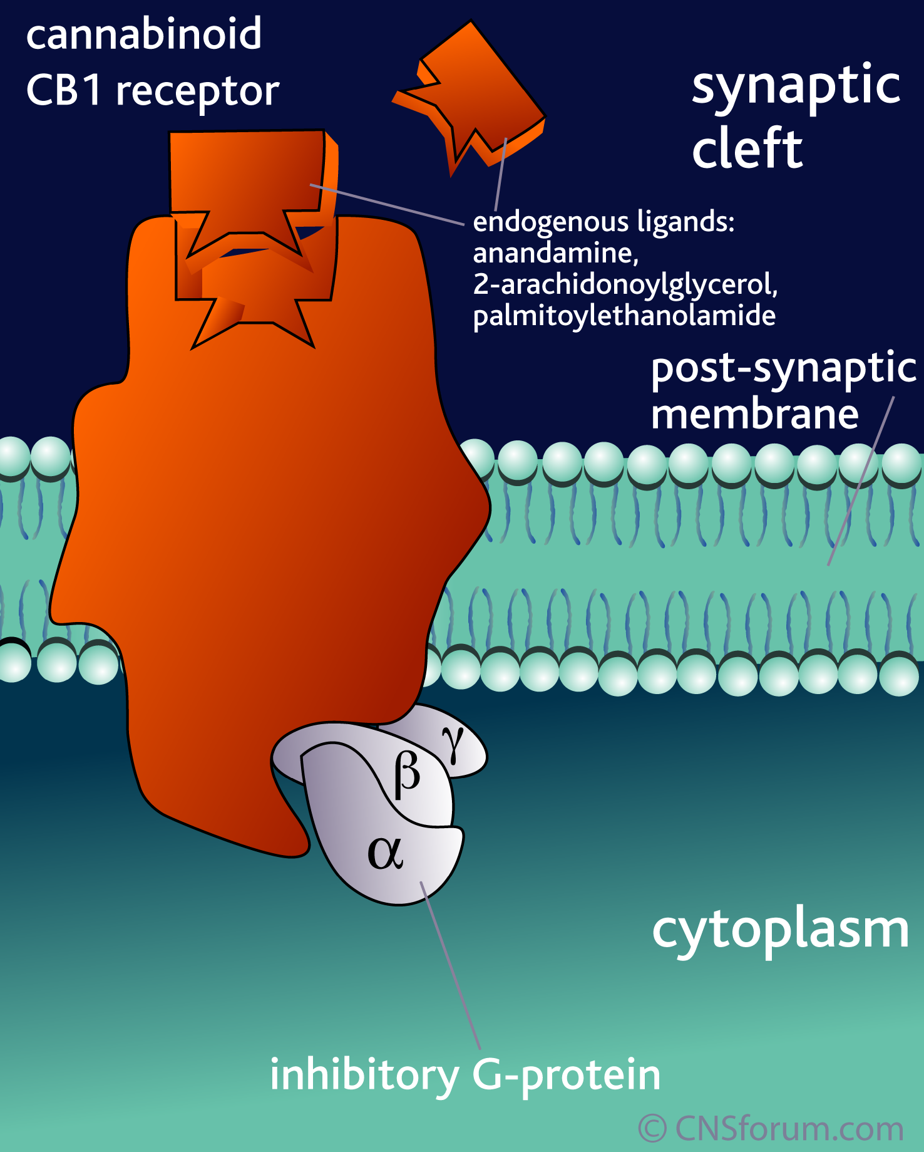
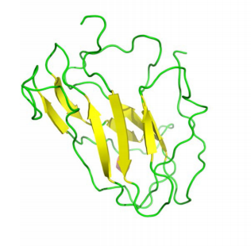
CB1 CRIP1a
Ahmed et al. 2015

Slide 5
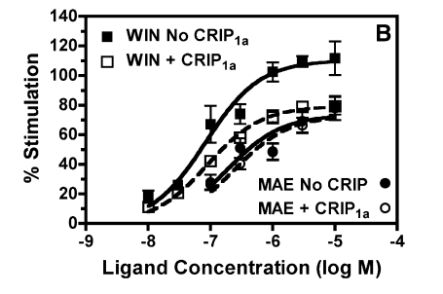
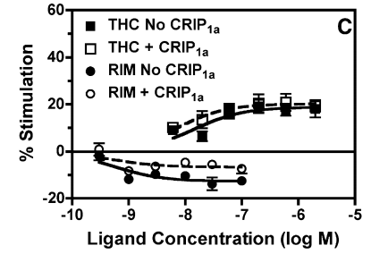
Current Research
Smith et al. 2015
Full agonist: WIN
Partial agonists: MAE and THC
Inverse agonist: RIM

Slide 6
What Triggers CRIP1a Modulation?
Extreme ends of stimulation are modulated (full agonists and inverse agonists)
Moderate stimulation is not modulated (partial agonists)

Slide 7
What Triggers CRIP1a Modulation?
Extreme ends of stimulation are modulated (full agonists and inverse agonists)
Moderate stimulation is not modulated (partial agonists)
Is CRIP1a modulation triggered by the intrinsic efficacy of a ligand or if stimulation caused by the ligand exceeds a range?

Slide 8
Background Experiments
Transfect Human Embryonic Kidney (HEK) cell lines
Line 1 = only CB1
Line 2 = CB1 and CRIP1a
Receptor Density
[³H]SR141716A binding assay
Control
Basal binding
[³⁵S]GTPγS binding assay without ligands present
Baseline

Slide 9
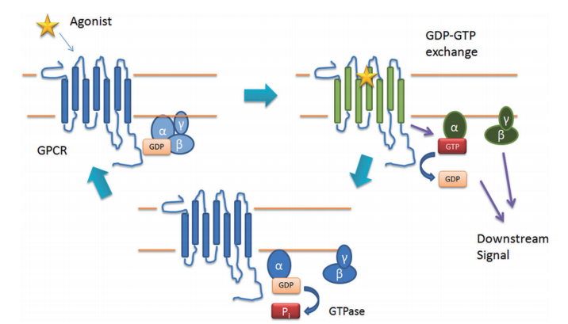
G-protein Coupled Receptor Activation
Smith et al. 2010

Slide 10
[³⁵S]GTPγS Binding Assay
[³⁵S]GTPγS
[³⁵S]GTPγS
Smith et al. 2010

Slide 11
[³⁵S]GTPγS Binding Assay
[³⁵S]GTPγS
[³⁵S]GTPγS
Smith et al. 2010

Slide 12
[³⁵S]GTPγS Binding Assay
[³⁵S]GTPγS
[³⁵S]GTPγS
Smith et al. 2010

Slide 13
[³⁵S]GTPγS Binding Assay
[³⁵S]GTPγS
[³⁵S]GTPγS
Smith et al. 2010

Slide 14
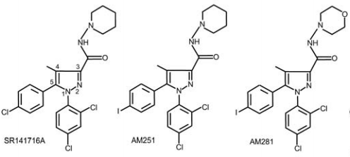
Inverse Agonists
Pertwee 2005

Slide 15
Experiment
Cell Line Reactions
Line 1 + inverse agonists + [³⁵S]GTPγS
Line 2 + inverse agonists + [³⁵S]GTPγS
Reaction stopped by vacuum filtration to remove unbound [³⁵S]GTPγS
Measure CB1 receptors bound with [³⁵S]GTPγS with scintillation counter

Slide 16
Data Analysis
Percent Stimulation
Receptors turned on by ligand compared to basal activity
Compare percent stimulation differences between both cell lines for each inverse agonist

Slide 17
Triggering CRIP1a Modulation
Intrinsic efficacy of ligand
Extreme ends of range
All three inverse agonists stimulation will be reduced to the same degree
Reduction of Stimulation
SR141716A = AM251 = AM281
Stimulation caused by the less potent inverse agonists will be reduced less than the more potent inverse agonists
Reduction of Stimulation
SR141716A > AM251 > AM281

Slide 18
Questions?

