Slide 1
Does a knockout of NDUFA2 Lead to Parkinson’s Disease?
Ruairidh Barlow

Slide 2
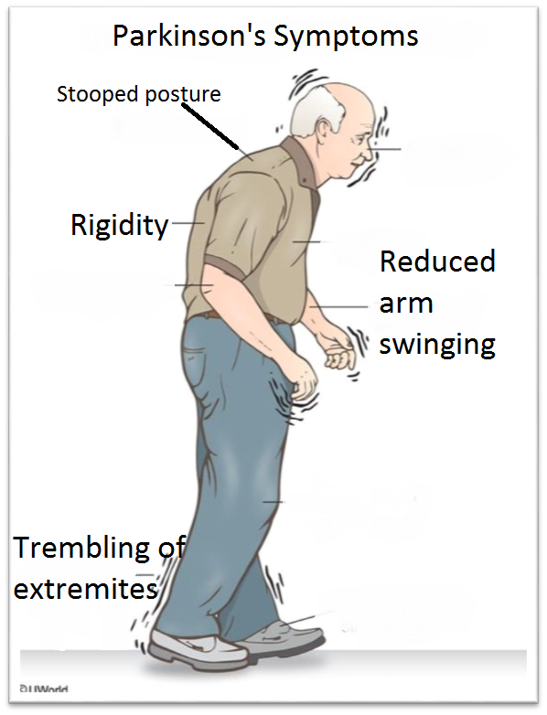
What is Parkinson's Disease (PD)?
Age related neurodegenerative disease
Symptoms: tremors, stiffness, and slow movement

Slide 3
MPP+ Induces Parkinson’s Symptoms

Slide 4
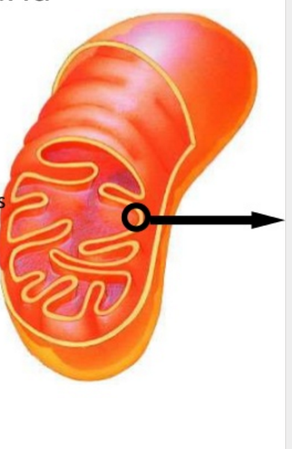
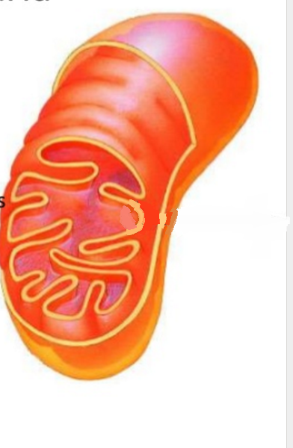
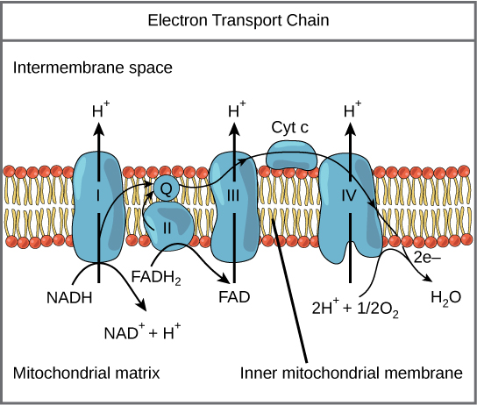
Complex I
Knockout
NDUFA2
MPP+
Null
DJ-1
?
NADH: ubiquinone oxidoreductase
Complex I catalyzes the transfer of electrons from NADH to coenzyme Q10
Complex I is made up of 44 protein subunits
Dysfunction
Dysfunction
BINDS AND INHIBITS

Slide 5
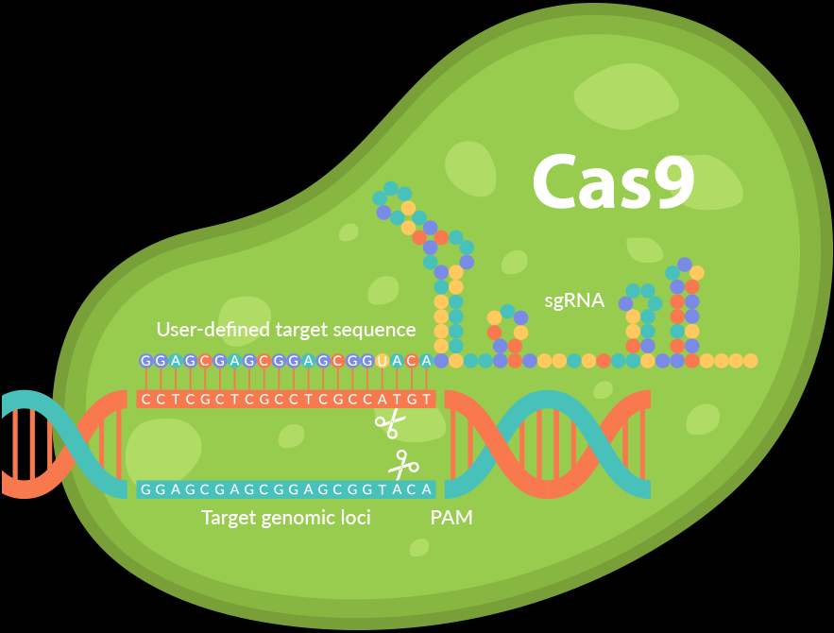
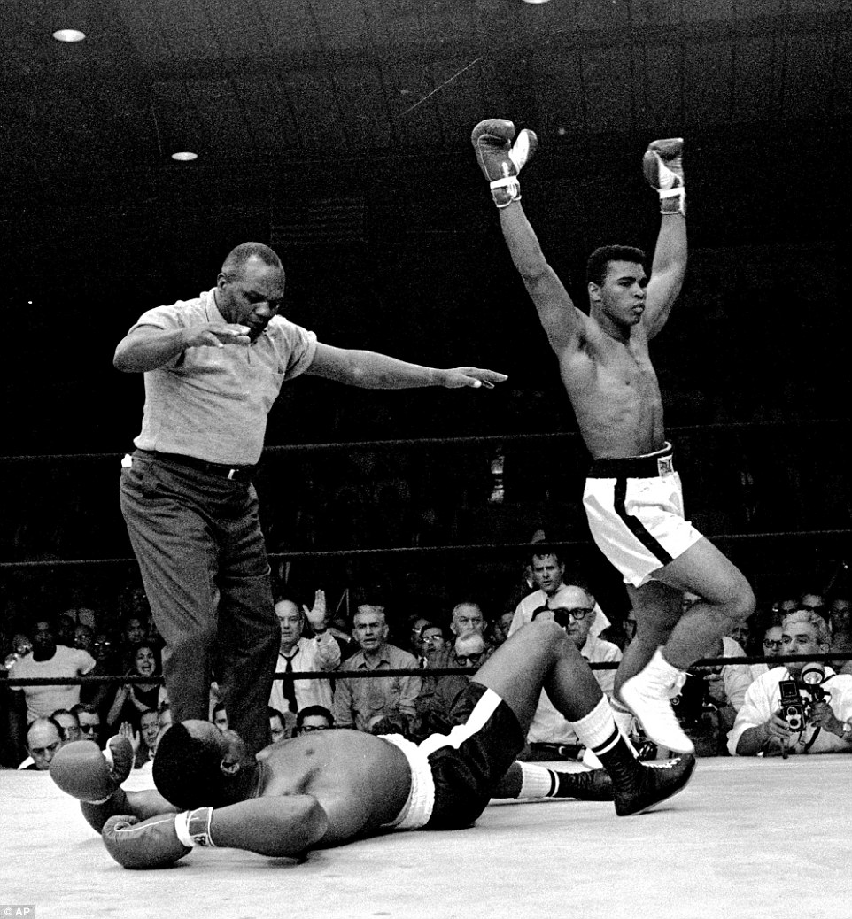
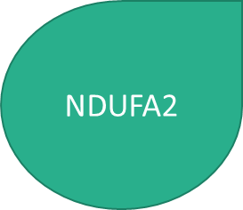
Does A Knockout of NDUFA2 Cause Symptoms Found In PD?
Gene knockout
Measure effects of knock out
Levels of cellular oxygen consumption
Mitochondrial membrane potential
Level of ATP synthesis
Compare results between cell types (control, experimental PD)
Parkinson’s?
CRISPR
NDUFA2

Slide 6
CRISPR/Cas9
Clustered regularly interspaced short palindromic repeats (CRISPR)
State of the art gene editing procedure
Derived from E. coli
CRISPR Associated genes (Cas)
Primarily helicase and nuclease

Slide 7
Knockout Procedure
NDUFA2 Target sequence
PAM
gRNA Design (Guiding RNA)
19 – 25 nucleotides long
Adjacent to a 5’-NGG-3’ proto-spacer motif (PAM)
Complement to target sequence
NDUFA2 target sequence “CCAGAGCTTGGGCTGCACAT”

Slide 8
Knockout Procedure
gRNA Design
Cloning of Oligo (gRNA) into a CRISPR/Cas9 Nuclease Vector

Slide 9
Knockout Procedure
gRNA Design
Cloning of Oligo (gRNA) into a CRISPR/Cas9 Nuclease Vector
Infection of Cell Line
NO TIME TO TALK ABOUT THESE STEPS

Slide 10
Refresher
What are you trying to do?
Knockout NDUFA2
What’s the purpose in making a knockout?
Observe the effects this knockout will have on a cell
Does the cell exhibit PD cell traits?
What do you want to measure?
Cell oxygen consumption
Mitochondrial Membrane potential
Levels of ATP synthesis

Slide 11
Isolation of Mitochondria

Slide 12
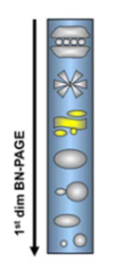
Complex I Intact in a NDUFA2 knockout?
Blue native-polyacrylamide gel electrophoresis (BN-PAGE)
One dimensional: Mitochondrial supercomplexes (Complex I)
Allows for separation of protein complex
Preserves protein subunit interaction

Slide 13
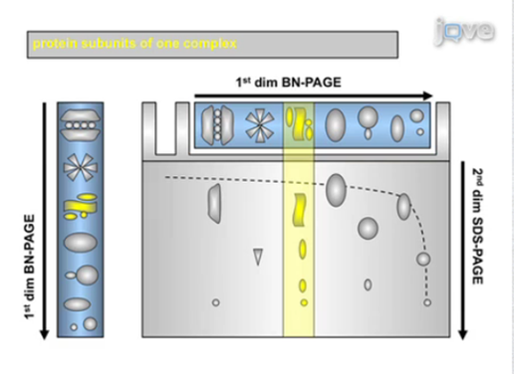
Complex I Intact in a NDUFA2 knockout?
Two dimensional SDS- PAGE: Complex subunits
Was the knockout a success?
Breaks down complexes into individual subunits
Protein subunits are visualized by silver staining

Slide 14
Native Gel Dimension
+Detergent

Slide 15
What Is Hoped To Be Seen
Control, all subunits present
Knockout, missing subunit

Slide 16
Measuring Effect of Knockout
Cell oxygen consumption
Mitochondrial Membrane potential
Levels of ATP synthesis
DON’T HAVE TIME, READ IN PROPOSAL

Slide 17
Discussion
By comparing oxygen consumption levels, membrane potential, and rate of ATP synthesis between the three cell types it can be determined what, if at all, the impact a knockout of NDUFA2 will have on a cell
The results from this experiment will help to further our understanding of NDUFA2’s potential role in Parkinson’s disease. This information will help determine whether Parkinson’s is just the expression of complex I dysfunction in dopaminergic neurons

Slide 18
Questions?

Slide 19
References
de Lau LM, Breteler MM. Epidemiology of Parkinson’s disease. Lancet Neurol 2006;5:525-535.
Tanner, C. M., & Aston, D. A. (2000). Epidemiology of Parkinsonʼs disease and akinetic syndromes. Current Opinion in Neurology, 13(4), 427-430. doi:10.1097/00019052-200008000-00010
Postuma RB, Berg D, Stern M, et al. MDS clinical diagnostic criteria for Parkinson’s disease. Mov Disord 2015;30:1591-1601.
Wirth, C., Brandt, U., Hunte, C., & Zickermann, V. (2016). Structure and function of mitochondrial complex I. Biochimica et Biophysica Acta (BBA) - Bioenergetics, 1857(7), 902-914. doi:10.1016/j.bbabio.2016.02.013
NDUFA2 NADH:ubiquinone oxidoreductase subunit A2 [Homo sapiens (human)] - Gene - NCBI. (n.d.). Retrieved April 15, 2017, from https://www.ncbi.nlm.nih.gov/gene?Db=gene&Cmd=ShowDetailView&TermToSearch=4695
Heo, J. Y., Park, J. H., Kim, S. J., Seo, K. S., Han, J. S., Lee, S. H., . . . Kweon, G. R. (2012). DJ-1 Null Dopaminergic Neuronal Cells Exhibit Defects in Mitochondrial Function and Structure: Involvement of Mitochondrial Complex I Assembly. PLoS ONE, 7(3). doi:10.1371/journal.pone.0032629
(n.d.). Retrieved April 15, 2017, from https://www.atum.bio/eCommerce/cas9/input
NDUFA2 - human gene knockout kit via CRISPR. (n.d.). Retrieved April 29, 2017, from http://www.origene.com/CRISPR-CAS9/KN202715/NDUFA2.knockout
Bao, L., Chen, S., Conrad, K., Keefer, K., Abraham, T., Lee, J. P., . . . Miller, B. A. (2016). Depletion of the Human Ion Channel TRPM2 in Neuroblastoma Demonstrates Its Key Role in Cell Survival through
Proteomics, C. (n.d.). 2D Blue Native. Retrieved April 29, 2017, from http://www.creative-proteomics.com/services/2d-blue-native-sds-page-for-complex-analysis.htm
Fiala, G. J., Schamel, W. W., Blumenthal, B. Blue Native Polyacrylamide Gel Electrophoresis (BN-PAGE) for Analysis of Multiprotein Complexes from Cellular Lysates. J. Vis. Exp. (48), e2164, doi:10.3791/2164 (2011).
University of Virginia School of Medicine. (n.d.). Retrieved April 29, 2017, from https://pharm.virginia.edu/facilities/seahorse-xf24-extracellular-flux-analyzer/
Vives‐Bauza, C., Yang, L., & Manfredi, G. (2007). Assay of Mitochondrial ATP Synthesis in Animal Cells and Tissues. Mitochondria, 2nd Edition Methods in Cell Biology, 155-171. doi:10.1016/s0091-679x(06)80007-5
Hodge, G. K., & Butcher, L. L. (1980). Pars compacta of the substantia nigra modulates motor activity but is not involved importantly in regulating food and water intake. Naunyn-Schmiedeberg's Archives of Pharmacology, 313(1), 51-67. doi:10.1007/bf005058

