Slide 1
Disruption of DISC1 via knockdown of NDEL1 stunts dendritic spine formation
Amanda Atrash
Notes:
.5 s

Slide 2
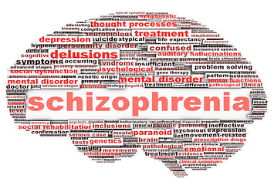
Notes:
Schizophrenia - 1% of population, about 2.2 million people, costs the state upwards of $62 billion/year bc of homelessness, violence, and suicide
Symptopms: positive, negative, cognitive
Drug therapy: only benefits positive and does very little for neg and cognitive symp. Which predict poor prognosis
The limitations of the presently available drugs underscore the need for identification of new antipsychotic compounds aiming at new molecular targets.
30s

Slide 3
DISC1 NDEL1
Disrupted-In-Schizophrenia-1
Protein
Gene susceptibility for mental disorders
Interacts with a variety of proteins
Nuclear Distribution Element-like 1
Protein
Involved in neuroplasticity
Relationship with DISC1
Notes:
Disrupted-in-Schizophrenia-1, a gene-encoding protein
genetic risk factor across a spectrum of psychiatric disorders.
DISC1 binding a number of other proteins together, one of which being NDEL1
Recent studies have suggested a link between DISC1 genotypes and elements of neurocognitive function
NDEL1 is a centrosomal protein that is involved in mitosis + neuroplasticity,
Neural plasticity refers to the brain’s ability to make changes to itself throughout its lifetime.
A recent study has demonstrated that NDEL1 expression is decreased in the hippocampus region of those suffering with schizophrenia
Neural plasticity causes cognitive symptoms
As well, an intact NDEL1-DISC1 interaction has been shown to be critical to multiple developmental processes such as neural outgrowth - again outgrowth
Both of these aspects suggest the importance of NDEL1 and DISC1 in understanding a new aspect and relationship in schizophrenia.
Define knockdown!!!!
Overview Method of experiment (~20-30s)

Slide 4
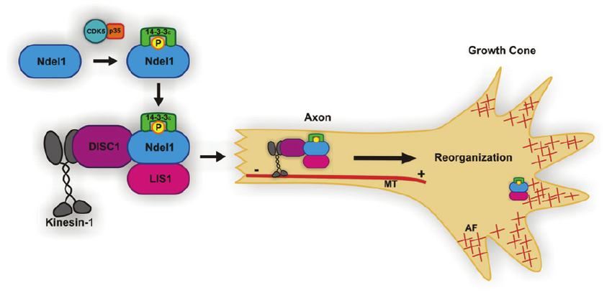
NDEL1 + DISC1 binding
https://www.researchgate.net/figure/228447593_fig1_Figure-1-The-Ndel1Lis114-3-3-e-Protein-Complex-for-Neurite-Outgrowth-14-3-3-e-binds
Notes:
As well, an intact NDEL1-DISC1 interaction has been shown to be critical to multiple developmental processes such as neural outgrowth - again outgrowth
Dendrite formation
Dednritic spines - receive inputs from the cell, important in memory and learning
serve as a storage site for synaptic strength and help transmit electrical signals to the neuron's cell body.

Slide 5
How does knockdown of NDEL1 disrupt DISC1?
Does this knockdown create schizophrenic-like symptoms?
Notes:
Disruption of DISC1 via knockout of NDEL1 stunts spine formation in the hippocampus region of mice

Slide 6
Overview of Experiment
Knockdown NDEL1 in NDEL1-DISC1 relationship
Inject experimental mixture into embryonic mice
Compare results of dendritic spine formation between experimental and control group

Slide 7
Are proteins bound together?

Slide 8
Process of Immunoprecipitation, https://goo.gl/images/R0BoLG
Notes:
Co-IP works by selecting an antibody that targets a known protein that is believed to be a member of a larger complex of proteins. By targeting this known member with an antibody it may become possible to pull the entire protein complex out of solution and thereby identify unknown members of the complex.
In the following experiment, similar anti-body tags will be used for the proteins: DISC1 and NDEL1. In Kayima et al. (2006), the antibodies used against DISC1 were raised in rabbits against amino acids 360-374 of rodent DISC1 and affinity-purified. The antibody for DISC1, then, would be rabbit polyclonal anti-DISC1 antibody and the antibody for NDEL1 is mouse monoclonal antibody, clone OTI1G10. Both of these can be purchased online for the purposes of this experiment. For this experiment, this would first occur in tissue cells, starting with anti-HA and anti-Myc antibodies then done again in the mouse brain with anti-DISC1 and anti-NDEL1 antibodies.

Slide 9
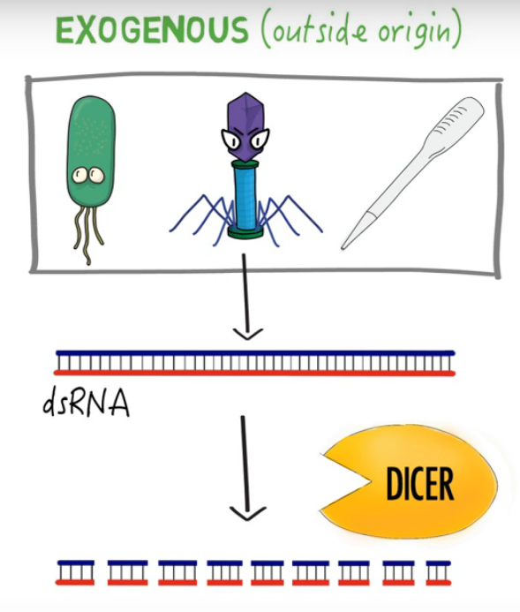
Knockdown NDEL1 via RNA interference
Notes:
RNAi is a gene silencing process in which double-stranded RNA (dsRNA) interferes with the expression of a gene through a homologous sequence shared with the dsRNA [1,2] . RNA silencing occurs when the RNase III enzyme Dicer initiates the cytoplasmic breakdown of dsRNA into small interfering RNA (siRNA) [3] . These siRNA fragments, generally 20–25 nucleotides in length, incorporate into the RNA-induced silencing complex (RISC) [4,5] . Once incorporated into the RISC, siRNA is unwound into a single-stranded RNA (ssRNA) where the sense strand ssRNA is then degraded [6] . The RISC containing sequence-specific antisense strand of ssRNA is then able to seek out and target mRNA that is complementary to the antisense strand [7] . Cleavage of mRNA occurs at nucleotide position 10 and 11 on the complementary antisense strand, relative to the 5' end [8] . To further amplify gene silencing, the RISC can continue on to destroy additional mRNA targets, allowing the therapeutic effect to last for up to 7 days in rapidly proliferating cells and for several weeks in nondividing cells [9] .
Instead of completely silencing the protein, a knockdown of NDEL1 will occur via RNA interference (RNAi). RNAi uses molecules of RNA that are complementary to the mRNA of the gene of interest. As shown in Figure 2, these molecules bind to mRNA and inhibit its translation into protein through the cytoplasmic breakdown of the double stranded RNA into small interfering RNA (siRNA) (Gujrati, M. and Lu, Z.R., 2012). These siRNA fragments, generally 20–25 nucleotides in length, incorporate into the RNA-induced silencing complex (RISC). RISC unwinds siRNA into single-stranded RNA and can then seek out and target the complementary mRNA (Gujrati, M. and Lu, Z.R., 2012). But not all mRNA molecules will be bound to its complement, meaning some might escape and get translated to give the functional protein, thus not completely eliminating the protein.
Knock down - expression is REDUCED, as opposed to knockdown where expression is completely silenced

Slide 11
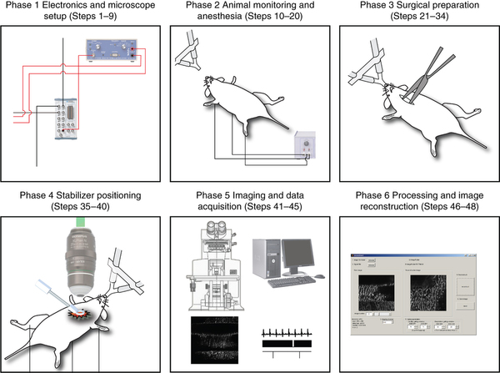
Confocal Imaging
Vinegoni et al. (2015)
Notes:
Slice the region of the brain
Randomly pick neurons
Use a program to then analyze
Use a confocal microscope for images

Slide 12
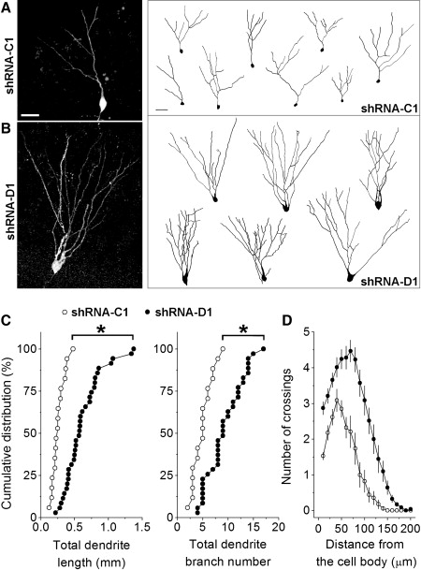
Golden et al. (2013), results
Notes:
Dendrite formation
Dednritic spines - receive inputs from the cell, important in memory and learning
serve as a storage site for synaptic strength and help transmit electrical signals to the neuron's cell body.

Slide 13
Spine Formation → Schizophrenia Drug Treatment
Notes:
Should the results be positive, then it were to suggest that targetting this interaction and making sure it stays intact could help treat schizophrenic symptoms

Slide 14
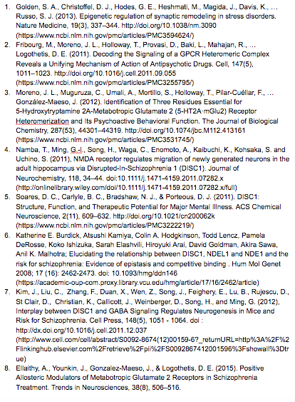
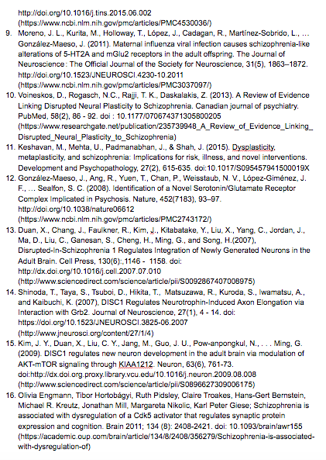
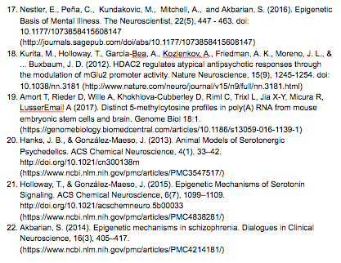
References

