Slide 1
Higher Affinity Heptapeptides Against Influenza Hemagglutinin-Sialic Acid Identification for Treating Flu Virus Disease
Ahmed ”e” Al Qaffas

Slide 2
People at risk of any pandemic
Vaccine is not enough
Current anti-Flu drugs inadequacy
We should consider a different approach

Slide 3
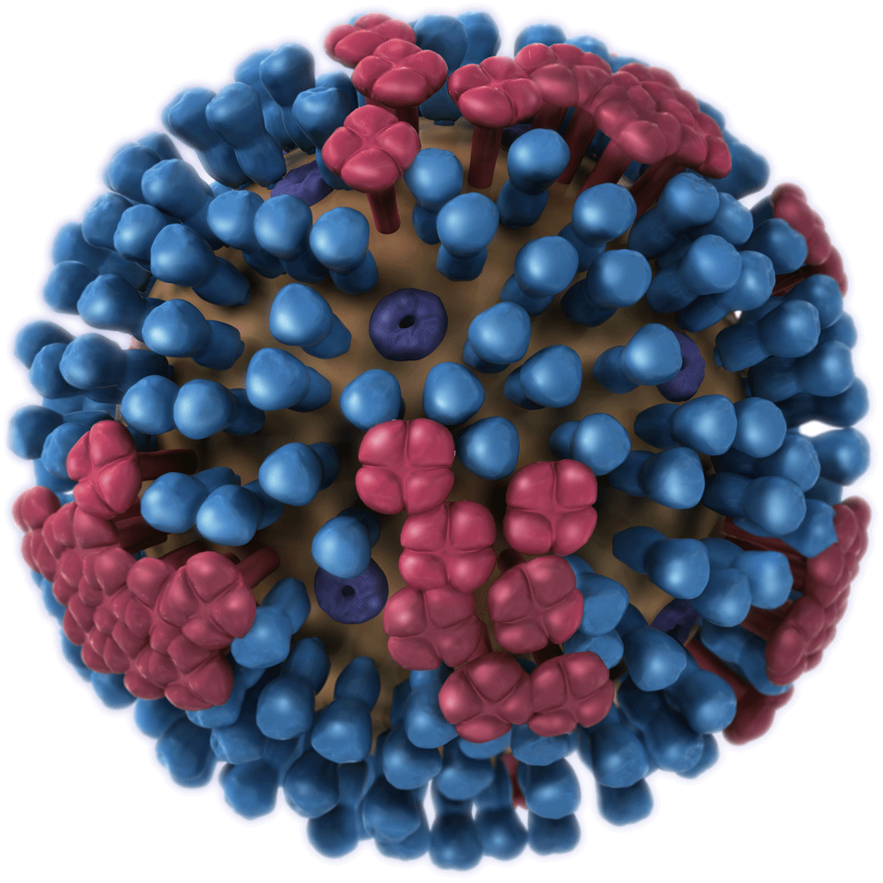
Would Peptide therapy provide a better solution?
Easily synthesized.
Their binding can be predicted using present software.
They are target specific.
Fig1) Influenza Virus outer structure.

Slide 4
“Sialic Acid-Mimic Peptides As Hemagglutinin Inhibitors for Anti-Influenza Therapy”
7a.a
Hemagglutinin
Heptapeptides
-7 amino acids in length
: LVPRLAL -Mimics sialic acid function
-Binds to hemagglutinin.
7a.a
7a.a
7a.a
H1N1

Slide 5
Testing The Affinity of the Heptapeptides against different Human infecting Strains
Software Prediction
Modified ELISA Validation
-Structural based -PDB references
- Color based detection - In-Well reaction

Slide 6
One Amino Acid Mutation In The Original Heptapeptides
(LVPRLAL) :original heptapeptide.
32768 possible combination
1 point mutation with hydrophobicity restriction
$50/heptapeptide
Strongest 50 Heptapeptides
$ 2500 in total.
$1634400 for heptapeptides synthesis alone!
Software Prediction

Slide 7
“Sialic Acid-Mimic Peptides As Hemagglutinin Inhibitors for Anti-Influenza Therapy”
Docking visual Prediction of Peptide-HA binding site.

Slide 8
Preparing The Wells
BSA
M
Well
Incubation overnight
D-H2O2 washing
HP
Pre-coated well
Melaimide conjugated buffer

Slide 9
Performing iELISA
- 4 steps method.
-Primary rabbit anti-flu antibodies.
- Secondary goat anti-rabbit antibodies. HRP-linked.
- H2O2 + 2 2' azinobis, color based detection

Slide 10
Pre-coated well
Viral introduction
Washing the well
DLCM
influenza strain X
Heptapeptide chain

Slide 11
Primary
antibody
Secondary antibody
HRP
HRP
HRP
Washing the well
Rabbit
Anti-flu antibodies
Goat’s
Anti-Rabbit
Antibodies

Slide 12
Binding detection
Positive reaction
H2O2 + 2 2' azinobis
HRP
HRP
HRP
HRP
HRP+H2O2> Green dye

Slide 13
“Sialic Acid-Mimic Peptides As Hemagglutinin Inhibitors for Anti-Influenza Therapy”
Strength comparison via ELISA

Slide 14
Questions

Slide 15
References:
Fig1
Influenza A infects a host cell when hemagglutinin grips onto glycans on its surface. Neuraminidase, an enzyme that chews sugars, helps newly made virus particles detach so they can infect other cells.
From the image bank of NIH, National Institute of General Medical Sciences. Credit: National Institute of General Medical Sciences (Crabtree + Company)
?????????
https://www.themuse.com/advice/4-steps-for-answering-offthewall-interview-questions
3d Virus http://www.microbiologybook.org/mhunt/3D_Influenza.gif

