Slide 1
Can ascorbic acid(vitamin C) reduce the mtDNA mutations in the aged induced pluripotent stem cells?
Alina Afzal
BNFO 300 Spring 2017

Slide 2
Introduction
Respiratory chain
Free radical theory of aging
Increased mtDNA mutations
ROS level (contains unpaired electron)
Vitamin C (donate or accept free electron )
ROS
mtDNA
Aging and other neurodegenerative diseases
Notes:
The big question I am addressing here is how aging can be prevented.
Aging is defined as the loss of energy which occurs over organism lifespan.
Mitrochondria are responsible for making energy in cell.
With age, mutations in mitochondrial DNA increases, causing mitochondrial dysfunction and hence resulting in diseases such as aging and neurodegeneration.
One of the most recognized sources of these DNA mutations is reactive oxygen species (ROS), such as superoxide and peroxide which are produced during the electron transport chain.
ROS damages the DNA either by damaging the DNA base by adding -OH over double bonds or by damaging the sugar by abstracting hydrogen from deoxyribose
Vitamin C is an anti-oxidant which has a free electron present, and holds the potential to bind to the ROS, and this it can act as ROS quencher and can prevent mtDNA damage.
Induced pluirpotent stem cells are the

Slide 3
Induced Pluripotent Stem Cells (iPSC)
Somatic cell
Generated from adults cells
Can be reprogramed to any other cell
ROS level increases.
Yield and efficiency are two limitations.
Used to study neurodegenerative diseases, aging and cancer.
IPSC
Bronchiolar cells
Hepatocytes
Neuronal cells
Red blood cells
Notes:
I am going to study aging in the induced pluripotetn stem cell, which are generated from adult cells and can be reprogram to any other cell in the body. It is found that they have increased level of ROS in them and also there were increased amount of mtDNA mutations found in the old ipsc cells as compared to adult one

Slide 4
Experimental Design
Notes:
This is the flow diagram for my experimental design. I will take fibroblast cells from the subject of 80 years old and will subdivide them into control and experimental. In both samples, I will induce the transcription factor as a retrovirus vectors into the cells. In control I will have no vitamin C and in experimental dish I will introduce few drops of vitamin C and after few days the iPSC colonies will be observed.

Slide 5
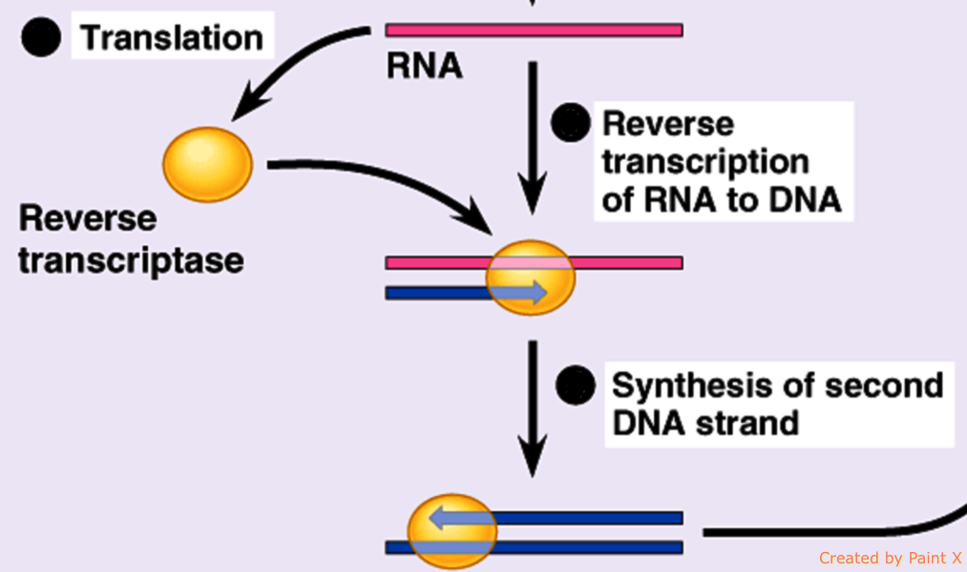
Mechanism for iPSCs reprogramming
Insertion of retro DNA into host cell DNA
Notes:
The mechanism behind reprogramming is that the transcription factors will be induced in the cells as retrovirus. The rna will be translated to the DNA by reverse transcription, and this DNA is then carried inside the nuclease where the inegrase cuts the cell DNA and retrovirus DNA is inserted into the cell DNA.
It increase transcription of stem cell specific genes and reprogramed the fibroblast cells to the ipsc.

Slide 6
ROS Level Detection
Notes:
After the generation of iPSc colonies, ROS level will be measured with the probes which will become fluroscent when they will come in contact with the reactive oxygen species.
Dihydroethidium (DHE) (OH)
MitoSOX Red mitrochondira (superoxide)

Slide 7
Extract the DNA
Gentra DNA extraction kit
Centrifuge to extract mtDNA
Centrifugation
Cell lysis
RNA and protein degradation
Purify DNA
mtDNA
Notes:
The I will extract the DNA with the help of Gentra DNA extraction kit. The principal behind this kit is that it will first break the cell membrane and nuclear membrane with a detergent which breaks the lipids in the membrane and then the RNA and proteins will be degraded using the salt and protein degrading enzymes and at end will purify the DNA by ethanol.
After the DNA is extracted, the centrifugation will be performed to separate the mtDNA from nuclear DNA, as nuclear DNA is larger in size
Cell lysis- the cell membrane is composed of lipid bilayer and detergent captures the lipids and proteins
Ethanol – DNA is insoluble in it

Slide 8
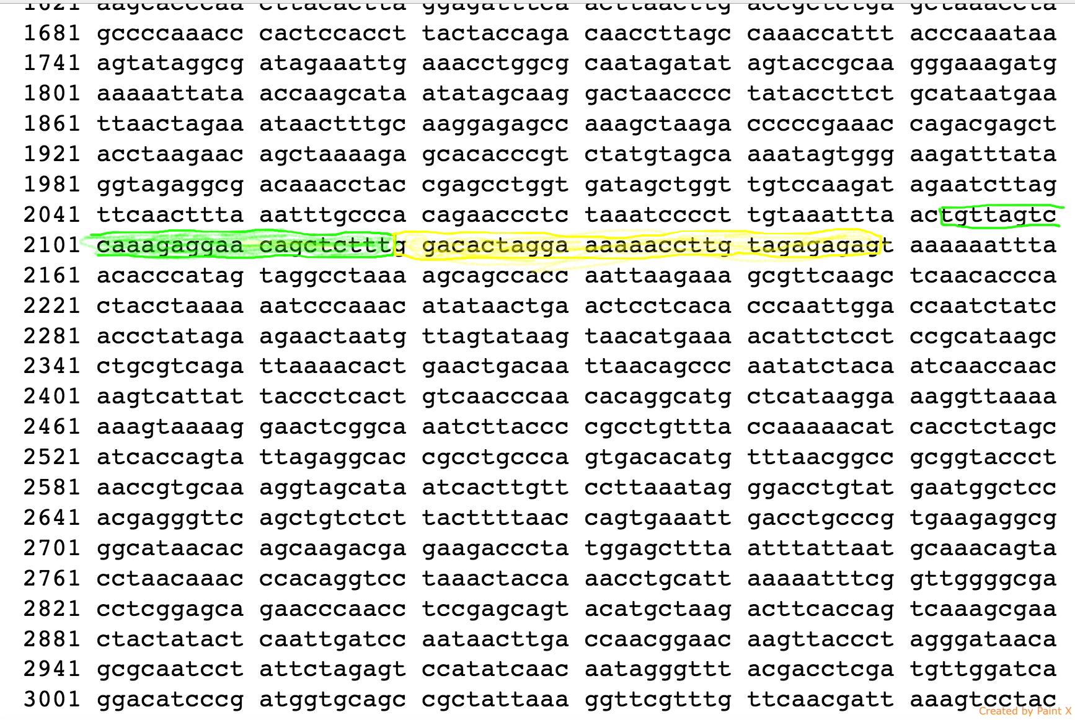
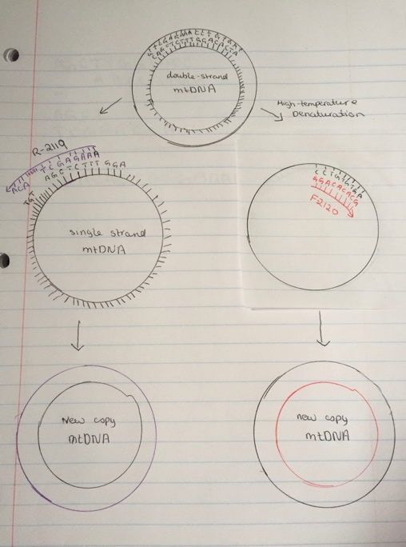
PCR
Primers
1)- mtDNA-F2120 (GGACACTAGGAAAAAACCTTGTAGAGAGAG )
2)-mtDNA-R2119
(AAAGAGCTGTTCCTCTTTGGACTAACA )
TAKARA LA Taq polymerase
Notes:
mtDNA will be amplified using the PCR.
The double stranded template will be denatured by high temperature.
Then Primer F2120 and R2119 will anneal to their corresponding sequencing sites,these primers are designed differentiate mtDNA from the nuclear DNA.
After the primers are attached, TAKARA LA taq polymerase will start synthesizing the new copy of mtDNA by adding bases to the strand. As shown in the picture the entire mtDNA will be amplified using these primers.

Slide 9
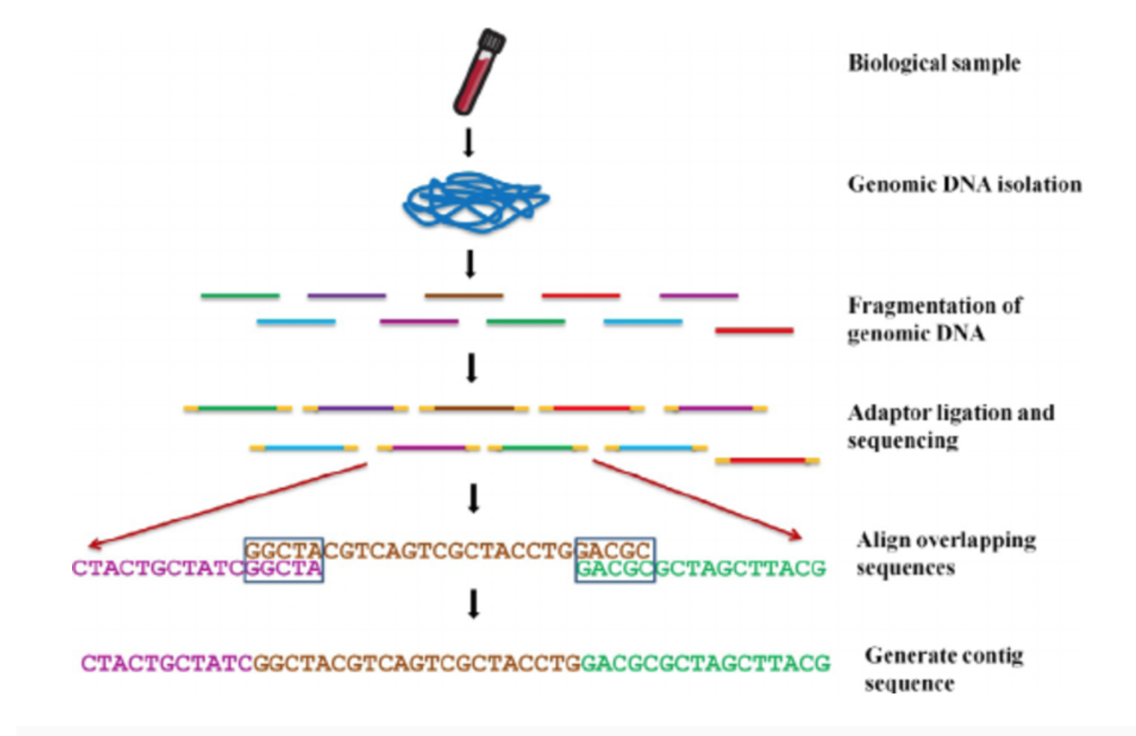
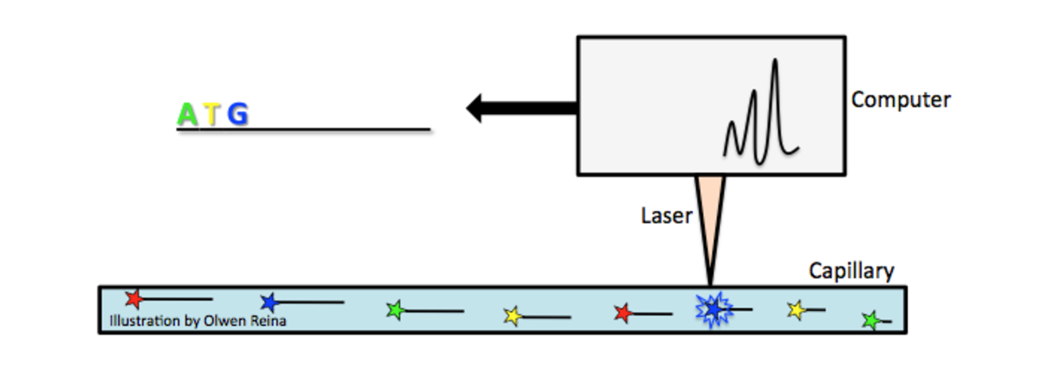
Next generation sequencing
Sequencing the mtDNA
Aligned with revised Cambridge Reference Sequence (rCRS) of the human mtDNA
Analyze mutations
Ranjan et al.,. "Application of Molecular and Serological Diagnostics in Veterinary Parasitology." The Journal of Advances in Parasitology 2.4 (2016): 80-99. Web.
Notes:
After the, the mtDNA will be sequenced using the bioinformatics tool next generation sequencing,
in which the mtDNA is randomly fragmented and adapters are added.
Four different fluorescent dyes each corresponding to the unique mtDNA base are added to the solution
When the solution will pass through the laser light, it will cause the molecule to fluoresce, and machine will detect the color and software will read the base corresponding to the color.

Slide 10
Expected result
Can vitamin C control the increased level of ROS?
Can vitamin C protect the mtDNA from further damage?
Can vitamin C improve the quality of induced pluripotent stem cells?
Notes:
If significant difference in the mtDNA mutations of the control and the experimental group will be found, I will be tempted to conclude that in the experimental cells vitamin C controlled the increasing level increasing of ROS and protected the proteins and mtDNA from further damage. I will conclude that the vitamin C does play role in aging and also in obtaining the better quality of induced pluripotent stem cells.
Induced pluripotent stem cells are being used to study cancer, premature aging diseases, so it is of utmost importance to obtain better quality induced pluripotent stem cells. If the study is successful, it may help scientists in making better quality induced pluripotent stem cell and also discovering a way to slow down the aging process.

Slide 11
THANK YOU !

