Slide 1
Is Candidatus Mycoplasma girerdii dependent on Trichomonas vaginalis for survival?
Sukhman Virk
BNFO 300

Slide 2
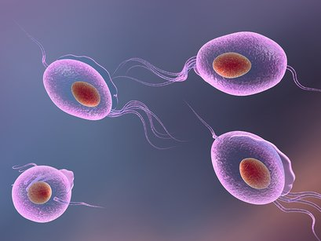
Trichomonas Vaginalis
Non-viral sexually transmitted infection (STI)
that causes Trichomoniasis
Lacks mitochondria and necessary enzymes
Obtains nutrients through phagocytosis.

Slide 3
According to clinical research, a strong association has been shown between T. Vaginalis and two other mycoplasmas:
Candidatus Mycoplasma girerdii and Mycoplasma hominis

Slide 4
T. Vaginalis and Mycoplasma hominis
First ever symbiotic relationship that involves two obligate human
pathogens

Slide 5
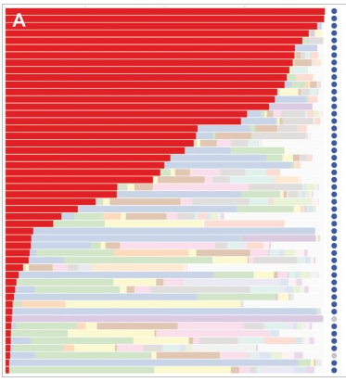
T. Vaginalis and Candidatus Mycoplasma girerdii
Vaginal Human Microbiome Project at VCU
Candidatus Mycoplasma girerdii was found
exclusively in female urogenital tract that have
been infected with T. Vaginalis

Slide 6
Question
The purpose of this experiment is to determine the cellular location of Candidatus Mycoplasma girerdii in respect to Trichomonais Vagianlis and therefore find out if the bacteria is dependent on the parasitic protozoa for survival.

Slide 7
Experiment
The association between the two organisms is going to be demonstrated by using:
Gentamicin protection assays
Double immunofluorescence
Confocal microscopy.

Slide 9
Gentamicin protection assays
Gentamicin kills extracellular bacteria

Slide 10
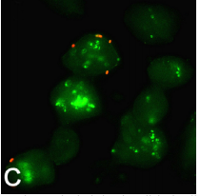
Double immunofluorescence
Location of intracellular and extracellular bacteria

Slide 11
Results
Using confocal microscopy, if there is fluorescence observed inside the trichomonad cell this means that Ca. M. girerdii has the ability to enter T. Vaginalis.

Slide 12
Thank You!

