Slide 1
Inhibiting aim2 IN ORDER TO RESTORE FUNCTION IN INJURED CARDIOMYOCYTES DUE TO Ischemia & reperfusion
Ankita Thakur
BNFO 300

Slide 2
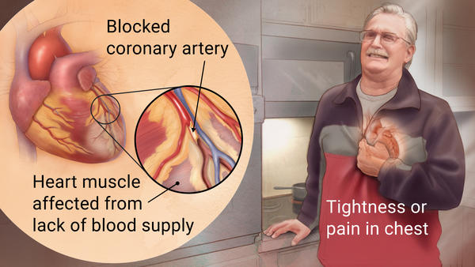
Acute Myocardial Infarction
Most commonly known as: Heart Attack
Affects about 735,000 Americans per year
Most common reason: Coronary Artery Disease
Blood Clot development
Plaque Build up
Spasms

Slide 3
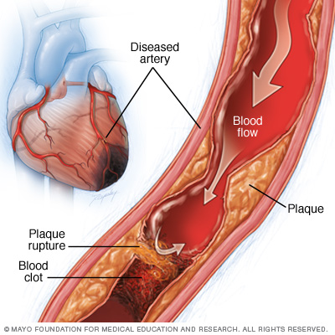
Ischemia
Definition: An inadequate blood supply to an area in myocardium
Can cause damage to heart muscle

Slide 4
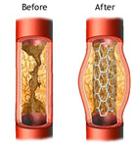
Reperfusion
Reperfusion is the act of restoring blood flow to the occluded area
It is the standard approach to reduce damage to myocardium, since it reestablishes blood flow & saves cells at risk

Slide 5
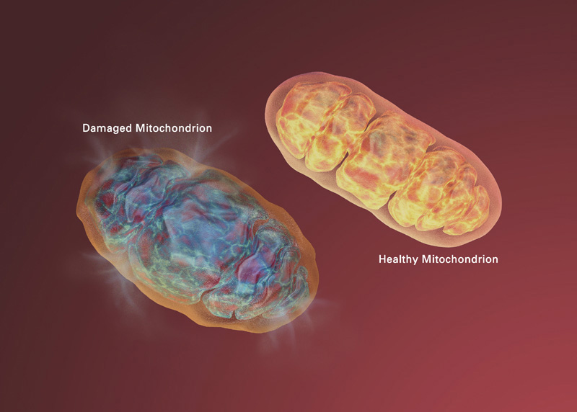
Why can Reperfusion be bad?
A problem that arises when blood flow is restored
New Reactive Oxygen Species (ROS) react with byproducts of previously dying cell
Damaged Electron Transport Chain (ETC) increases ROS production
Increased ROS & Ca2+ in mitochondria can lead to opening of mitochondrial permeability transition pore (MPT)

Slide 6
Reperfusion Injury – continued
Damage to mitochondria changes ion homeostasis & causes ATP deficiency
Leads to cell death
ATP & other damage associated molecular patterns (DAMPs) are released from dying cell
Formation of inflammasome triggered
Pyroptosis initiated

Slide 7
Why is AIM2 important?
AIM2 – DNA sensor that forms AIM2 inflammasome after detecting cytoplasmic dsDNA
Normally recognizes dsDNA of viral or bacterial origin in a sequence-independent manner
Which is why it can recognize dsDNA found in cytoplasm as a substrate

Slide 8
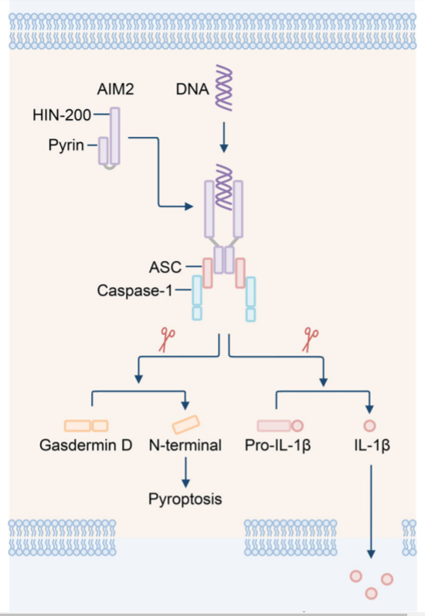
AIM2 Mechanism

Slide 9
Mitochondrial DNA
mtDNA can be released from damaged mitochondria
mtDNA enters cytoplasm of cell that underwent myocardial ischemia reperfusion injury
AIM2 can recognize mtDNA, since similar to bacterial DNA

Slide 10
Hypothesis
Mitochondrial DNA may be acting as a DAMP, which is what leads to the activation of AIM2.
How can this be approached assuming the release of mtDNA is inevitable due to damage?

Slide 11
Overview of Study
Three Checkpoints
Reduce AIM2 expression in the mouse & Confirm AIM2 inhibition
pay attention to caspase-1, indicator for inflammasome formation
Induce Ischemia/Reperfusion Injury & Measure Infarct size + Heart Function
Measure Mitochondrial DNA presence

Slide 12
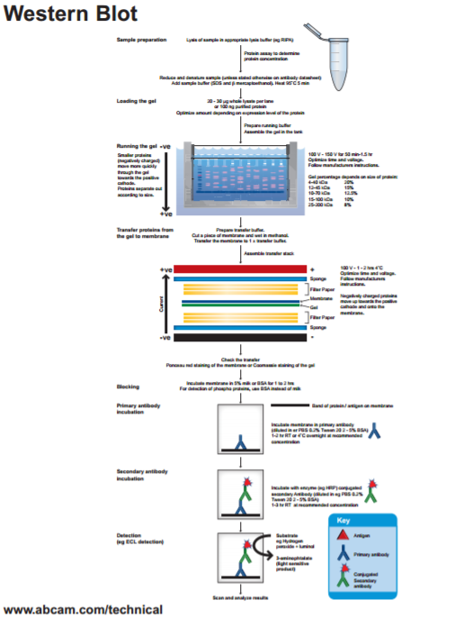
Objective 1: Measure Reduced AIM2
Two Methods to Reduce AIM2 expression:
Use of siRNAs
Use of commercially available knockout mouse (more promising + convenient)
Need to run a Western Blot to confirm reduced AIM2 expression
(Confirmation of reduction is necessary to make sure ischemic mechanisms take place without binding to intracellular dsDNA)

Slide 13
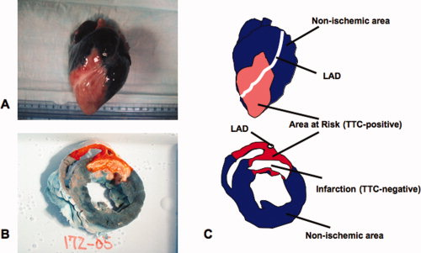
Objective 2: Induction of Ischemia/Reperfusion Injury
Surgically performed:
Tie a suture around the coronary artery including a plastic tube inside the loop to compress the coronary artery
Keep artery closed for 30 minutes
Open artery by removing plastic and allow reperfusion for 24 hours
Observation of Cells
Use a combo of staining = Triphenyl tetrazolium chloride (TTC) + Evan’s blue
Helps to see unaffected cells (blue), dead cells (white), and cells that were at risk (red)

Slide 14
Objective 3: Measure mtDNA release
It needs to be measured to see if the mitochondrial DNA is released into the cytoplasm
Best measured by Real Time Polymerase Chain Reaction (qPCR)
Sample for test will be from the affected mouse heart cells, from which there will be a mitochondrial and cytoplasmic extract prepared
DNA from extracts should be precipated
qPCR should be run on cytoplasmic fraction to measure how much mtDNA can be found
Quantitative analysis should be performed using a known amount of mtDNA to prepare a standard curve to quantify the DNA

Slide 15
Discussion
AIM2 Silencing/Knocking out
Hope to not spend too much confirming reduced AIM2 expression
Need to confirm reduced caspase-1 activity: Noted through improved heart function & reduction of cell death after reperfusion due to lack of pyroptosis in the area affected during ischemia
Mitochondrial DNA presence
Expected qPCR results: Inhibited AIM2 sample would have intact mtDNA, as opposed to sample with AIM2 expressed
Hopes
If AIM2 expression reduction shows to have significant impact on reduction of reperfusion injury, then there will be a need to develop specific AIM2 inhibitors to reduce AIM2 activity after AMI

Slide 16
References
Buja, L.M. (2005) Myocardial ischemia and reperfusion injury. Cardiovascular Pathology, 14. 170-175. doi:10.1016/j.carpath.2005.03.006
Hausenloy, D., Yellon, D. (2013) Myocardial ischemia-reperfusion injury: a neglected therapeutic target. The Journal of Clinical Investigation, 123(1) : 92–100. doi:10.1172/JCI62874
Jabir, M., Hopkins, L., Ritchie, N., Ullah, I., Bayes, H., Li, D., Tourlomousis, P., Lupton, A., Puleston, D., Simon, A., Bryant, C., and Evans, T. (2015) Mitochondrial damage contributes to Pseudomonas aeruginosa activation of the inflammasome and is downregulated by autophagy. Autophagy, 11(1). pp. 166-182. http://dx.doi.org/10.4161/15548627.2014.981915
Lian, Q., Xu, J…..Geng, M. (2017) Chemotherapy-induced intestinal inflammatory responses are mediated by exosome secretion of double-strand DNA via AIM2 inflammasome activation. Springer Nature: Cell Research. 1-17. doi:10.1038/cr.2017.54
Mangino, M.J, Tian, T., Lindell, S.L. (2012). Ezring functionality and ischemia-reperfusion (I/R) injury in transplantation. The FASEB Journal, 26: 56.7. Retrieved from: http://www.fasebj.org/content/26/1_Supplement/56.7.short
Marchetti, C., Chojnacki, J., Toldo, S.,...Abbate, A. (2014) A novel pharmacologic inhibitor of the nlrp3 inflammasome limits myocardial injury following ischemia-reperfusion in the mouse. J Cardiovasc Pharmacol. 63(4): 316–322. doi:10.1097/FJC.0000000000000053.
Mezzaroma, E., Toldo, S.,....Abbate, A. (2011) The inflammasome promotes adverse cardiac remodeling following acute myocardial infarction in the mouse. PNAS, 108(49). 19725-19730. doi:10.1073/pnas.1108586108.
Ming Man, S., Karki, R., Kanneganti, T. (2016) AIM2 inflammasome in infection, cancer, and autoimmunity: Role in DNA sensing, inflammation, and innate immunity. European Journal of Immunology, 46. 269-280. DOI: 10.1002/eji.201545839

Slide 17
References
Murphy, E., Steenberg, C. (2008) Mechanisms underlying acute protection from cardiac ischemia-reperfusion injury. Physiology Review, 88. 581-609. doi:10.1152/physrev.00024.2007.
Toldo, S., Arrosa, J.F.,...Quader, M. (2016) Determination of optimal coronary flow for the preservation of “donation after circulatory death” heart. Circulation, (134): A18989. Retrieved from: http://circ.ahajournals.org/content/134/Suppl_1/A18989
Toldo, S., Marchetti, C.,..., Abbate, A. (2016) Inhibition of NLRP3 inflammasome limits the inflammatory injury following myocardial ischemia–reperfusion in the mouse. International Journal of Cardiology, 209: 215-220. doi: http://dx.doi.org/10.1016/j.ijcard.2016.02.043
Trankle, C., Thurber, C.J., Toldo, S., Abbate, A. (2016) Mitochondrial membrane permeability inhibitors in acute myocardial infarction: still awaiting translation. JACC: Basic To Translational Science, 1(6): 524-535. doi: http://dx.doi.org/10.1016/j.jacbts.2016.06.012
Protocols:
http://docs.abcam.com/pdf/protocols/general-western-blot-protocol.pdf
https://www.thermofisher.com/content/dam/LifeTech/Documents/PDFs/PG1503-PJ9169-CO019861-Update-qPCR-Handbook-branding-Americas-FLR.pdf
Protocol Image:
http://www.abcam.com/ps/pdf/protocols/Western_blot_diagram.pdf
Other Images:
http://www.mayoclinic.org/diseases-conditions/myocardial-ischemia/multimedia/causes-of-myocardial-ischemia/img-20008606
http://www.mayoclinic.org/diseases-conditions/myocardial-ischemia/basics/definition/con-20035096
https://www.researchgate.net/figure/5862083_fig7_Figure-3-Excised-heart-stained-with-Evans-blue-dye-and-TTC-The-pictures-demonstrate-the

