Slide 1
L-citrulline coupled with Arsenic Trioxide as a potential inducer of the PERK/eIF2-alpha apoptotic pathway in GBM cells
Center for the Study of Biological Complexity
Peter Samuel
BNFO 300

Slide 2
Center for the Study of Biological Complexity
Questions and Objective
What are some of the current difficulties that face cancer patients considering current cancer therapies?
Specificity
Cost
Malignancy
Learn more about the induction of apoptotic pathways in cancer cells
Investigate whether the proposed cancer therapy induces the PERK/eIF2-alpha apoptotic pathway
Performing cell death assay analysis
Performing western blot analysis

Slide 3
Center for the Study of Biological Complexity
Cellular Stress and Cell Death
Apoptosis
Necroptosis
Autophagy
http://www.earthlotus.com/Cell-Breakdown-Image.jpg

Slide 4
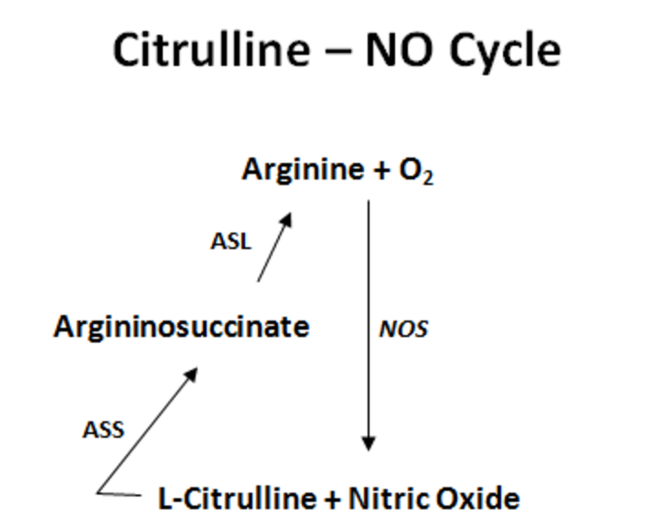
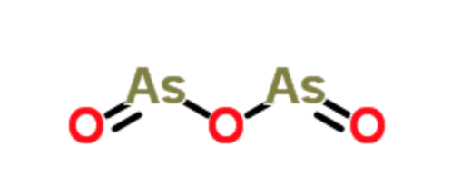
Center for the Study of Biological Complexity
L-citrulline & Arsenic Trioxide (ATO) → Reactive Oxygen Species (ROS)
http://www.chemspider.com/ImagesHandler.ashx?id=229103&w=250&h=250
http://i585.photobucket.com/albums/ss297/stcasey34/Citrulline---Arginine--NO-cycle.png?t=1329194472
Münzel et al. (2011)

Slide 5
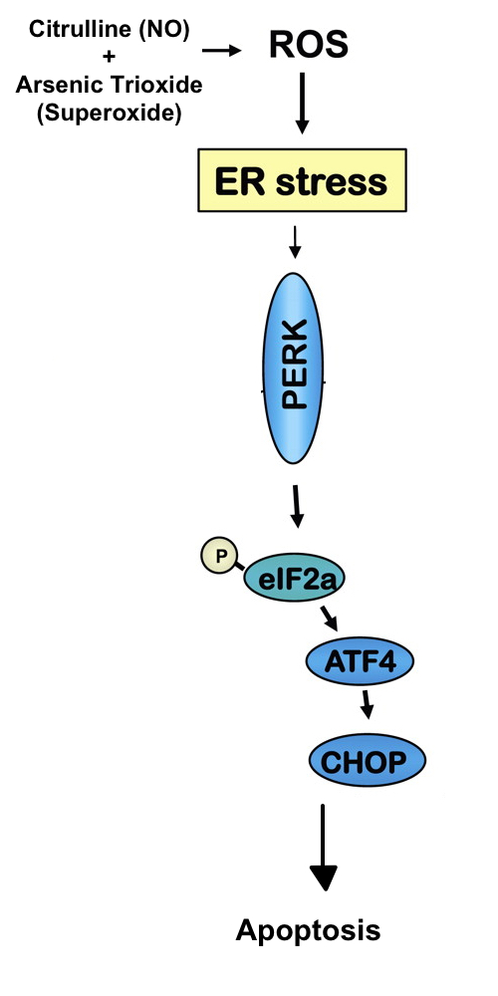
Center for the Study of Biological Complexity
ROS in the ER results in ER Stress
ROS → ER Stress (Verfaillie et al. 2012)
Protein synthesis arrested
ATF4/CHOP proteins generated
Eventually, apoptosis
Adapted from Velasco et al. (2010)

Slide 6
Center for the Study of Biological Complexity
Experiment – Negative Control vs.
Treatment Group
GBM Cells
Negative Control
Treatment Group
siRNA knock down of PERK
No use of siRNA
Sub-groups
Saline
L-citrulline
ATO
L-citrulline/ATO
Sub-groups
Saline
L-citrulline
ATO
L-citrulline/ATO

Slide 7
Center for the Study of Biological Complexity
Measurements – Western Blot and Trypan Blue Assays
Western Blots
Trypan Blue Assays
Negative Control Group
Treatment Group
https://eurekabrewing.files.wordpress.com/2012/07/yeastcount.jpg

Slide 8
Center for the Study of Biological Complexity
Understanding Apoptosis in GBM
Learned more about PERK/eIF2-alpha apoptotic pathway
ROS → ER Stress → PERK → peIF2-alpha → apoptosis
Different Results/Possible Explanation
Trypan Blue Assays
Different apoptotic pathway?
Understanding the interactions between drug therapies and apoptosis in cancer
Further studies needed

Slide 9
Center for the Study of Biological Complexity
Questions?

