Slide 1
Comparison of Exemplars of Rotamer Clusters Across the Proteinogenic Amino Acids

Slide 2
Comparison of Exemplars of Rotamer Clusters Across the Proteinogenic Amino Acids
Proteins:
Drug targets
Pharmaceutical agents
Methods of determining similarity
Sequence alignment
Homology Modelling
Threading

Slide 3
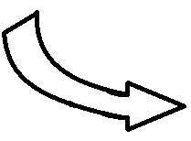
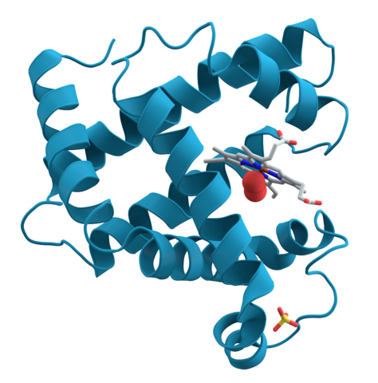
MVHFTAEEKAAVTSLWSKMNVEEAG...

Slide 4
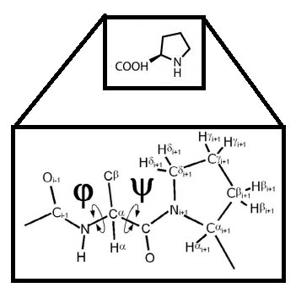
Figure adapted from Lovell et al
(2003). Depicts the phi-psi angles
on a proline.

Slide 5
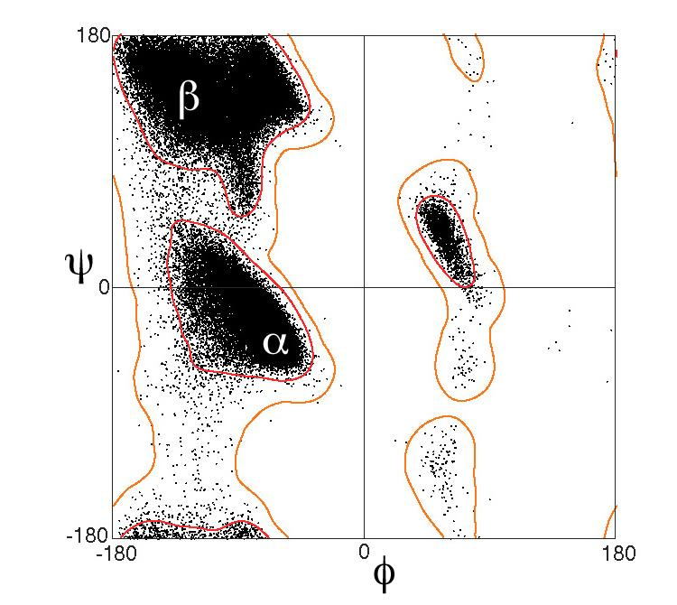
Figure adapted from Lovell et al (2003).

Slide 6
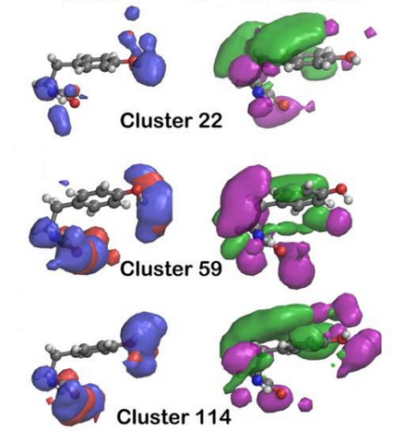

Slide 7
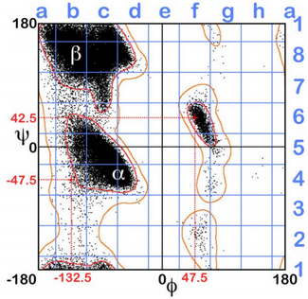
Figure adapted from Ahmed et al (2015)

Slide 8
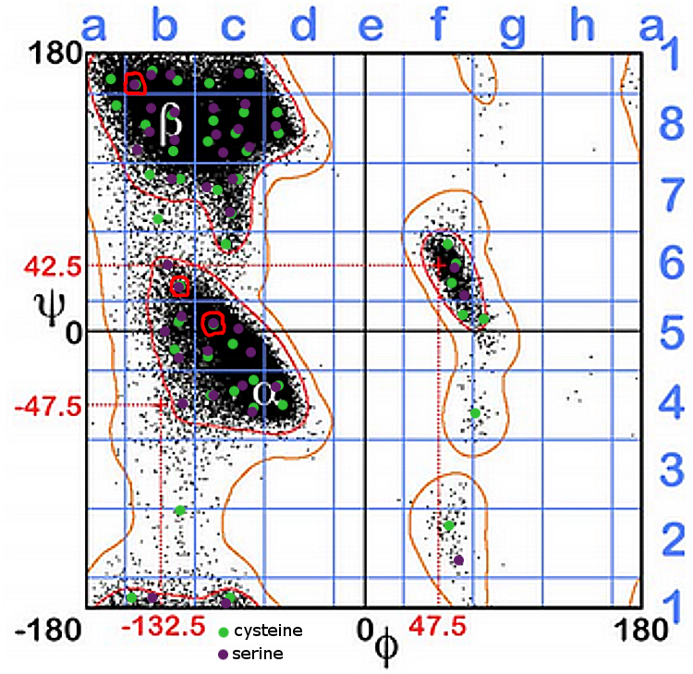
The Question
Do there exist highly-similar groups of rotamers among disparate types of amino acids?

Slide 9
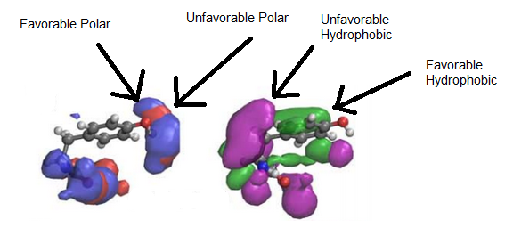
Rotamers in silico
Each rotamer is represented as a set of four maps, each representing a class of forces affecting the conformation of the protein.

Slide 10
Procedure
Using known clusters of rotamers, we can find their exemplars*
and use those to represent their respective clusters
By repeating the clustering procedure used in Ahmed et al (2015), we can determine whether these exemplars cluster as well as they do in Ahmed et al (2015).
In brief:
Calculate the similarity between each pair of rotamer cluster exemplars,
...sort them into groups based on those similarity scores,
...and then validate the results.
*Exemplars - those rotamers most similar to the map quartet derived from averaging the cluster members.

Slide 11
L(Gt) transforms individual points in the map
to a form more appropriate to our calculations
D(I,J) finds the similarity between two
rotamer maps. We repeat this four times,
once for each map in the exemplar quartet.
C(m,n) calculates a weighted average
of the maps, creating an overall score
of similarity.
The calculated similarity of each pair of
exemplars is stored in a matrix

Slide 12
Clustering
We use k-means clustering.
K-means clustering involves splitting a set of datapoints into k groups.
To determine a good value of k, we use the “gap statistic”.

Slide 13
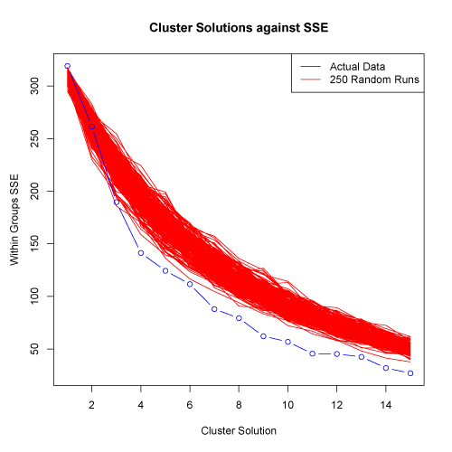
Validation
In brief:
Scramble matrix of similarity scores 250 times to generate 250 new similarity matrices.
Perform clustering for a range of cluster counts.
Calculate sum of squared error (SSE) for the actual data and the generated data
Plot SSE vs number of clusters.
Figure adapted from http://www.mattpeeples.net/kmeans.html

Slide 14
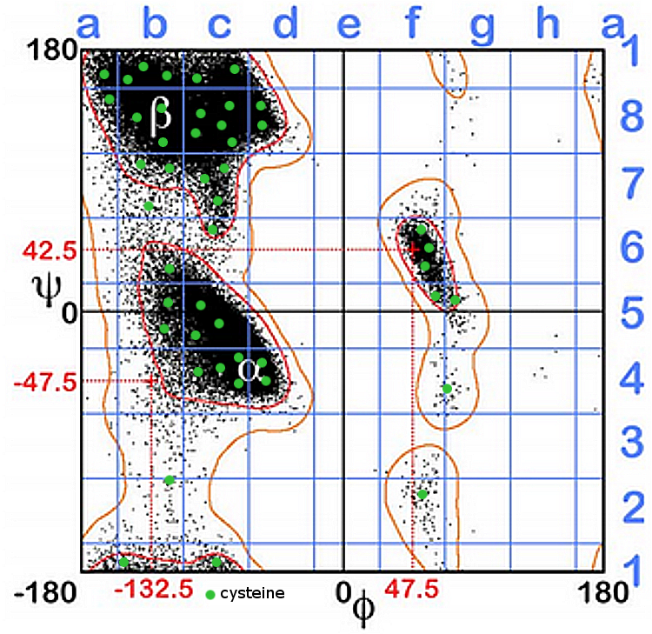
Figure adapted from Ahmed et al (2015)

Slide 15
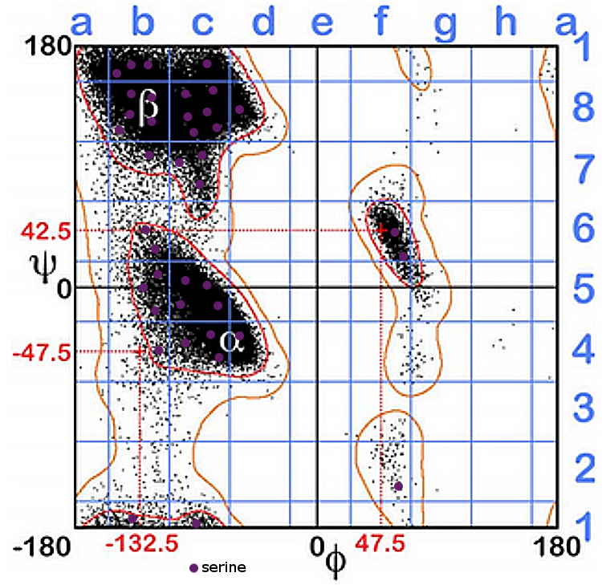
Figure adapted from Ahmed et al (2015)

Slide 16
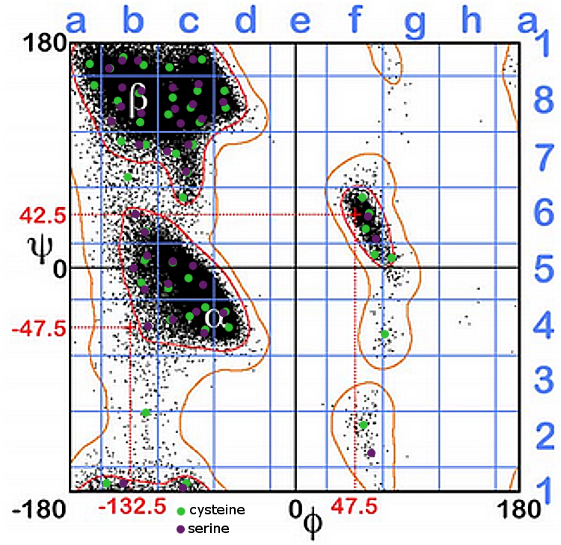
Figure adapted from Ahmed et al (2015)

Slide 17
Figure adapted from Ahmed et al (2015)

Slide 18
References
1. Ahmed, M. et al (2015). 3D interaction homology: The structurally known rotamers of tyrosine
derive from a surprisingly limited set of information-rich hydropathic interaction
environments described by maps. Proteins 83: 1118-1136.
2. Ramachandran, G.N., Ramakrishnan, C. & Sasisekharan, V. (1962). Stereochemistry of
Polypeptide Chain Configurations. J. Mol. Biol. 7: 95-99.
3. Lovell, S. et al (2003). Structure Validation by C-alpha Geometry: Phi, Psi, and C-beta
Deviation. Proteins 50: 437-450.
4. Forster, M.J. (2002). Molecular modelling in structural biology. Micron 33: 365-384.
5. Ho, B.K. & Brasseur, R. (2005). The Ramachandran plots of glycine and pre-proline. BMC
Structural Biology 5:14.

