Slide 1
Determination of Short, Amyloid-Beta Derived Peptides Which Reduce APOE Mediated Amyloid-Beta Aggregation
Research Proposal
By Thomas Raymond

Slide 2
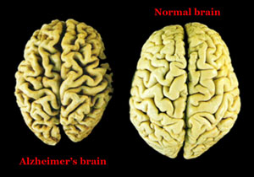
Introduction: Alzheimer’s Disease
Neurological disorder
Neuronal Death
Current drugs²
Slow, but don’t stop

Slide 3
Amyloid Beta (Aβ) and the Aβ Cascade Hypothesis
The Aβ Cascade Hypothesis asserts that the cause of Alzheimer’s is the build up of Aβ plaques in the brain, which then leads to injury and death³
Plaques contain fibrils (fibers of protein) of amyloid beta
Aβ1-40 and Aβ1-42

Slide 4
Apolipoprotein E (APOE)
APOE is the primary transporter of cholesterol in the brain⁵
Three isoforms: APOE2, APOE3, and APOE4
APOE4 is associated with a heightened risk of developing Alzheimer’s, while APOE2 is associated with a lower risk. APOE3 is the “normal” variant¹
The presence of APOE has been shown to be associated with increased aggregation of Aβ
Order of increasing aggregation levels: APOE2 → APOE3 → APOE4⁶

Slide 5
APOE and Aβ Aggregation Mechanism⁶

Slide 6
Targeting the APOE-Aβ Complex
One path that has been studied in order to decrease Aβ aggregation is inhibition of the APOE-Aβ binding complex
When APOE and Aβ bind, the binding residues of Aβ are 12-28¹⁰
These residues are used in studies to design peptide inhibitors, with varying lengths being used (ex.: 12-28 or 20-29)^{7, 14}

Slide 7
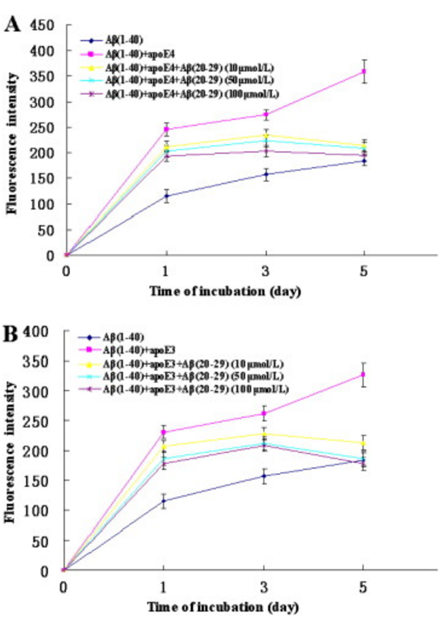
Hao et. al (2010): Aβ20–29 peptide blocking apoE/Aβ interaction reduces full-length Aβ42/40 fibril formation and cytotoxicity in vitro
Hao et. al tested the ability of Aβ20-29 to reduce APOE4 mediated Aβ1-40 or Aβ1-42.
This testing was done by testing fluorescent intensity given off by Thioflavin T when combined with aggregation assays of:
1) Aβ
2) Aβ and APOE4
3) Aβ and APOE4 in the presence of varying concentrations of inhibitors

Slide 8
Structure-Based Drug Synthesis
While the ability of peptides to inhibit APOE-Aβ binding seems to be successful, the usage of peptides as drugs is usually unsuccessful
Problems with stability and delivery (Blood-brain barrier or Digestion)¹¹
The process of using peptide structures to design drugs similar in structure
Ideally, peptides will be 6-8 residues in length

Slide 9
The Research Proposal
The goal of the following proposed experiment is to determine 6-8 residue sections within Aβ12-28 which are capable of reducing aggregation of Aβ in the presence of APOE.

Slide 10
The Peptides Being Tested
Because Aβ residues 12-28 are the binding site, these residues will be focused on
Each terminal will be cut by four amino acids, and then cut by one amino acid individually and together
Peptides | Number of Residues
Aβ17-23 | 6
Aβ17-24, Aβ16-23 | 7
Aβ16-24 | 8

Slide 11
Aggregation Assay and Thioflavin T
Aggregation assays are used to test the aggregation of a protein in the presence of certain compounds
Thioflavin T (ThT)
A fluorescent tag which binds to amyloid deposits¹²
Binding is thought to be a result of ThT’s interaction with beta sheets in amyloid deposits
Fluorescent enhancement when binding with amyloid aggregations¹³
This enhancement can then be visualized using fluorescent spectroscopy

Slide 12
The Experiment: Aggregation Assays
APOE4 will be used in the aggregation assays.
Additionally, Aβ1-42 and Aβ1-40 will be used in the aggregation assays.
The assays prepared will test the ability of Aβ12-28 derived peptides to inhibit the aggregation of Aβ1-42 and Aβ1-40
Each peptide will be added in 10, 50, and 100 µM concentrations
Controls:
Aggregation assays of just Aβ1-42 or Aβ1-40 and aggregation assays of APOE4 and Aβ1-42 or APOE4 and Aβ1-40

Slide 13
The Experiment: Measuring Aggregation
Every six hours for 120 hours, a sample will be taken.
ThT will be added to the sample
A spectrofluorometer will be used to measure the level of fluorescence of the sample.

Slide 14
Expected Results
The presence of a peptide results in reduced fluorescent intensity when compared to the APOE4+Aβ control
This would suggest reduced aggregation, which would suggest a capability of the tested peptide to inhibit interactions of Aβ and APOE4
The presence of a peptide does not show reduced fluorescent intensity when compared to the APOE4+Aβ control
This would suggest no reduced aggregation, which would suggest no inhibition of the Aβ and APOE4 binding by the tested peptide
The presence of a peptide shows increased fluorescent intensity when compared to the APOE4+Aβ control
This would suggest increased aggregation, which would suggest that the peptide being tested contributes to fibrilization (the process of forming fibrils) of Aβ

Slide 15
References
1. Alzheimer’s Association. 2016. 2016 Alzheimer’s disease facts and figures. Alzheimer’s & Dementia: The Journal of the Alzheimer’s Association, 12(4): 459-509. (https://www.ncbi.nlm.nih.gov/pubmed/27570871#)
2. Kumar, A., Singh, A., Ekavali. 2014. A review on Alzheimer’s disease pathophysiology and its management: an update. Pharmacological Reports, 67(2): 195-203. (http://www.sciencedirect.com.proxy.library.vcu.edu/science/article/pii/S1734114014002886)
3. Barageb, S.H., Sonawane, K.D. 2015. Amyloid cascade hypothesis: Pathogenesis and therapeutic strategies in Alzheimer’s disease. Neuropeptides, 52: 1-18. (http://www.sciencedirect.com/science/article/pii/S0143417915000657)
5. Puglielli, L., Tanzi, R.E., Kovacs, D.M. 2003. Alzheimer’s disease: the cholesterol connection. Nature Neuroscience, 6: 345-351.
6. Garai, K., Verghese, P. B., Baban, B., Holtzman, D. M., & Frieden, C. 2014. The Binding of Apolipoprotein E to Oligomers and Fibrils of Amyloid-β Alters the Kinetics of Amyloid Aggregation. Biochemistry, 53(40), 6323–6331. (https://www.ncbi.nlm.nih.gov/pmc/articles/PMC4196732/)
7. Sadowski, M. J., Pankiewicz, J., Scholtzova, H., Mehta, P. D., Prelli, F., Quartermain, D., & Wisniewski, T. (2006). Blocking the apolipoprotein E/amyloid-β interaction as a potential therapeutic approach for Alzheimer's disease. Proceedings of the National Academy of Sciences of the United States of America, 103(49), 18787–18792. (http://www.pnas.org/content/103/49/18787.full)
9. Marsden, I. T., Minamide, L. S., & Bamburg, J. R. (2011). Amyloid-β-induced amyloid-β secretion: A possible feed-forward mechanism in Alzheimer disease. Journal of Alzheimer’s Disease : JAD, 24(4), 681–691. (https://www.ncbi.nlm.nih.gov/pmc/articles/PMC4447202/)
10. Strittmatter, W. J., Weisgraber, K. H., Huang, D. Y., Dong, L. M., Salvesen, G. S., Pericak-Vance, M., … Roses, A. D. (1993). Binding of human apolipoprotein E to synthetic amyloid beta peptide: isoform-specific effects and implications for late-onset Alzheimer disease. Proceedings of the National Academy of Sciences of the United States of America, 90(17), 8098–8102. (https://www.ncbi.nlm.nih.gov/pmc/articles/PMC47295/)
11. Adessi, C.; Soto, C. 2002. Converting a Peptide into a Drug: Strategies to Improve Stability and Bioavailability. Current Medicinal Chemistry, 9(9): 963-978. (http://www.ingentaconnect.com/contentone/ben/cmc/2002/00000009/00000009/art00005)
12. Biancalanaa, M., Koide, S. Molecular mechanism of Thioflavin-T binding to amyloid fibrils. Biochimica et Biophysica Acta – Proteins and Proteomics, 1804(7): 1405-1412. (http://www.sciencedirect.com/science/article/pii/S1570963910000993)
13. Wolfe, L. S., Calabrese, M. F., Nath, A., Blaho, D. V., Miranker, A. D., & Xiong, Y. (2010). Protein-induced photophysical changes to the amyloid indicator dye thioflavin T. Proceedings of the National Academy of Sciences of the United States of America, 107(39), 16863–16868. (https://www.ncbi.nlm.nih.gov/pmc/articles/PMC2947910/)
14. Hao, J., Zhang, W., Zhang, P., Liu, R., Liu, L., Lei, G., Su, C., Miao, J., Li, Z. 2010. Aβ20–29 peptide blocking apoE/Aβ interaction reduces full-length Aβ42/40 fibril formation and cytotoxicity in vitro. Neuropeptides, 44(4): 305-313. (http://www.sciencedirect.com/science/article/pii/S0143417910000296)

