Slide 1
Defining Epidermal Growth Factor Receptor exon 20 mutant sensitivity to tyrosine kinase inhibition
Danny Rayes

Slide 2
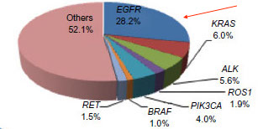
Lung Cancer and Epidermal Growth Factor Receptor
Lung cancer is a leading cause cancer-related death
Two types of lung cancer
Non small cell (NSCLC) 80-85%
Small cell (SCLC) 15-20%
Mutations in Epidermal growth factor receptor account for ~30% of all NSCLC

Slide 3
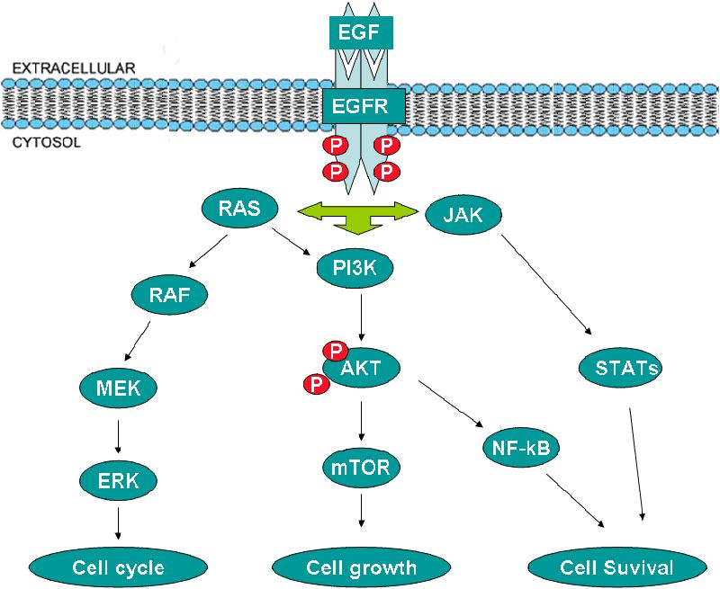
EGFR and cancer
When active, EGFR initiates several pathways that cause cell growth and proliferation

Slide 4
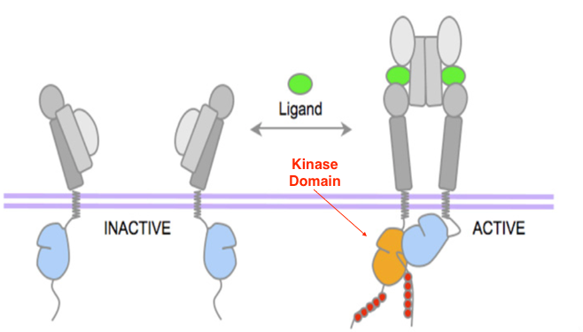
EGFR and cancer
EGFR binds to a ligand, EGF, and dimerizes to become active
Activating mutations affect the kinase domain, causing it to be in the active conformation in the absence of a ligand.
ATP binding then initiates kinase activity

Slide 5
Inhibiting activating mutations
Tyrosine kinase inhibitors competitively bind to the kinase domain in the place of ATP, stopping kinase activity
Some mutations are more sensitive to tyrosine kinase inhibitors

Slide 6
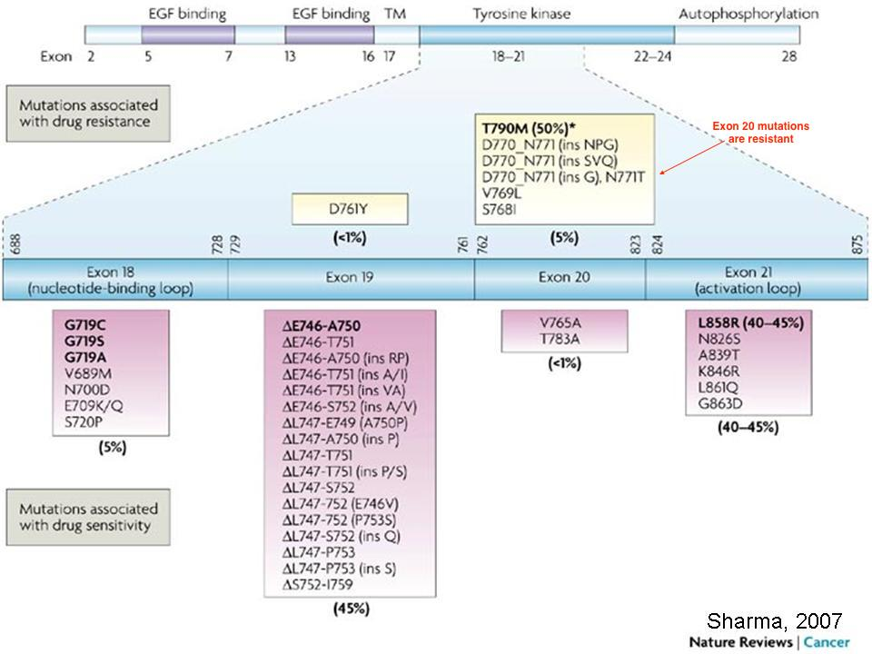

Slide 7
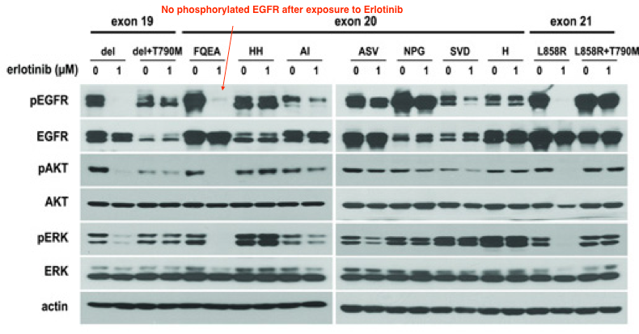
What makes exon 20 mutations resistant?
Yasuda et al 2013 studied the resistance of seven prevalent exon 20 mutations to TKIs
Unexpectedly, they found one mutation that was sensitive. An insertion of four amino acids, FQEA, between residue 763 and 764

Slide 8
Experimental Question
Are there other exon 20 insertion mutations that display sensitivity to tyrosine kinase inhibitors?

Slide 9
My Experiment
Choose clinically prevalent exon 20 mutations that have not been tested in vitro→ create stable cell lines expressing mutant EGFR→ expose cell lines to Erlotinib and Western blot EGFR and downstream proteins Akt and ERK1/2

Slide 10
Expressing mutations
recombine the wild type EGFR gene into a plasmid with a selectable marker like green fluorescent protein
Design forward and reverse primers for the mutated site.
Expose plasmid to primers and amplify by PCR, a new plasmid is synthesized containing the mutation
Expose cells that grow in the absence of IL3 to Erlotinib
Transfect plasmid into Ba/F3 cells. Select for successfully transected cells by identification of GFP
Grow Ba/F3 cells in the absence of IL3.

Slide 11
Western Blotting
Lyse whole, successfully transfected cells and centrifuge lysate
Separate proteins by size and charge using gel electrophoresis
Transfer proteins to a solid membrane and add primary antibody that binds at specific residues. For EGFR this is the Tyrosine at residue 202
Add secondary antibodies that bind to primary, these antibodies will be the ones that show up on film

Slide 12
Predictions
How do we know if the mutation is sensitive?
EGFR, Akt and ERK activity is signified by phosphorylation
If we can detect phosphorylation of proteins after exposure to Erlotinib, we know that EGFR was not inhibited and therefore not sensitive.
Western blotting with antibodies at specific residues can distinguish between phosphorylated and phosphorylated protein

Slide 14
Limitations
This experiment tests sensitivity in vitro, meaning it does not directly translate to live cells
If Erlotinib inhibits a mutation, it does not necessarily mean that treatment would be effective for a diseased patient
Another study must be done to asses the dose response of the mutation to Erlotinib
There must be a therapeutic window, aka Erlotinib must bind to the mutated EGFR with higher affinity than the Wild type EGFR in order to be a viable treatment

