Slide 1
The effect of duplication of the variable region stem loop structures of the 3’UTR on sfRNA virulence in the dengue virus
NIKHITA PUTHUVEETIL

Slide 2
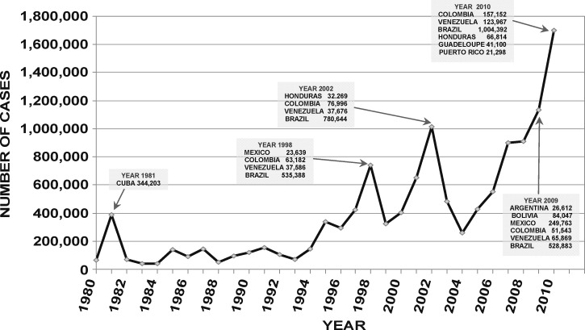
Outbreaks of Dengue

Slide 3
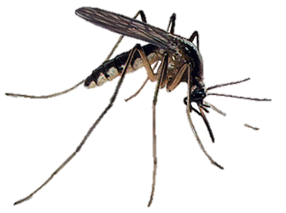
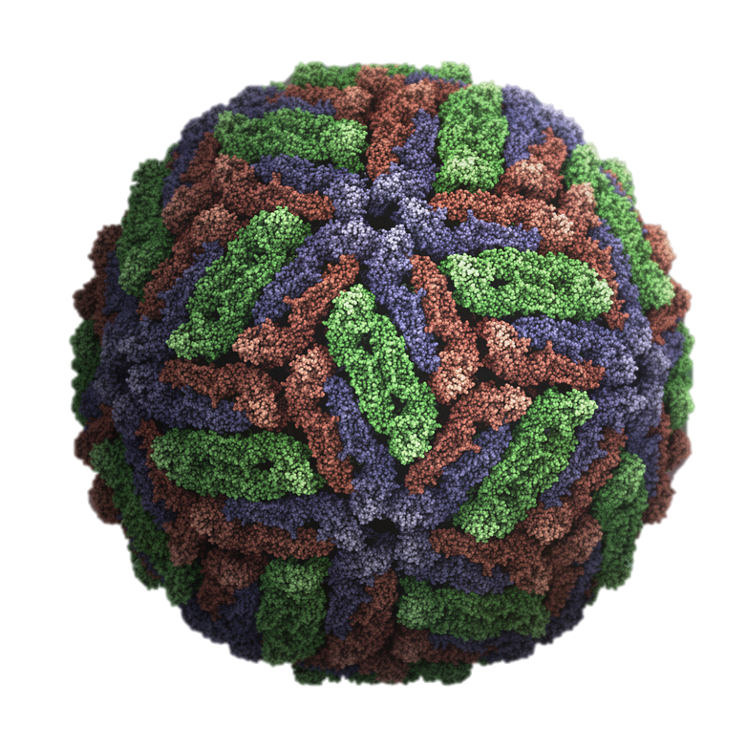
The dengue virus prefers humans

Slide 4
The dengue virus prefers humans
How do we stop this cycle?

Slide 5
How does the dengue virus survive in a host?
Dengue virus affects both humans and mosquitoes
The dengue virus needs to survive in mosquitoes in order to get to its next host
Mutations allow it to adapt to its host

Slide 6
Dengue genome

Slide 7
Adaptation mutations are usually found in 3’UTR

Slide 8
Mutations will be host-specific: only allows survival in one host

Slide 9
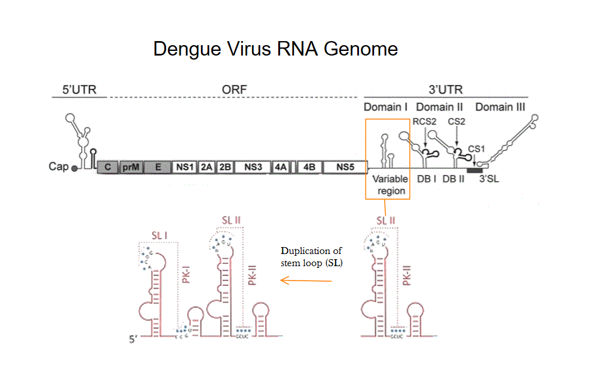
Duplication of a hair pin/stem loop

Slide 10
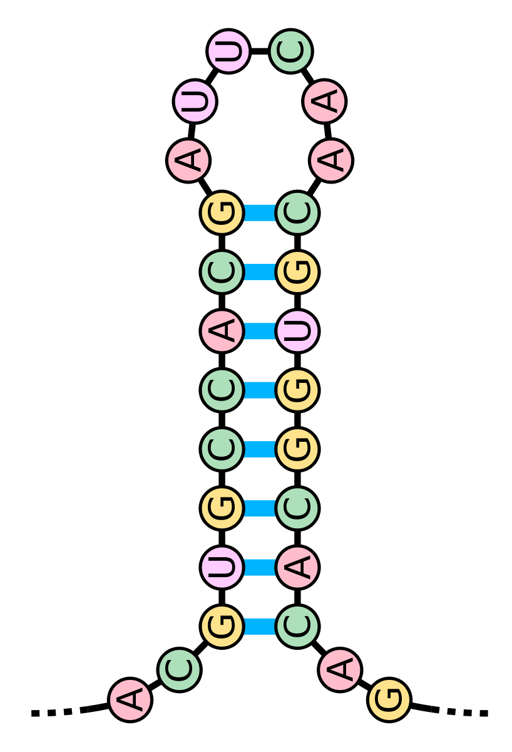
How Duplication of Stem Loops Work

Slide 11
How Duplication of Stem Loops Work

Slide 12
Stem Loops are the starting point for subgenomic flavivirus RNA (sfRNA)
XRN1

Slide 13
Starting point for sfRNA
XRN1

Slide 14
Starting point for sfRNA
XRN1 is an exoribonuclease created as a part of the host immune response
XRN1 stalls at stem loop
Resulting structure is sfRNA
XRN1

Slide 15
Functions of sfRNA
Immune Response

Slide 16
Functions of the sfRNA
Immune Response

Slide 17
Two stem loops vs. one stem loop
How does it change the virulence of sfRNA in humans?

Slide 18
Step 1: Generate sfRNA
Infect mosquito cells with dengue virus
Serial passage in same cell line for 10 passages
Will create a genome that is adapted to a mosquito environment

Slide 19
Step 1: Generate sfRNA
Sequence for a mosquito-adapted virus
Reverse Transcriptase
Sequencing

Slide 20
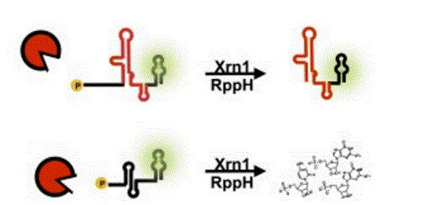
Step 2: Test for Resistance
Attach a fluorescent aptamer downstream the sfRNA
Attach a 40 nucleotide leader sequence upstream
If sfRNA is resistant to XRN1, then fluorescence will be maintained
XRN1

Slide 21
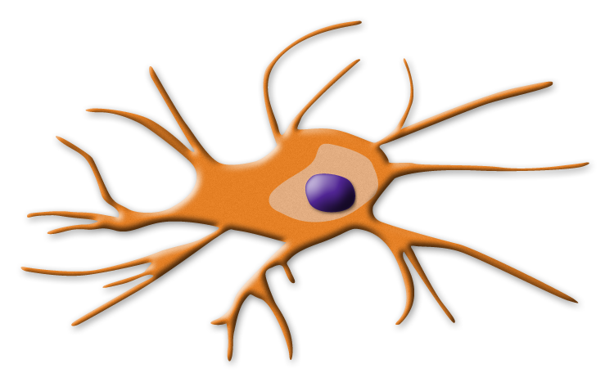
Step 3: Test for Virulence
sfRNA will be transfected into human dendritic cells
Dendritic cells will produce an immune response due to the sfRNA
Will show if the sfRNA can adapt to a new environment: humans
May show the effects of duplication of the stem loops

Slide 22
Step 3: Test for Virulence
RNA Binding Proteins
RNA Binding Proteins will attempt to destroy sfRNA
If successful, they will activate interferon genes
causes an increase in the levels of Interferon-β, (IFN-β) an inflammatory cytokine
ELISA will measure the level of IFN- β
IFN-β

Slide 23
Step 3: Test for Virulence
RNA Binding Proteins
sfRNA will bind to RNA binding proteins
Will stop the activation of interferon genes
Causes a decrease of secretion of IFN-β
IFN-β

Slide 24
Expected Results
Duplicated stem loop sfRNA should be virulent
Will show low levels of IFN-β
XRN1 resistant
Since:
Second stem loop will provide it the advantage to grow in a human environment
The one stem loop sfRNA should show low virulence
XRN1 resistant

