Slide 1
Furin-Enhanced In Vivo Production of Factor IX
Aarthi Prakash
May 2, 2017

Slide 2
Overview
Overview Background Current Information Experiment Review
Background
Hemophilia B
Factor IX
Furin
Experiment
Verification
Quantification
Discussion
What to expect
Possible Implications
Notes:
https://www.walldevil.com/wallpapers/a44/cool-postcard-background-wallpaper-desktop-design-media.jpg

Slide 3
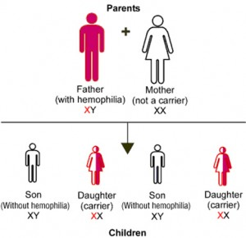
Hemophilia B
Overview Background Current Information Experiment Review
X-linked Recessive
Mutated or reduced FIX
1/30,000 Affected
Frequency and Severity
Notes:
http://www.ihtc.org/wp-content/uploads/2010/05/Hemophilia-Figure-2-300x290.jpg

Slide 4
Factor IX
Overview Background Current Information Experiment Review
Clotting Factor
Distinct Domains
Many posttranslational modifications
Ex) Gamma Carboxylation (Glu residue) – phospholipid and calcium bonding

Slide 5
Furin/PACE
Overview Background Current Information Experiment Review
Serine Protease
Profactor → mature FIX
Type of Paired Amino acid Cleaving Enzyme
Hepatocyte – ubiquitous
Chinese Hamster Ovary Cells

Slide 6
Current Treatment
Overview Background Current Information Experiment Review
Prophylactic – recombinant FIX
Transient, reduced efficacy
Long Term – multiple complications
Clinical Trial – Viral Approaches
Notes:
https://www.spineuniverse.com/sites/default/files/imagecache/gallery-large/wysiwyg_imageupload/3998/2015/10/26/injection5926682_M.jpg

Slide 7
Current Research
Overview Background Current Information Experiment Review
Clinical Trial – Nathwani et al.
Adeno-virus associated virus (AAV)
FIX 2%-11% of normal
Less adverse effects
Longer time between prophylaxis
Buchlis et al.
10 years later AAV FIX expression in skeletal/muscle tissue

Slide 8
Vector Development
Overview Background Current Information Experiment Review
Use HB mice
Vector plasmid with liver-specific enhancer/promoter
Human FIX gene
Furin gene
RT-PCR to analyze proper gene transcription
Notes:
Photo from Wang et al. (1999)

Slide 9
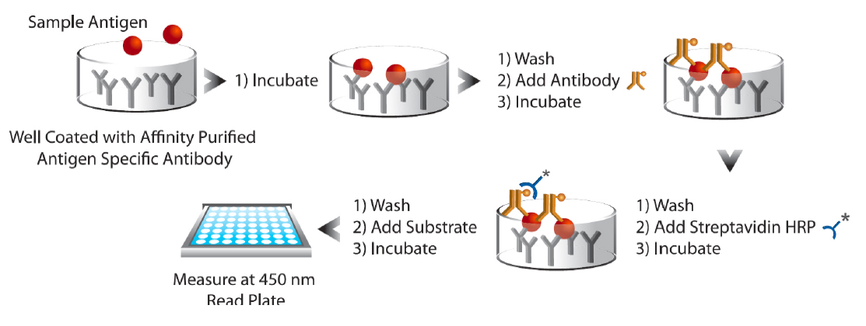
Quantification
Overview Background Current Information Experiment Review
ELISA – detection of [FIX] and [Furin]
Western Blot Analysis – 2
Target propeptide FIX and mature FIX
Notes:
http://www.enzolifesciences.com/fileadmin/redacteur/bilder/Platforms/Immunoassay_and_Assay_Development/Immunoassay_kits/2014-06-Immunoassay-ELISA-figure1.jpg

Slide 10
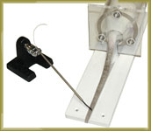
Phenotypic Expression
Overview Background Current Information Experiment Review
Tail Clip Test for HB phenotype
Measure Bleeding Times
Notes:
https://www.iitcinc.com/images/tailtempwithrat.jpg

Slide 11
Review
Overview Background Current Information Experiment Review
Does Furin Enhance FIX processing and ameliorate the HB phenotype in vivo with mice?
AAV vector transmission with co-expression
Measured through Western Blot and ELISA

