Slide 1
Implementing CRISPR Type III-B in Human cell to Target RNA Encoded Viruses
Presented By: Diana Marquez

Slide 2
Introduction
Figure 1
The Rhinovirus, while often synonymous with the “common cold” has also been found to be a contributing factor for the occurrence of acute respiratory conditions such as asthma and inhibit effective infection resolution in at risk individuals (Figure 1). At this current time, an effective means of combating the Rhinovirus has not been established. What treatment options that have been available are limited to addressing the physical symptoms of the virus versus providing treatment to address the virus itself

Slide 3
What IS CRISPR?
CRISPR is a biological defense mechanism against phages and plasmids that functions by targeting and recognizing a specific site to induce breaks in the targeted ribonucleic acid, (RNA) or deoxyribonucleic acid (DNA)
There are three distinct types and six unique subtypes of CRISPR systems.
Type I and Type III systems are known to utilize a sizable multi-Cas protein complex for the purpose of target sequence degradation and crRNA binding, the Type II system in contrast, utilizes a solitary Cas9, a single DNA endonuclease.
CRISPR Type III-B complex possesses 6 Cmr proteins Although the exact functional nature of every Cmr protein is not fully known, for CRISPR Type III-B complexes that have been derived from Pyrococcus furiosus (P. furiosus) Cmr 4 is believed to function as the slicer while the Cmr 1 and Cmr 6 appear to be linked to binding target RNA. All Cmr proteins are essential to achieve binding reactions against the target RNA.

Slide 4
Overview of the experiment
CRISPR Type III – B
We will be following the methods of Hale et al to create the crRNA binding assay and the target RNA binding and cleavage assays
Certain requirements must be met to effectively cleave the target RNA and accomplish cRNA binding. Cmr1 and Cmr6 are essential for targeting as well as binding target RNA. The evaluation of the effectiveness of the binding- cleavage reaction will be achieved through analyzing the results of gel electrophoresis.
Repeat Tag- Essential for targeting and binding- also for Cmr complex formation and function.
Can be used to engineer functional crRNA’s

Slide 5
Methods
It is expected that the Rhinovirus RNA, as suggested by the preliminary findings of BioBike and Blastn, will be shown to be vulnerable to the binding and cleavage assays and will display evidence of RNA degradation
GC Content - BioBike
Rhinovirus RNA sequence was spliced into 100 and then 37 nucleotides per sequence to analyze GC Content.
Hale et. al.
Tag | Target RNA (P. furiosus) | GC content
AUUGAAAG | CUGAAGUGCUCUCAGCCGCAAGGACCGCAUACUACAA | 54%
Gene HRV89gp1
Seqs. | Tag (8nt) + 37 nt sequence | Coordinates | CG Content
1 | ATTGAAATGTGCCAAGTTGACACACTCATTCCTGTTAACAATACA | 1756 - 1801 | 36%
2 | ATTGAAACTAGATATGTTATAACTGATCAAACAAGGGATGAAACA | 2491 - 2536 | 29%
3 | ATTGAAAATTGATTACCTAACCAAATTAAAACAACTTAATCTCTT | 4047 - 4092 | 22%
4 | ATTGAAATAAACACCCTTCATGATTTATCCTTAAAATTCTTACCA | 4150 - 4195 | 27%

Slide 6
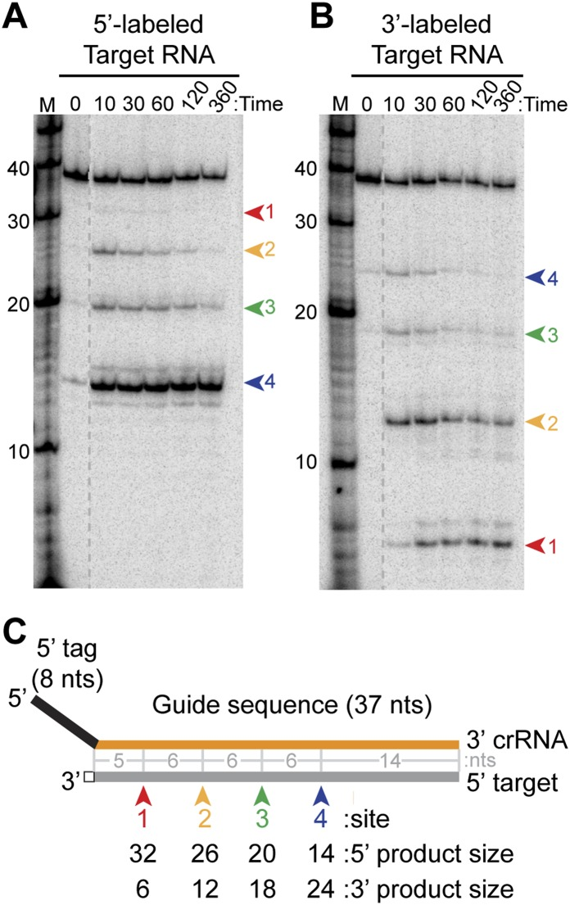
To the right:
Figures A:
Cleavage analysis of the target RNA on a sequence of 45nt starting from the 5’ – end.
Figure B:
Cleavage analysis of the target RNA on a sequence of 45nt starting from the 3’ – end.
Figure C:
Target RNA (gray) is fully complementary to the guided region (orange). The arrows indicate the cleavage sites in both products of the figures A and B. The cleavage is observed in both cases every 6nt.
To the left:
Figure D:
Native gel electrophoresis demonstrating the Cmr protein requirements for crRNA binding.

Slide 7
Discussion
The demonstrated ability of the CRISPR Type III-B complex to bind and cleave the viral RNA of the Rhinovirus would set a precedent toward expanding this research to target similar RNA based viruses and plasmids.
A limitation of utilizing the CRISPR Type III- B complex is the fact that the functions of the Cmr proteins will vary depending upon what purified form of bacteria is utilized
Another possible limitation is in regard to viral mutations. Most of the research that has been made available addresses wild type viruses and has not clearly addressed whether or not viral mutations would limit the effectiveness of the CRISPR Type III- B complex

Slide 8
Feedback
Questions???

Slide 9
References
Estrella M.A., Kuo F., Bailey S. (2016). RNA-activated DNA cleavage by the Type III-B CRISPR-Cas effector complex. Genes and Development, 30(4): 460-470. DOI: 10.1101/gad.273722.115
Foxman, E., Iwasaki, A (2011). Genome-virome interactions: examining the role of common viral infections in complex disease. National Review of Microbiology, 9(4): 254-264. Doi: 10.1038/nrmicro2541
Hale C. R., Cocozaki A., Hong L., Terns R.M., & Terns M. P. (2014) Target RNA capture and cleavage by the Cmr type III-B CRISPR-Cas effector complex. Genes and Development (28):2432-2443. DOI: 10.1101/gad.250712.114
Tamulaitis G., Venclovas C., Siksnys V. (2017) Type III CRISPR-Cas Immunity: Major differences Brushed Aside. Trends in Microbiology 25(1): 49-61. DOI: 10.1016/j.tim.2016.09.012
Taylor D.W., Zhu Y., Staals R.H., Kornfeld J. E., Shinkai A., van der Oost J., Nogales E., Doudna J. (2015) Structures of the CRISPR-Cmr complex reveal mode of RNA target positioning. Science 348(6234): 581-585. DOI: 10.1126/science.aaa4535
Wright A.,Nunez J., Doudna (2016).Biology and applications of CRISPR systems: harnessing nature’s toolbox for genome engineering. Cell 164(1–2):29–44
Van der Oost J, Westra ER, Jackson RN, Wiedenheft B. 2014. Unravelling the structural and mechanistic basis of CRISPR–Cas systems. Nat. Rev. Microbiology. 12(7):479–92

