Slide 1
Downregulation of Sox2 with CBD via AMPK
Jared Mann

Slide 2
Glioblastoma (GBM)
14.6 month median survival – highly malignant

Slide 3
Glioblastoma (GBM)
14.6 month median survival – highly malignant
GBM tumors contain Cancer Stem Cells

Slide 4
Glioblastoma (GBM)
14.6 month median survival – highly malignant
GBM tumors contain Cancer Stem Cells
Cancer Stem Cells contain transcription factors that increase proliferation rate, self-renewal, and other stem like qualities

Slide 5
Glioblastoma (GBM)
14.6 month median survival – highly malignant
GBM tumors contain Cancer Stem Cells
Cancer Stem Cells contain transcription factors that increase proliferation rate, self-renewal, and other stem like qualities
Sox2 is one of these transcription factors

Slide 6
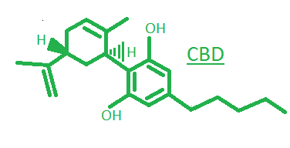
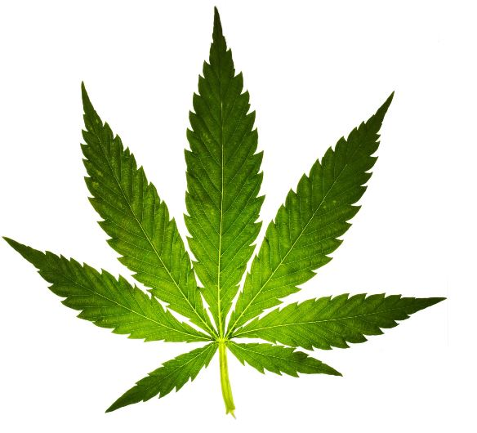
cannabidiol
Cannabidiol (CBD) – a molecule found in cannabis with no psychoactive effects

Slide 7
cannabidiol
Cannabidiol (CBD) – a molecule found in cannabis with no psychoactive effects
  has been shown to have antitumor activity through many pathways in multiple types of cancerous cells

Slide 8
cannabidiol
Cannabidiol (CBD) – a molecule found in cannabis with no psychoactive effects
  has been shown to have antitumor activity through many pathways in multiple types of cancerous cells
  has been shown to downregulate expression of the transcription factor Sox2 in GBM

Slide 9
cannabidiol
Cannabidiol (CBD) – a molecule found in cannabis with no psychoactive effects
  has been shown to have antitumor activity through many pathways in multiple types of cancerous cells
  has been shown to downregulate expression of the transcription factor Sox2 in GBM
  still needs further research to understand its molecular mechanisms

Slide 10
Cbd/sox2 background
Cbd has been shown to increase reactive oxygen species in cancer cells as one of its antitumor pathways
p38 activation is a downstream product of ros
p38 increases production of p21, a kinase inhibitor, that binds directly with sox2 promoters
something is missing – what activates the p38 pathway?

Slide 11
AMP Kinase
Multi-Functional enzyme
Has three subunits within its complex
AMPK activation has been shown to be a downstream product of two kinases, LKB1 and CAMKK
It can be activated through oxidative stress alone through intracellular sensors

Slide 12
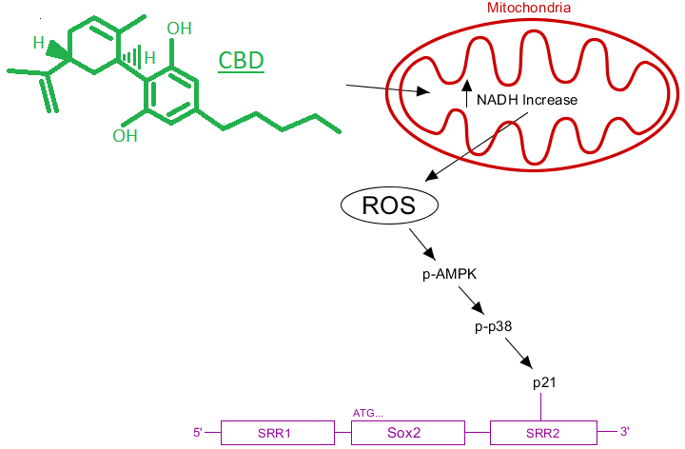
mechanism
CBD enters the cell and increases NADH with its metabolism.

Slide 13
mechanism
CBD enters the cell and increases NADH with its metabolism.
2) This causes an activation of the ETC and
an increase in ROS

Slide 14
mechanism
CBD enters the cell and increases NADH with its metabolism.
2) This causes an activation of the ETC and
an increase in ROS
3) ROS activates AMPK through cellular
sensors.

Slide 15
mechanism
CBD enters the cell and increases NADH with its metabolism.
2) This causes an activation of the ETC and
an increase in ROS
3) ROS activates AMPK through cellular
sensors.
4) AMPK has downstream products, such as
p-38^{MAPK}

Slide 16
mechanism
CBD enters the cell and increases NADH with its metabolism.
2) This causes an activation of the ETC and
an increase in ROS
3) ROS activates AMPK through cellular
sensors.
4) AMPK has downstream products, such as
p-38^{MAPK}
5) and p21

Slide 17
mechanism
CBD enters the cell and increases NADH with its metabolism.
2) This causes an activation of the ETC and
an increase in ROS
3) ROS activates AMPK through cellular
sensors.
4) AMPK has downstream products, such as
p-38^{MAPK}
5) and p21
6) p21 downregulates Sox2 by binding to
the SRR2 promotor
Inhibitory Bond

Slide 18
Research question
What is the extent to which CBD, a non-psychoactive cannabinoid, downregulates the expression of the Sox2 transcription factor in human multiforme GBM via AMP Kinase?

Slide 19
The experiment
In vivo experiment aimed at measuring protein content
Analyzed with a Western Blot
U251 GBM cell lines will be used because of their high Sox2 content

Slide 20
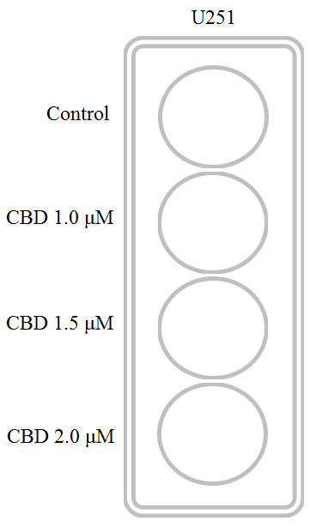
variables
To answer research question there must be multiple variables

Slide 21
variables
To answer research question there must be multiple variables
  Control – no CBD
  CBD 1 – 1.0 micromole dilution CBD in ethanol
  CBD 1.5 – 1.5 micromole dilution CBD in ethanol
  CBD 2 – 2.0 micromole dilution CBD in ethanol

Slide 22
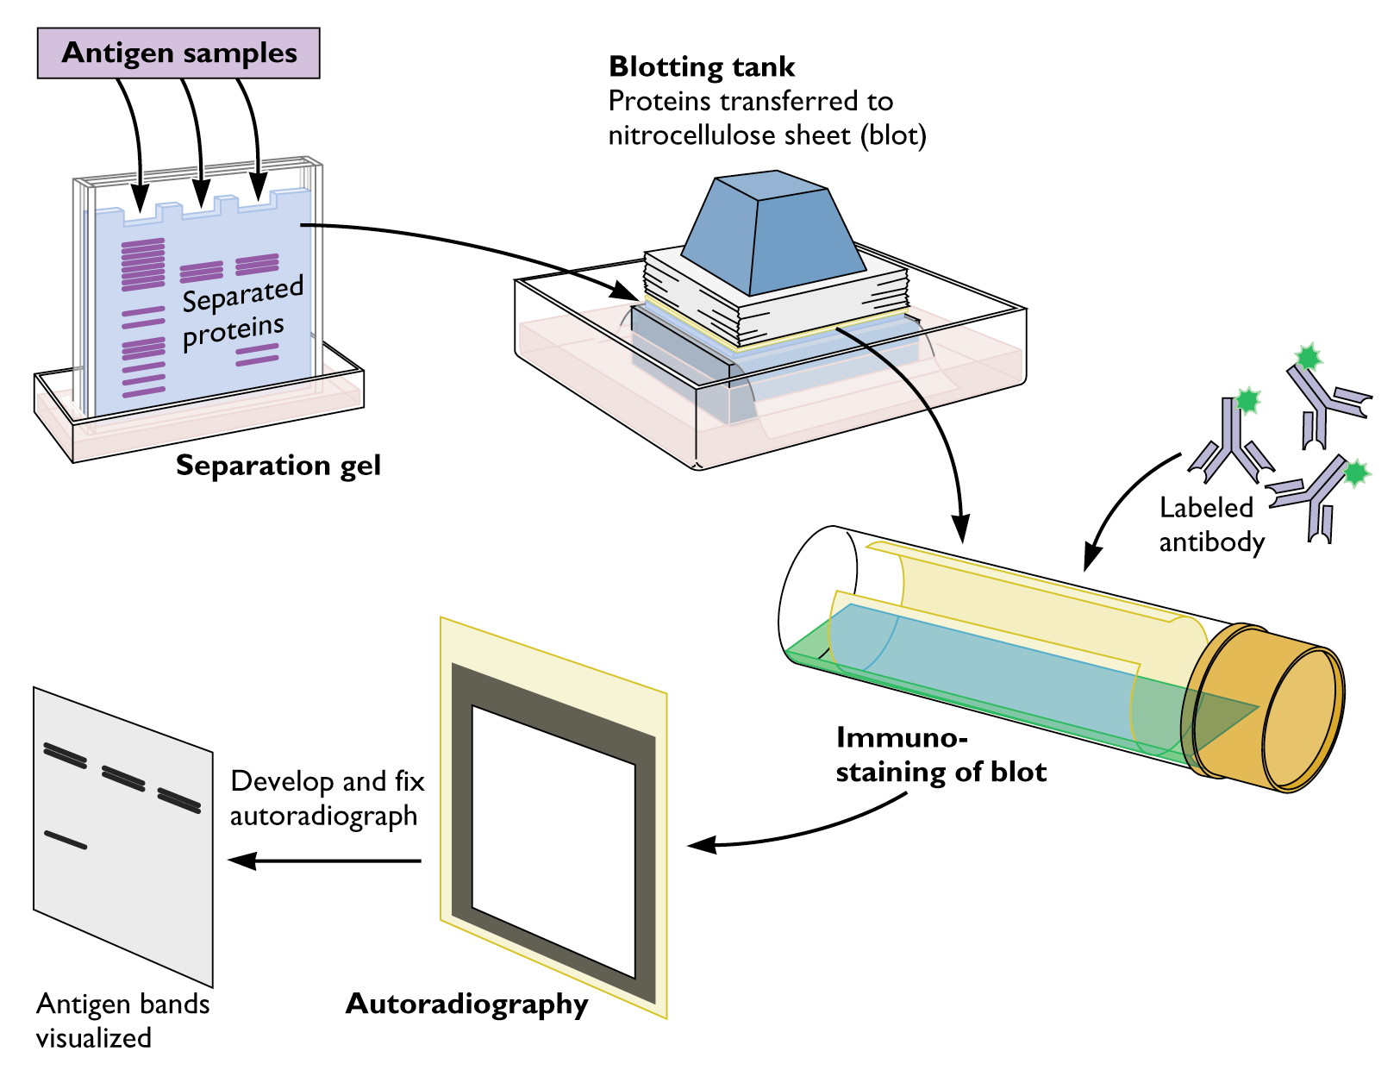
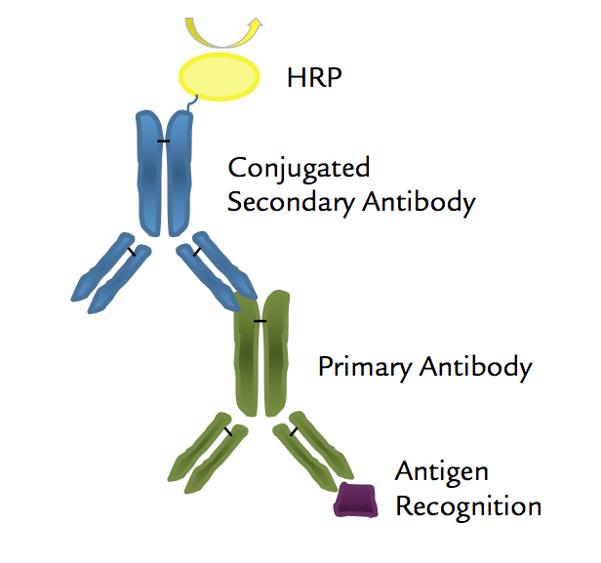
Western analysis procedure
After lysing the cells, protein is separated by SDS-Page
2)
1)
3)
4)
5)
5)

Slide 23
Western analysis procedure
After lysing the cells, protein is separated by SDS-Page
Blotting tank transfers protein to membrane
2)
1)
3)
4)
5)
5)

Slide 24
Western analysis procedure
After lysing the cells, protein is separated by SDS-Page
Blotting tank transfers protein to membrane
Primary antibodies will probe specific proteins
  Primary: Anti Sox2, Anti AMPK, Anti p-AMPK, Anti Actin
2)
1)
3)
4)
5)
5)

Slide 25
Western analysis procedure
After lysing the cells, protein is separated by SDS-Page
Blotting tank transfers protein to membrane
Primary antibodies will probe specific proteins
  Primary: Anti Sox2, Anti AMPK, Anti p-AMPK, Anti Actin
Secondary: anti-rabbit horseradish peroxidase HRP, will probe the primary antibodies
2)
1)
3)
4)
5)
5)

Slide 26
Western analysis procedure
After lysing the cells, protein is separated by SDS-Page
Blotting tank transfers protein to membrane
Primary antibodies will probe specific proteins
  Primary: Anti Sox2, Anti AMPK, Anti p-AMPK, Anti Actin
Secondary: anti-rabbit horseradish peroxidase HRP, will probe the primary antibodies
Visualization with Thermo Super Signal West Femto Substrate – interacts with HRP and darkens into a band
2)
1)
3)
4)
5)
5)

Slide 27
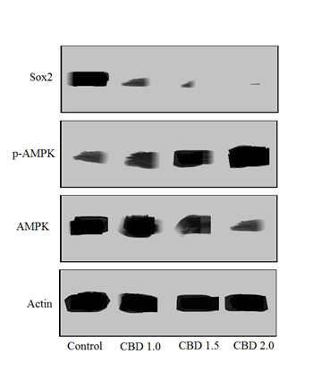
Expected results
If all goes well…
  Control should show signs of Actin, AMPK and sox2 but low signs of p-AMPK

Slide 28
Expected results
If all goes well…
  Control should show signs of Actin, AMPK and sox2 but low signs of p-AMPK
  CBD 1.0 should start to increase p-AMPK and decrease Sox2

Slide 29
Expected results
If all goes well…
  Control should show signs of Actin, AMPK and sox2 but low signs of p-AMPK
  CBD 1.0 should start to increase p-AMPK and decrease Sox2
  Cbd 1.5 should continue this increase

Slide 30
Expected results
If all goes well…
  Control should show signs of Actin, AMPK and sox2 but low signs of p-AMPK
  CBD 1.0 should start to increase p-AMPK and decrease Sox2
  Cbd 1.5 should continue this increase
  Cbd 2.0 should have the highest increase in p-AMPK and decrease in Sox2

Slide 31
densitometry
Image j or some other software will be used for densitometry analysis

Slide 32
Discussion
If CBD shows increase in p-AMPK this supports the hypothesis that CBD activates AMPK
To what extent: higher levels of CBD shows increase in p-AMPK
Knowing that p-AMPK is involved in the downregulation of Sox2 is important for understanding the mechanism of this drug
Understanding the mechanisms by which CBD downregulates Sox2 is important for treatment and future research

Slide 33
references
Fong, Y. W., Inouye, C., Yamaguchi, T., Cattoglio, C., Grubisic, I., & Tjian, R. (2011). A DNA repair complex functions as an Oct4/Sox2 coactivator in embryonic stem cells. Cell, 147(1), 120-131.
McAllister, S. D., Soroceanu, L., & Desprez, P. Y. (2015). The antitumor activity of plant-derived non-psychoactive cannabinoids. Journal of Neuroimmune Pharmacology, 10(2), 255-267.
Singer, E. Judkins, J. Salomonis, N. Matlaf, L. Soteropoulos, P. McAllister, S. Soroceanu, L. (2015). “Reactive oxygen species-mediated therapeutic response and resistance in glioblastoma”. Nature Publishing Group. DOI: 10.1038/cddis.2014.566.
Usami, N., Yamamoto, I., & Watanabe, K. (2008). Generation of reactive oxygen species during mouse hepatic microsomal metabolism of cannabidiol and cannabidiol hydroxy-quinone. Life sciences, 83(21), 717-724.
Valvassori, S. S., Bavaresco, D. V., Scaini, G., Varela, R. B., Streck, E. L., Chagas, M. H., ... & Quevedo, J. (2013). Acute and chronic administration of cannabidiol increases mitochondrial complex and creatine kinase activity in the rat brain. Revista Brasileira de Psiquiatria, 35(4), 380-386.
Wang, W., & Guan, K. L. (2009). AMP‐activated protein kinase and cancer. Acta Physiologica, 196(1), 55-63.
Mackenzie, R. M., Salt, I. P., Miller, W. H., Logan, A., Ibrahim, H. A., Degasperi, A., ... & Dominiczak, A. F. (2013). Mitochondrial reactive oxygen species enhance AMP-activated protein kinase activation in the endothelium of patients with coronary artery disease and diabetes. Clinical science, 124(6), 403-411.
Emerling, B. M., Weinberg, F., Snyder, C., Burgess, Z., Mutlu, G. M., Viollet, B., ... & Chandel, N. S. (2009). Hypoxic activation of AMPK is dependent on mitochondrial ROS but independent of an increase in AMP/ATP ratio. Free Radical Biology and Medicine, 46(10), 1386-1391.
Han, Y. T., Chen, X. H., Gao, H., Ye, J. L., & Wang, C. B. (2015). Physcion inhibits the metastatic potential of human colorectal cancer SW620 cells in vitro by suppressing the transcription factor SOX2. Acta Pharmacologica Sinica.
El Alami, M., Vina-Almunia, J., Gambini, J., Mas-Bargues, C., Siow, R. C., Penarrocha, M., ... & Vina, J. (2014). Activation of p38, p21, and NRF-2 mediates decreased proliferation of human dental pulp stem cells cultured under 21% O 2. Stem cell reports, 3(4), 566-573.
Zhao, Z., Yin, J. Q., Wu, M. S., Song, G., Xie, X. B., Zou, C., ... & Wang, J. (2014). Dihydromyricetin activates AMP-activated protein kinase and P38MAPK exerting antitumor potential in osteosarcoma. Cancer Prevention Research, 7(9), 927-938.
Lanna, A., Henson, S. M., Escors, D., & Akbar, A. N. (2014). AMPK-TAB1 activated p38 drives human T cell senescence. Nature immunology, 15(10), 965.
Kim, I., & He, Y. Y. (2013). Targeting the AMP-activated protein kinase for cancer prevention and therapy. Frontiers in oncology, 3, 175.
Soroceanu, L., Murase, R., Limbad, C., Singer, E., Allison, J., Adrados, I., ... & Khan, S. (2013). Id-1 is a key transcriptional regulator of glioblastoma aggressiveness and a novel therapeutic target. Cancer research, 73(5), 1559-1569.
Mo, L. J., Ye, H. X., Mao, Y., Yao, Y., & Zhang, J. M. (2013). B7-H4 expression is elevated in human U251 glioma stem-like cells and is inducible in monocytes cultured with U251 stem-like cell conditioned medium. Chinese journal of cancer, 32(12), 653-660.
Immobilon® Membranes, Sandwiches and Blotting Filter Paper. (2005). Immobilon. EMD Millipore, Billerica, Massachusetts.
Schindelin, J., Rueden, C. T., Hiner, M. C., & Eliceiri, K. W. (2015). The ImageJ ecosystem: an open platform for biomedical image analysis. Molecular reproduction and development, 82(7-8), 518-529.
GW Pharmaceuticals. (2017). GW Pharmaceuticals Achieves Positive Results in Phase 2 Proof of Concept Study in Glioma [Press Release].
Images: Pot leaf taken from the partnership for drug free kids, Western blot procedure: virology blog, antibodies: biopioneer

Slide 34
Thanks

Slide 35
Questions?

