Slide 1
Identifying the Mechanism of LIN52 Degradation
Amanda Luong

Slide 2
From the American Cancer Society
Notes:
https://cancerstatisticscenter.cancer.org/#/

Slide 3
The Cell Cycle
http://www.biologynoteshelp.com/mpfapccyclosome/
Notes:
http://www.biologynoteshelp.com/mpfapccyclosome/

Slide 4
The DREAM Complex
p130
LIN52
MuvB Core

Slide 5
MMB Complex
B-MYB
LIN52
MuvB Core

Slide 6
MMB Complex
DREAM Complex
X
B-MYB
LIN52
p130
LIN52

Slide 7
LIN52 – K106 Ubiquitination
Adapted from Chen, D., Dou, P. (2010).

Slide 8
Overall Goal: Identify the E3 Ligase involved in LIN52 ubiquitination

Slide 9
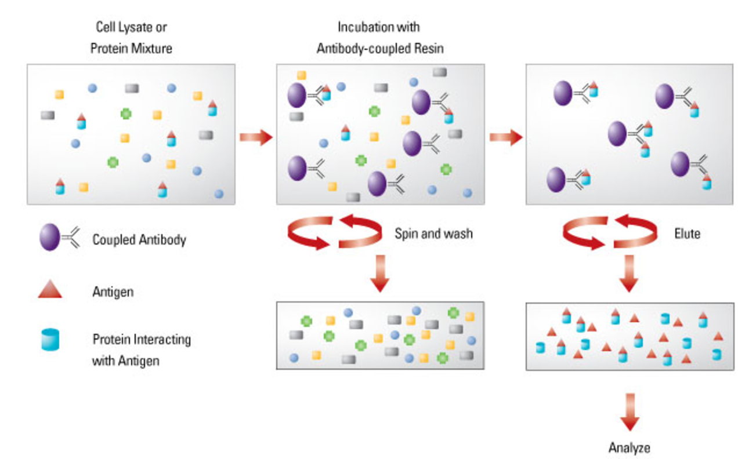
Co-Immunoprecipitation of LIN52

Slide 10
Multidimensional Protein Identification Technology (MudPIT)
Mass Spectrometer
Adapted from Washburn 2015

Slide 11
siRNA Knockdown

Slide 12
Western Blotting
Notes:
https://www.bio-rad-antibodies.com/western-blotting-immunoblotting-introduction.html

Slide 13
Overview
High specificity of MudPIT identifies a number of E3 Ligases.
siRNA knockdown validates the identification of the ligase responsible.
The relationship between LIN52 and the identified E3 Ligase can be visualized on a Western Blot.
A specific E3 ligase will be identified as the main protein involved in the ubiquitination of LIN52.

