Slide 1
How Attenuation Of Microglial Cell Using Cre-Lox Can Effect Pathology of EAE Induce Mice
By Kevin Limlengco

Slide 2
Introduction
Multiple Sclerosis
Inflammatory disease of the Central Nervous System
Over 400,000 cases
2 out of 5 results in death
No cure
No known causes
Symptoms – Loss of motor Function, loss of vision etc..

Slide 3
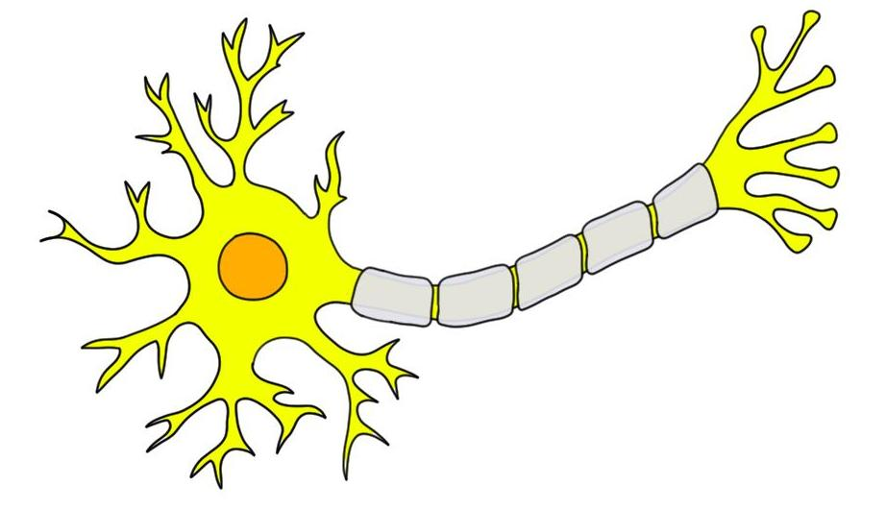
Introduction (Closer Look) - Neuron

Slide 4
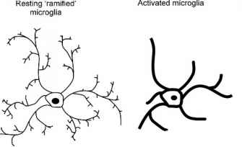
Neuron During M.S.
Neuron
Inflammation
Demyelination
Degeneration
Microglia (MS)- Changes from Resting State to Reactive State

Slide 5
Experiment (Clark et al. 2016)
Investigate the AIS Under Inflammatory Model
EAE Induced Mice
Assessment of mice
Didox Administration
Inhibits Replication
Intervention – Prevent and Reverse Pathology

Slide 6
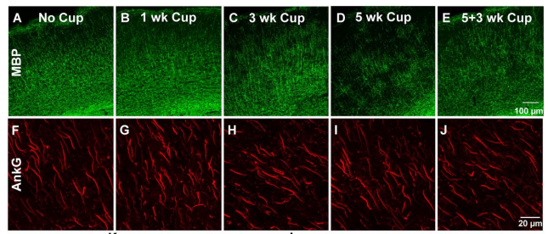
My Proposal
Attenuation of The Microglia
Cre-Lox Recombinase – CSF1R
EAE
Antibodies! – Ankryn-G & Microglia
Confocal Microscopy

Slide 7
Conclusion

Slide 8
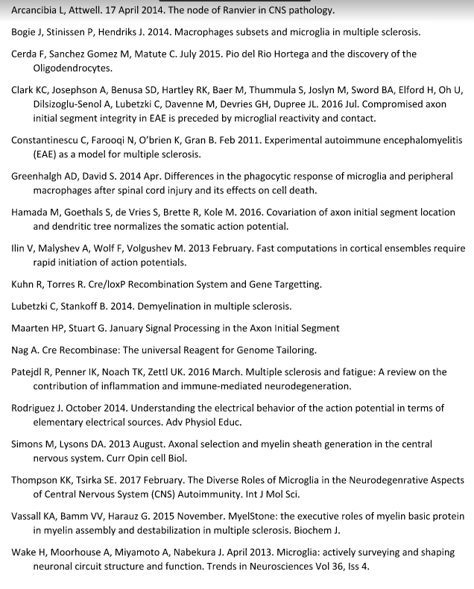
Reference

