Slide 1
Investigating regulation of aging by transcription factors DAF 16 and SKN-1 in the IIS pathway in C. elegans
Tejaswini Katravulapalli
BNFO 300

Slide 2
Introduction
Aging in eukaryotic organisms is a deleterious process that can result in changes in metabolism, reproduction and physiology
Understanding molecular pathways of aging and regulation can lead to developing methods to decrease effects of age-linked diseases, therefore improving human health and lifespan
There have been many studies conducted on model invertebrate organisms such as Caenorhabditis elegans (C. elegans) that have found genes that have a significant effect on longevity.

Slide 3
Background Information
The Insulin/insulin like growth factor (IGF)-1 signaling (IIS) pathway has been shown to regulate aging in many organisms
The role of the IIS pathway encompasses connecting functions like reproduction and aging to nutrition sensing is highly conserved, which gives it increasing importance to study.
Caenorhabditis Elegans, also known as the roundworm is an ideal invertebrate model to study aging as it has a short lifespan, along with a low cost

Slide 4
Insulin/Insulin like growth factor signaling (IIS) pathway
Peptides secreted in response to food bind to DAF-2/IGF-1
This activates AGE-1/PI3K in turn activating AKT-1, AKT-2 and PDK-1
DAF-16 is phosphorylated, which is a homolog of the FoxO transcription factors in humans
Phosphorylation translocates it from the nucleus to the cytoplasm
When IIS is down regulated, DAF-16 is able to promote expression of longevity and stress resistance related genes in the nucleus
It acts with along with HSF-1 and SKN-1

Slide 5
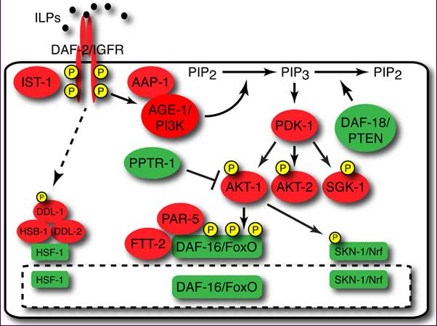
IIS pathway

Slide 6
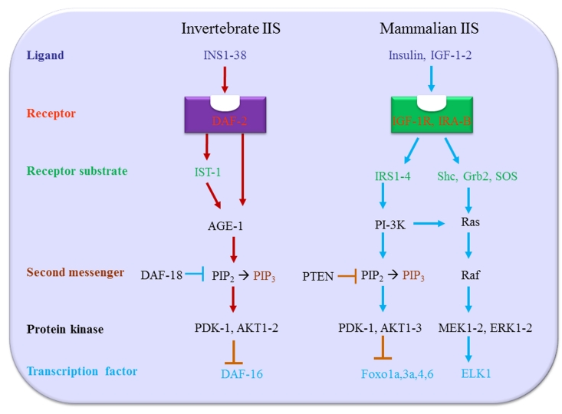
IIS pathway

Slide 7
Research Question and Hypothesis
SKN-1 is also isolated to the cytoplasm through phosphorylation by AKT-1/-2 and other protein kinases
Longevity phenotypes produced by DAF-16 and SKN-1 mutants are similar, which suggests that they might function together to increase the lifespan of C. elegans
They are also both inhibited by IIS in a similar way
Do DAF-16 and SKN-1 regulate each other to control the promotion of longevity related gene expression during the down regulation of the IIS pathway in C. elegans?

Slide 8
Experimental Objective
The objective of this experiment is to determine if SKN-1 and DAF-16 act together to promote longevity in C. elegans, through a reduction in the IIS pathway
Testing a DAF-2 mutant for longevity without altering expression of any other factors will serve as the control.
Then DAF-2/SKN-1 double mutants will be used to determine what phenotypes are expressed and if the lifespan can be altered by DAF-16 without SKN-1.
The same will be done using a DAF-2/DAF-16 double mutant

Slide 9
Methods
The target genes will be cloned and amplified by PCR from the genomic DNA of the desired strains of C. elegans
RNA interface: RNA interface also known as Post-Transcriptional gene silencing is a process that can regulate the expression of protein coding genes. C. elegans will be fed worms of E. coli, which are genetically modified to induce transcription of dsRNA that is homologous to a target gene
Oxidative stress response: Stage 4 larvae will be exposed to varying concentrations of 5-hydroxy-p-napthoquinone (juglone). This exposure will mimic oxidative stress and is able to form damaging proteins that the C. elegans need to recover from

Slide 10
Methods
GFP Fusion protein scoring system: GFP, also known as green fluorescent protein can be visualized by fluorescent microscopy. It will be used in this experiment to tag the sequences of the transcription factors to see how efficiently they travel to the nucleus to promote their target genes
Lifespan and Healthspan analysis: The lifespan of C. elegans must be monitored periodically from hatching to study the adaptive reactions to oxidative stress. To measure the mutants’ health, movement assays will be performed

Slide 11
Conclusion
If the DAF-2/DAF-16 mutant shows decreased signs of longevity, then this will indicate that SKN-1 is related to DAF-16 in some way that affects its ability to increase lifespan
Results that show that the two transcription factors are related will provide insight into how similar homologs in humans and other mammals also act together to further the lifespan and healthspan
In the case that the two transcription factors are not related to each other, experiments with different methods could be used to confirm these results
DAF-16 could be tested with other transcription factors, to see which ones play a role in its regulation

Slide 12
References
Altintas, O., Park, S., & Lee, S.-J. V. (2016). The role of insulin/IGF-1 signaling in the longevity of model invertebrates, C. elegans and D. melanogaster. BMB Reports, 49(2), 81–92. http://doi.org/10.5483/BMBRep.2016.49.2.261
Eleftherianos, I., & Castillo, J. C. (2012). Molecular Mechanisms of Aging and Immune System Regulation in Drosophila. International Journal of Molecular Sciences, 13(8), 9826–9844. http://doi.org/10.3390/ijms13089826
Hsu, A., Murphy, C. T., & Kenyon, C. (2003). Regulation of Aging and Age-Related Disease by DAF-16 and Heat-Shock Factor. Science,300(5622), 1142-1145. doi:10.1126/science.1083701
Murphy, C. T. (2013). Insulin/insulin-like growth factor signaling in C. elegans. WormBook, 1-43. doi:10.1895/wormbook.1.164.1
Przybysz, A. J., Choe, K. P., Roberts, L. J., & Strange, K. (2009). Increased age reduces DAF-16 and SKN-1 signaling and the hormetic response of Caenorhabditis elegans to the xenobiotic juglone. Mechanisms of Ageing and Development,130(6), 357-369. doi:10.1016/j.mad.2009.02.004
Snapp, E. (2005). Design and Use of Fluorescent Fusion Proteins in Cell Biology. Current Protocols in Cell Biology / Editorial Board, Juan S. Bonifacino ... [et Al.], CHAPTER, Unit–21.4. http://doi.org/10.1002/0471143030.cb2104s27
Tullet, J. M. A., Hertweck, M., Hyung An, J., Baker, J., Hwang, J. Y., Liu, S., … Blackwell, T. K. (2008). Direct inhibition of the longevity promoting factor SKN-1 by Insulin-like signaling in C. elegans. Cell, 132(6), 1025–1038. http://doi.org/10.1016/j.cell.2008.01.030
Uno, M., & Nishida, E. (2016). Lifespan-regulating genes in C. elegans. Npj Aging and Mechanisms of Disease,2(1). doi:10.1038/npjamd.2016.10
Van Heemst, D. (2010). Insulin, IGF-1 and longevity. Aging and Disease, 1(2), 147–157.

